Slide 1
Group 4 – Topic 5
Service composition
Christoph Paur, Ondrej Balún, Dominik Kertys

Slide 2
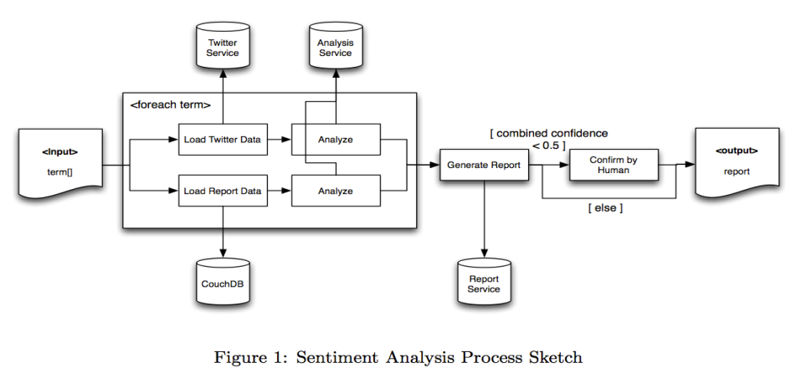
Main goal
build a service composition that integrates different existing or yet-to-built Web services

Slide 3
Stage 1
build missing base services
configure CouchDB, populate it with test data
implement the core composition

Slide 4
Our services
Twitter service
Custom Web Service (handles OAuth)
CouchDB service
Custom Web Service (handles Search function generation)
ToPDF
convert base64binary(array of bytes) to PDF document
later report will be confirmed by human analyst

Slide 5
Provided services
Report service
generateReport
in: 2x TermListReponse; out: base64binary
Analysis service
getSentiment
in: StringListResponse;
out: TermListResponse(text,confidence,sentiment);
mergeLists
in: 2x TermListResponse; out: TermListResponse
getOverallConfidence
in: TermListResponse; out: decimal

Slide 6
Composition tools
Apache ODE + BPEL for Eclipse
Last Update June 2011 (Eclipse)
„guaranteed not to turn your hair blue“
JOpera
Last Update October 2011
trouble with lists (CSV)
troubles with loading existing services

Slide 7
Composition tools
NetBeans 6.5.1 with SOA(service-oriented architecture)
GlassFish ESB v2.1 – free standard application server
easy drag&drop editor
composite app – includes multiple BPEL Modules and other types of Java Business Integration (JBI) modules
easy test integration
easy to implement own Java services

Slide 8
Demo tool

Slide 9
Q&A
?

