Slide 1
Group 4 – Topic 5
Service composition
Christoph Paur, Ondrej Balún, Dominik Kertys

Slide 2

QoS based service selection in WS Composition
Optimization-based – local/global
Negotiation-based – automated process by negotiator agent
Hybrid approaches
Matchmaking
Provider selection
Agreement configuration

Slide 3
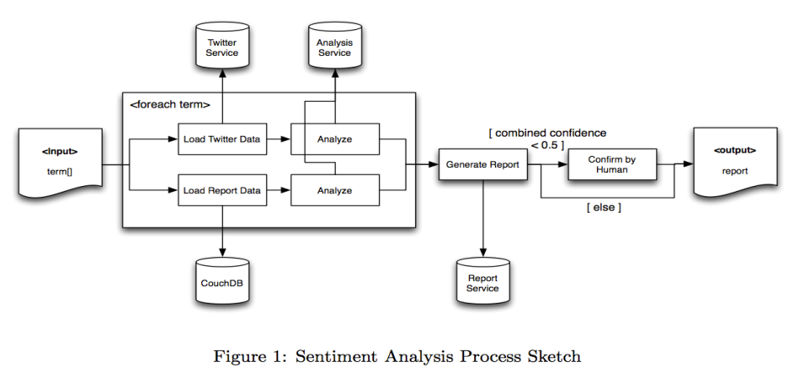
Main goal
build a service composition that integrates different existing or yet-to-built Web services

Slide 4
Composition IDE Tools
NetBeans 6.5.1 with SOA(service-oriented architecture)
GlassFish ESB v2.1 – free standard application server
easy drag&drop editor
composite app – includes multiple BPEL Modules and other types of Java Business Integration (JBI) modules
easy test integration
easy to implement own Java services

Slide 5
Our services
Twitter service
Custom Web Service (handles OAuth)
troubles with SSL certificate
CouchDB service
Custom Web Service (handles Search function generation)
HumanActivity service
Receives low confidence reports from BPEL Web Service
Returns confirmed or altered report depend. on Human choice

Slide 6
GUI
JAXB Binding – Java Architecture for XML binding
JSP
deploying of WSs to Glassfish
Analyse servlet – executes the composition
ViewPdf servlet – enables PDF functionality
Confirm by Human – accept,reject,upload PDF

Slide 7
BPEL - Advantages
Really simple cases work
Automatic Generation of Process Flow
Impress your CEO
Lots of presentations with corporate fuzz
May help with decision makers
Language Focus Process Orchestration
Compensation-Handlers
Run on finished scopes if a fault happens later
Necessary when no locks can be held for rollback

Slide 8
BPEL - Disadvantages
Even simple tasks take forever
More complex tasks quickly turn unwieldy
Complex in the BPEL sense
E.g. Merge two Lists or Arrays
Check if a variable is unassigned (null)
Graphical designer cannot hide the complexities of BPEL
Complex IF conditions
Data Conversions (XML Namespaces!)

Slide 9
BPEL - Disadvantages
Need to switch between Graphical Designer and Source Code
No Auto-Complete for Variables and Properties
Namespaces unintuitive
Multiple Technologies involved
Obviously: BPEL
WSDL, XSD, XSLT, …
WS-Adressing, WS-Security, …
Debugging is extremely cumbersome
Deploying to BPEL Engine takes a while
Data stored in XML

Slide 10
BPEL - Problems
Not really platform-agnostic
Every vendor has their own set of extensions
E.g. <bpelx:append>, :remove>, :copyList>
Address most common Shortcomings
Leads to vendor-specific „code“
BPEL-Specification not fully supported

Slide 11
BPEL - Problems
Kind of dead, though some might argue
Oracle 11g released before 2009
Apache ODE still alive (Oct. 2013)
Just BPEL Engine, not an IDE (see Eclipse BPEL)
Only Bugfixes and Performance improvements?
Last Open Source Updates:
Netbeans SOA 2008, (jOpera 2011),
Eclipse BPEL Designer 2011

Slide 12
BPEL - Problems
Poor Support for Parallelism
No Synchronization Constructs (Locks, etc)
<For>-Loop: parallel=true not supported by Netbeans/SUN BPEL Engine
Even Oracle seems to have (had?) problems
No true parallelism, just preemptive multitasking
Web Service calls still block the Process
Even Wait blocks
http://technology.amis.nl/2008/10/23/

Slide 13
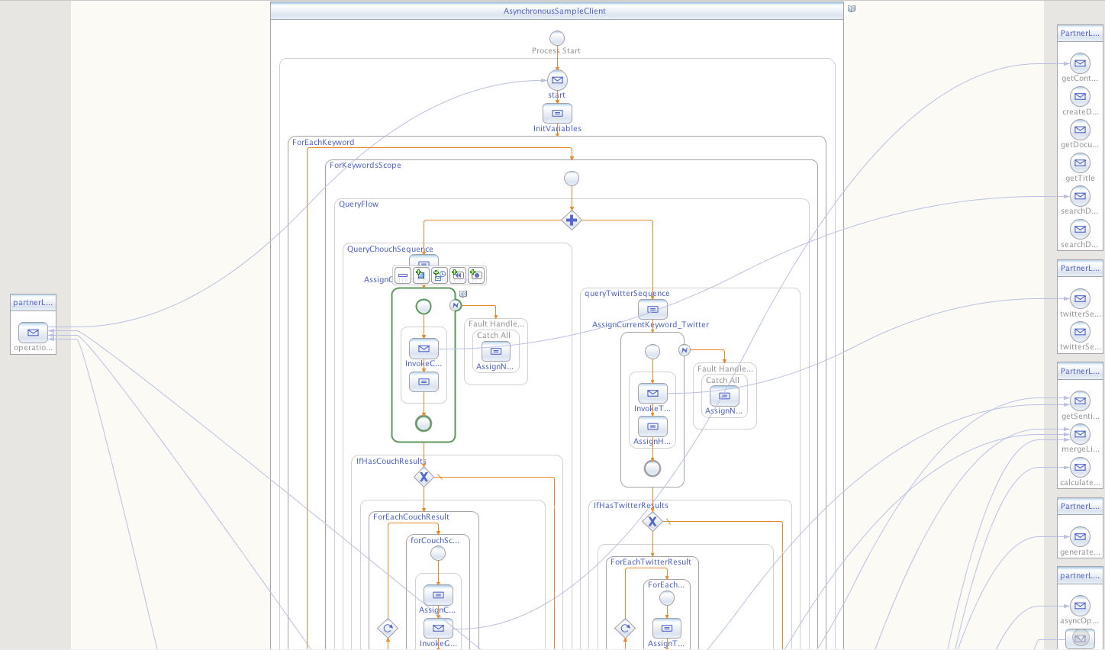
Our composition

Slide 14
Demo tool

Slide 15
Q&A
?

