Slide 2
BPEL – Process Structure
Receive Keywords
Pick Keyword
Query Twitter
Query CouchDb
Call Analysis
Call Analysis
Merge Results
More Keywords?
Generate Report

Slide 3
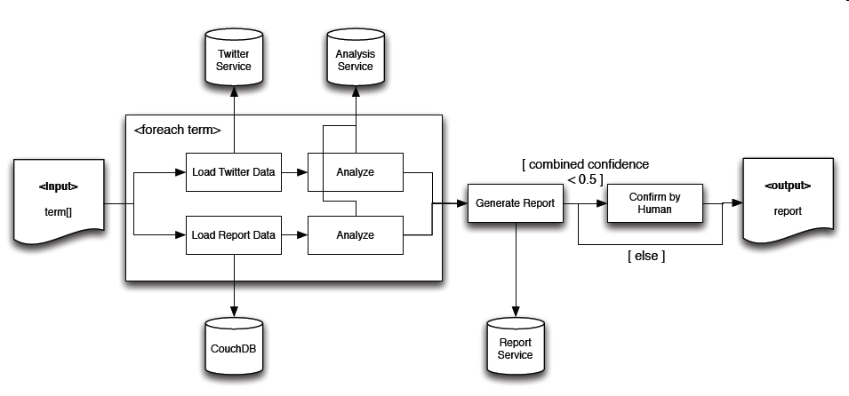
Process

Slide 4
BPEL – Advantages
Really simple cases work
Automatic Generation of Process Flow
  Impress your CEO
Lots of presentations with corporate fuzz
  May help with decision makers
Language Focus Process Orchestration
  Compensation-Handlers
    Run on finished scopes if a fault happens later
    Necessary when no locks can be held for rollback

Slide 5
BPEL – Disadvantages
Even simple tasks take forever
More complex tasks quickly turn unwieldy
  Complex in the BPEL sense
    E.g. Merge two Lists or Arrays
    Check if a variable is unassigned (null)
Graphical designer cannot hide the complexities of BPEL
  Complex IF conditions
  Data Conversions (XML Namespaces!)

Slide 6
BPEL – Disadvantages
Need to switch between Graphical Designer and Source Code
  No Auto-Complete for Variables and Properties
  Namespaces unintuitive
Multiple Technologies involved
  Obviously: BPEL
  WSDL, XSD, XSLT, …
  WS-Adressing, WS-Security, …
Debugging is extremely cumbersome
  Deploying to BPEL Engine takes a while
  Data stored in XML

Slide 7
BPEL - Problems
Not really platform-agnostic
  Every vendor has their own set of extensions
    E.g. <bpelx:append>, :remove>, :copyList>
    Address most common Shortcomings
  Leads to vendor-specific „code“
  BPEL-Specification not fully supported

Slide 8
BPEL - Problems
Kind of dead, though some might argue
  Oracle 11g released before 2009
  Apache ODE still alive (Oct. 2013)
    Just BPEL Engine, not an IDE (see Eclipse BPEL)
    Only Bugfixes and Performance improvements?
  Last Open Source Updates:
  Netbeans SOA 2008, (jOpera 2011),
  Eclipse BPEL Designer 2011

Slide 9
BPEL – Problems
Poor Support for Parallelism
  No Synchronization Constructs (Locks, etc)
  <For>-Loop: parallel=true not supported by Netbeans/SUN BPEL Engine
  Even Oracle seems to have (had?) problems
    No true parallelism, just preemptive multitasking
    Web Service calls still block the Process
    Even Wait blocks
    http://technology.amis.nl/2008/10/23/

