Slide 1
DATA ANALYSIS

Slide 2
What exactly did we learn?
Data Analysis is not Data Science
(but there are controversies!)
Python is amazing!
Excel is boring!!!!

Slide 3


Tools
+
Python
Jupyter
Pandas
Data Visualization
SQL (Postgresql)

Slide 4
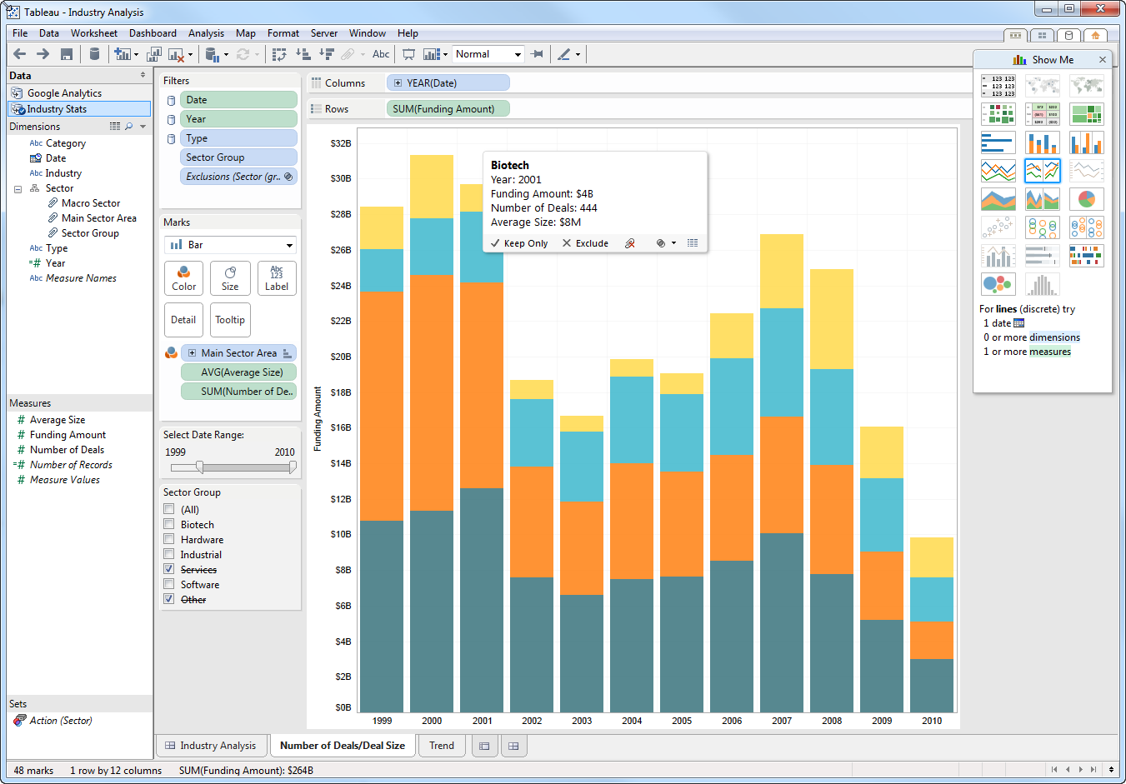
Other tools
Tableau (Julia Dau)

Slide 5
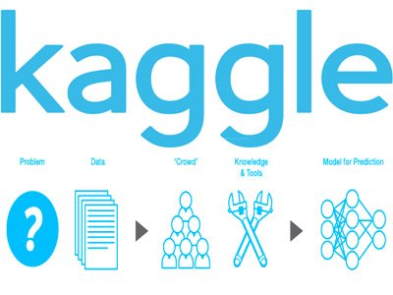
Choosing the Dataset

Slide 6

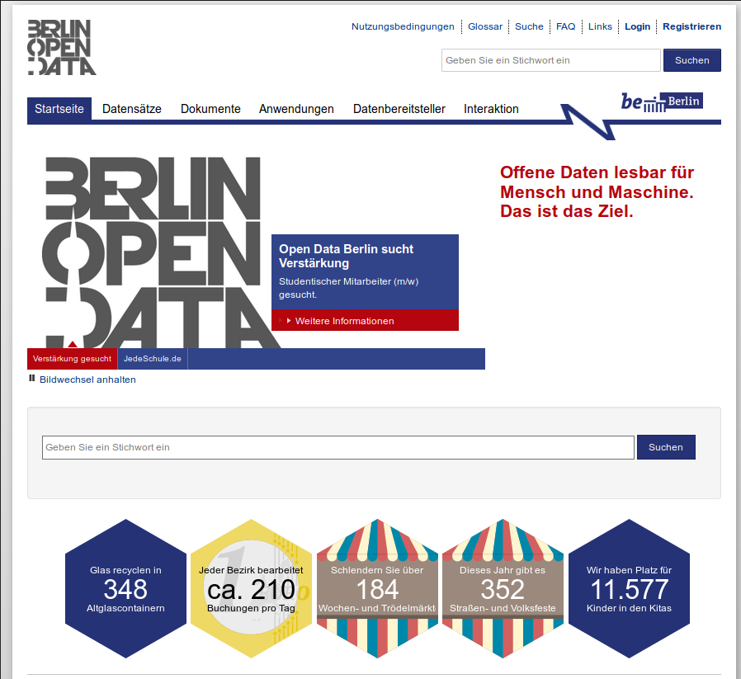
Choosing the Dataset
Berlin Open Data Portal

Slide 7
Berlin Open Data Portal
Analysis of the most common names in Berlin

Slide 8
Selected problem: American Dream!
Police killings on United States

Slide 9
SQL / Pandas
Cleaning the data: empty data, wrong, missing, repeating

Slide 10
Looking for more Data
Crossing with other datasets
Census (Population density by ethnic group)
FBI Police dataset
Counties and States maps

Slide 11
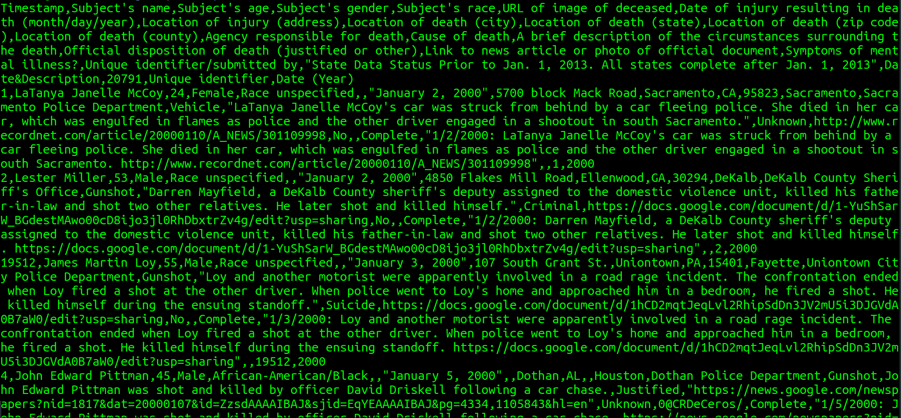
Visualization
How went from this:

Slide 12
Visualization
To this!

