Slide 1
Data Analytics
Final project
Credit Card User Behaviour
Dmytro Ivashchenko
Munich 2025

Slide 2

Why did I choose this project?
Project: Churn prediction in banking is a real-world problem impacting revenue.
Idea: Combines domain knowledge from banking with practical data analysis skills.
Dataset: has rich customer info: demographics, transaction history, credit limits.
Dataset: allows exploration of preprocessing, feature engineering, visualization, and predictive modelling.

Slide 3

Project structure
1. Problem Statement and Dataset Selection
2. Data Cleaning & Preprocessing
Data Loading
Missing Values
Data Type Conversion
Outlier Treatment
Working with Categorical Features
Feature Engineering
3. Exploratory Data Analysis (EDA)
  General understanding of the data
  Statistics on key features
  Visualizations
  Interpretation of identified patterns
4. Ethical Considerations & Limitations

Slide 4
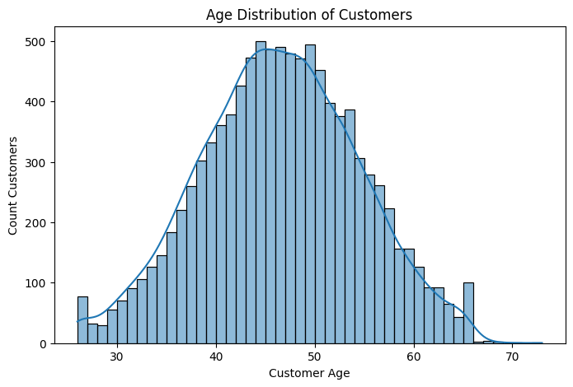
Project structure

Slide 5
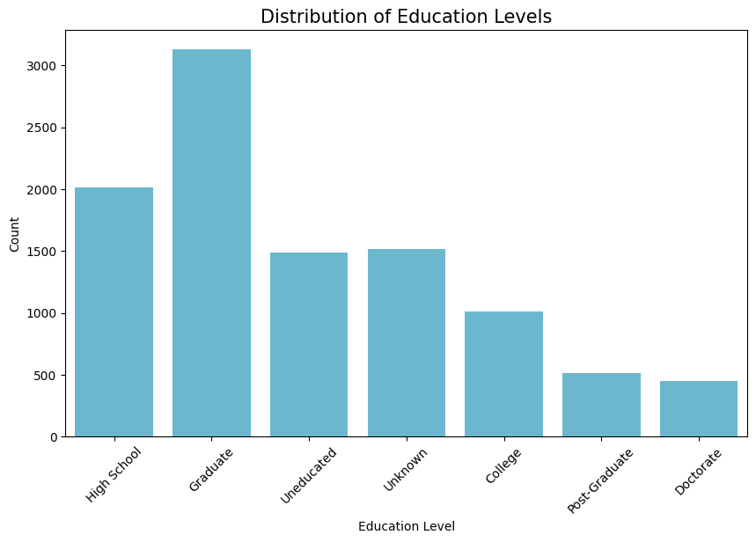
Project structure

Slide 6
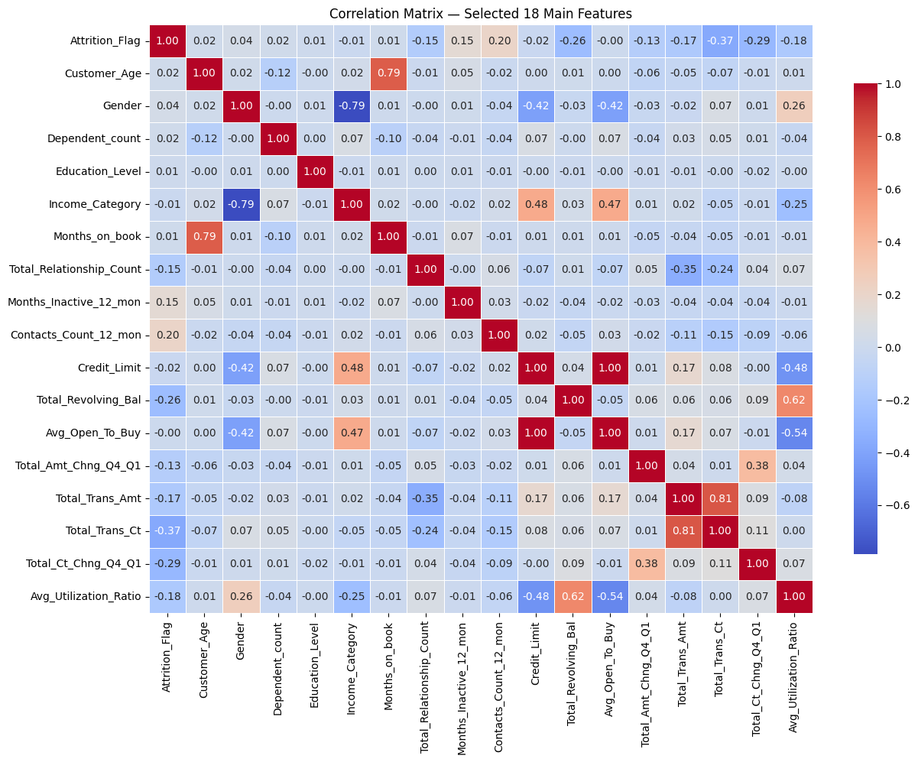
Project structure
Notes:
In Pearson correlation is no correlation between Attrition_Flag and metrics Total_Trans_Ct & Avg_Utilization_Ratio because of non lineal values in Attrition_Flag. That’s why I use Box & Violin plot next.

Slide 7
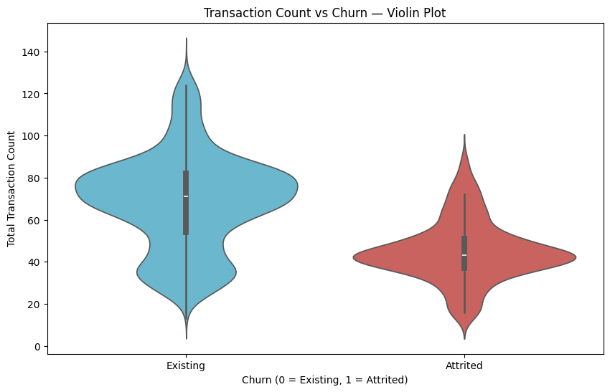
Project structure

Slide 8
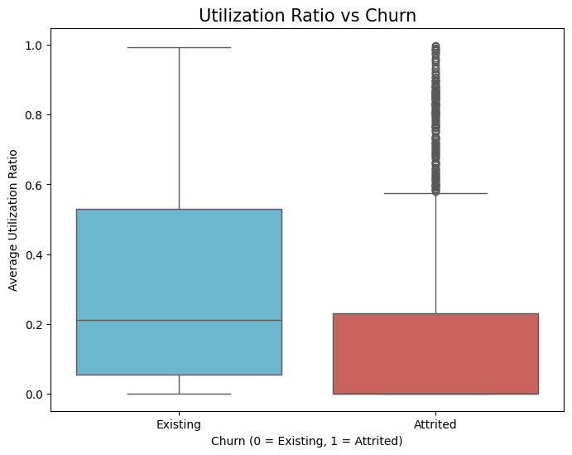

Slide 9
Project result
Found that churn correlates strongly with transaction activity and utilization ratio.
Identified high-risk customers who are less active or underutilizing credit.
Provides actionable insights for banks: targeted retention campaigns, personalized engagement.
Highlights importance of monitoring low-activity customers to reduce revenue loss.

Slide 10

Difficulties and roadblocks
  Dataset was mostly clean → needed to justify preprocessing steps carefully.
Categorical features had potential order ambiguity → resolved using ordinal encoding for Education_Level and Income_Category.
Class imbalance (~16% churn) → noted in limitations, suggested stratified sampling and evaluation metrics like ROC-AUC.
Addressed each challenge with methodical, well-documented steps.

Slide 11

Conclusions
Include additional features: transaction trends over time, external behavioral data, communication history.
Experiment with advanced predictive models (RandomForest, XGBoost) and handle class imbalance.
Integrate model in banking dashboards for real-time churn risk monitoring.
Apply fairness and privacy-aware techniques for ethical, responsible deployment.

Slide 12
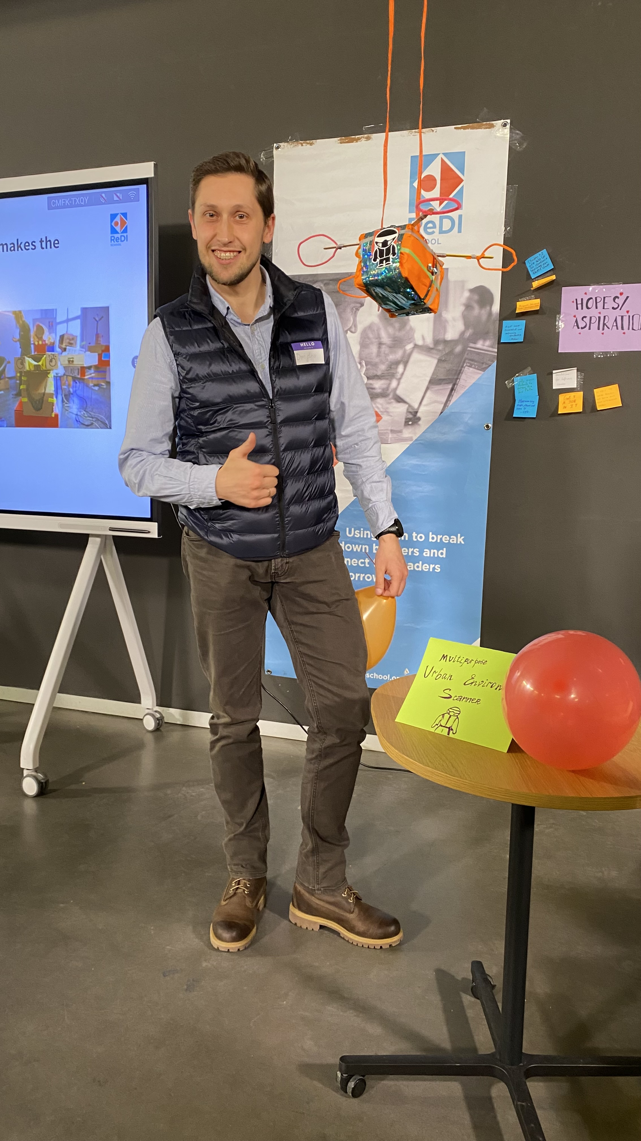
Thanks a lot!
Contact
Dmytro Ivashchenko
Student of Data analytics course
dnytsyk@gmail.com

