Slide 1

Python Intro
Jan-Hendrik Peters / Microsoft

Slide 2
Agenda
Teachers and Students introduction
Course and tools introduction
Python introduction

Slide 3
Teachers and students
Introduce yourselves ☺

Slide 4

Name Why this course? What do I expect?

Slide 5
Course intro

Slide 6
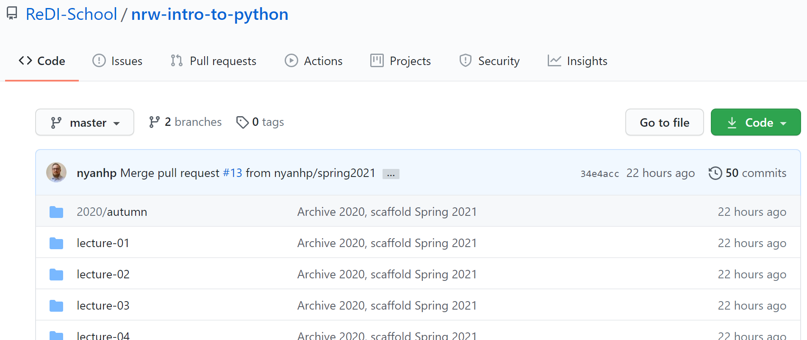
Course Content
https://github.com/redi-school/nrw-intro-to-python

Slide 7
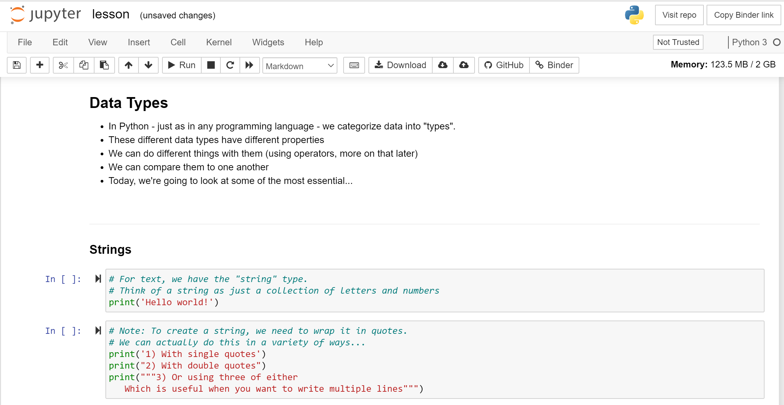
Accessing content
https://mybinder.org/v2/gh/redi-school/nrw-intro-to-python/HEAD

Slide 8
Additional Tools
Python and IDLE
iPython
Visual Studio Code
PyCharm
…or any other editor

Slide 9
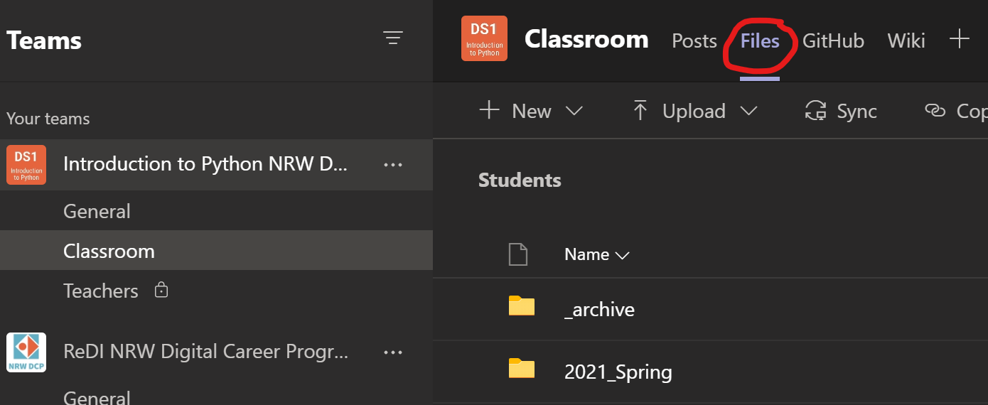
Teams
Join online classes
Find homework
Get help
Upload homework

Slide 10

Final project
You get to choose!
Solve a data science problem
Design a REST API
We will prepare you in the upcoming lessons

Slide 11
Python Introduction

Slide 12
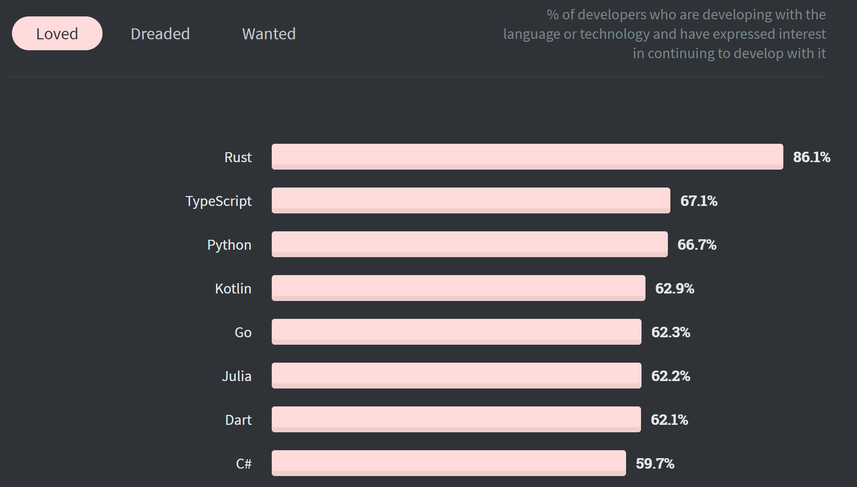
2020 still in top 3
Source

Slide 13

A little history
First released 1991
Current version 3.9
Designed by Guido van Rossum
Name pays hommage to Monty Python

Slide 14
What is Python?
All-purpose
Web Development
APIs
GUIs and games
Data science
…
Object-oriented
Interpreted
„Runs without a compiler“
Strongly-typed and dynamically typed
Easy to learn

Slide 15
Python features
„Batteries included“
Many libraries included
Cross-platform
Open-source
Huge ecosystem of libraries
pip (pip installs packages) is used to connect to repositories
Libraries extend functionality greatly
Some libraries will be part of this course: NumPy, pandas, MatPlotLib, django, Flask
Well-structured, (mostly) beautiful code

Slide 16
Community
Extended by open-source community
Core components change through PEP
Python Enhancement Proposal
PEP8 https://pep8.org – Style Guide
PEP20 https://pep20.org – the Zen of Python

Slide 17
Beautiful is better than ugly

Slide 18
Simple is better than complex

Slide 19
Complex is better than complicated

Slide 20
Flat is better than nested

Slide 21
Readability counts

Slide 22
If the implementation is hard to explain, it’s a bad idea.

Slide 23
Homework
https://forms.office.com/Pages/ResponsePage.aspx?id=Opo3HBpIjEGHV5chJ_yqfyBpv-NKSRVPrnCFDfkSECNUNjFQMDlQQUxLQUwwVVQzS0FPUjZKOVhWViQlQCN0PWcu
Will be graded on Monday March 22nd, so please submit until 16:00 on the 22nd !

