Slide 1


Introduction to programming with Python
ReDI School of Digital Integration

Slide 2
Who are we?

Slide 3
Who are you?
(Time to introduce yourself)

Slide 4
What is this course about?
What will you learn?
Basic programming concepts
Same for many modern programming languages (Python, Java, C++, PHP, Javascript etc.)
Words like: loop, variable, function, parameter, library etc.
Programming skills
Problem analysis
Problem decomposition
Design and implementation
Testing and debugging
Python syntax
Essential subset of Python3 features

Slide 5


What is this course about?
Don’t worry, it’s not a theoretical computers science course
Learning skills requires practicing
We will have to code

Slide 6
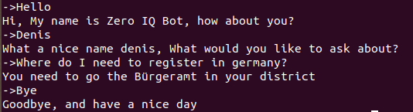
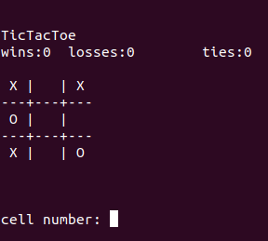
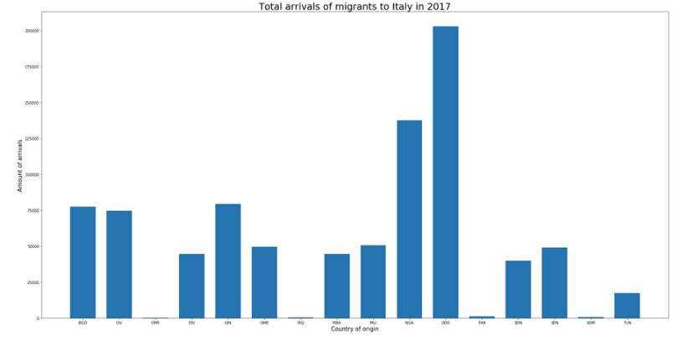
What is this course about?
What will you be capable of at the end of the course?
Continue learning programming by yourself
Convert an idea into a working program
Examples of projects
Chat bot
Dictionary
Simple console game
Data analysis/plots

Slide 7
How will we learn?
Class work: Theory + Programming tasks
Please ask questions
Slides and code samples are published
Homework
Based on the previous class
Published after the lesson
Not mandatory but we highly recommend you to do it - programming is a skill and requires practice
Feedback form
Please complain
https://goo.gl/forms/0vzhNp7qLigY84Wq2
Attendance tracking
You have to attend at least 80% of lessons to get the confirmation letter from ReDI

Slide 8
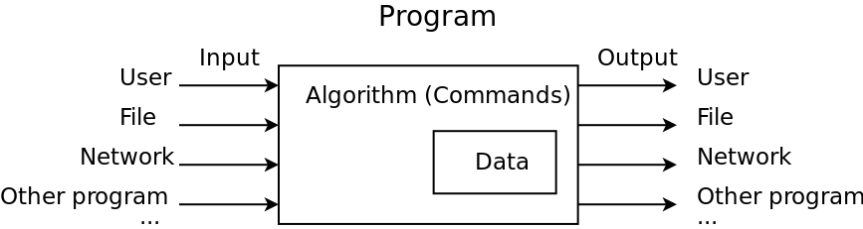
What is a program?
“Lives” inside a “computer”
Performs some task

Slide 9
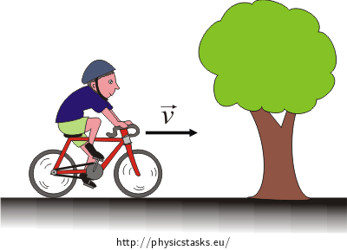
Algorithm
You have distance (S) and time (t), how to calculate the average speed?
1st attempt: “Divide S by t”
Computer doesn’t know, what S and t is
2nd attempt:
Request and remember a number for S
Request and remember a number for t
Divide S by t and remember the result
Print the result
3rd attempt: ...

Slide 10

How to explain an algorithm to a computer
Physical hardware (CPU) has a set of commands (100-500 commands) - instruction set
Not really readable for a human: “move 16 bytes from address xxx to address yyy”
Natural human language is not formal enough - hard for computer to understand (yet)

Slide 11
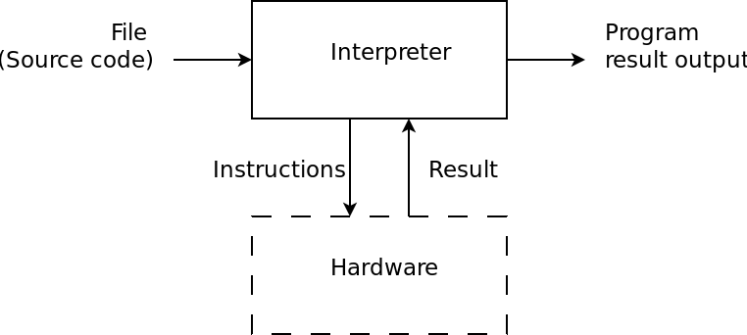
How to explain an algorithm to a computer?
High-level programming languages (Python, C++, Java, Javascript etc)
Formal
Can be read and written by humans
Can be compiled as or interpreted to instruction set

Slide 12
Why Python?
1994: Version 1
Not young (But is actively developed)
Mature
Goals (some of them)
Easy and intuitive but as powerful as those of the major competitors
Suitable for everyday tasks allowing for short development times
Open-source (free)
Many areas of application
Web-development (backend)
Automation (e.g. automated testing)
Robotics (prototyping)
Artificial Intelligence
Data Science

Slide 13






Why Python?
Python in Web:
Youtube
Dropbox
Google
Quora
Instagram
BitTorrent (Earlier Version)
Spotify
Reddit
Pinterest
BitBucket
EVE Online MMOPG
Mercurial Source Control
Other areas: https://www.python.org/about/success/

Slide 14

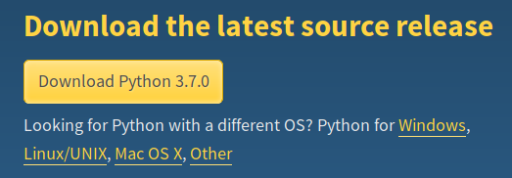
Setting up Python3
Linux: Should be installed: open Terminal (Ctrl+Alt+T on Ubuntu) and type python3:
Windows & MacOSx: If not installed (nothing with the word Python in start menu), go to https://www.python.org/downloads/ download and install latest 3.x version

Slide 15
You’re good to go
You have have the interpreter installed (Python3)
You can use any text editor to create a python source file and “feed it to the interpreter”
But…
We’ll be using IDE (Integrated development environment) in this course
Very convenient code editor
Has button “Run”
...

Slide 16
Installing PyCharm
Ubuntu
In Terminal: sudo snap install pycharm-community --classic
Not Ubuntu:
Go to: https://www.jetbrains.com/pycharm/download/
Choose Community Edition
Windows:
Install the downloaded file
Other Linux (Not Ubuntu)
Uncompress the downloaded file
In Terminal type: 'cd <path of bin folder inside the extracted folder>'
then type 'sh pycharmXXX.sh'

Slide 17
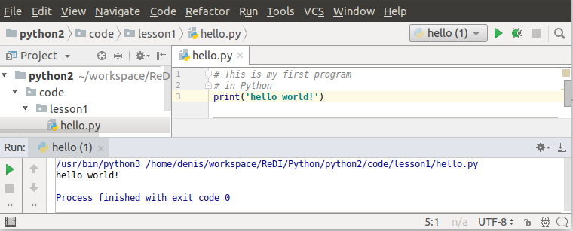
Running your first program
Open PyCharm
Click File -> Open -> <Path to lesson1 materials>/code
Click Run -> Run…

Slide 18
Understanding your first program
# This is my first program
# in Python
# source: code/hello.py
Comments:
Ignored by interpreter
Write it for yourself or for somebody else who is supposed to read your code in future
Built-in functions:
Part of the language
Sub-program
Has unique name, effect or result, list of arguments (parameters)
https://docs.python.org/3/library/functions.html
Literals:
Represent fixed values in code
Different types: numbers (also floating-point), boolean, string and some others
print('hello world!')
'hello world!'

Slide 19
Breaking your first program
# This is my first program
# in Python
print('hello world!'
File "<some path>/code/hello.py", line 4
^
SyntaxError: unexpected EOF while parsing
Usually it’s enough to search for the text of an error, if you can’t understand it right away:
https://duckduckgo.com/?q=python3+unexpected+EOF+while+parsing&t=canonical&ia=qa

Slide 20
Multi-instruction program
# This is my first program
# in Python
# source: code/two-instructions.py
print('hello world!')
print("My name is Denis")
Not more than instruction per line
Empty lines are allowed
Instructions are executed one after another
Look at the quotes (both ways work with string literals)

Slide 21
Additional materials and where to find help
https://automatetheboringstuff.com/ - Online book, covers all the basics of Python and how to use it
https://docs.python.org/3/index.html - Python3 documentation (including Tutorial)
Internet search - community is big, many questions were already posted somewhere
Pay special attention to the information at stackoverflow.com

