Slide 1
Lesson 2
Input, variables, operators, conditionals

Slide 2
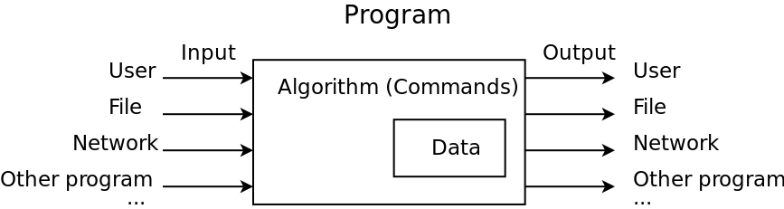
Recap: your first program
# This is my first program
# in Python
# source: code/two-instructions.py
print('hello world!')
print("My name is Denis")
Has no input
Contains only instructions, doesn’t store data

Slide 3
Your first interactive program
# Lesson2: First interactive program
# source: code/input.py
print('Enter your name')
name = input()
print('Hello, ')
print(name)
Run and check the result, please
What’s new:
input() - another useful built-in function
Returns value (has result)
Can have parameters
variable

Slide 4
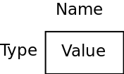
Variables
“A bucket” where you can store some value for later use in your program
Has unique name
Can contain letters, numbers or underscores, but can’t start from number
Case-sensitive
Can’t be the same as Python language keywords
Has type
int, float, bool, string and some more will come later
Has value
Python “guesses“ the type of the variable by the first value assigned to it
Valid variable names: name, last_name, _first_name, name1
Invalid variable names: 4name, -name, last_$name, 100

Slide 5
Example
# Lesson2: Variables
# source: code/variables.py
num = 3
print(num, type(num))
Num = -5
print(Num, type(Num))
pi = 3.14
print(pi, type(pi))
smallNumber = 3E-10
print(smallNumber, type(smallNumber))
b1 = True
print(b1, type(b1))
b1 = False
print(b1, type(b1))
letters = "abcdefghijk"
newString = letters
print(letters, type(letters))
print(newString, type(newString))

Slide 6
Explanation: integers
num = 3
print(num, type(num))
Num = -5
print(Num, type(Num))
Not related to variables:
Function print() can accept several parameters - will print them one after another
Function type() returns the type of the variable given as parameter
Type ‘int’ for integers
Can be negative or positive
NB: Here we have two different variables with different names

Slide 7
Explanation: floating-point numbers
pi = 3.14
print(pi, type(pi))
smallNumber = 3E-10
print(smallNumber, type(smallNumber))
Type ’float’ for floating-point numbers
Different notations:
32.5
0.3
.4
E-notation: 3E-10 means 3 * 10 ^ (-10)

Slide 8
Explanation: booleans
b1 = True
print(b1, type(b1))
b1 = False
print(b1, type(b1))
Type ‘bool’ for boolean variables
Have two possible values: True or False
We’ll see later why they are so important
Btw, you can re-assign another value to the existing variable

Slide 9
Explanation: strings
letters = "abcdefghijk"
newString = letters
print(letters, type(letters))
print(newString, type(newString))
Type ’str’ for strings
Store text (sequence of symbols)
Can be empty: “”
Btw, you can assign value of one variable to another one
There are more built-in types which we’ll cover later in this course

Slide 10
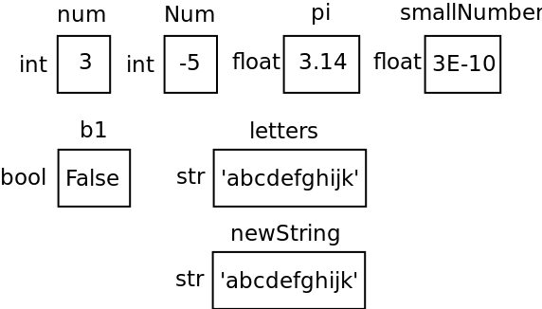
Explanation

Slide 11
Operators: Arithmetic
Operator | Description | Example (a = 10, b = 21)
+ Addition | Adds values on either side of the operator. | a + b = 31
- Subtraction | Subtracts right hand operand from left hand operand. | a – b = -11
* Multiplication | Multiplies values on either side of the operator | a * b = 210
/ Division | Divides left hand operand by right hand operand | b / a = 2.1
% Modulus | Divides left hand operand by right hand operand and returns remainder | b % a = 1
** Exponent | Performs exponential (power) calculation on operators | a**b =10 to the power 21
// Floor division | The division of operands where the result is the quotient in which the digits after the decimal point are removed. | 9//2 = 4 and 9.0//2.0 = 4.0, -11//3 = -4, -11.0//3 = -4.0

Slide 12
Precedence of operators
Precedence of operators in Python is the same as in math
2 + 2 * 2 -> 6
2 + 2 ** 3 * 2 -> 18
Most of the operators have left-sided binding (expression with operators with the same priorities is calculated from left to right):
9 % 6 % 2 -> 1
Except for exponentiation:
2 ** 2 ** 3 -> 256
Use parentheses:
5 * ((25 % 13) + 100) / (2 * 13) // 2

Slide 13
Example: operators and numbers
# Lesson2: Operators with numbers
# source: code/numbers_operators.py
a = 21
b = 10
c = 0
c = a + b
print ("Line 1 - Value of c is ", c)
c = a - b
print ("Line 2 - Value of c is ", c )
c = a * b
print ("Line 3 - Value of c is ", c)
c = a / b
print ("Line 4 - Value of c is ", c )
c = a % b
print ("Line 5 - Value of c is ", c)
a = 2
b = 3
c = a**b
print ("Line 6 - Value of c is ", c)
a = 10
b = 5
c = a//b
print ("Line 7 - Value of c is ", c)
Please note, that variable c changes it’s type on one of the assignments.

Slide 14
Example: operators and strings
You can apply arithmetic operators to strings (text)
# Lesson2: Operators with strings
# source: code/strings_operators.py
a = 'hello'
b = 'class'
c = ''
c = a + b
print(c)
c = a * 5
print(c)
c = 10 * b
print(c)
Please note the empty string

Slide 15
Type conversions
Let’s modify our first interactive program so that it requests user’s age and tells, how old they’ll be in 5 years:
# Lesson3: Age input
# source: code/input_age.py
name = input('Enter your name\n')
age = int(input('Enter your age\n'))
print('Hello,', name,)
print('In 5 years you\'ll be', age + 5)
input() function can take a parameter (called “prompt”)
String can contain “special symbols” - they are marked for Python interpreter by the escape character \:
\n, \t, \’, \”, \\
input() function always returns string, but we need to convert it to a number
int(), str(), float(), bool()

Slide 16
Type conversions
What happens to the previous example if we don’t convert input to int?
What happens if user enters some text instead of a number for age?
Let’s try and see
(that’s the first thing you should do when you’re not sure about Python behavior)

Slide 17
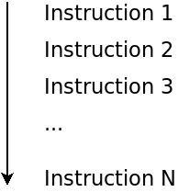
Conditional operations
Our programs so far:
What if we want our program to do something in one case and something else in the other, depending on user input?

Slide 18
Conditional operations
# Lesson2: Conditional operations
# source: code/conditionals.py
c = int(input('Enter degrees (c):\n'))
if c < 0:
print("It's cold, stay at home")
elif c < 20:
print("Put a jacket on")
else:
print("It's a good weather for a T-shirt")
# Syntax for conditionals
if condition1:
# perform operations when condition1 is true
elif condition2:
# perform operations when condition1 is false
# and condition2 is true
else:
# perform operations when condition1 and condition2
# are false
Mind the gap after if, elif, else (indentation) - it’s part of Python syntax
Defines the block - set of instructions which will be performed if the respective condition is fulfilled
if - is mandatory, one per conditional
elif - optional, as many, as you want
else - optional, one per conditional

Slide 19
Conditions
Implicitly converted to bool
Numbers: 0 -> False; everything else -> True
Strings: Empty strings -> False, all the other strings -> True
Comparison operators:
==
!=
>
<
>=
<=
Boolean (logical) operators:
and
or
not

Slide 20
Tracing a program
n = 11
if n > 5:
print('Number is greater than 5')
elif n > 10:
print('Number is greater than 10')
else:
print('Number is less than 5')
n = 11
if n > 5:
print('Number is greater than 5')
if n > 10:
print('Number is greater than 10')
else:
print('Number is less than 10')
What will both programs print?
What if n = 7?

Slide 21
Nested conditions
# Lesson2: Nested conditions
# source: code/nested_conditions.py
age = int(input('Enter your age:\n'))
hour = int(input('What is the hour? (0-24)\n'))
is_late = hour >= 22
is_too_young = age <= 12
if is_late:
if is_too_young:
print('You should be sleeping ...')
else:
print('Want to watch a movie?')
else:
print('Go for a walk!')
Is the program correct? (what is the result if the hour is 1?)
How to fix it?
How to rewrite this example without nested conditions? (Hint: use boolean operators)

