Slide 1
Lesson 3
Loops: for, while; lists

Slide 2
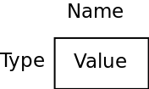
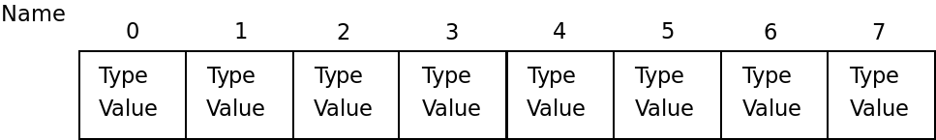
Introducing lists
Another built-in type
A sequence of values
Variables we had before:
One name for all the sequence
Each element can be accessed by it’s index in the sequence
Types of elements can be different (and can be anything, even another list)

Slide 3
Example
# Lesson3: Lists
# source: code/lists.py
l1 = [1, 5, 0, 4] # create a list
print(l1)
l1.sort() # sort the list
print(l1)
l1.append('a') # add an element
print(l1)
del l1[2] # remove an element
print(l1)
print(len(l1)) # length of the list
print('The first element is', l1[1])
empty_list = [] # create an empty list
print(len(empty_list))
# create a list from range: [0-10)
l2 = list(range(10))
print(l2)
# create a list from range: [5-10)
l3 = list(range(5, 10))
print(l3)
l1.sort() - call a method sort of this list
Method - is just a function which belongs to a particular variable of a particular type
There are many more built-in functions for dealing with lists - we’ll meet some of the later
Note the range() function
Returns the range of integers (iterator), which can be converted to a list
What happens if I access the element with an index -1?

Slide 4
List is a mutable type
# Lesson3: List is mutable
# source: code/list_is_mutable.py
original_list = list(range(1, 6))
print(original_list)
new_list = original_list
new_list[2] = 128
print(original_list)
print(new_list)
What is the result?
Why?

Slide 5
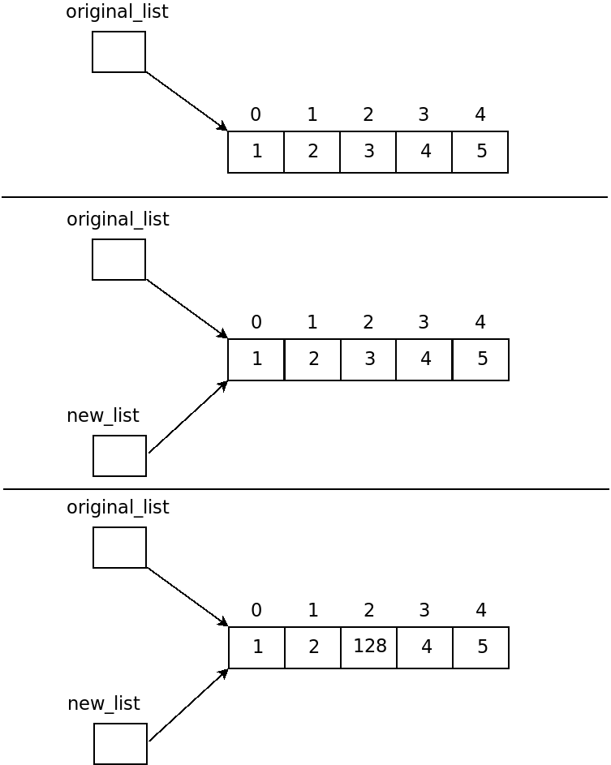

Slide 6
List is a mutable type
How to copy a list?
# Lesson3: Copy a list
# source: code/list_copy.py
original_list = list(range(1, 6))
print(original_list)
new_list = original_list.copy()
new_list[2] = 128
print(original_list)
print(new_list)

Slide 7
Introducing loops
Many computational tasks require repetition of the same operations
Print square roots for all numbers from 1 to 100
Add 50 to all elements for the list of integers
How many ‘a’ characters is in the given text?
We could solve those tasks only with conditionals, but...
Programmers don’t like extra typing
Python has something to help us here

Slide 8
Example
# Lesson3: for loop
# source: code/for.py
import math
for num in range(100):
sqrt = math.sqrt(num)
print(num, ":", sqrt)
# Syntax of for loop
for var in something:
# instructions
What is “something”?
How does it work?

Slide 9
How does it work
Something can be anything iterable (anything, representing a sequence)
Result of range(), list, string, etc (others come later)
In our example:
Variable num is created, and the first value from the sequence provided by range() assigned to it
Instructions of the block inside the for are called one after another
The sequence is checked: is there another element?
If there is an element - it’s value is assigned to the variable num and the loop continues
If there is no elements anymore - the loop finishes and the program continues to execute instructions following the loop (nothing in our case)
Important word: iteration - it’s one cycle of the loop (iterate over something - go through all the elements of something)
Notes on the example:
Import - allows you to use modules which are not part of the core of the language
math.sqrt(num) - method of module math returning square root of the given parameter

Slide 10
More examples
# Lesson3: for loop over a string
# source: code/for_string.py
s = 'this is a random string with several letters \'a\''
counter = 0
for character in s:
if character == 'a':
counter += 1
print('Found', counter, 'letters \'a\' in the given string')
a += b is the same as a = a + b
There are also: -=, *=, /=, %=, //=, **=

Slide 11
More examples
# Lesson3: for loop over a list
# source: code/for_list.py
l = [12, 3, -11, 12.5, 146, 33.82]
for num in l:
num += 50
print(l)
Will it work?
Not sure? - run and see
Why?
What will happen if we change the input list of this program to:
['a', 3, -11, 12.5, 146, 33.82]
How to implement the task we had a few slides ago: increase all the elements of given list by 50?

Slide 12
While loop
Sometimes we have to perform a set of instructions several times, but we have no sequence
Wait a certain input from user
Do some calculations until we reach a desired result
...
It’s impossible to apply for loop to those tasks, but still…
Programmers don’t like extra typing
There is something in Python that can help us here

Slide 13
Example
# Lesson3: while loop
# source: code/while.py
text = ''
while text != 'stop':
text = input('Tell me something:\n')
print('you told me:', text)
print('... and I\'m stopping')
# Syntax for while loop
while condition:
# instructions
Conditions: the same rules apply as for conditionals
How does this work?

Slide 14
Conditions
Implicitly converted to bool
Numbers: 0 -> False; everything else -> True
Strings: Empty strings -> False, all the other strings -> True
Comparison operators:
==
!=
>
<
>=
<=
Boolean (logical) operators:
and
or
not

Slide 15
How does it work
In our example:
Condition is evaluated
If the result is true: instructions of the block inside the for are called one after another
If the result is false: the loop finishes and the program continues to execute instructions following the loop (print in our case)
Another example:
# Lesson3: another while loop example
# source: code/while_number.py
num = int(input('Give me a number:\n'))
counter = 0
while num > 0:
num -= 2
counter += 1
print('Your number contains', counter, 'twos')
What does it do?
Does it work correctly for all inputs?
How to fix it?
How to make an infinite loop?

Slide 16
Take-away
If you have to perform the same set of instructions (may be for different data) several times - you should think about using one of the loops
If you have a sequence and you have to do the same operations for every element of the sequence - it’s for loop
If you don’t have a sequence, but when you think of your algorithm, you’re using the words “while” or “until” - it’s while loop

Slide 17
Bonus
How to iterate over the sequence using only while loop?
E.g. print all the elements of the list, one per line

