Slide 1
Lesson 4
Functions

Slide 2
Why create functions?
Simplify the program’s code
Organize the code
Functions make program code easier to write and understand

Slide 3
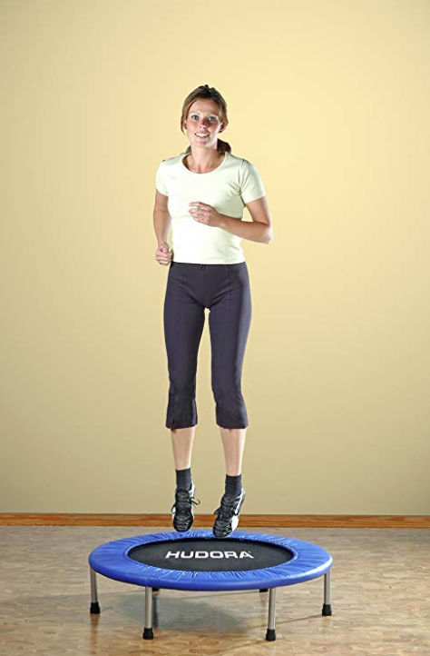
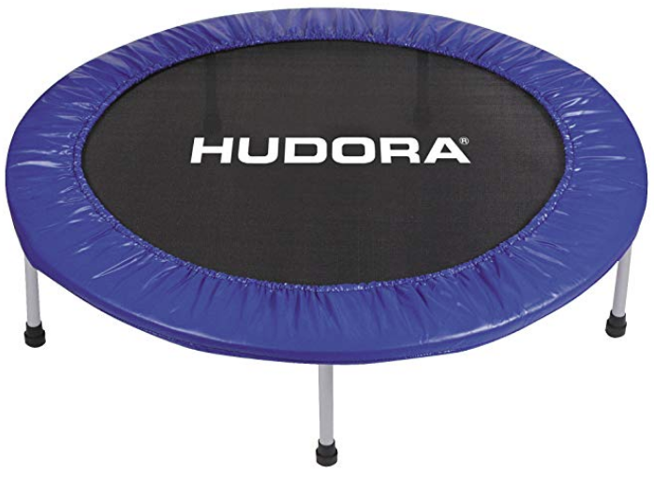
Example from my work last week: Amazon images
Write a program that generates a list of possible “lifestyle” images
High level: a sequence of functions and loops
Reads a list of Amazon item id’s from a file
Requests a list of images for each item
Checks each image to determine
If it is large enough (at least 500 pixels on each side)
If it has a white border
Prints a line for each image that passes the checks

Slide 4
Examples of functions
print("Enter a number")
favorite_number = input()
double_favorite = 2 * int(favorite_number)
print("Here is twice that number”, double_favorite)

Slide 5
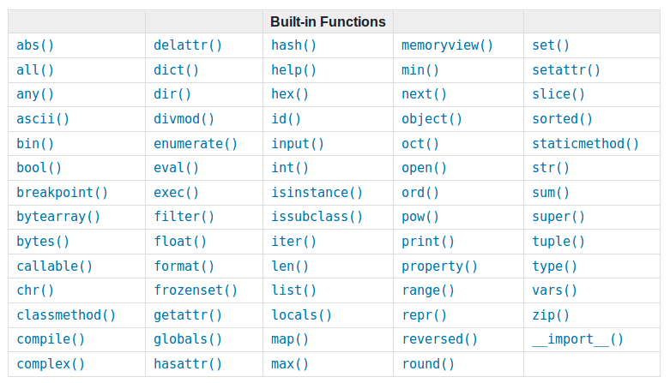
Built-in functions
Documentation: https://docs.python.org/3.7/library/functions.html

Slide 6
result_value = my_function(input_parameter)
Input parameters
Side effects
my_function
User interaction
Read data Write data from disk from Internet
Result value

Slide 7
What is a function?
An instruction that does something
Generate a result value
Make something happen (“side effects”). For example:
Display information on screen
Collect information from keyboard
Change the value of a variable stored in memory
Zero, one, or more input parameters
Every function must have a unique name

Slide 8
Writing your own function
def calculate_area(radius):
pi = 3.1415
answer = pi * (radius ** 2)
return answer
print("Enter a radius")
my_radius = int(input())
area = calculate_area(my_radius)
print("The area of the circle is”, area)
Function defined here
Function called here
def keyword defines the name of the function
radius is the only input parameter in this example
This function returns a result value using the return command
Function instructions are indented as a block

Slide 9
result_value = calculate_area(radius)
radius
calculate_area
Result value

Slide 10
?? int() print() input() Math.sqrt() ??
Input parameters
Side effects
my_function
User interaction
Read data Write data from disk from Internet
Result value

Slide 11
Break?

Slide 12
Exercise: list input and display
Write a program that collects one or more individual strings from the user, until the user enters an empty string. Next, the program should show the following information about each item in the list: its type, its value, and its length.
Organize your program by creating two functions:
collect_list()
show_item(my_item)
Hint: You can use both a while loop and a for loop.

Slide 13
Variables scopes
variables, created inside the function are “local” (variables created in the program are “global”)
# Lesson4: example of variables scopes
# source: code/scope_example.py
def calculate_area(radius): # parameters are local variables
area = pi * (radius ** 2) # local variable, is not visible
# outside of the function
# and shadows global variable with the same name
return area
pi = 3.14 # global variable - is visible in function if defined
# before the first call of the function (try to move it
# after the first call of calculate_area function )
area = 100 # global variable with the same name as local one in function
area1 = calculate_area(10)
area2 = calculate_area(20)
print(area1, area2)
print(area) # prints the one of the closest scope
print(radius) # Error here, there is no radius variable in the global scope

Slide 14
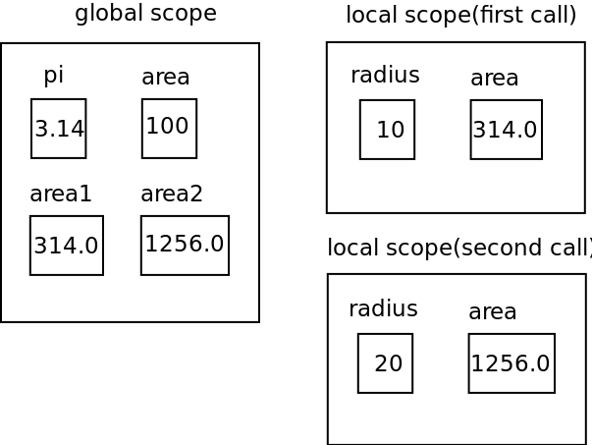
Variables scopes
Local scope is created when the function is called
Local scope is destroyed when the function finishes
Global variables are visible from the local scope
Local variables “shadow” global variables with the same names from the global scope

Slide 15
Using a function from a different file
You can put a function definition into a separate file
Makes you main file smaller -> code more readable
You can re-use your function in other programs without copying its code
# Lesson4: importing a function from another file
# source: code/import_example.py
from area import calculate_area
area1 = calculate_area(10)
area2 = calculate_area(20)
print(area1, area2)
You can import all the definitions from a file with a construction:
from file import *
Files with definitions are called “modules”
You can import the whole module (see next)

Slide 16
Python Standard library
Python has a rich standard library
Before implementing something by yourself, check, if somebody did it already
Documentation: https://docs.python.org/3.7/library/index.html
# Lesson4: importing a math function
# source: code/math_example.py
import math
c = math.ceil(1.5)
print(c)
# Lesson4: importing a browser module
# source: code/browser_example.py
import webbrowser
webbrowser.open("https://www.youtube.com")

