Slide 1
Lesson 5
Files

Slide 2
Reading from a file
Input to our programs so far:
Hard coded values (data in code)
User input
What if we have a file with data?
# Lesson5: reading from a file line by line
# source: code/file_read_by_line.py
f = open('file_for_reading.txt', 'r')
for line in f:
print(line)
f.close()
In general:
Open a file (get a file variable)
Do something with file (using file variable - file descriptor)
Close file

Slide 3
Reading from a file - explanation
Opening a file
Filename (with path if not in the same directory as your python program)
Mode: ‘r’, ‘w’, ‘a’, ‘r+’, ‘w+’ and modifier ‘b’ for binary (e.g. ‘wb’)
Reading from opened file
Variable f is “iterable” which means that we can use it in for loops
There is a way to read all the file at once (see next slide)
Closing the file
Some python versions might not be able to close opened files when program is finished
Some OSes (Windows) treat opened files as locked, so no other program can read from it until it’s closed
How not to forget to close a file? See next slides.
f = open('filename', 'r')
for line in f:
print(line)
f.close()

Slide 4
Reading from a file at once
# Lesson5: reading all the file at once
# source: code/file_read_whole.py
f = open('file_for_reading.txt', 'r')
text = f.read()
print(text)
f.close()
Do it, when you don’t need to process every line
Function read() returns a string with the whole file contents

Slide 5
Reading from a file two times
# Lesson5: reading file contents twice
# source: code/file_read_twice.py
f = open('file_for_reading.txt', 'r')
text = f.read()
print(text)
print("\nNow reading for a second time:")
text_copy = f.read()
print(text_copy)
f.close()
What is the expected result?
What do we get (you never know until you try)
Why it doesn’t work as expected?

Slide 6
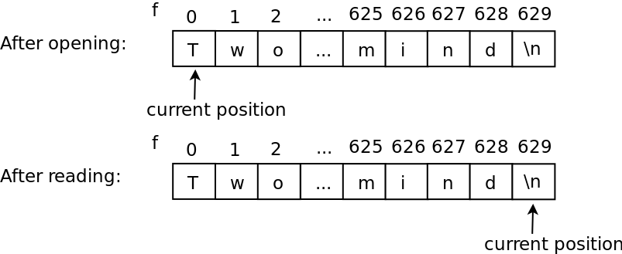
Reading from a file two times
You can think of open file as a list
File descriptor contains current place inside the file where the last operation finished

Slide 7
Changing current position in a file
# Lesson5: changing current position
# source: code/file_seek.py
f = open('file_for_reading.txt', 'r')
text = f.read()
print(text)
print("\nNow reading for a second time:\n")
f.seek(0)
text_copy = f.read()
print(text_copy)
f.close()
Function seek() changes current position in file
In text files:
Parameter - number of symbols from the beginning of file
In binary files:
Number of bytes
Is possible to move from the end of file

Slide 8
Writing to a file
# Lesson5: writing to a file
# source: code/file_write.py
f = open('test.txt', 'w')
f.write('Hello World!\n')
f.close()
Open file for writing with ‘w’ file access mode
If there was a file already with the same name - it will be overwritten (deleted on opening and re-created)
Use write() function of file descriptor variable
Behaves like print() function, but writes text to the file
Don’t forget to close the file

Slide 9
How not to forget to close a file?
Context managers will help!
# Lesson5: Automatically closing a file
# source: code/context_manager.py
with open('file_for_reading.txt', 'w') as f:
text = f.read()
print(text)
# syntax of context managers
with file_open_instruction as variable_name:
# instructions related to file
# file is closed after exiting the block
# other program instructions

Slide 10
Writing to an existing file
# Lesson5: appending to a file
# source: code/file_append.py
with open('test.txt', 'a') as f:
f.write('New line at the end of a file\n')
Open file for appending with ‘a’ file access mode
If there was no file with such a name - it will be created
Current file position is set to the end of file
When you call write - the existing content will not be overwritten

