Slide 1
Lesson 6
Tuples, sets, dictionaries

Slide 2
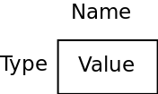
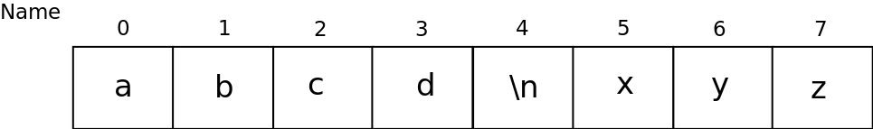
Revisiting types
int, bool, float
Variable stores one value
Immutable (do you remember what this means? - check the lesson about lists if you forgot)
string
Variable is a sequence of letters forming a string
Immutable
Has some useful methods (capitalize(), find(), split() etc)
Each character can be accessed by index (like elements of the list) and string can be iterated over using for loop

Slide 3
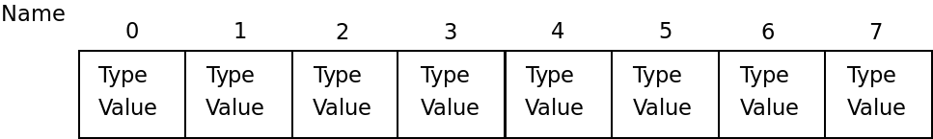
Revisiting types
Lists
Variable stores a sequence of values of any types (values of different types can be in the same list)
Mutable
Has some useful methods (append() etc)
Each element can be accessed by index. List can be iterated over using for loop

Slide 4
Tuples
Sequence of elements of any types (like list)
Immutable (like string)
Once initialized, can’t be changed - only re-initialized
# Lesson6: Tuples
# source: code/tuples.py
t1 = (1, 5, 0, 4, 'string', [0, 1, 2]) # create a tuple
print(t1)
print(len(t1)) # length of the tuple
print('The first element is', t1[1])
t1[0] = '25'

Slide 5
Sets
Sequence of elements of different types (like list), but ...
All elements within the set are unique
Can contain only “hashable” objects (all built-in immutable types are hashable, mutable are not)
Supports mathematical operations to sets: union, intersection, difference, symmetric difference
Convenient for removing duplicates from a sequence
Unordered
No indexing of elements
You can’t rely on the order of the elements within the set - it’s implementation depended
# Lesson6: Sets
# source: code/sets_creation.py
s1 = {1, 5, 'string', 5, 4, 'string'}
print(s1)
print(len(s1))
print(s1[0])

Slide 6
Sets: example
We asked the students in each REDI class to state their mother tongue languages and got the results:
Python class: russian, french, arabic, arabic, arabic, arabic, farsi
Java class: english, kurdish, arabic, arabic, french
We would like the answer the following questions:
How many different languages do we have in each class?
What are the languages spoken in both classes?
What are the common languages between the two classes?
What are the languages that are found in only one class (not in both)?
What are languages found in Python class but not in Java class?

Slide 7
Sets: example
# Lesson6: Sets
# source: code/sets_operations.py
# Input data
python_languages = ['russian', 'french', 'arabic', 'arabic', 'arabic', 'arabic', 'farsi']
java_languages = ['english', 'kurdish', 'arabic', 'arabic', 'french']
# How many different languages do we have in each class?
python_set = set(python_languages)
java_set = set(java_languages)
print('Python:', len(python_set), 'Java:', len(java_set))
# What are the languages spoken in both classes?
print('All languages:', python_set | java_set)
# What are common languages between the two classes?
print('Common languages:', python_set & java_set)
# What are the languages that are found in only one class (not in both)?
print('One-class languages:', python_set ^ java_set)
# What are languages found in Python class but not in Java class?
print('Python class specific languages:', python_set - java_set)

Slide 8
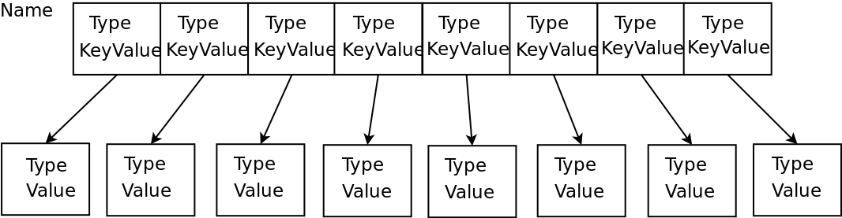
Dictionaries
Sequence of pairs: key - value
Keys should be of hashable types
Keys can have different types
Keys are unique
Values can be of any type
Mutable
In some other programming languages are called maps
You can think of it as of list, where indexes can have other than integer types

Slide 9
Dictionaries: example
We want to build a program which stores semester grades of a student - one grade per subject, for example
Math => 5
Science => 3
English => 10
German => 6
We want our program to do two things:
Print the grade for the student for the subject, given as a program input
Store the grade of a student for the subject - both given as an input
If the subject already has a grade - update it
If there is no such subject stored - add it with the given grade

Slide 10
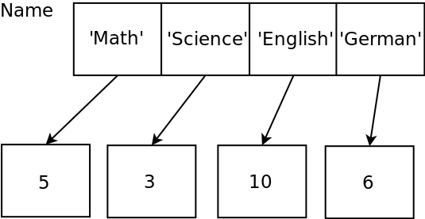
Dictionaries: example
How will we store our data in our program?
Is it a sequence of pairs of values?
Are the values in pair unique (one part of a pair)?
In our case:
We have pairs of values: subject name -> grade
Subject names are unique (student can’t have two grades for one subject)
So a dictionary perfectly fulfills our needs
It’s not the only option, but the most convenient one

Slide 11
Example: creating a dictionary and reading from it
Let’s pretend, that the data is given (we don’t need user’s input) and focus on the creation of the dictionary.
# Lesson6: Dictionaries
# source: code/dictionary_creation.py
grades = {'Math': 5,'Science': 3, 'English': 10,'German': 6}
subject = input('Please enter the name of a subject:\n')
print(grades[subject])
What happens if I type ‘biology’ as as input?
You never know, until you try!

Slide 12
Example: reading from a dictionary in a correct way
# Lesson6: Dictionaries
# source: code/dictionary_creation_improved.py
grades = {'Math': 5,'Science': 3, 'English': 10,'German': 6}
subject = input('Please enter the name of a subject:\n')
if subject in grades:
print('The grade is:', grades[subject])
else:
print('No such subject')
Is it better?

Slide 13
Example: adding values to a dictionary
# Lesson6: Dictionaries
# source: code/dictionary_add.py
grades = {}
subject = input('Please enter the name of a subject:\n')
grade = int(input('Please enter the grade:\n'))
grades[subject] = grade
for key in grades:
print(key, ':', grades[key])
The program gets one pair and exits (removing all the data from the memory) - let’s modify it.

Slide 14
Example: modifying values of a dictionary
# Lesson6: Dictionaries
# source: code/dictionary_modify.py
grades = {}
finish = 'no'
while finish != 'yes':
subject = input('Please enter the name of a subject:\n')
grade = int(input('Please enter the grade:\n'))
grades[subject] = grade
for key in grades:
print(key, ':', grades[key])
finish = input('Do you want to quit the program? (type "yes" or "no"):\n').lower()

Slide 15
Example: finalizing the program
Now we have to:
Combine reading from our dictionary and modifying it’s values
Give to the user possibility to select one of those actions
See next slide.

Slide 16
# Lesson6: Dictionaries
# source: code/dictionary_modify.py
grades = {}
finish = 'no'
while finish != 'yes':
action = int(input('Please type "1" for reading the data and "2" for modifying:\n'))
if action == 1:
subject = input('Please enter the name of a subject:\n')
if subject in grades:
print('The grade is:', grades[subject])
else:
print('No such subject')
elif action == 2:
subject = input('Please enter the name of a subject:\n')
grade = int(input('Please enter the grade:\n'))
grades[subject] = grade
for key in grades:
print(key, ':', grades[key])
else:
print('Wrong input')
finish = input('Do you want to quit the program? (type "yes" or "no"):\n').lower()

Slide 17
Exercise
Write a program, which analyses given text and prints for each word of the text the number of its occurrences in the text.
Example:
Input: “I like cats. Cats are so cool. I can't stop talking about cats.”
Output: i : 2, like : 1, cats : 3, are : 1, so : 1, cool : 1, can't : 1, stop : 1, talking : 1, about : 1
Hints:
“Cats” and “cats” - is the same word
Use split() method of string to split the text into words by spaces
Use strip() method of the word to cut punctuation symbols of a word:
'Cats.'.strip('.') -> 'Cats'

