Slide 1

ReDi
6 Feb 2025 19:20:01

Slide 2
Purpose
This model documents the architecture of the ReDi Rehabilitation Diary application. This application was created as a solution for keeping track of and aiding rehabilitation progress using a microservices architecture.
ReDi
2
/ 15

Slide 3
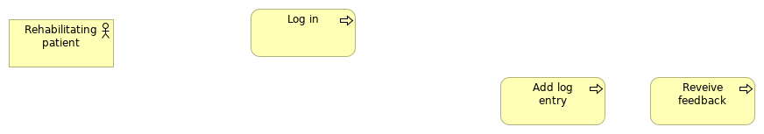
Views
Add log entry
No viewpoint
Elements
Element
Type
Add log entry
Business Process
Log in
Business Process
Rehabilitating patient
Business Actor
Reveive feedback
Business Process
ReDi
3
/ 15

Slide 4

FIDDLE TO DEPLOY
Properties
_hide_from_export_
true
ReDi
4
/ 15

Slide 5
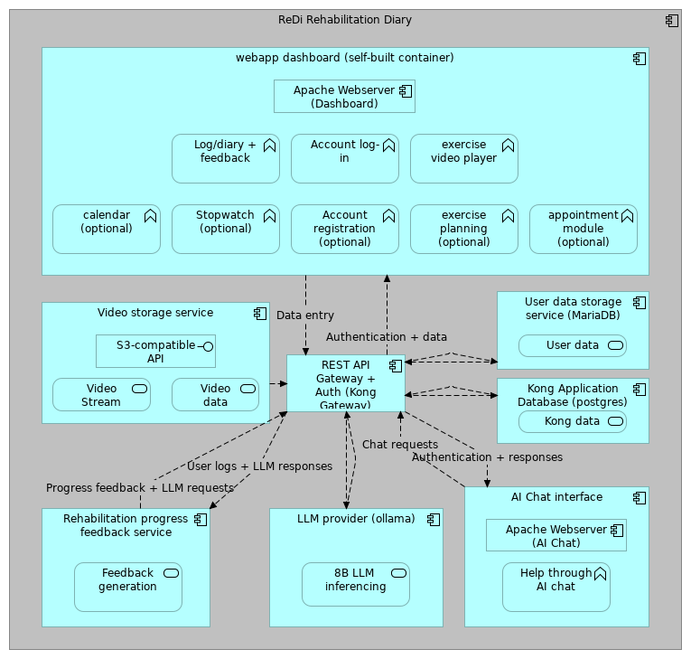
Overview
No viewpoint
Elements
Element
Type
8B LLM inferencing
Application Service
Account log-in
Application Function
Account registration (optional)
Application Function
AI Chat interface
Application Component
Apache Webserver (AI Chat)
Application Component
Apache Webserver (Dashboard)
Application Component
appointment module (optional)
Application Function
calendar (optional)
Application Function
exercise planning (optional)
Application Function
ReDi
5
/ 15

Slide 6
Element
Type
exercise video player
Application Function
Feedback generation
Application Service
Help through AI chat
Application Function
Kong Application Database (postgres)
Application Component
Kong data storage
Application Service
LLM provider (ollama)
Application Component
Log/diary + feedback
Application Function
ReDi Rehabilitation Diary
Application Component
Rehabilitation progress feedback service
Application Component
REST API Gateway + Auth (Kong Gateway)
Application Component
S3-compatible API
Application Interface
Stopwatch (optional)
Application Function
User data
Application Service
User data storage service (MariaDB)
Application Component
Video data
Application Service
Video storage service
Application Component
Video Stream
Application Service
webapp dashboard (self-built container)
Application Component
ReDi
6
/ 15

Slide 7
Business Layer
Add log entry
Type
Business Process
Log in
Type
Business Process
Rehabilitating patient
Type
Business Actor
Reveive feedback
Type
Business Process
ReDi
7
/ 15

Slide 8
Application Layer
8B LLM inferencing
Type
Application Service
Account log-in
Type
Application Function
Account registration (optional)
Type
Application Function
AI Chat interface
Type
Application Component
Apache Webserver (AI Chat)
Type
Application Component
Apache Webserver (Dashboard)
Type
Application Component
appointment module (optional)
Type
Application Function
maken van afspraken
calendar (optional)
Type
Application Function
exercise planning (optional)
Type
Application Function
weergeven schema (e.g. oefening X en Y 4x per week)
exercise video player
Type
Application Function
Feedback generation
Type
Application Service
Help through AI chat
Type
Application Function
Kong Application Database (postgres)
Type
Application Component
ReDi
8
/ 15

Slide 9
Kong data storage
Type
Application Service
LLM provider (ollama)
Type
Application Component
Log/diary + feedback
Type
Application Function
ReDi Rehabilitation Diary
Type
Application Component
ReDi is a
Rehabilitation progress feedback service
Type
Application Component
REST API Gateway + Auth (Kong Gateway)
Type
Application Component
paired with external auth using https://github.com/aunkenlabs/kong-external-auth/
S3-compatible API
Type
Application Interface
Stopwatch (optional)
Type
Application Function
User data
Type
Application Service
User data storage service (MariaDB)
Type
Application Component
Video data
Type
Application Service
Video storage service
Type
Application Component
Minio is an S3-compatible storage provider
ReDi
9
/ 15

Slide 10
Video Stream
Type
Application Service
webapp dashboard (self-built container)
Type
Application Component
ReDi
10
/ 15

Slide 11
Relations
Realization relation
Type
Realization relation
Source
webapp dashboard (self-built container)
Target
Stopwatch (optional)
Realization relation
Type
Realization relation
Source
webapp dashboard (self-built container)
Target
Log/diary + feedback
Composition relation
Type
Composition relation
Source
ReDi Rehabilitation Diary
Target
LLM provider (ollama)
Realization relation
Type
Realization relation
Source
webapp dashboard (self-built container)
Target
calendar (optional)
Composition relation
Type
Composition relation
Source
ReDi Rehabilitation Diary
Target
Rehabilitation progress feedback service
Composition relation
Type
Composition relation
Source
ReDi Rehabilitation Diary
Target
Kong Application Database (postgres)
Realization relation
Type
Realization relation
Source
Video storage service
Target
Video Stream
Composition relation
Type
Composition relation
Source
ReDi Rehabilitation Diary
Target
AI Chat interface
Realization relation
Type
Realization relation
ReDi
11
/ 15

Slide 12
Source
Rehabilitation progress feedback service
Target
Feedback generation
Composition relation
Type
Composition relation
Source
ReDi Rehabilitation Diary
Target
User data storage service (MariaDB)
Flow relation
Type
Flow relation
Source
Video storage service
Target
REST API Gateway + Auth (Kong Gateway)
Realization relation
Type
Realization relation
Source
webapp dashboard (self-built container)
Target
Account registration (optional)
Flow relation
Type
Flow relation
Source
User data storage service (MariaDB)
Target
REST API Gateway + Auth (Kong Gateway)
Realization relation
Type
Realization relation
Source
AI Chat interface
Target
Help through AI chat
Composition relation
Type
Composition relation
Source
webapp dashboard (self-built container)
Target
Apache Webserver (Dashboard)
Realization relation
Type
Realization relation
Source
webapp dashboard (self-built container)
Target
appointment module (optional)
Flow relation
Type
Flow relation
Source
Kong Application Database (postgres)
Target
REST API Gateway + Auth (Kong Gateway)
ReDi
12
/ 15

Slide 13
Composition relation
Type
Composition relation
Source
ReDi Rehabilitation Diary
Target
Video storage service
Realization relation
Type
Realization relation
Source
webapp dashboard (self-built container)
Target
Account log-in
Realization relation
Type
Realization relation
Source
Kong Application Database (postgres)
Target
Kong data storage
Realization relation
Type
Realization relation
Source
webapp dashboard (self-built container)
Target
exercise planning (optional)
Realization relation
Type
Realization relation
Source
User data storage service (MariaDB)
Target
User data
Composition relation
Type
Composition relation
Source
AI Chat interface
Target
Apache Webserver (AI Chat)
Flow relation
Type
Flow relation
Source
REST API Gateway + Auth (Kong Gateway)
Target
Kong Application Database (postgres)
Composition relation
Type
Composition relation
Source
ReDi Rehabilitation Diary
Target
webapp dashboard (self-built container)
Composition relation
Type
Composition relation
Source
Video storage service
Target
S3-compatible API
ReDi
13
/ 15

Slide 14
Flow relation
Type
Flow relation
Source
REST API Gateway + Auth (Kong Gateway)
Target
LLM provider (ollama)
Serving relation
Type
Serving relation
Source
Stopwatch (optional)
Target
webapp dashboard (self-built container)
Realization relation
Type
Realization relation
Source
webapp dashboard (self-built container)
Target
exercise video player
Flow relation
Type
Flow relation
Source
REST API Gateway + Auth (Kong Gateway)
Target
User data storage service (MariaDB)
Realization relation
Type
Realization relation
Source
LLM provider (ollama)
Target
8B LLM inferencing
Composition relation
Type
Composition relation
Source
ReDi Rehabilitation Diary
Target
REST API Gateway + Auth (Kong Gateway)
Realization relation
Type
Realization relation
Source
Video storage service
Target
Video data
Flow relation
Type
Flow relation
Source
LLM provider (ollama)
Target
REST API Gateway + Auth (Kong Gateway)
Authentication + data
Type
Flow relation
Source
REST API Gateway + Auth (Kong Gateway)
ReDi
14
/ 15

Slide 15
Target
webapp dashboard (self-built container)
Authentication + responses
Type
Flow relation
Source
REST API Gateway + Auth (Kong Gateway)
Target
AI Chat interface
Chat requests
Type
Flow relation
Source
AI Chat interface
Target
REST API Gateway + Auth (Kong Gateway)
Data entry
Type
Flow relation
Source
webapp dashboard (self-built container)
Target
REST API Gateway + Auth (Kong Gateway)
Progress feedback + LLM requests
Type
Flow relation
Source
Rehabilitation progress feedback service
Target
REST API Gateway + Auth (Kong Gateway)
User logs + LLM responses
Type
Flow relation
Source
REST API Gateway + Auth (Kong Gateway)
Target
Rehabilitation progress feedback service
ReDi
15
/ 15

