Slide 1

LINIYA OGNYA is a military-tactical club specializing in team laser tag games.

Slide 2
Displays statistics for all player battles.
Site Structure for Players
Main Page
The main section providing quick access to all essential information.
Battle Statistics
Displays statistics for all player battles.
Polygons
A catalog of all available polygons for players.
Scenarios
A variety of game scenarios for laser tag.
Equipment
A showcase of the available equipment for games.
Personal Account
A section where users can view detailed personal statistics.
Notes:
Main Page
The main section providing quick access to information.
Battle Statistics
This section contains statistics for all player battles.
Polygons
A section featuring all the polygons where players can participate.
Scenarios
Various types of scenarios for playing laser tag.
Equipment
A page showcasing the equipment available for the game.
Personal Account
The user’s account with detailed personal statistics.

Slide 3
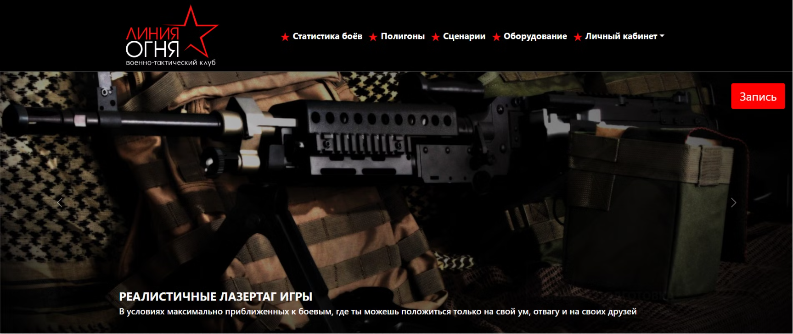
Main Page of My Website
The main page includes a Game Request button.
Users can easily apply for a game directly through the website.

Slide 4
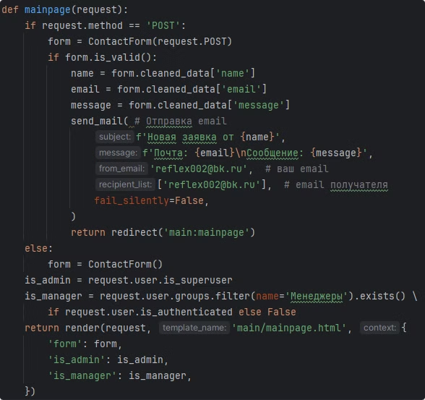
Main page view
It contains a method that sends a request to the mail

Slide 5
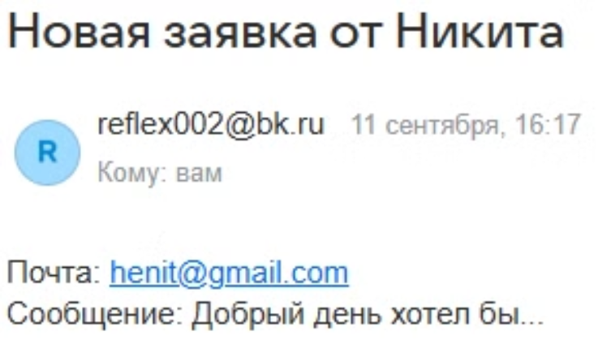
Example of a User Request

Slide 6
Target Audience
The target audience includes individuals aged 11 to 40 years.
This ranges from teenagers seeking an exciting hobby to adults looking for immersive war games and simulations.

Slide 7
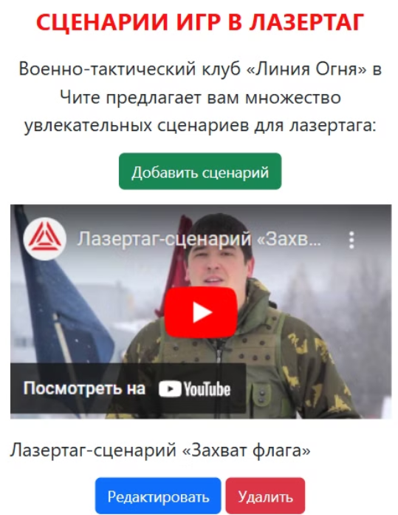
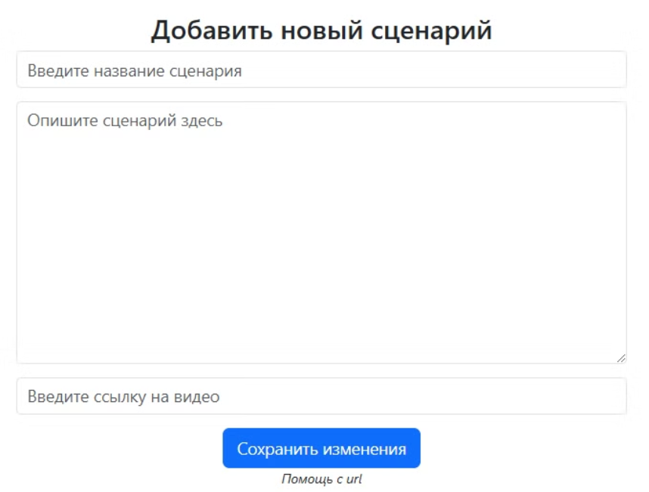
Administrative Features
The website provides advanced features for administrators:
Add, edit, and delete polygons, scenarios, and equipment.
Ensure content remains relevant and updated for players.
Notes:
The website includes functionality specifically designed for administrators. They can add, edit, and delete polygons, scenarios, and equipment efficiently.
This ensures that the content stays up-to-date and meets the needs of the players.

Slide 8
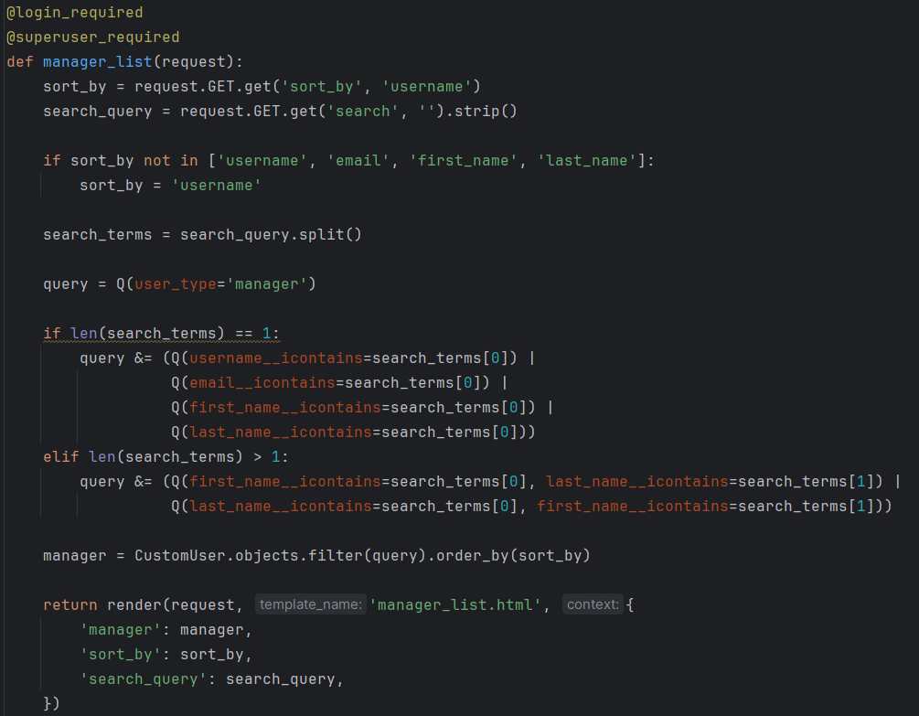
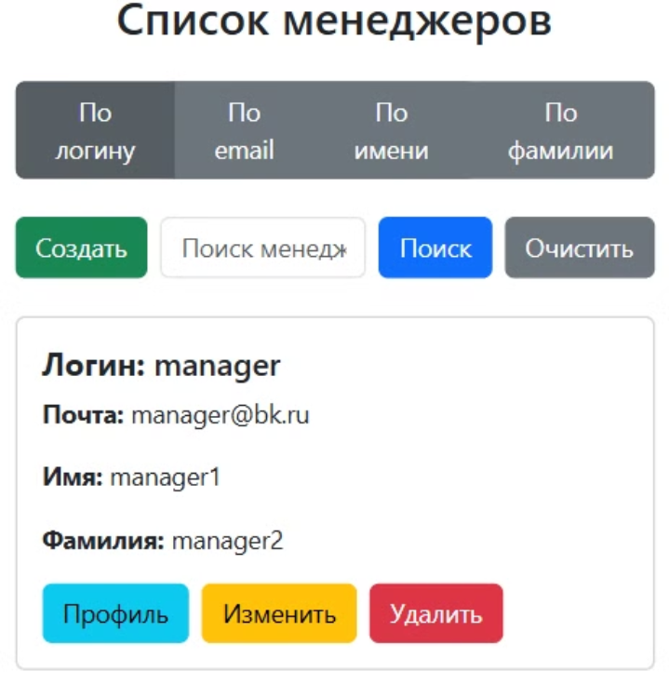
Administrators also have full control
over moderators.

Slide 9
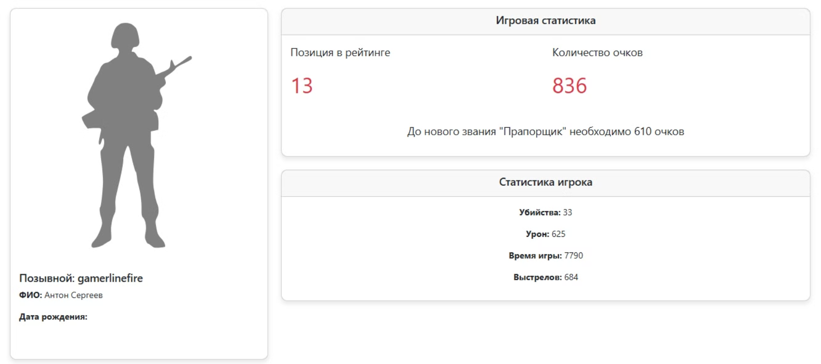
Moderator Features
Moderators can manage players and have control over game statistics.
They can upload game files, and the statistics from these files are automatically added to players' profiles.
Notes:
Moderators, in addition to managing players, also have control over game statistics. They can upload game files, and the statistics from these files are automatically added to the players' profiles.

Slide 10
Thank You for Your Attention!
I am ready to answer your questions.

