Slide 1
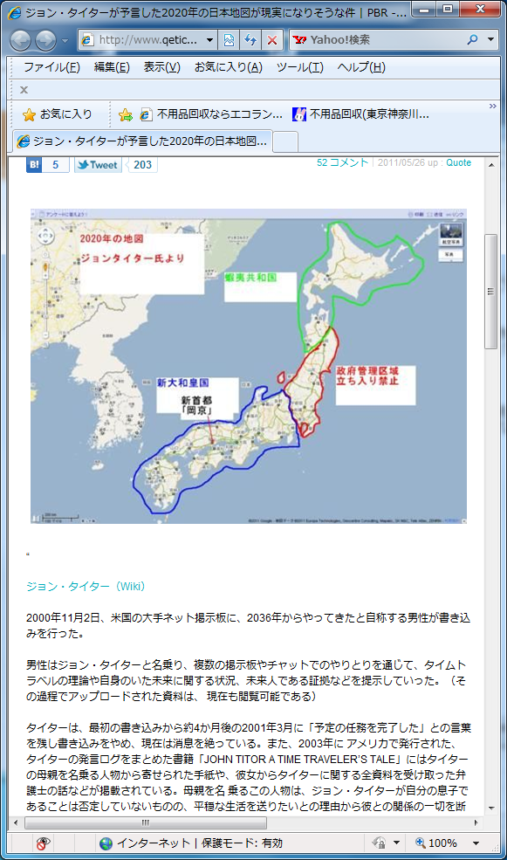
http://www.qetic.jp/blog/pbr/?p=3654

Slide 2
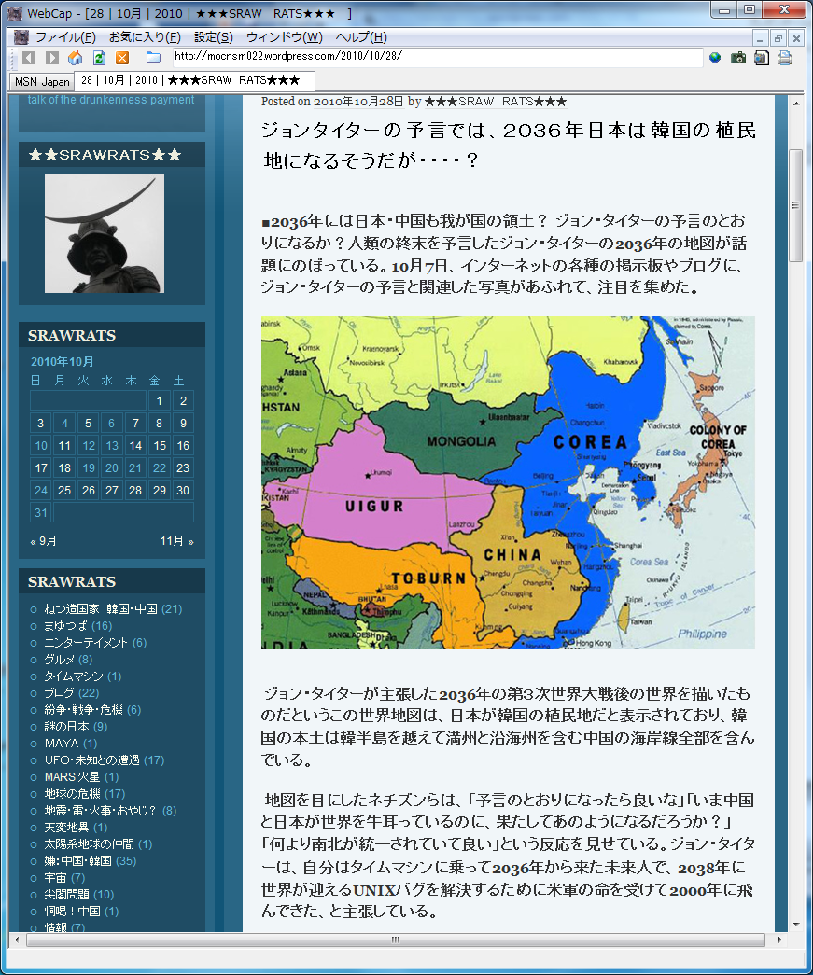
http://mocnsm022.wordpress.com/2010/10/28/

