Slide 1
ECM comparison report
Building: SFH_Greece_1946_1969
Category: Single Family House
Country: Greece
Weather source: pvgis
Simulations: 7 total, 7 successful, 0 failed
Total runtime: 167.84 s
Included scenarios: Baseline (no changes), wall_insulation, window_replacement, roof_insulation, floor_insulation, deep_envelope, deep_retrofit_hp_pv + heat pump COP=3.2
Generated on: 2026-03-24 17:08
HTML report: results/ecm_api/sfh_greece_1946_1969__wall_insulation_window_replacement_roof_insulation_floor_insulation_deep_envelope_deep_retrofit_hp_pv__report__pvgis.html

Slide 2
Process
The workflow runs a baseline plus the configured renovation scenarios defined in RENOVATION_SCENARIOS.
Each scenario produces hourly ISO 52016 results, annual UNI/TS 11300 primary energy, and scenario-specific CSV exports.
CO2 is computed with the same core logic used by the API emission endpoints and then aggregated per scenario.
The presentation focuses on annual scenario deltas so the ranking is easy to read for decision making.

Slide 3
Generated Data
Scenario | ISO total [kWh] | Primary energy [kWh] | Final energy [kWh] | CO2 [t/y] | CO2 saving [%]
Baseline (no changes) | 69,309.68 | 176,233.77 | 160,741.34 | 32.76 | 0.00
wall_insulation | 56,459.28 | 142,720.64 | 129,921.91 | 26.49 | 19.10
window_replacement | 66,425.63 | 168,538.16 | 153,555.31 | 31.30 | 4.40
roof_insulation | 52,395.63 | 133,067.66 | 121,278.72 | 24.72 | 24.50
floor_insulation | 67,829.08 | 172,400.06 | 156,979.01 | 32.00 | 2.30
deep_envelope | 29,402.49 | 72,729.79 | 65,025.60 | 13.31 | 59.40

Slide 4
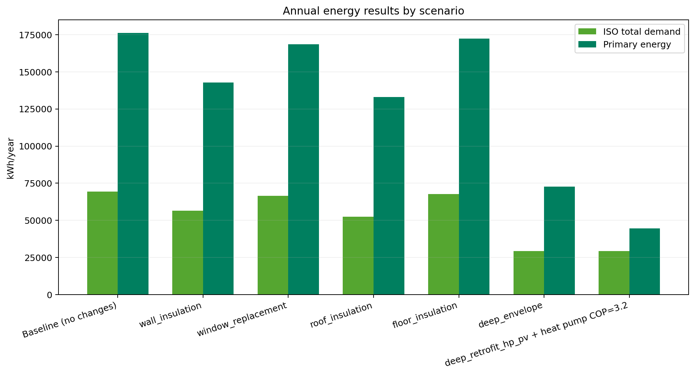
Energy Results

Slide 5
{width=88%}
The grouped bars compare annual ISO demand and annual primary energy for each scenario.
This view highlights whether a retrofit mainly reduces building demand, generation losses, or both.

Slide 6
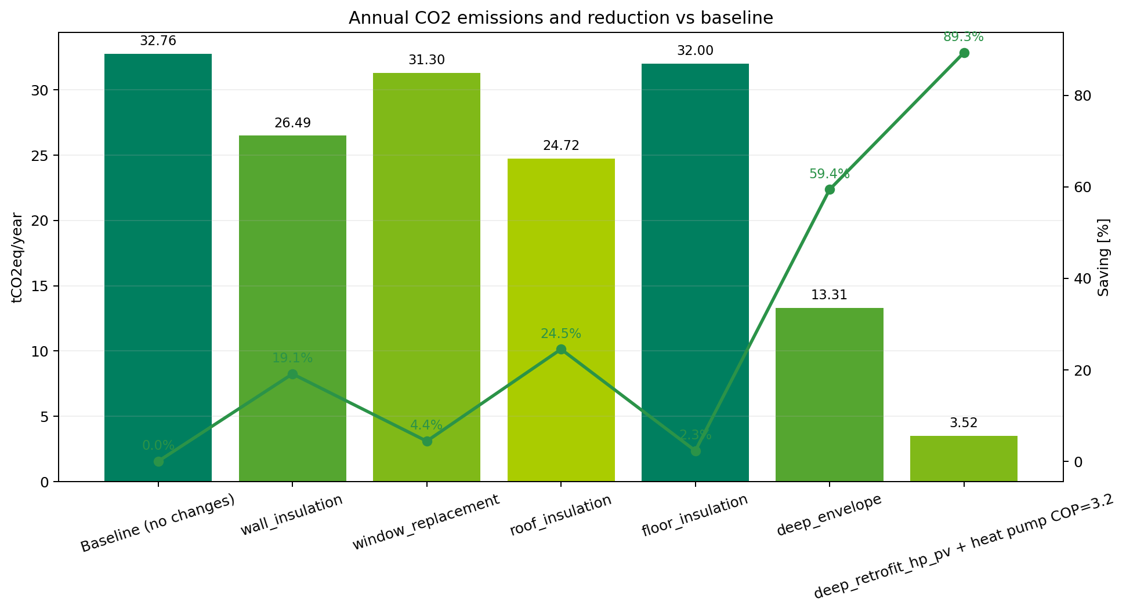
CO2 Results

Slide 7
{width=88%}
Lowest annual CO2: deep_retrofit_hp_pv + heat pump COP=3.2 with 3.52 tCO2eq/year (89.3% vs baseline).
Lowest annual primary energy: deep_retrofit_hp_pv + heat pump COP=3.2 with 44,611 kWh/year.
Lowest annual ISO 52016 demand: deep_envelope with 29,402 kWh/year.

Slide 8
Considerations
CO2 uses a final-energy carrier split: delivered thermal energy is mapped to natural gas, grid imports to grid electricity, and self-consumed PV to solar PV.
Country codes outside the explicit IT/DE mappings fall back to EU emission factors so archetypes such as Greece remain covered.
The comparison is operational and annual: it does not include embodied carbon of retrofit materials or replacement systems.
Results depend on the selected weather source, scenario definitions, and UNI/TS 11300 configuration used during the run.

