Slide 1
A Second Look at Classes and Objects

Slide 2
Review of the following OO Concepts:
Instance variables & instance methods
Static variables & static methods
Passing & returning objects to methods
.toString method
“this”

Slide 3
Review of a Domain Class
public class SuperHeroDomain
{
private String firstName;
private String lastName;
private String superPower;
private String favoriteColor;
public SuperHeroDomain(String aFirstName, String aLastName, String aSuperPower, String aFavoriteColor)
{
firstName = aFirstName;
lastName = aLastName;
superPower = aSuperPower;
favoriteColor = aFavoriteColor;
}
public String getFirstName()
{ return firstName;
}
public void setFirstName(String aFirstName)
{ firstName = aFirstName;
}
public String toString()
{ return firstName + " " + lastName + ", superhero, has " + superPower + " super powers, and has a favorite color of " + favoriteColor;
}
}
instance variables-
every object has its own copy.
constructor
used to initialize instance variables when an object is created/instantiated.
setters & getters
toString
used to represent the object
9-<number>

Slide 4
Static Class Members
Static fields and static methods do not belong to a single instance of a class.
To invoke a static method, the class name, rather than the instance name, is used.
Example:
double val = Math.sqrt(25.0);
Class name
Static method
9-<number>

Slide 5
Static Fields
static int instanceCount
3
Object1
Object2
Object3
9-<number>

Slide 6
Static Fields - Also called a “class” variable
Class fields are declared using the static keyword between the access specifier and the field type.
  private static int instanceCount = 0;
The field is initialized to 0 only once, regardless of the number of times the class is instantiated.
Primitive static fields are initialized to 0 if no initialization is performed.
9-<number>

Slide 7
static Variables
A static variable belongs to the class, not to any object of the class.
To assign bank account numbers sequentially
  Have a single value of lastAssignedNumber that is a property of the class, not any object of the class.
Declare it using the static reserved word
  public class BankAccount
  {
  private double balance;
  private int accountNumber;
  private static int lastAssignedNumber = 1000;
  public BankAccount()
  {
  lastAssignedNumber++;
  accountNumber = lastAssignedNumber;
  }
  . . .
  }

Slide 8
Static Methods
Methods can also be declared static by placing the static keyword between the access modifier and the return type of the method.
  public static double milesToKilometers(double miles)
  {…}
When you wish to break up the code in main, you may create static methods within the driver class, that are called from main.
Static methods may not communicate with instance fields, only static fields.
9-<number>

Slide 9
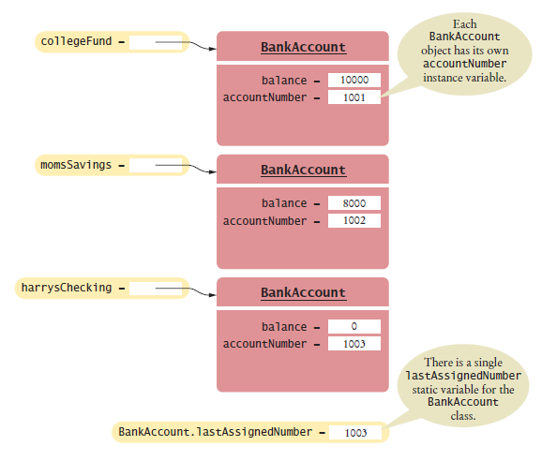
static Variables and Methods
Figure 5 A static Variable and Instance Variables

Slide 10
Check Your Latest Program
Did you need to define any static variables or methods in your Battleship programming assignment?
  Give examples of why or why not

Slide 11
Passing Objects as Arguments
Objects can be passed to methods as arguments.
When an object is passed as an argument, the value of the reference variable is passed.
The value of the reference variable is an address or reference to the object in memory.
A copy of the object is not passed, just a pointer to the object.
When a method receives a reference variable as an argument, it is possible for the method to modify the contents of the object referenced by the variable.
9-<number>

Slide 12
Passing Objects as Arguments
A Rectangle object
length:
width:
12.0
displayRectangle(box);
5.0
Address
public static void displayRectangle(Rectangle r)
{
// Display the length and width.
System.out.println("Length: " + r.getLength() +
" Width: " + r.getWidth());
}
9-<number>

Slide 13
Returning Objects From Methods
Methods are not limited to returning the primitive data types.
Methods can return references to objects as well.
Just as with passing arguments, a copy of the object is not returned, only its address. Method return type:
  public static BankAccount getAccount()
  {
  …
  return new BankAccount(balance);
  }
9-<number>

Slide 14
Returning Objects from Methods
account = getAccount();
A BankAccount Object
balance:
3200.0
address
public static BankAccount getAccount()
{
…
return new BankAccount(balance);
}
9-<number>

Slide 15
Passing & Returning Objects
An Account object
balance:
account number:
12.0
abc123
Address
public static void processAccount(Account checking )
{
checking.setBalance(userInput);
}
object will return to
calling method changed,
even though it is not
explicitly returned.

Slide 16
The toString Method
The toString method of a class can be called explicitly:
  Stock xyzCompany = new Stock("XYZ", 9.62);
  System.out.println(xyzCompany.toString());
However, the toString method does not have to be called explicitly but is called implicitly whenever you pass an object of the class to println or print.
Stock xyzCompany = new Stock ("XYZ", 9.62);
System.out.println(xyzCompany);
9-<number>

Slide 17
The this Reference
The this reference is simply a name that an object can use to refer to itself.
The this reference can be used to overcome shadowing and allow a parameter to have the same name as an instance field.
  public void setFeet(int feet)
  {
  this.feet = feet;
  //sets the this instance’s feet field
  //equal to the parameter feet.
  }
Local parameter variable feet
Shadowed instance variable
9-<number>

