Slide 1
BCI Final Project: Schizophrenia Disorder Detection
108062224 廖珞珽
111062574 徐瑞憫
111062575 許詠晴

Slide 2
Outline
Introduction
Motivation
Dataset Description
Program Description
Methods
ERP Dataset
Data Preprocessing
Machine Learning on ERP Dataset
Raw Dataset
Data Preprocessing
Deep Learning on Raw Dataset
Result
Reference

Slide 3
Outline
Introduction
Motivation
Dataset Description
Program Description
Methods
ERP Dataset
Data Preprocessing
Machine Learning on ERP Dataset
Raw Dataset
Data Preprocessing
Deep Learning on Raw Dataset
Result
Reference

Slide 4
Motivation
Schizophrenia is a disease which is hardly identified from healthy individuals as they act like normal ones.
Traditionally, diagnosis requires much time or resources, including consulting a psychologist, not to mention that some of patients lack insight.
However, with the help of EEG, we can propose a more efficient alternative to distinguish them.

Slide 5
Dataset Description
Dataset source
Kaggle: EEG data from basic sensory task in Schizophrenia
By Northern California Institute for Research and Education
Three tasks
Button Tone (active play tone)
Play Tone (passive playback)
Button Alone (baseline)
Two datasets
ERP dataset
Raw dataset

Slide 6
ERP Dataset
Size: 114MB
9 channels: Fz, FCz, Cz, FC3, FC4, C3, C4, CP3, CP4
81 subjects
32 Healthy Controls (HC)
49 Schizophrenia (SZ)
1 trail/subject
sample rate: 1024

Slide 7
Raw Dataset
Size: 19.2GB
70 channels: 65 EEG channels + 5 others
40 subjects
25 Healthy Controls (HC)
15 Schizophrenia (SZ)
100 trails/subject
sample rate: 1024

Slide 8
Program Description
Program GitHub link: BCI_Schizophrenia
Three parts
Preprocessing: data preprocessing
Preprocessing.py: ICLabel and Artifact subspace reconstruction (ASR)
data_split.py: split data to train set and test set for Deep Learning (DL)
MLWithERPdata: Machine Learning on ERP Dataset
statistic_ERPdata.ipynb: visualize ERP dataset
randomforest_forERPdata.ipynb: classify ERP dataset using random forest method
DeepLeaning: Deep Learning on Raw Dataset
loaddata.py: load preprocessed raw dataset for training
model.py: build 1D CNN and LSTM model structure
train.py: train and test model

Slide 9
Outline
Introduction
Motivation
Dataset Description
Program Description
Methods
ERP Dataset
Data Preprocessing
Machine Learning on ERP Dataset
Raw Dataset
Data Preprocessing
Deep Learning on Raw Dataset
Result
Reference

Slide 10
Preprocessing: ERP Dataset
The ERP dataset has preprocessed by the provider, so we use the dataset directly.
The reference paper[2] finds that the schizophrenia patients can’ t distinguish between external and internal stimuli. That is, patients cannot suppress their brains’ responses such as N100.
Thus, we try to visualize the difference of N100 in some channels.

Slide 11
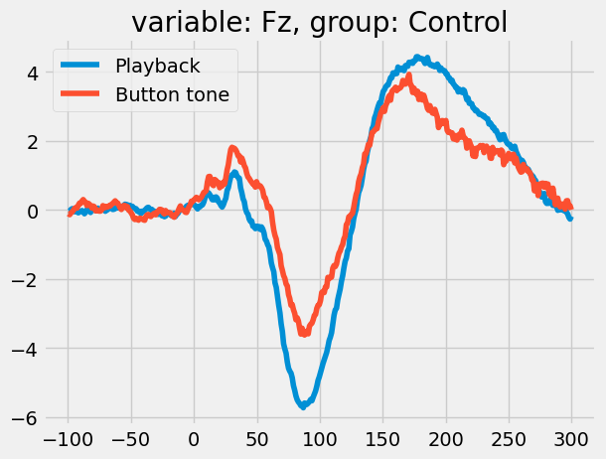
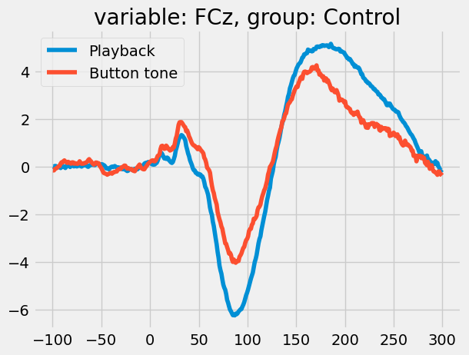
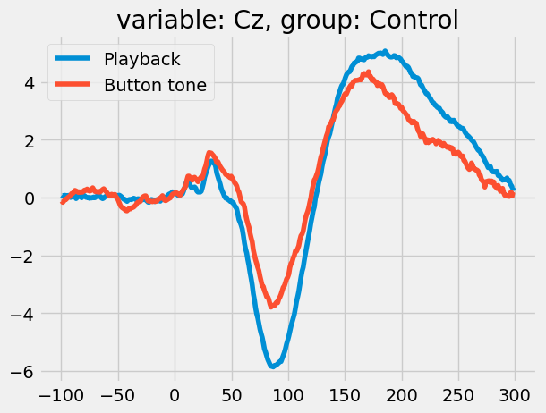
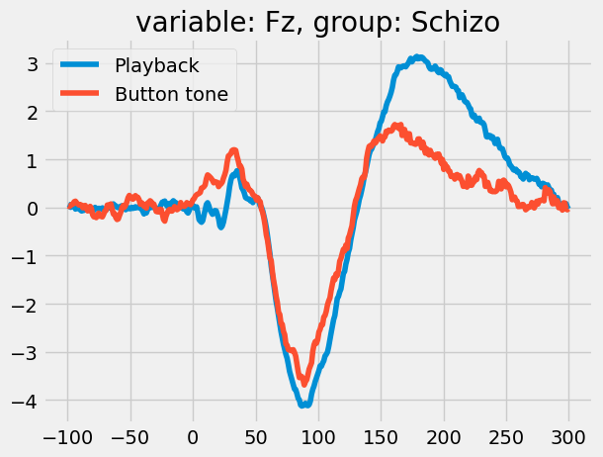
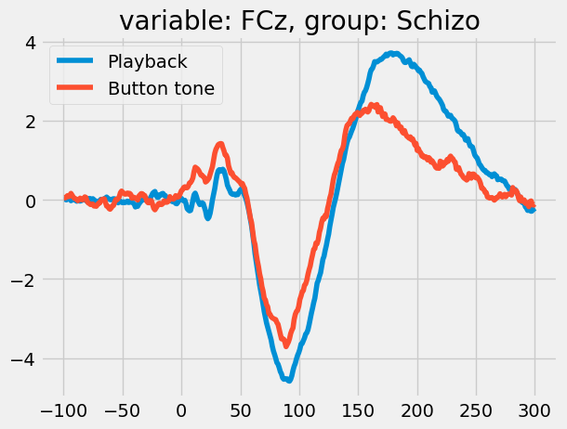
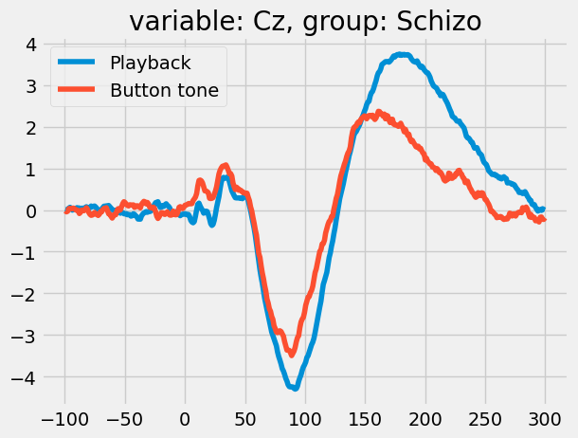
Visualize N100 Signals
Fz Channel
FCz Channel
Cz Channel
average
Healthy Control
(HC)
averge
Schizophrenia
(SZ)

Slide 12
Preprocessing: ERP Dataset
It shows that HC and SZ exists a gap of N1 suppression, so maybe we can easily use the feature of N1 suppression to classify.
Thus, the shape of each data is (2, )
one is readiness potential (RP), the other is N1 suppression (N1supp)
However, ERP data has 81 subjects, and each subject has only 1 trails
That means the number of data in ERP Dataset is only 81.
64 for training, 17 for testing
Notes:
From the above observation, In the previous slides shows that HC and SZ exists a gap of N1 suppression

Slide 13
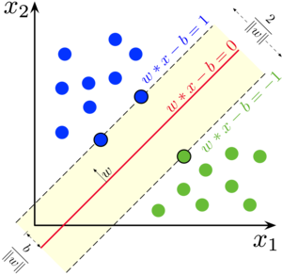
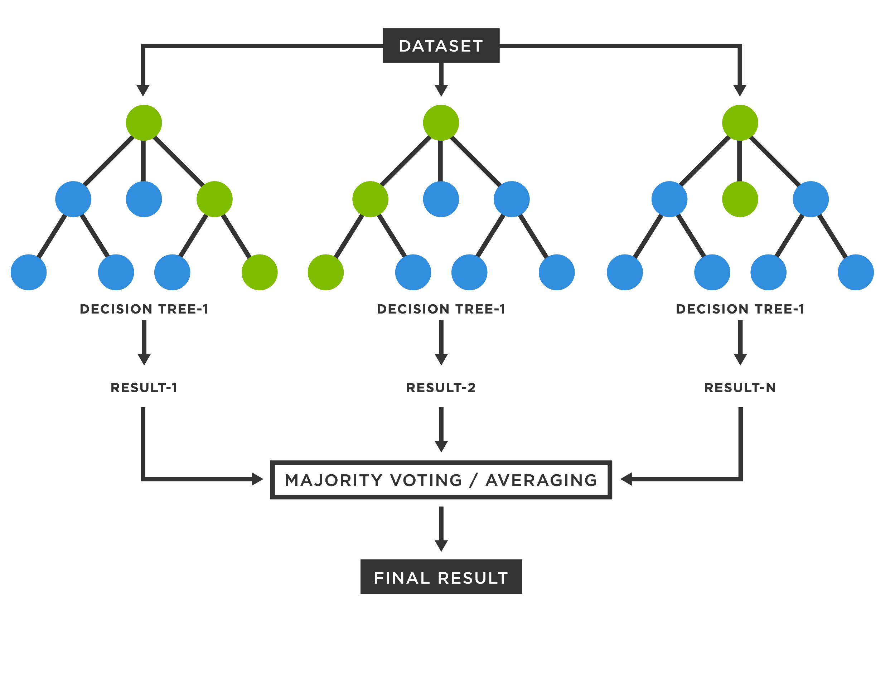
Machine Learning on ERP Dataset
The number of training data is 64, which is less. Thus we use machine learning method to classify.
Using methods:
Random forests: good way to classify small training samples.
SVM
https://en.wikipedia.org/wiki/Support_vector_machine
https://www.tibco.com/zh-hant/reference-center/what-is-a-random-forest
Notes:
The number of training data is 64, which is less. Thus we use machine learning method to classify.
Random forests are a good way to classify small training samples.

Slide 14
Classification Results For Machine Learning
Methods | Accuracy(%) | Precision(%) | Recall(%) | F1-score(%)
Random Forests | 52.94 | 50.78 | 52.94 | 51.16
SVM | 52.94 | 33.09 | 52.94 | 40.72

Slide 15
Problem of using N1 with ML in ERP dataset
The images demonstrate the average N1 amplitude values difference between HC and SZ.
Not all subjects exactly follow that rule.
Thus, it is not precise using N1 suppression and Readiness Potential (RP) for classification, especially the number of each subject’s data is just one.
Notes:
In the previous slides shows that HC and SZ exists a gap of N1 suppression, so that we can easily classify whether the subject is patient or not.
However, the N1 amplitude values difference shown between HC and SZ is just the average values of all subjects.
That is, not all subjects follow the rule (HC musty suppress responses dramatically, SZ cannot).
Thus, if we just use N1 suppression and Readiness Potential (RP) to classify is not enough, especially the number of data of each subject is just only 1.

Slide 16
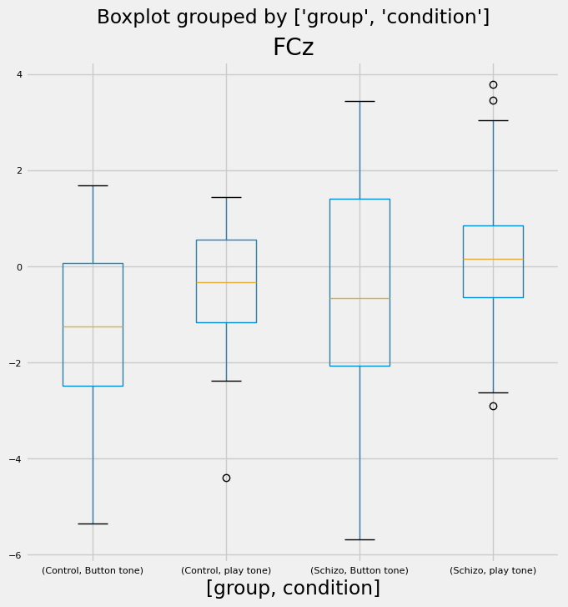
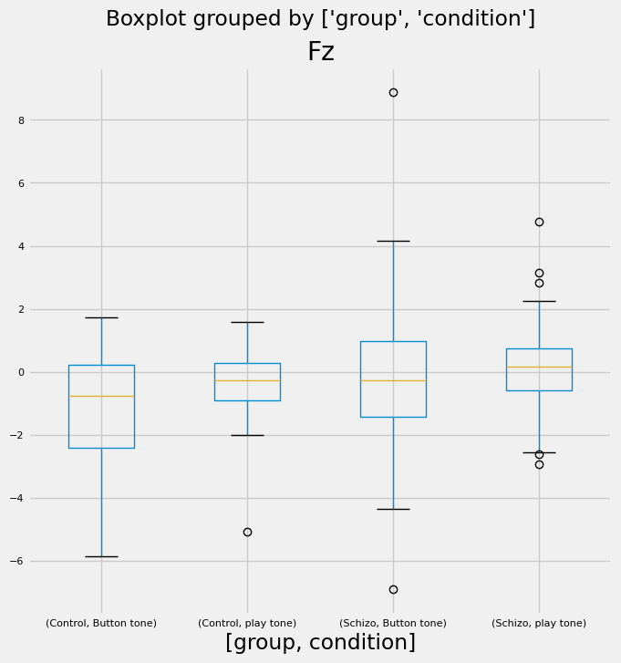
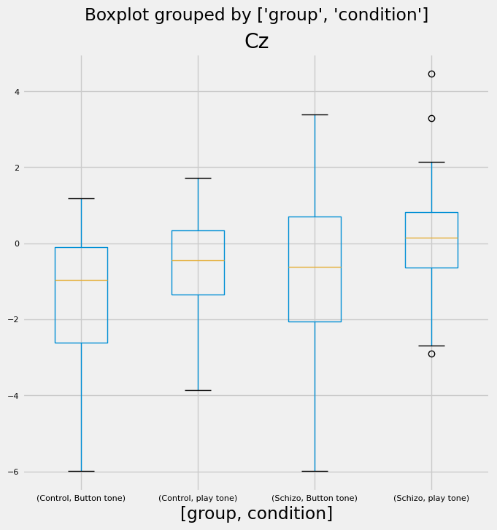
Problem of using N1 with ML in ERP dataset
standard
SZ
Visualize the Box plot for EEG signal for HC and SZ
For Example, FCz channel. If N1 suppression values of a SZ subject is smaller than the standard, this subject will be misclassified
N1 suppression
Notes:
The above three figures can explain why.
Take channel ‘FCz‘ for example, there exists a SZ subject whose data value is represented by two red thick line, and if N1 suppression values of the subject is smaller than standard, the SZ subject will misclassify.

Slide 17
Problem of using DL in ERP Dataset
In recent years, Deep learning is a good and widely used way in classification problem. Many SOTAs are using deep learning method.
However, our ERP dataset has only 81 trails (each subject has 1).
The dataset is is too small to use DL, unless we augment the data.
It just so happens that we have a dataset- Raw dataset with a large number of dataset
So next, we use this dataset to improve our performance

Slide 18
Outline
Introduction
Motivation
Dataset Description
Program Description
Methods
ERP Dataset
Data Preprocessing
Machine Learning on ERP Dataset
Raw Dataset
Data Preprocessing
Deep Learning on Raw Dataset
Result
Reference

Slide 19
Preprocessing: Raw Dataset
Load CSV Files
Change to mne.io.RawArray type for preprocessing
Apply ASR
Apply ICA
Reconstruct EEG data
Save preprocessed data to npy format and fif format
Save ICLabel Result

Slide 20
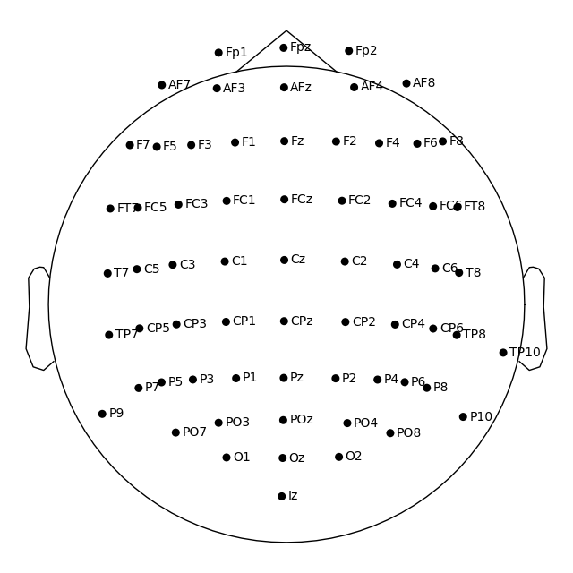
Preprocessing: Raw Dataset
The total number of data is 3571
3391 for training, 180 for testing
The shape of each data is (9216, 65)
65 channels:
Fp1, AF7, AF3, F1, F3, F5, F7, FT7, FC5, FC3, FC1, C1, C3, C5, T7, TP7, CP5, CP3, CP1, P1, P3, P5, P7, P9, PO7, PO3, O1, Iz, Oz, POz, Pz, CPz, Fpz, Fp2, AF8, AF4, AFz, Fz, F2, F4, F6, F8, FT8, FC6, FC4, FC2, FCz, Cz, C2, C4, C6, T8, TP8, CP6, CP4, CP2, P2, P4, P6, P8, P10, PO8, PO4, O2, TP10

Slide 21
ICLabels
Pre-processing |  |  | Average percent of Ics classified by ICLabel (%)
EEG (65Channel, Raw Dataset) | Bandpass filter | ASR | Brain | Muscle | Eye | Heart | Line Noise | Channel Noise | Other
Raw | x | x | 14.31 | 0.45 | 1.16 | 0.72 | 0.16 | 1.59 | 81.62
filtered | v | x | 22.42 | 1.16 | 1.68 | 1.23 | 0.26 | 3.75 | 69.50
ASR | x | v | 16.93 | 6.39 | 1.20 | 0.46 | 0.10 | 2.41 | 78.26
Filtered-ASR | v | v | 25.31 | 1.27 | 1.36 | 1.07 | 0.26 | 4.92 | 65.81
Notes:
{'brain': 0.14308776932283462, 'muscle artifact': 0.004490959119496855, 'eye blink': 0.011592589374249547, 'heart beat': 0.00711674248799665, 'line noise': 0.0015625, 'channel noise': 0.015909643918572258, 'other': 0.8162397957768501}
{'brain': 0.22416536031196155, 'muscle artifact': 0.01163553620672368, 'eye blink': 0.01680369680866651, 'heart beat': 0.012275425925280341, 'line noise': 0.002603666555891025, 'channel noise': 0.03750083703339947, 'other': 0.6950154771580775}
{'brain': 0.16928996371427274, 'muscle artifact': 0.006390679594689028, 'eye blink': 0.011986195074071015, 'heart beat': 0.004563557901793195, 'line noise': 0.0009925314465408805, 'channel noise': 0.024144878963418614, 'other': 0.7826321933052147}
{'brain': 0.25310972801827747, 'muscle artifact': 0.012710699605416492, 'eye blink': 0.013591609232821633, 'heart beat': 0.010683317170318136, 'line noise': 0.0025633419736409767, 'channel noise': 0.04924108780656832, 'other': 0.6581002161929572}

Slide 22
Deep Learning on Raw Dataset
Load Data
Split Dataset Train: Val = 8:2
Model Structure
1D CNN
LSTM
Training Process
Testing Process

Slide 23
Model Structure
LSTM
1D CNN
7
7
features
vector
features
vector
stride = 2
5
5
stride = 2
2
2
5
5
4
4
4
4
1
128
128
1
256
32
32
64
128
256
64
64
128
32
32
32
The input shape of each data is (time_steps= 9216, channels = 65)
each data is a time serial data, so it is suitable for 1D CNN and LSTM.
However, the time steps is 9216, which may results the overload of memory when training especially in stack of LSTM.
Thus, we have to do downsample through maxpool1d or set stride to 2.
Conv1d
Relu
maxpool1d
Dense
LSTM
Kernel Size
Pool Size
Channels
Channels

Slide 24
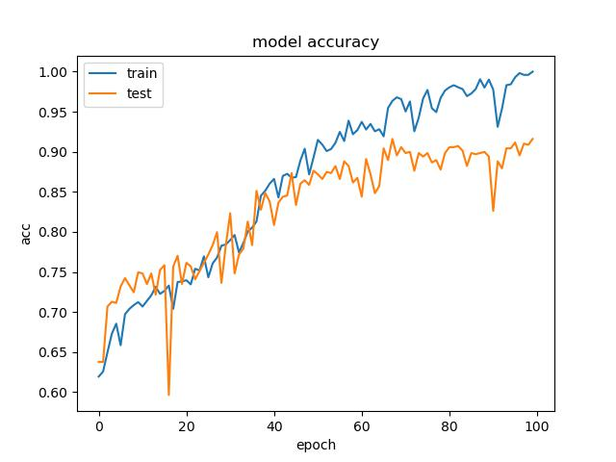
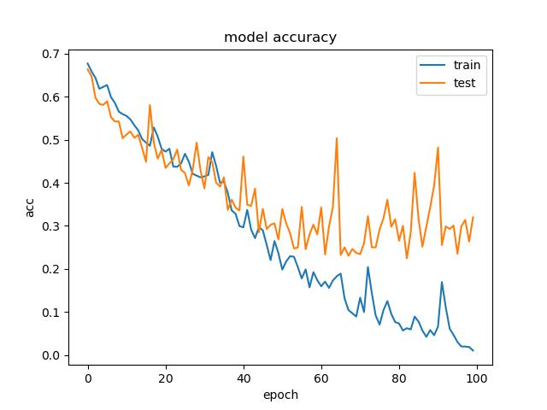
Training Loss and Accuracy
Model: 1D CNN
Preprocessing: filter + ASR
Dataset: 65 Channels
model accuracy
model loss
acc
loss

Slide 25
Testing Dataset Accuracy & Loss
Model | # of Channels | raw |  | filter |  | asr |  | filter+asr
 |  | ACC (%) | Loss | ACC (%) | Loss | ACC (%) | Loss | ACC (%) | Loss
1D CNN | 65 | 92.78 | 0.359 | 67.22 | 0.643 | 92.78 | 0.163 | 96.67 | 0.092
 | 9 | 81.11 | 0.539 | 86.66 | 0.314 | 86.11 | 0.356 | 91.67 | 0.195
LSTM | 65 | 62.78 | 0.672 | 70.00 | 0.623 | 71.67 | 0.563 | 71.11 | 0.603
 | 9 | 70.00 | 0.667 | 62.78 | 0.656 | 68.89 | 0.580 | 65.56 | 0.749

Slide 26
Classification Results-1
Raw
Model | # of Channels | Accuracy(%) | Precision(%) | Recall(%) | F1-score(%)
1D CNN | 65 | 92.78 | 97.35 | 91.67 | 94.42
 | 9 | 81.11 | 84.96 | 84.96 | 84.96
LSTM | 65 | 62.78 | 100.00 | 62.78 | 77.13
 | 9 | 70.00 | 90.27 | 70.34 | 79.07
Bandpass Filter
Model | # of Channels | Accuracy(%) | Precision(%) | Recall(%) | F1-score(%)
1D CNN | 65 | 67.22 | 100.00 | 65.71 | 79.30
 | 9 | 89.67 | 82.30 | 95.88 | 88.57
LSTM | 65 | 70.00 | 84.96 | 72.18 | 78.05
 | 9 | 62.78 | 84.07 | 65.97 | 73.93

Slide 27
Classification Results-2
ASR
Model | # of Channels | Accuracy(%) | Precision(%) | Recall(%) | F1-score(%)
1D CNN | 65 | 92.78 | 95.78 | 93.10 | 94.32
 | 9 | 86.11 | 81.42 | 95.83 | 88.04
LSTM | 65 | 71.67 | 88.50 | 72.46 | 79.68
 | 9 | 68.89 | 96.46 | 67.7 | 79.56
Bandpass Filter + ASR
Model | # of Channels | Accuracy(%) | Precision(%) | Recall(%) | F1-score(%)
1D CNN | 65 | 96.67 | 97.35 | 97.35 | 97.35
 | 9 | 91.67 | 97.35 | 90.16 | 93.62
LSTM | 65 | 62.78 | 100.00 | 67.78 | 77.13
 | 9 | 59.00 | 69.17 | 69.17 | 69.17

Slide 28
Outline
Introduction
Motivation
Dataset Description
Program Description
Methods
ERP Dataset
Data Preprocessing
Machine Learning on ERP Dataset
Raw Dataset
Data Preprocessing
Deep Learning on Raw Dataset
Result
Reference

Slide 29
Compare with others
We compare our results with others whose has higher like in Kaggle
Other1: https://www.kaggle.com/code/owaiskhan9654/training-of-eeg-schizophrenia-disorder-using-cnn
Other2: https://www.kaggle.com/code/naubergois/training-of-eeg-schizophrenia-disorder-using-cnn
Other3: https://www.kaggle.com/code/satyamsaha/eeg-schizophrenia

Slide 30
Compare Results
Methods | Accuracy(%) | Precision(%) | Recall(%) | F1-score(%)
Random Forests | 52.94 | 50.78 | 52.94 | 51.16
SVM | 52.94 | 33.09 | 52.94 | 40.72
1D CNN | 96.67 | 97.35 | 97.35 | 97.35
LSTM | 71.67 | 88.50 | 72.46 | 79.68
Other 1 | 58.91 | 0 | 0 | NaN
Other 2 | 69.06 | 55.36 | 63.87 | 59.31
Other 3 | 67.94 | 55.54 | 61.85 | 58.52

Slide 31
Outline
Introduction
Motivation
Dataset Description
Program Description
Methods
ERP Dataset
Data Preprocessing
Machine Learning on ERP Dataset
Raw Dataset
Data Preprocessing
Deep Learning on Raw Dataset
Result
Reference

Slide 32
Reference
[1] Kaggle: EEG data from basic sensory task in Schizophrenia, https://www.kaggle.com/datasets/broach/button-tone-sz
[2] FORD, Judith M., et al. Did I do that? Abnormal predictive processes in schizophrenia when button pressing to deliver a tone. Schizophrenia bulletin, 2014, 40.4: 804-812. https://academic.oup.com/schizophreniabulletin/article/40/4/804/1898326?login=true
[3] Project Details: Predictive Coding Abnormalities in Psychosis: EEG and fMRI, https://reporter.nih.gov/project-details/9187052
[4] GitHub: EEG-data-from-basic-sensory-task-in-Schizophrenia, https://github.com/karljaats/EEG-data-from-basic-sensory-task-in-Schizophrenia.git
[5] Automated EEG Cleaning - A Comparison, https://digyt.github.io/automated_EEG_cleaning_comparison/
[6] MNE, https://mne.tools/stable/index.html
[7] GitHub: asrpy https://github.com/DiGyt/asrpy.git
[8] CSDN: MNE-Python | 使用 ICLabel 模型进行 ICA 并自动修复样本, https://blog.csdn.net/qq_44930039/article/details/127734713
[9] TensorFlow: Time series forecasting, https://www.tensorflow.org/tutorials/structured_data/time_series

Slide 33
Thanks

