Slide 1
Let’s find a new house for Novae Spes Company
Alberto Bortolotti
August 02, 2021

Slide 2
Introduction
Our offices are way too small and our position outside the city is not suitable with our quality and our growth.
The company’s board has accepted to start the process of finding a new location for our office.
Requested features:
Easy to reach for either clients and employees
Enjoyable for launch pause and events after work
Cost is important but not prevailing over the others features

Slide 3
Approach
Focus on finding the best borough where to find the location
Computation of a suitability score to define how suitable a borough is to find the new office
Each of the feature required by the board must have a specific score
We are going to express how much a borough is suitable for our new house!!

Slide 4
Data source
Municipality of Milan:
List of address and their geographical coordinates
Address clustering in different borough
Distance from city center
Specialised house pricing website:
Price of houses in each borough

Slide 5
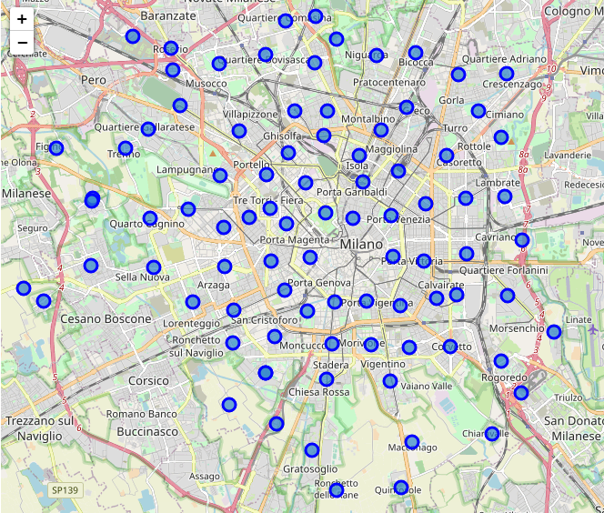
Milan Borough map

Slide 6
Methodology: scores computation
All the scores will be normalise in order to get a percentage value
List of scores:
Train station score
Public transport score
Parks score
Restaurant scores
Price score
Distance from city center

Slide 7
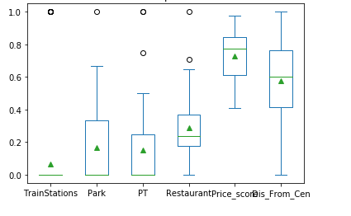
Individual score analysis
Train station is almost a binary variable but this is good since is a strong requirement (it’s fundamental for reachability)
Price distribution bias is wanted beacus price score must not prevail over the other scores
Public transport distribution is quite poor beacuse of Foursquare engine characteristhics

Slide 8
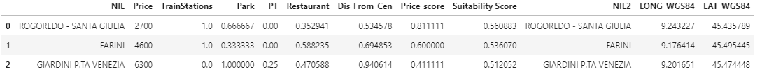
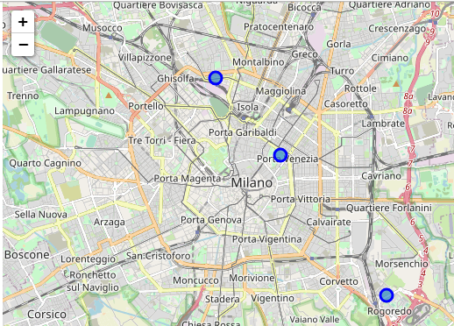
Results: Winner Boroughs

Slide 9
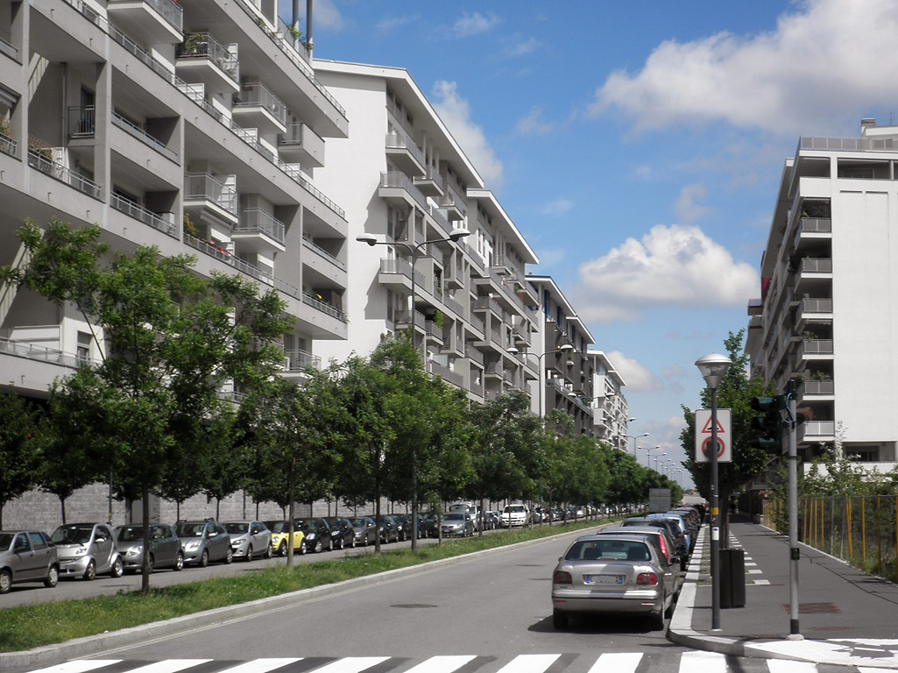
Results: Winner Borhough analysis
ROGOREDO – SANTA GIULIA
Advantages:
Big Train station
Very low house price
Good park price
Disadvantages:
Low restaurant score
Extrimely far from city center

Slide 10
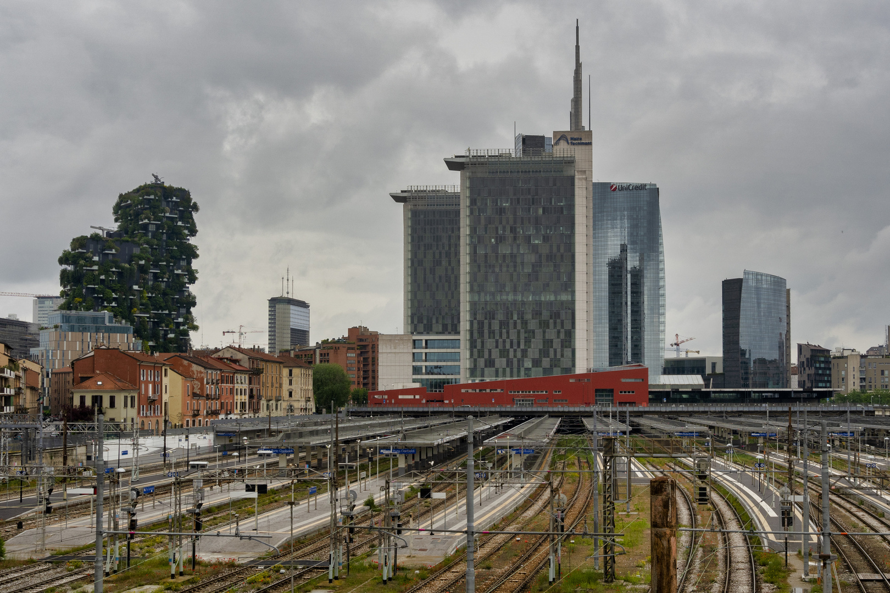
Results: Winner Borhough analysis
FARINI
Advantages:
Good ratio between price and distance from city center
Almost all the scores are above the average
Disadvantages:
Very low public transport score
Low park score
We suggest to investigate is the low public transport score is due to Foursquare features or if it is real

Slide 11
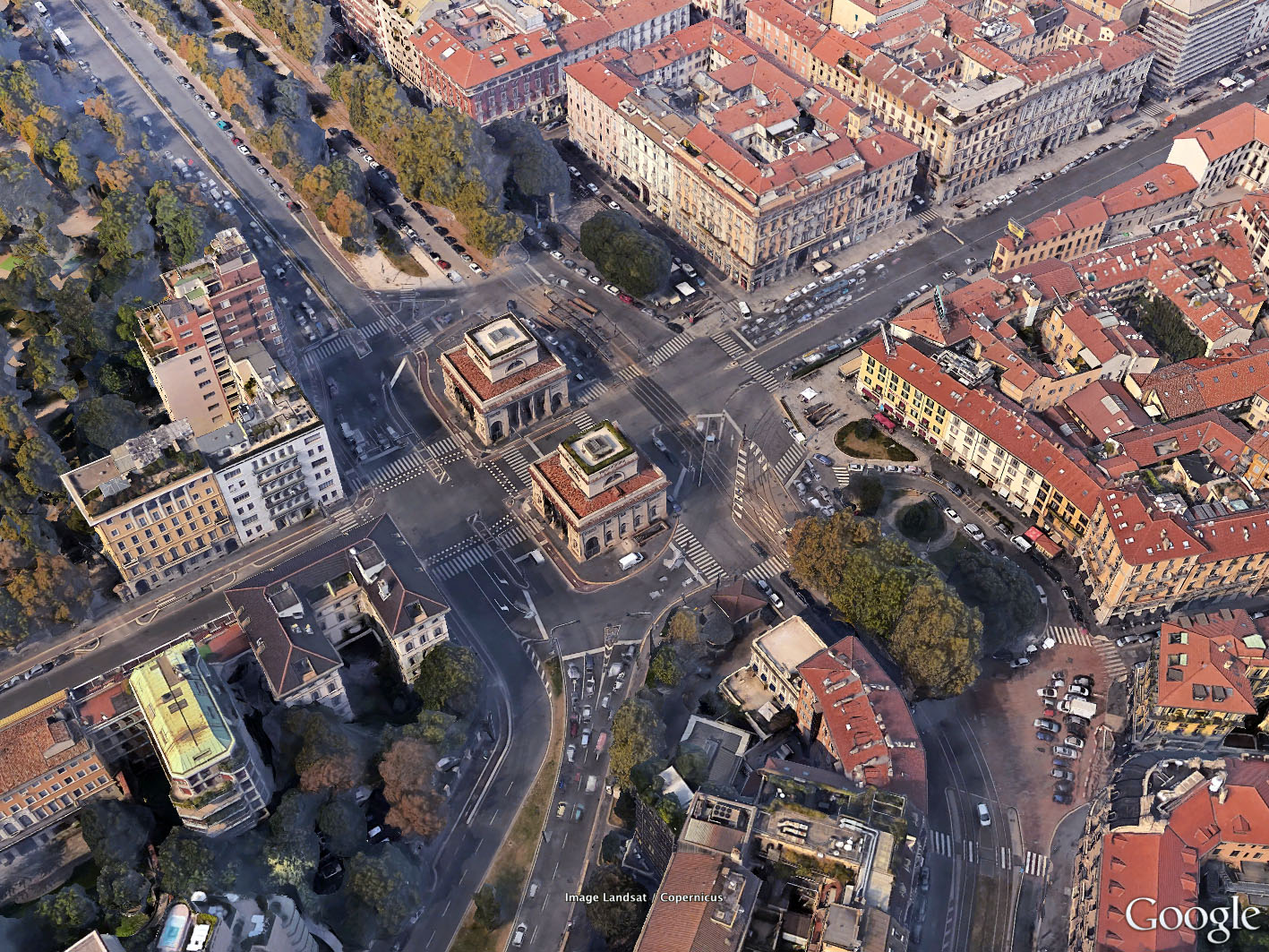
Results: Winner Borhough analysis
GIARDINI P.TA VENEZIA
Advantages:
Very close to city center
Lots of events and attractio
High restaurant and park score
Disadvantages:
One of the most expensive borough in the city
Very low public transport score
We suggest to investigate is the low public transport score is due to Foursquare features or if it is real

Slide 12
Conclusions
We have found the three most suitable borough in the city
Borough can be large so suitability score can change within the same borough.
Next steps:
Finding a set of location in these borough
Launch the model on the subset of these locations
Suitability score is a good overall measure but do not consider it as the only evaluation indicator
All keypoints are important: best borough should have as many high score as possible

Slide 13
Thanks for the attention and good luck for the final choice!

