Slide 1
Implementing PowerCampus eTranscripts with NSC
WYATT BEST
Director of Enterprise Systems,
New York Conservatory for Dramatic Arts
SESSION ID: EL256216

Slide 2
Disclaimer
The views and opinions in this presentation are those of the presenter and do not necessarily reflect the position of Ellucian.
2

Slide 3
Introduction
Technical workings are very complex.
Implementation has traditionally been daunting.
Goal: Attendees can implement eTranscripts via NSC without an Action Line screen share session.

Slide 4
Goals
Overview implementation timeline.
Understand how your PowerCampus, Ellucian, and NSC communicate.
Avoid common pitfalls.
Equip for troubleshooting.

Slide 5
Topics
1 | Sample Timeline
2 | Architecture
3 | Implementation Steps
4 | Troubleshooting
5 | The Land of Unsupported Things

Slide 6
Sample Timeline
Implemented late 2017 on PowerCampus 8.8.1

Slide 7
Sample Timeline
Sept 27: Ellucian Cloud Enablement Processed
Oct 31: Began Deploying Service Bus
Nov 15: Service Bus Testing Passed
Nov 17: Kickoff Meeting with NSC
Nov 20: Basecamp Site Provisioned
Nov 22: Revenue Agreement Finalized

Slide 8
Sample Timeline
Nov 22 – Dec 5: Initial to Successful Order Tests
Nov 22: Test Order Didn’t Reach PowerCampus
Nov 27: Order Stuck in PowerCampus
Dec 1: Order Stuck in Ellucian Cloud
Dec 5: Successful Round Trip
Nov 27: Student-Facing Text, Images, and Stops Emails Finalized
Dec 7: Transcript Template Finalized
Dec 5 – 14: Testing Matrix
Dec 15: eTranscripts Goes Live!

Slide 9
Downloads Shopping List
PowerCampus Version | 8.7.5 | 8.8.4
Service Bus Version | 8.7.0 | 8.8.0
Service Bus Install Doc | PowerCampus 8.7.5 Installation Guide.pdf | PowerCampus 8.8.4 Installation Guide.pdf
Service Bus Installer | PowerCampusServiceBus87Setup.exe | PowerCampusServiceBus880Setup.exe
Web API Version | 8.7.0 | 8.8.3
SOAP Services Version | 8.7.0 | 8.8.2
Web API and SOAP Services Install Doc | PowerCampus Self-Service 8.7.4 Installation Guide.pdf | PowerCampus Self-Service 8.8.3 Installation Guide.pdf
Web API and SOAP Services Installer | PCSelfService871.exe | PCSelfService883.exe

Slide 10
Architecture

Slide 11
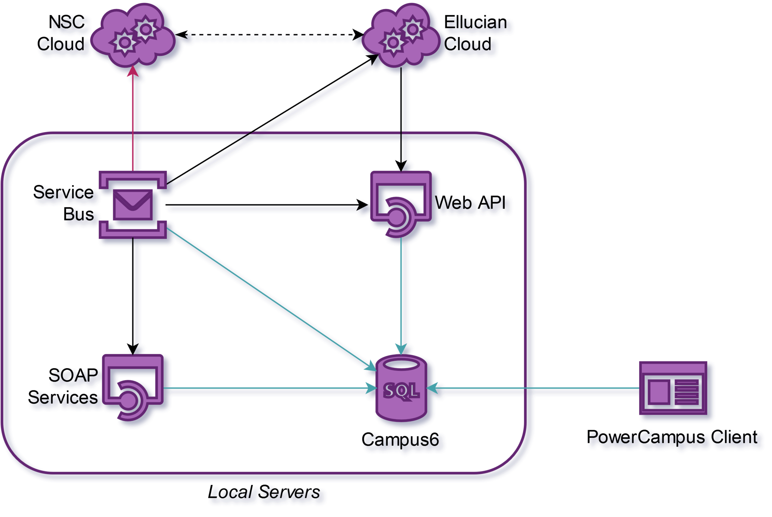
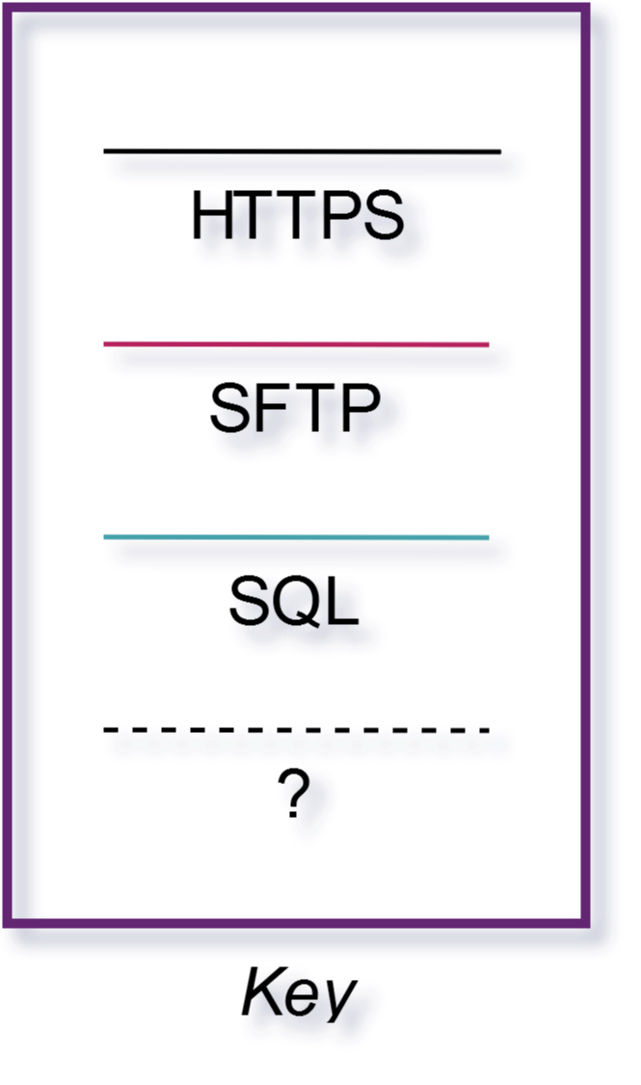
Notes:
Ellucian Cloud hits the Web API with new orders, and Service Bus polls these orders from the database.
Then Service Bus hit the Ellucian Cloud, Web API, and SOAP Services with updates and uploads PDF’s via SFTP.
Ellucian Cloud also polls the Web API proactively, which helps catch any status updates that failed to transmit from Service Bus. The Ellucian test Cloud polls hourly, and the production Cloud polls daily.
[Solicit questions]

Slide 12
Architecture Tips
Web API must be reachable from the Internet. Use SSL!
Do a little testing to be sure access controls work.
SOAP services can be internal-only. Use SSL!
Self-Service, SOAP, Web API, and Service Bus can all be on the same server but don’t have to be.
Service Bus and PowerCampus client must be on the same server.
Provision a clean Windows Server 2016 virtual machine.
If things get hairy, just revert snapshot and start over.

Slide 13
Implementation Steps

Slide 14
Implementation Steps
Do Ellucian Paperwork
Install Web API
Install SOAP Services
Install Service Bus
Provision Service Bus
Install PowerCampus Client
Install GhostScript
Install PostScript “Printer”
Generate SFTP Key
Configure Service Bus
Configure Ellucian Cloud
Pass TestConfiguration.ps1
Do NSC Paperwork
Customize NSC Student Site
Customize NSC Stops Emails
Customize Transcript Template
Pass NSC Testing Matrix

Slide 15
Install Web API and SOAP Services
Verify that…
Web API website can be loaded in a browser outside your network (i.e. your smartphone).
Web API returns JSON, not HTML.
Firefox will display the JSON in a nice format; IE will prompt you to download a strange text file.
SOAP Services can be loaded in a browser inside your network.

Slide 16
Implementation Steps
Do Ellucian Paperwork
Install Web API
Install SOAP Services
Install Service Bus
Provision Service Bus
Install PowerCampus Client
Install GhostScript
Install PostScript “Printer”
Generate SFTP Key
Configure Service Bus
Configure Ellucian Cloud
Pass TestConfiguration.ps1
Do NSC Paperwork
Customize NSC Student Site
Customize NSC Stops Emails
Customize Transcript Template
Pass NSC Testing Matrix

Slide 17

Install Service Bus
Do I already have Service Bus installed? If so, what server?
Remember to edit ServiceBus.Subcription if you clone your production environment as a test environment!

Slide 18
Provision Service Bus
After running installer, follow provisioning steps exactly.
You will be prompted to enter names when provisioning the PowerCampus Publisher, PowerShell Subscriber, and optionally MSMQ Publisher. Just use defaults.
The current setup uses one “instance” (comprised of the three services above) for all purposes.
Understand that we could theoretically multiply templates and/or instances (and thus Windows Services endpoints) in the future.
Notes:
I have to choose names??

Slide 19
Implementation Steps
Do Ellucian Paperwork
Install Web API
Install SOAP Services
Install Service Bus
Provision Service Bus
Install PowerCampus Client
Install GhostScript
Install PostScript “Printer”
Generate SFTP Key
Configure Service Bus
Configure Ellucian Cloud
Pass TestConfiguration.ps1
Do NSC Paperwork
Customize NSC Student Site
Customize NSC Stops Emails
Customize Transcript Template
Pass NSC Testing Matrix

Slide 20
Misc Installs
PowerCampus Client (alongside Service Bus)
GhostScript (from the Internet)
PostScript Printer
PuTTYgen (from the Internet; for SFTP key)
Follow directions in the PDF guide under “Automating PDF File Generation”
Notes:
Anecdote about MG and actually having to work to make SFTP key.

Slide 21
Implementation Steps
Do Ellucian Paperwork
Install Web API
Install SOAP Services
Install Service Bus
Provision Service Bus
Install PowerCampus Client
Install GhostScript
Install PostScript “Printer”
Generate SFTP Key
Configure Service Bus
Configure Ellucian Cloud
Pass TestConfiguration.ps1
Do NSC Paperwork
Customize NSC Student Site
Customize NSC Stops Emails
Customize Transcript Template
Pass NSC Testing Matrix

Slide 22
Configure Service Bus: You Will Need
Ellucian [Test] Cloud credentials. Use the service account, not your own!
SOAP Services URL
SOAP Services Credentials
Web API URL
Web API Credentials
NSC FTP Credentials (incl. your key files)
Notes:
You are doing this in test first, right?
I have NSC paperwork later on the checklist, but hopefully you have started the process already. They should give you this early on.

Slide 23
Configure Service Bus: Notes on User Accounts
If you set up a service user to run the Service Bus Windows services, it user must have had at least one interactive logon to the machine. Otherwise, transcriptprinter.exe will output nothing!
The user doesn't have to be a domain admin, but it will need permissions to basically everything referenced in the config file.
The user doesn't have to be the same account as ElectronicTranscriptUserName.

Slide 24
Configure Service Bus: ElectronicTranscript.config
Don’t mess with the XML formatting or comments.
CloudCertificateLocation should be left blank.
LanguageCode is a code value: EN for English.
Don’t touch FtpPassword. Even an extra linebreak or non-printing character can cause an error.

Slide 25
Configure Service Bus: ElectronicTranscript.config
FtpPrivateKeyLocation is a file name, not a folder name.
FtpPrivateKeyPassPhrase is a string.
PDFLocationForTranscript must be populated even if you don't use TranscriptOutputTypeAsPDF and/or PrintTranscriptOutputToPrinter.
It’s just a working directory. Make sure it not shared with the world.

Slide 26
Implementation Steps
Do Ellucian Paperwork
Install Web API
Install SOAP Services
Install Service Bus
Provision Service Bus
Install PowerCampus Client
Install GhostScript
Install PostScript “Printer”
Generate SFTP Key
Configure Service Bus
Configure Ellucian Cloud
Pass TestConfiguration.ps1
Do NSC Paperwork
Customize NSC Student Site
Customize NSC Stops Emails
Customize Transcript Template
Pass NSC Testing Matrix

Slide 27
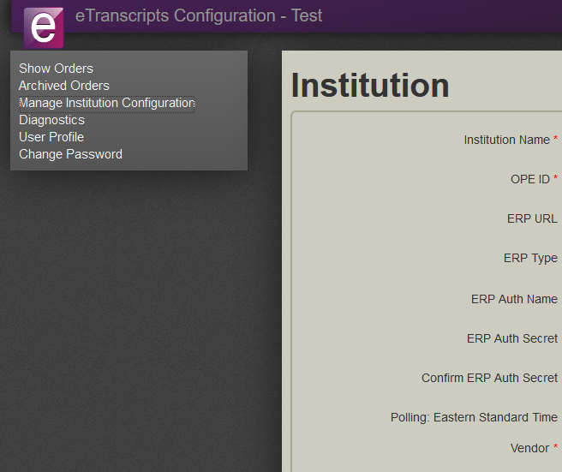
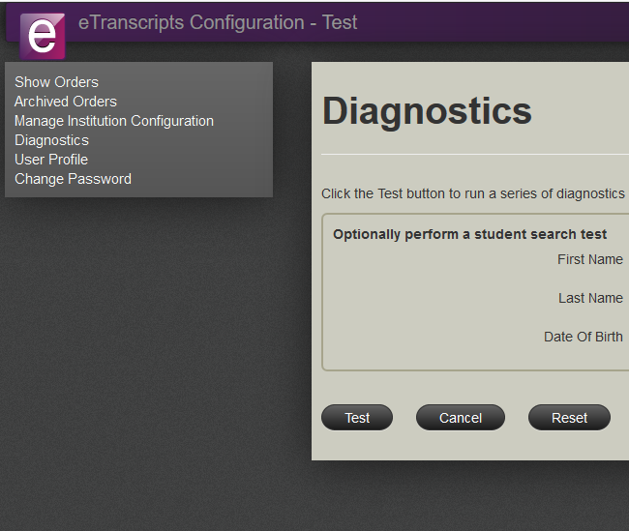
Configure Ellucian Cloud
Web API URL and Auth
Must Pass Diagnostic
Notes:
Log in as yourself or service user; doesn’t matter.
NSC also has a cloud interface, but you don’t do any technical provisioning there as I recall. It’s all stuff your non-IT people can do.
A new order created on NSC's website takes about 3 minutes to go to the Ellucian Cloud. During this time, the status is new but appears as null on NSC’s site. Do not change the status during this time or the order will be permanently broken.

Slide 28
Implementation Steps
Do Ellucian Paperwork
Install Web API
Install SOAP Services
Install Service Bus
Provision Service Bus
Install PowerCampus Client
Install GhostScript
Install PostScript “Printer”
Generate SFTP Key
Configure Service Bus
Configure Ellucian Cloud
Pass TestConfiguration.ps1
Do NSC Paperwork
Customize NSC Student Site
Customize NSC Stops Emails
Customize Transcript Template
Pass NSC Testing Matrix

Slide 29
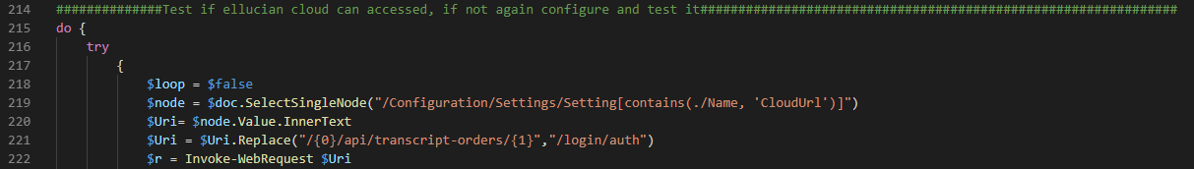
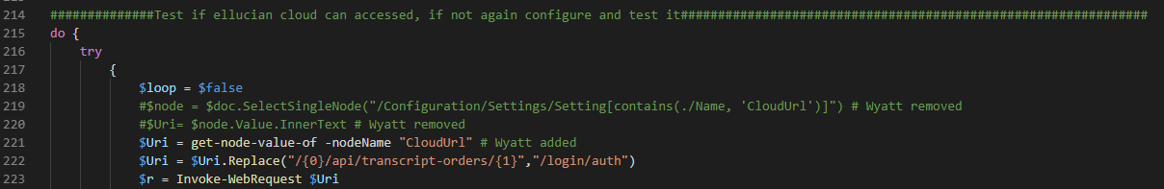
Pass TestConfiguration.ps1
Notes:
Depending on your PowerShell environment, you may need to change one of the functions used to pull a value from ElectronicTranscript.config. Can’t say why this happens, but I’ve seen it more than once.
Keep twiddling till you can pass this.

Slide 30
Implementation Steps
Do Ellucian Paperwork
Install Web API
Install SOAP Services
Install Service Bus
Provision Service Bus
Install PowerCampus Client
Install GhostScript
Install PostScript “Printer”
Generate SFTP Key
Configure Service Bus
Configure Ellucian Cloud
Pass TestConfiguration.ps1
Do NSC Paperwork
Customize NSC Student Site
Customize NSC Stops Emails
Customize Transcript Template
Pass NSC Testing Matrix

Slide 31
Working with NSC
IT shouldn’t do all of this! Do tasks in parallel.
Utilize Basecamp. Don’t moan cause you love email.
Send contracts and paperwork to executives.
Send the logo and PDF layout tasks to Marketing/Creative Services.
Send the site text and email stops tasks to registrar and bursar.
Get lots of people to work on the testing matrix.
Notes:
The testing matrix is a fantastic way for your staff to learn the PowerCampus and NSC interfaces! You’ll accomplish training at the same time.

Slide 32
Implementation Steps
Do Ellucian Paperwork
Install Web API
Install SOAP Services
Install Service Bus
Provision Service Bus
Install PowerCampus Client
Install GhostScript
Install PostScript “Printer”
Generate SFTP Key
Configure Service Bus
Configure Ellucian Cloud
Pass TestConfiguration.ps1
Do NSC Paperwork
Customize NSC Student Site
Customize NSC Stops Emails
Customize Transcript Template
Pass NSC Testing Matrix

Slide 33
Troubleshooting
compmgmt.msc

Slide 34
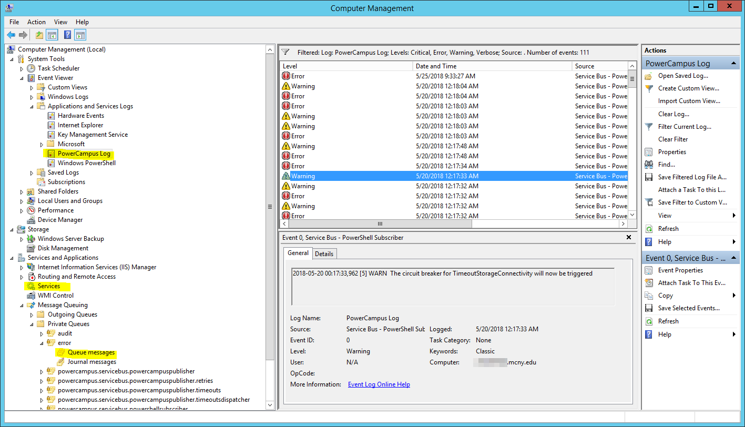
Notes:
Computer Management is your most important tool. Here you can view the PowerCampus Log, stop and start Services, and see the Message Queues.

Slide 35
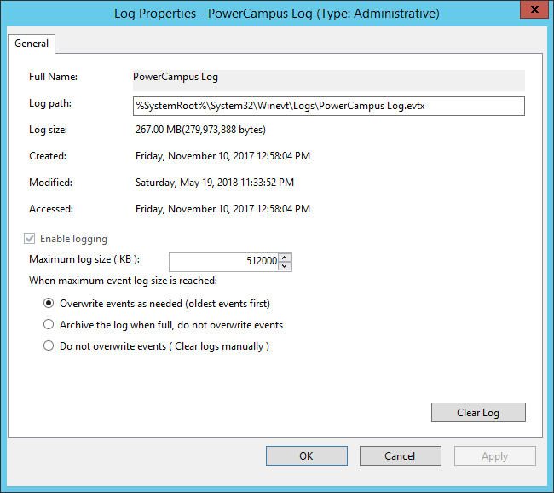
Recommend: Increase Event Log Size
Notes:
Storage is cheap; your time is not.
Defaults store less than a day’s logs.
I cranked it up to 0.5 GiB, which is just over 2 months’ worth in our experience.

Slide 36
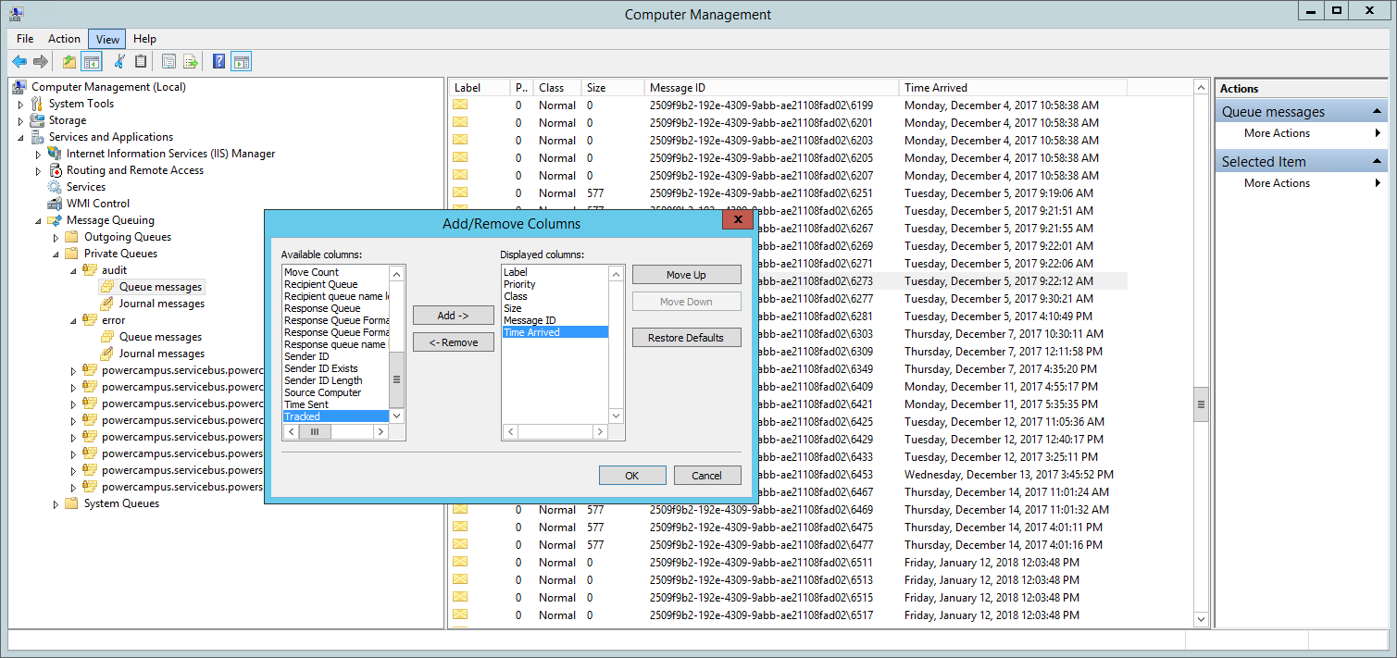
Adding Time Column
Notes:
We’re still in Computer Management, but now viewing a message queue. Messages all look kinda inscrutable, but a time column can help.

Slide 37
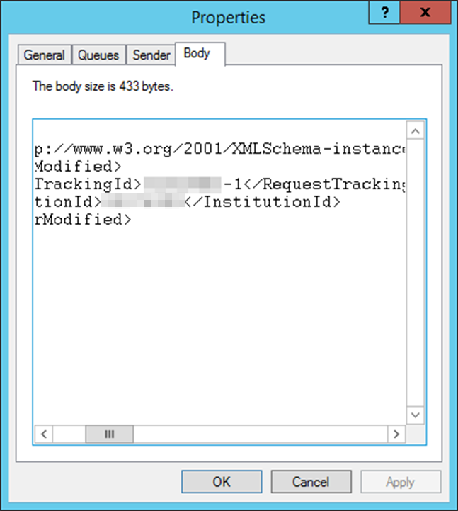
Message Body
Mere existence of the message means order was created/modified.
Contains institution ID and request tracking ID.
Copy/paste tracking ID into PowerCampus.

Slide 38
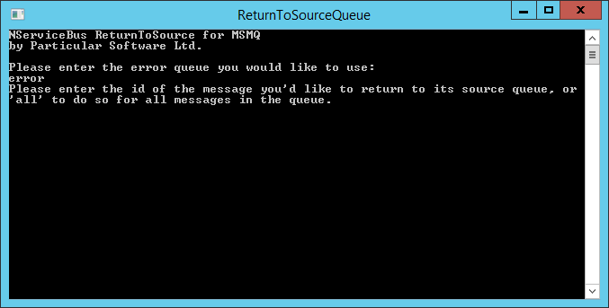
Retry a Message from the Error Queue
Notes:
C:\Program Files (x86)\Ellucian\PowerCampus ServiceBus\Tools\ReturnToSourceQueue.exe
Can retry an individual message or all messages in the error queue.

Slide 39
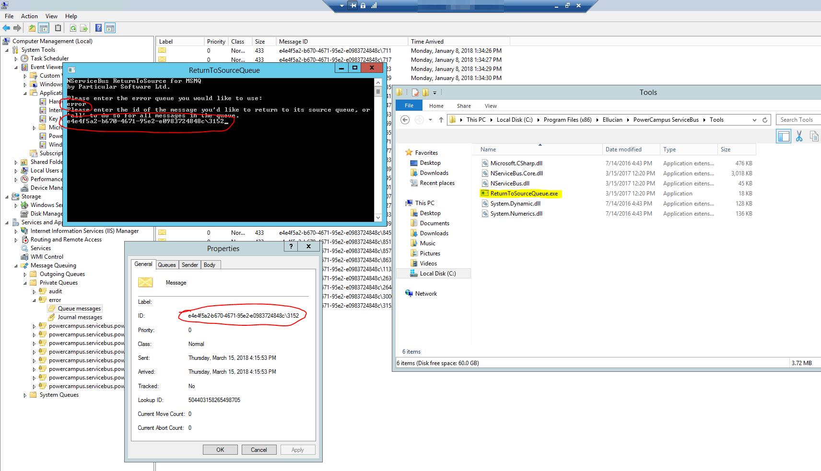
Notes:
I’ve opened the ReturnToSourceQueue tool, selected the ‘error’ queue, and copied and pasted the ID of a particular message.

Slide 40
Clearing the Error Queue
AFAIK, it’s always safe to retry a message.
Some MSMQ messages will never resolve because the order was fulfilled and updated by the external polling from the Ellucian Cloud.
When confident that all error messages are dead…
Right click > All Tasks > Purge
Notes:
I mention the exact steps because it’s far from obvious in the interface.

Slide 41
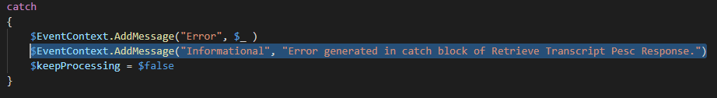
Custom Log Output
Notes:
If you’re really stuck, you can go into the PowerShell modules and insert your own log output. You could determine how far into the process you get, or you could dump variables. This will appear in the PowerCampus Log event log.

Slide 42
The Land of Unsupported Things

Slide 43
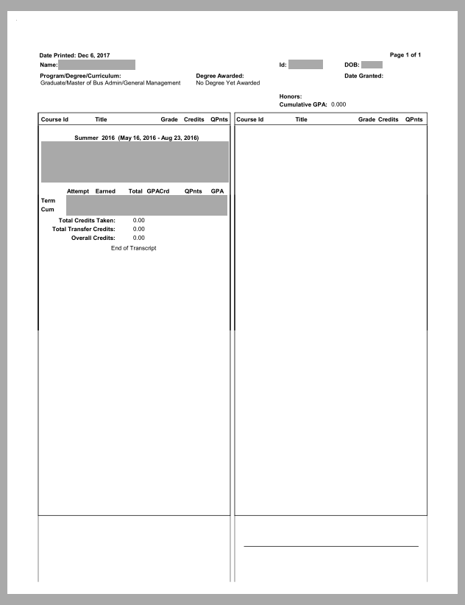
Weird Vertical Lines?
Notes:
There are weird vertical lines on the PDF’s output by transcriptprinter.exe but not by the regular client. Higher impact on some templates than others.
Confirmed in 8.8.1 and 8.8.4. This is a PS as viewed by GSView 6.0, which likely shares the same rendering code as GhostScript.

Slide 44
Weird Vertical Lines?
transcriptprinter.exe outputs PostScript, which is human-readable code.
TranscriptGenerating.ps1 then runs the PS through GhostScript to produce a PDF, which is not human-readable.
Extra PowerShell code can be added that uses regex backreferences to remove the vertical lines from the PostScript.
Attempt at your own risk!

Slide 45
Running PowerShell Subscriber as Local System
Don’t want to keep track of yet another service account for the Windows service?
Two modifications will allow
Registry key allowing transcriptprinter.exe to find the PS printer. (Normally created by an interactive logon.)
Altering a parameter passing method in TranscriptGenerating.ps1 to use an array instead of a concatenated string.

Slide 46
Summary
Follow the Service Bus instructions very carefully.
Make sure you successfully pass all the diagnostic tools.
Get familiar with the troubleshooting tools.
Utilize the testing matrix.

Slide 47
Questions
SESSION ID: EL256216

Slide 48
Thank you.
We want to hear from you.
WYATT BEST
wyatt@nycda.edu
SESSION ID: EL256216

