Slide 1
eTranscripts Usage and Maintenance
Wyatt Best, Enterprise Systems Manager
Metropolitan College of New York
Notes:
Drafted 2018-05
http://paletton.com/#uid=74j1W0klllzlL1OqE5VfUK2kHVU for colors

Slide 2
Background
Problem: Credentials Solutions/SCRIP-SAFE dropping us
Workload: Transcript custodian for three closed schools
Solution: Ellucian eTranscripts via National Student Clearinghouse

Slide 3
Table of Contents
The PowerCampus Operator Interface
Architecture and Troubleshooting
Problem Scenarios

Slide 4
PowerCampus Operator Interface
Audience: Functional Staff
Notes:
Let’s walk through the workflow and drill down to get a sense of how it works.

Slide 5
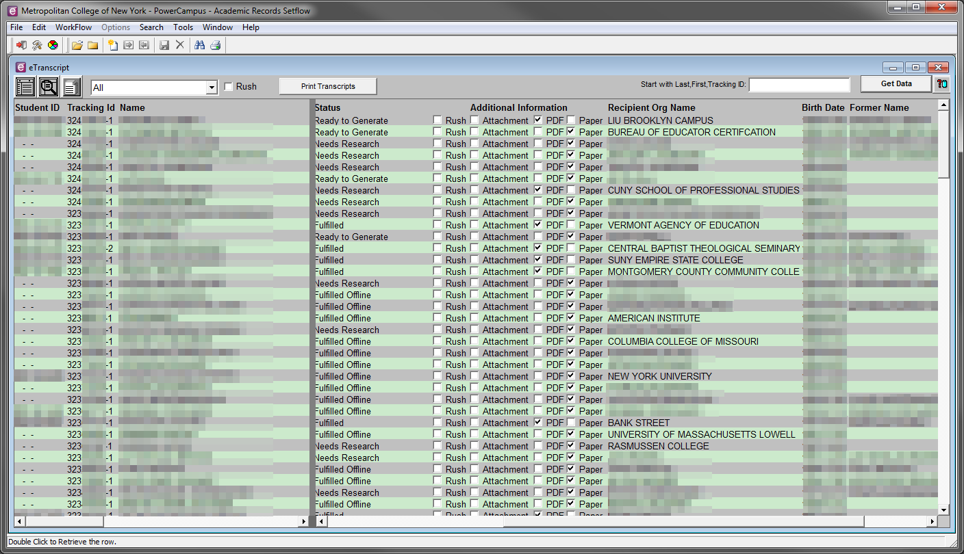
eTranscripts Workflow

Slide 6
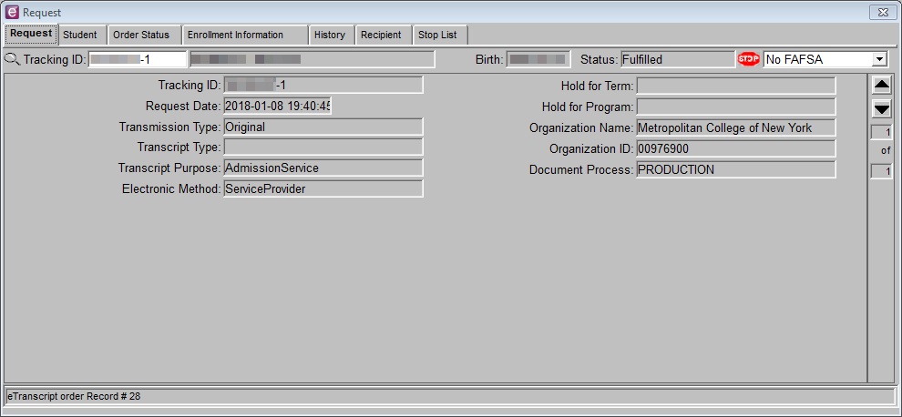
Drill Down – Request
Notes:
HoldForTermId and HoldForProgramId are nonstandard codes. AG works fine; AD may have a defect.
Transcript Type would be used if we have different transcripts for UG and Grad.
A number of fields, such as Electronic Method, offer no useful information to the operator. We are considering hiding them with Magic Easel. They are indicated with the red icon.

Slide 7
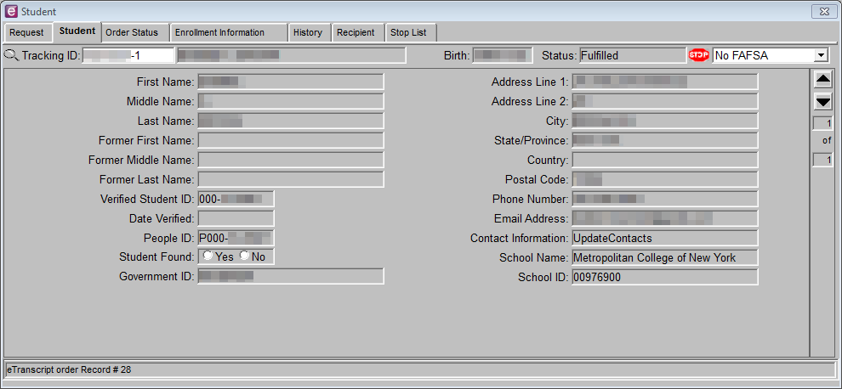
Drill Down – Student
Notes:
UpdateContact must be completed manually.
None of the information in eTranscript comes from the PEOPLE table! If you associate the wrong student Id, it’s not at all obvious.

Slide 8
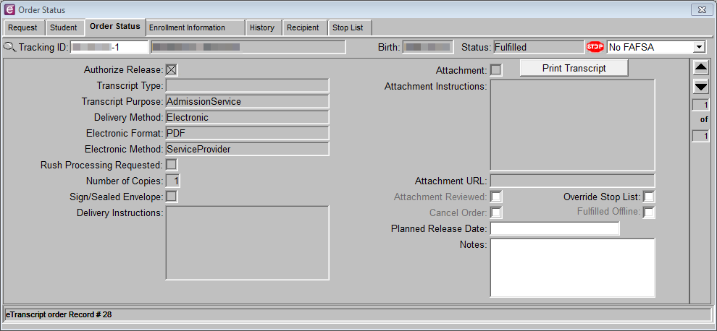
Drill Down – Order Status
Notes:
ElectronicFormat is either null or PDF. NSC’s “legacy” question restricts orders to mail and hold for pickup methods. We use it for custodial transcripts.
As far as I can tell, Notes and Planned Release date are soley for internal reference.
Attachments: Sometimes nursing or other prof cert transcripts need a special form signed by registrar as attachments. Sometimes it’s a barcode the recipient wants. Sometimes they’re junk.

Slide 9
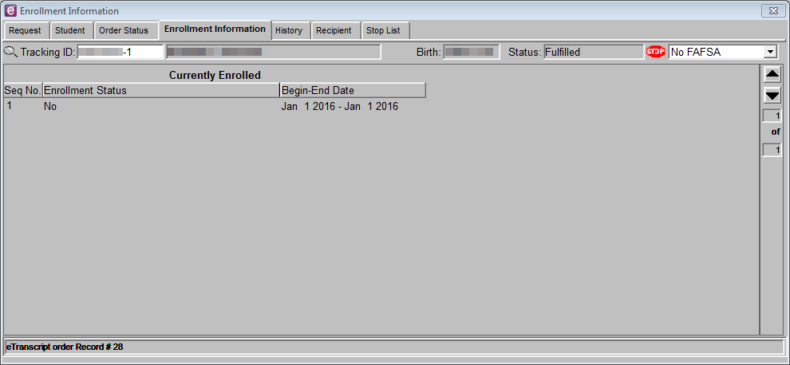
Drill Down – Enrollment Information
Notes:
In our experience, the Seq No is always 1, even for students with multiple transcript sequences.

Slide 10
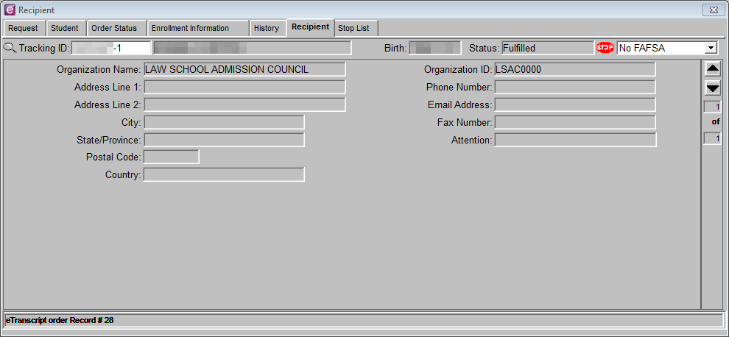
Drill Down – Recipient
Notes:
Note that this org isn’t in our Org tables; it came from NSC’s org list. They electronically handle sending the transcript. No need for student or sending institution to know recipient address or email information. For more info, see http://www.studentclearinghouse.org/etx_registry.php?col=1

Slide 11
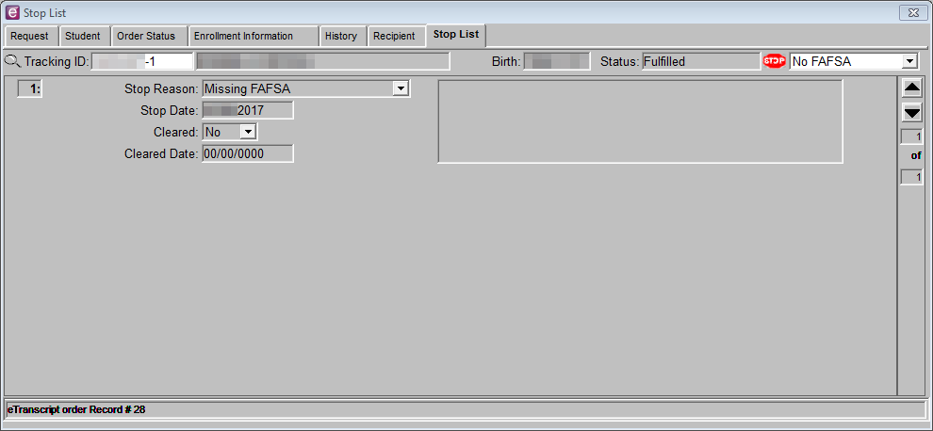
Drill Down – Stop List

Slide 12
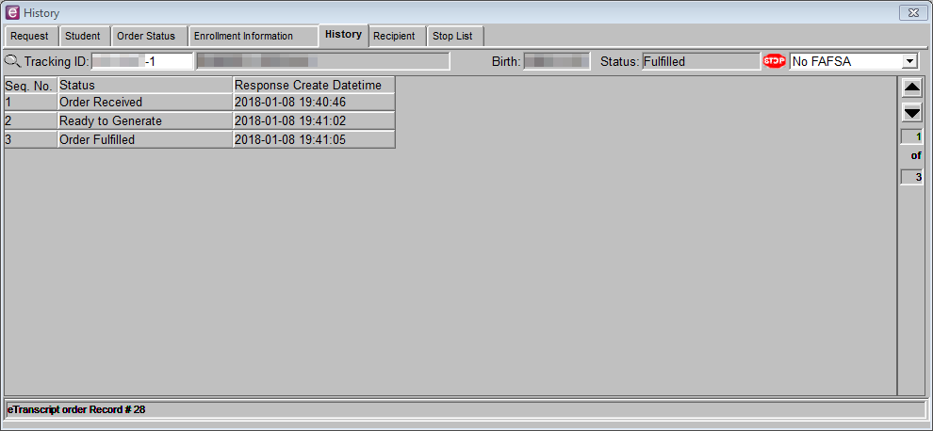
Drill Down – History
Notes:
History tab slide intentionally out of order.

Slide 13
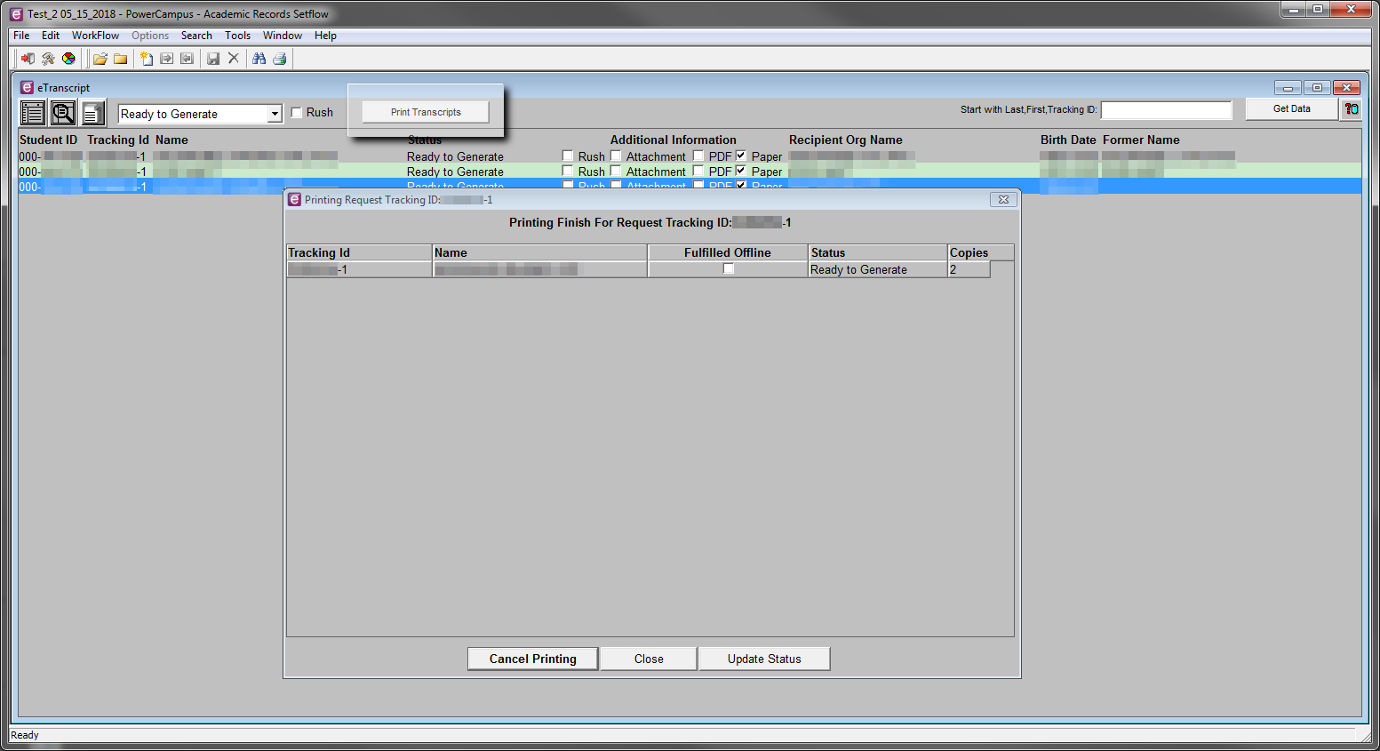
Print from Workflow
Notes:
Print from Workflow
Registrar uses NSC to create label information. She finds it easier to download in Excel format than using all the tabs in PC.

Slide 14
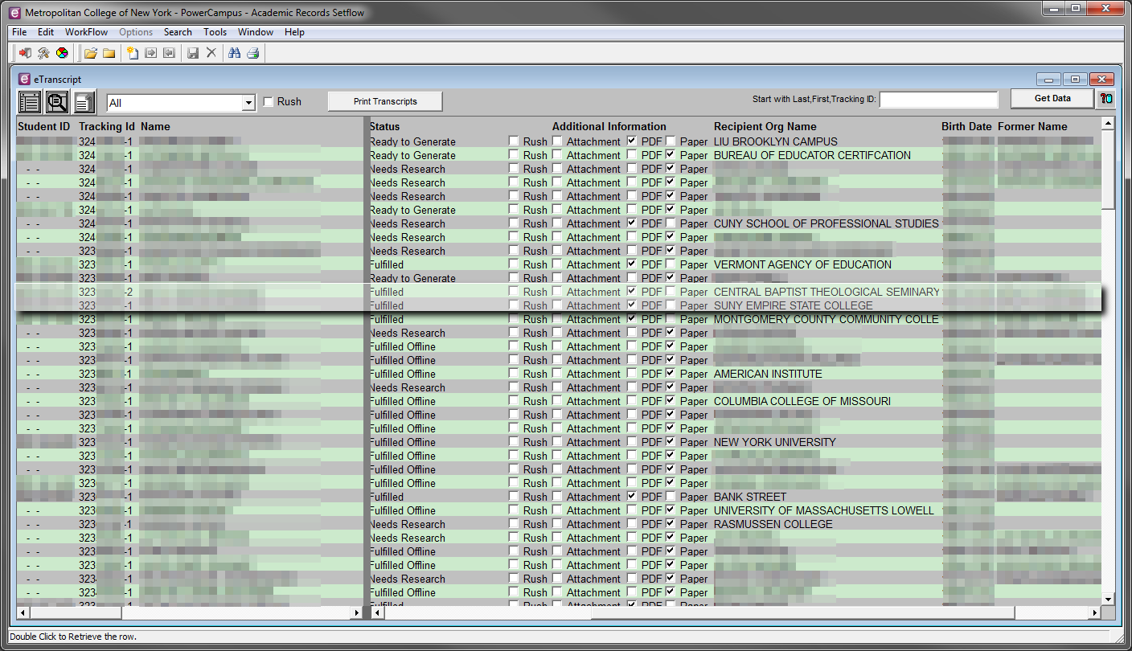
Multiple Recipients
Notes:
Multiple Recipients

Slide 15
Operator Tips
Sort for Sanity
Filter for Finesse
Tracking ID field in drill-down:
Use double-click or Ctrl + V to paste, then tab out.
Cannot copy Tracking ID out of field.

Slide 16
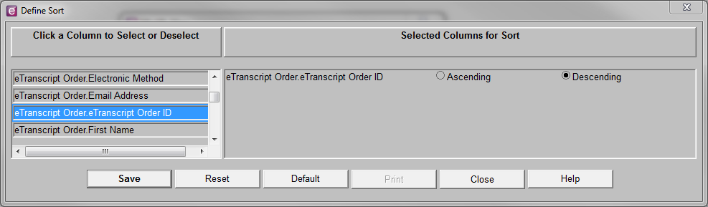
Sorting for Sanity

Slide 17
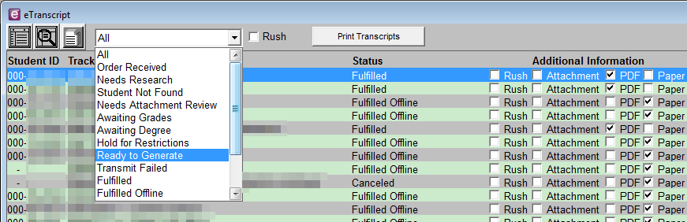
Filtering for Finesse
Quick filtering method

Slide 18
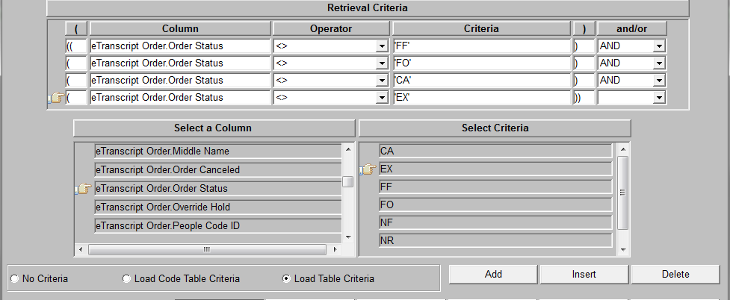
Filtering for Finesse
Statuses not currently existing in the table will not appear in the Select Criteria list. You can type them manually.
Notes:
“Load Code Table Criteria” seems to be an alias for “Load Table Criteria” in this case; I can’t find a code table.

Slide 19
Status Codes
OR = Order Received
NR = Needs Research
HR = Hold for Restrictions
NF = Student Not Found
EX = Expired
RG = Ready to Generate
FF = Fulfilled Online
FO = Fulfilled Offline
AD = Awaiting Degree
AG = Awaiting Grades
AR = Attachment Needs Review
CA = Cancelled
TF = Transmit Failed
Notes:
Not all statuses automatically expire.
AD - Waiting for graduation processing for a particular degree specified in the order.
AG – Waiting for grades for a particular term specified in the order
AR – Attachment on NSC website to review manually
CA – Cancelled by operator
EX - HR, NF, was not resolved within 30 days.
FF - Electronic PDF sent
FO - Printed
HR - Stops exist
NF - Communicate, then cancel. Or if legacy/custodial transcript, manually fulfill.
NR - Supply correct PCID. Does not expire.
OR - Default, momentary status
RG – Waiting for “printing” by human or service bus
TF – Something is busted!

Slide 20
NSC Email Communications for PDF
To Requestor
To Recipient
Order Confirmation
Consent Form Received
Electronic Transcript Sent
Electronic Transcript Retrieved
Transcript Link
Transcript Password
Notes:
It’s somewhat in this order – electronic orders tend to happen all at once, and so sometimes the emails are seconds apart or in slightly different orders.

Slide 21
Architecture and Troubleshooting
Audience: Technical Staff

Slide 22
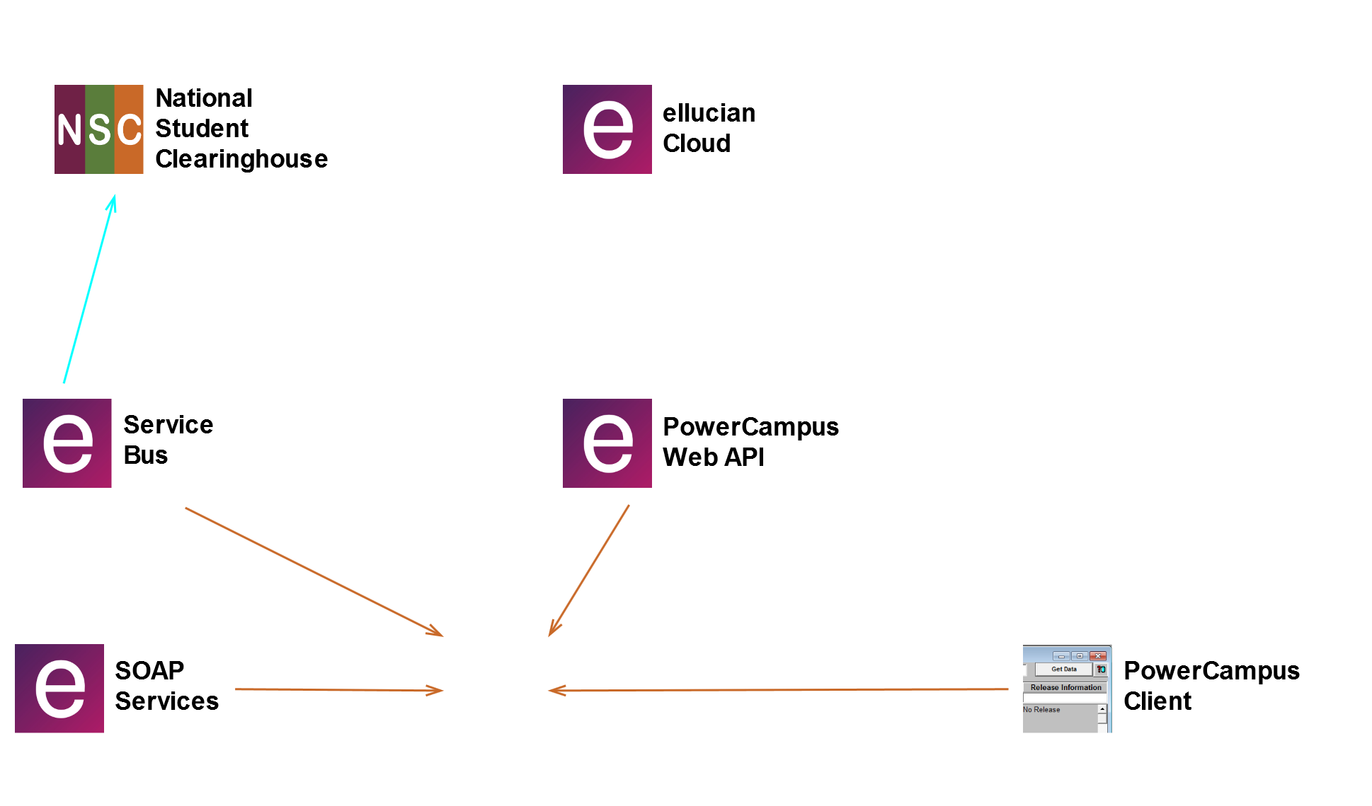

Notes:
Make sure to mention daily polling first time around.

Slide 23
What if Service Bus is down?
Paper orders can be printed, but remote status doesn’t update until daily polling.
PDF orders stop in RG status.
Why would it go down?
Auto-shutdown if too many SQL connection attempts fail.
You forgot to turn it back on.
Configuration issues
Defect
Notes:
In our experience, the Service Bus randomly hangs every few months and needs to be kicked over.

Slide 24
What happens when Service Bus comes back up?
Messages for PDF orders waiting in RG status:
Will proceed to FF status.
Messages for orders waiting in intermediate status, like HR:
Unknown
Messages for orders already updated be dialing polling:
Event Log will record 403 from cloud. Retry them. No harm done.
Message will return to error queue.
Solution: Purge error queue after all orders are resolved.
Notes:
Example: Service Bus is offline, paper transcript is mailed. Order status updated during daily polling from cloud. Service bus starts again; cloud will not accept order update for FO order.
This would be a concern for specifying ‘all’ messages with the ReturnToSourceQueue tool.

Slide 25
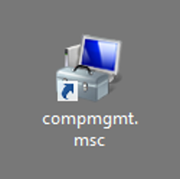
compmgmt.msc
It has a toolbox icon for a reason.
Notes:
We’re used to using IIS, but unlike Self-Service, SOAP Services, and the Web API, the Service Bus doesn’t use IIS.

Slide 26
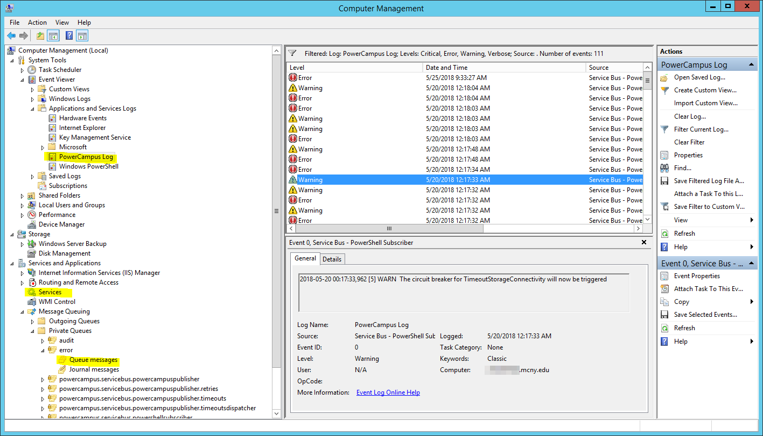
Notes:
Global view of Computer Management tools

Slide 27
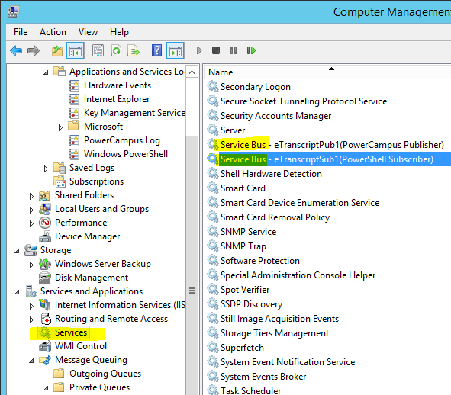
Starting and Stopping Service Bus

Slide 28
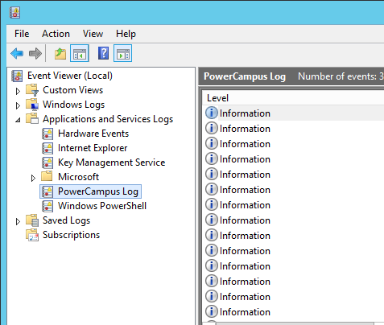
Accessing the Event Log
Computer Management or Windows Event Viewer
Can filter to just errors and warnings.

Slide 29
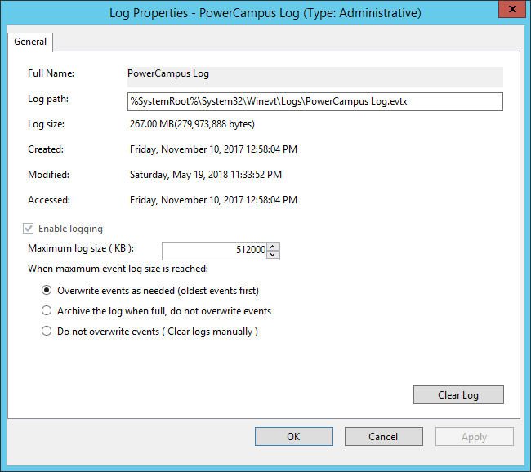
Recommend: Increase Event Log Size
Storage is cheap; your time is not.
Defaults originally stored less than a day’s logs in our instance.
Notes:
I cranked it up to 0.5 GiB, which is just over 2 months’ worth in our experience.

Slide 30
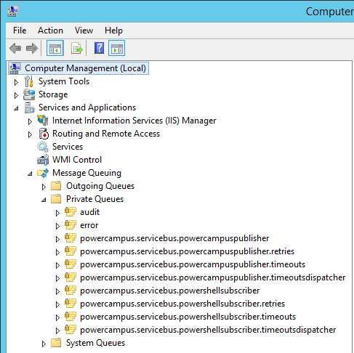
Accessing MSMQ
Especially note error queue

Slide 31
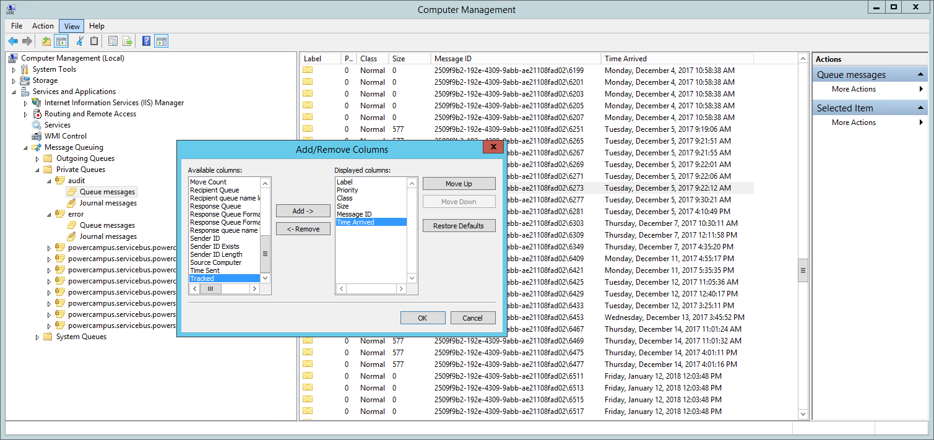
Adding Time Column

Slide 32
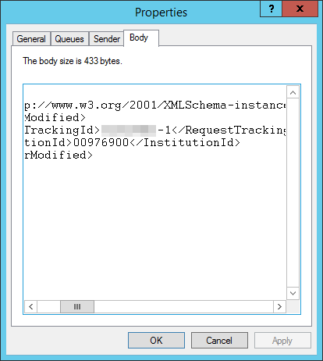
Message Body
Contains request tracking Id, institution Id, and the fact that the order was modified.
Can copy and past the request tracking Id into PowerCampus to see which order was affected.

Slide 33
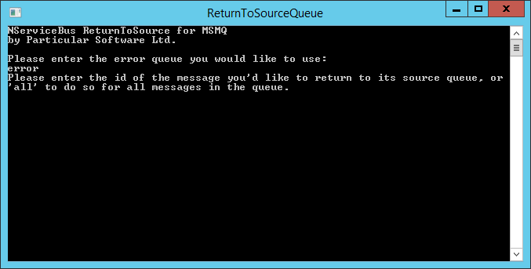
Retry a Message from the Error Queue
C:\Program Files (x86)\Ellucian\PowerCampus ServiceBus\Tools\ReturnToSourceQueue.exe

Slide 34
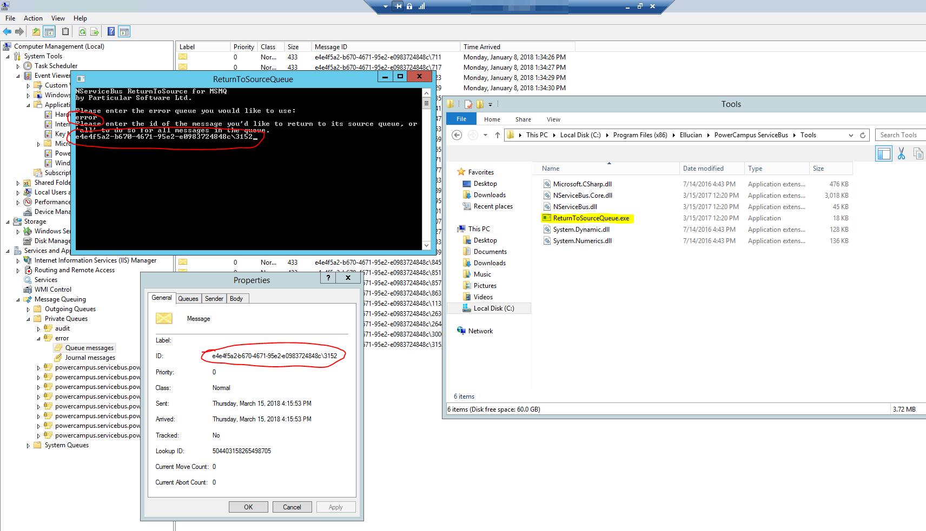
Notes:
Point out Explorer window first.

Slide 35
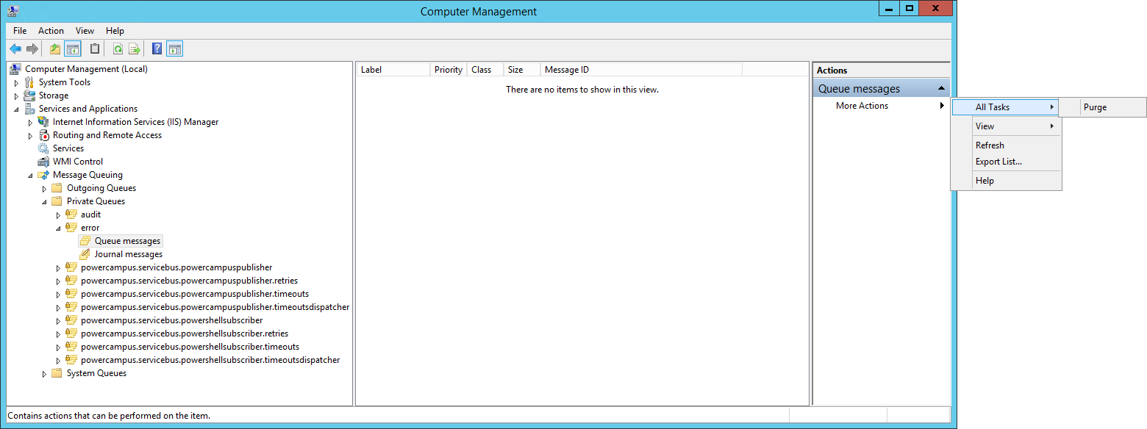
Purging the error Queue
Notes:
Don’t purge until all relevant orders resolved!

Slide 36
Transcript Order Scenarios
Audience: Everyone

Slide 37
Hold for Restrictions
Automatic email to requestor based on stop reason.
Order expires if not cleared in 30 days.
Operator can override stops on Order Status tab.
Notes:
No screenshots because they’re all resolved!

Slide 38
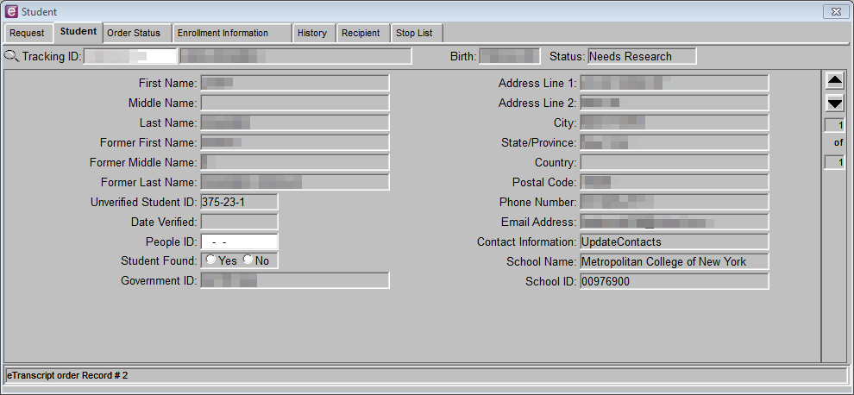
Needs Research – Various Resolutions
Enter correct people ID and save.
Mark Student Found as No and save.
If legacy/custodial paper transcript, print manually and check Fulfilled Offline on Order Status tab.

Slide 39
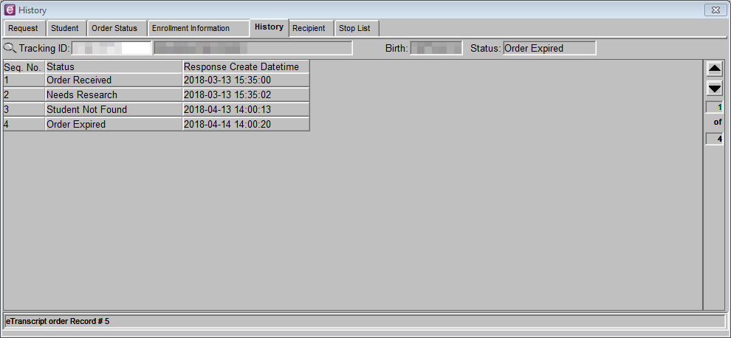
Needs Research: Wrong School
Notes:
Suppose you get an order from someone you have absolutely no record of. Maybe they sent their order to the wrong school.
You would mark Student Found as No, switching it to NF status. Now it will expire ~30 days after order placement. You could also communicate and Cancel the order immediately (probably better).

Slide 40
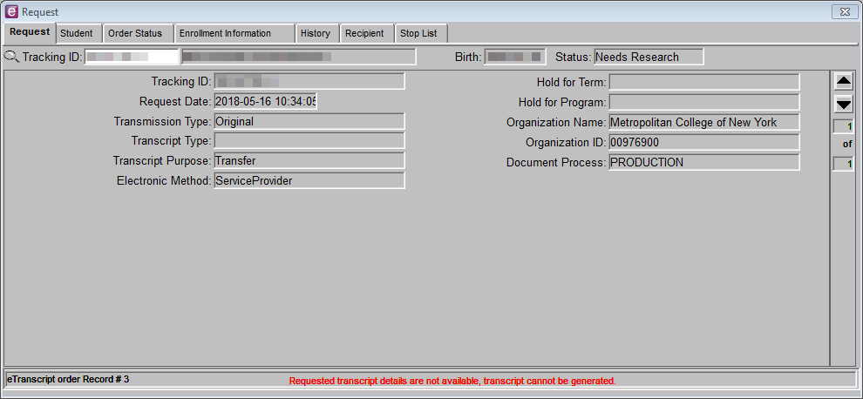
Needs Research: No Transcript Detail
Notes:
Student applied but never attended. No TRANSCRIPTDETAIL rows.

Slide 41
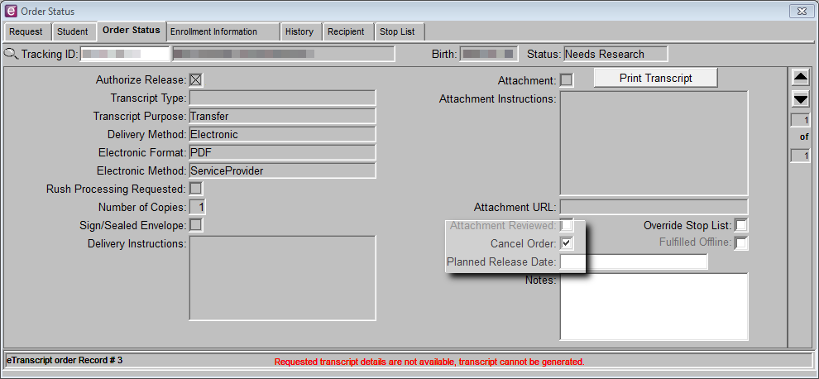
Needs Research: No Transcript Detail
Notes:
Only option is to cancel this order. Fulfilled Offline is only an option for paper orders.
Now, what if an order was in this “must cancel” status that shouldn’t be?

Slide 42
No Academic Record, Duplicate PCID
Former student submitted new admissions application under a new name.
Submitted PDF transcript order under the new name.
Order automatically attached to newer student Id.
Order is in “must cancel” status (HR and no transcript detail).
A transcript exists, but under older student Id.
Notes:
Essentially the same scenario as previous, except there’s a real transcript under another PEOPLE_CODE_ID.
Sorry I don’t have screenshots for this example.

Slide 43
No Academic Record, Duplicate PCID - Solution
Merge Id’s
ETranscriptOrder.PeopleCodeId column will be updated because of a FK constraint.
ETranscriptOrder.VerifiedStudentId will not be updated.
At this point, the client still shows the old number under People ID and is in “must cancel” status.
Use SQL to set VerifiedStudentId to NULL.
Operator then “finds” the student using the client.
Notes:
Glad to see Ellucian using foreign keys!

Slide 44
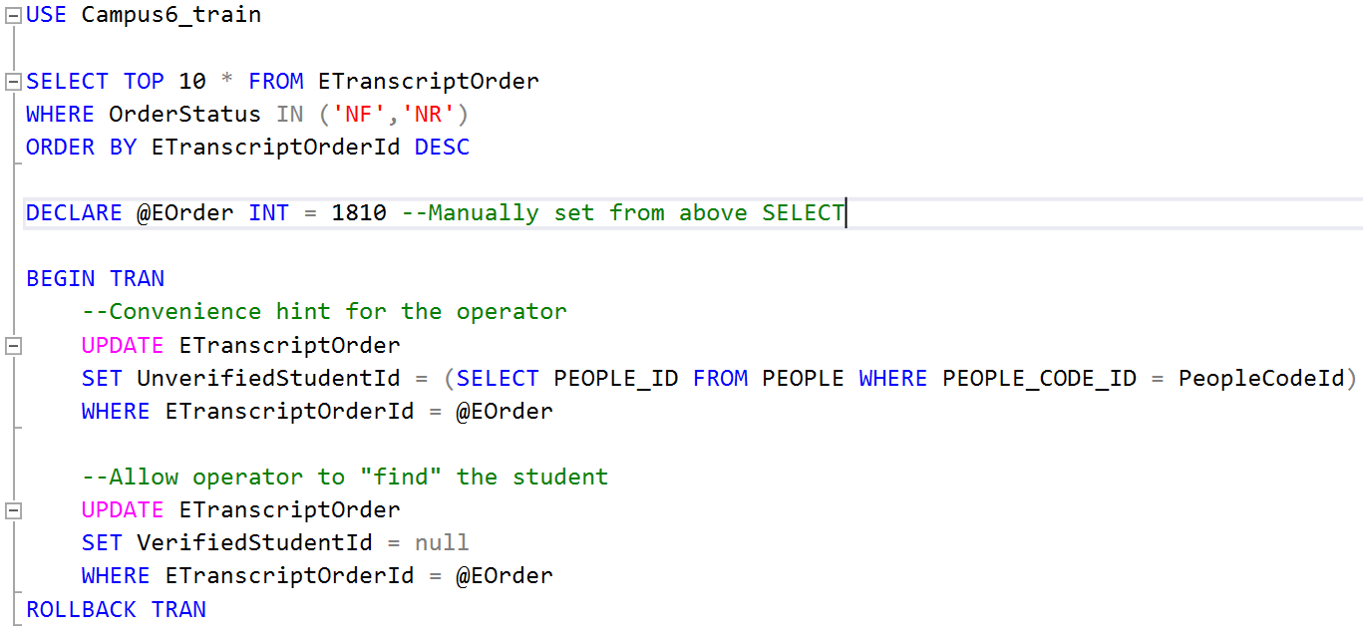
SQL – Unstick Order After People Merge
Notes:
USE Campus6_train
SELECT TOP 10 * FROM ETranscriptOrder
WHERE OrderStatus IN ('NF','NR')
ORDER BY ETranscriptOrderId DESC
DECLARE @EOrder INT = 1810 --Manually set from above SELECT
BEGIN TRAN
--Convnience hint for the operator
UPDATE ETranscriptOrder
SET UnverifiedStudentId = (SELECT PEOPLE_ID FROM PEOPLE WHERE PEOPLE_CODE_ID = PeopleCodeId)
WHERE ETranscriptOrderId = @EOrder
--Allow operator to "find" the student
UPDATE ETranscriptOrder
SET VerifiedStudentId = null
WHERE ETranscriptOrderId = @EOrder
ROLLBACK TRAN

Slide 45
It’s so much easier! With the old system, we had to type everything by hand.
Noreen Smith, Registrar
Less manual effort.
Students get tracking information.
IT has been involved for less than 1% of orders.
Notes:
Although I just talked about one scenario that required manual intervention, our registrar has involved IT for less than 1% of orders! We’re very happy with it overall.

Slide 46
Questions? Discussion?
wbest@mcny.edu
Notes:
Thank you for attending!

