Slide 1
Indra vs Vritra
Submitted in the partial fulfillment for the award of the degree of
BACHELOR OF ENGINEERING
IN
GRAPHICS AND GAMING
Submitted by:
Anirudh Pathania(22BCG10054)
Shubham Bajaj(22BCG10077)
Adityajeet Yadav(22BCG10087)
Under the Supervision of:
Yogiraj Anil Bhale
Department of AIT-CSE
DISCOVER . LEARN . EMPOWER

Slide 2
Outline
Introduction to Project
Problem Formulation
Objectives of the work
Methodology used
Results and Outputs
Conclusion
Future Scope
References

Slide 3
Introduction to Project
Narrative-driven adventure game.
Conflict between Indra(the king of the Devas) and Vritra(fearsome demon controlling the waters).
Rooted in ancient Hindu epics.
Driven from texts like the Rigveda and Shrimad Bhagwat Puran.
Engage players with its rich storytelling and immersive gameplay experience.

Slide 4
Problem Formulation
Cultural Sensitivity: Respect and accuracy in cultural representation.
Engagement: Retaining player interest over time.
Education vs Entertainment: Balancing learning and gameplay.
Adaptation: Creative interpretation of the mythological story.
Audience: Appeal and accessibility to a broad audience.
Resources: Balancing game quality and available resources.
Monetization: Implementing a user-friendly monetization strategy.

Slide 5
Objectives of the Work
Preserve and promote ancient Hindu text.
An immersive narrative-driven adventure game.
Educate players about Hindu epics.
Provide an enjoyable gaming experience.
Engage a diverse audience, including ancient history enthusiast and gamers.
Achieve commercial success by reaching a wide audience and generating revenue.

Slide 6
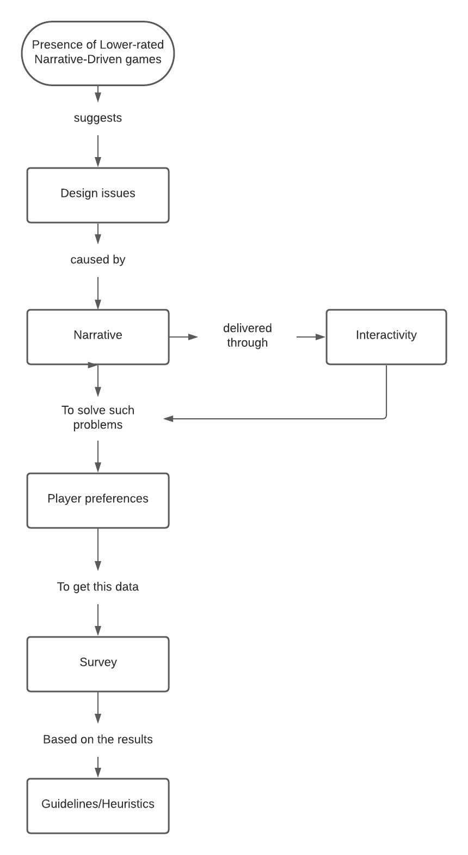
Methodology used

Slide 7
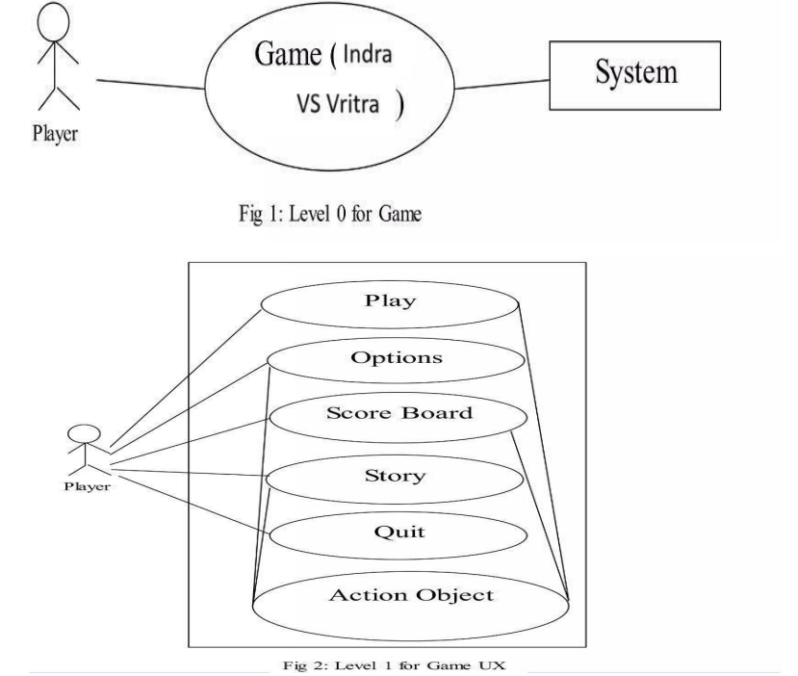
Methodology used(contd.)

Slide 8
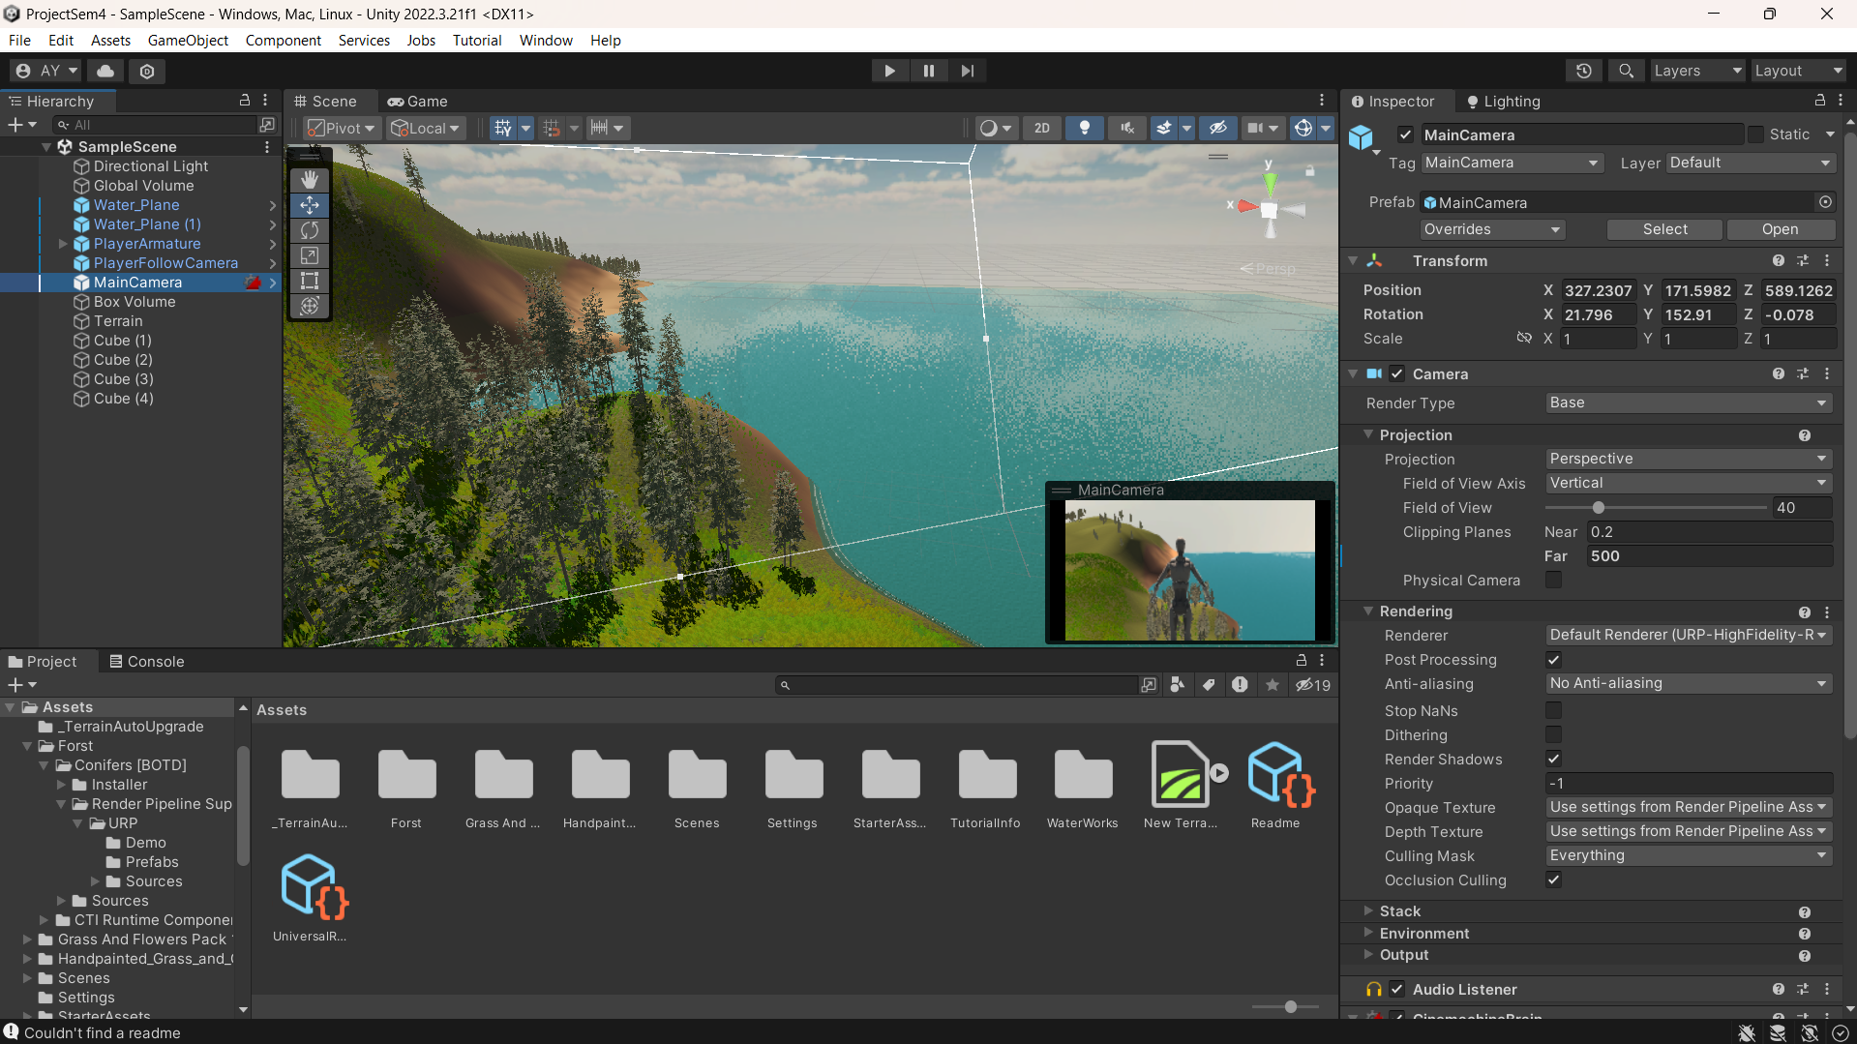
Results and Outputs

Slide 9
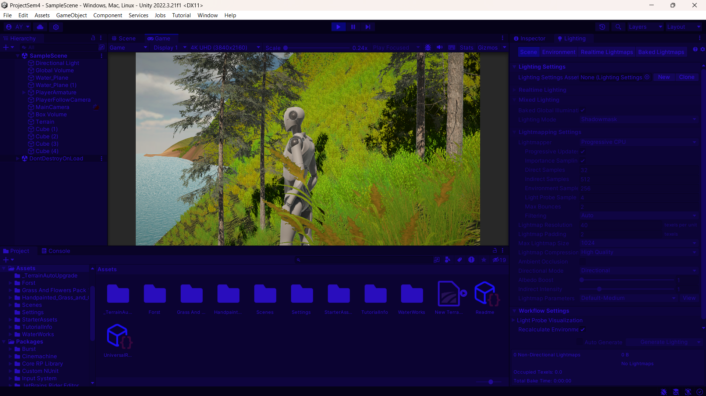
Results and Outputs(contd.)

Slide 10
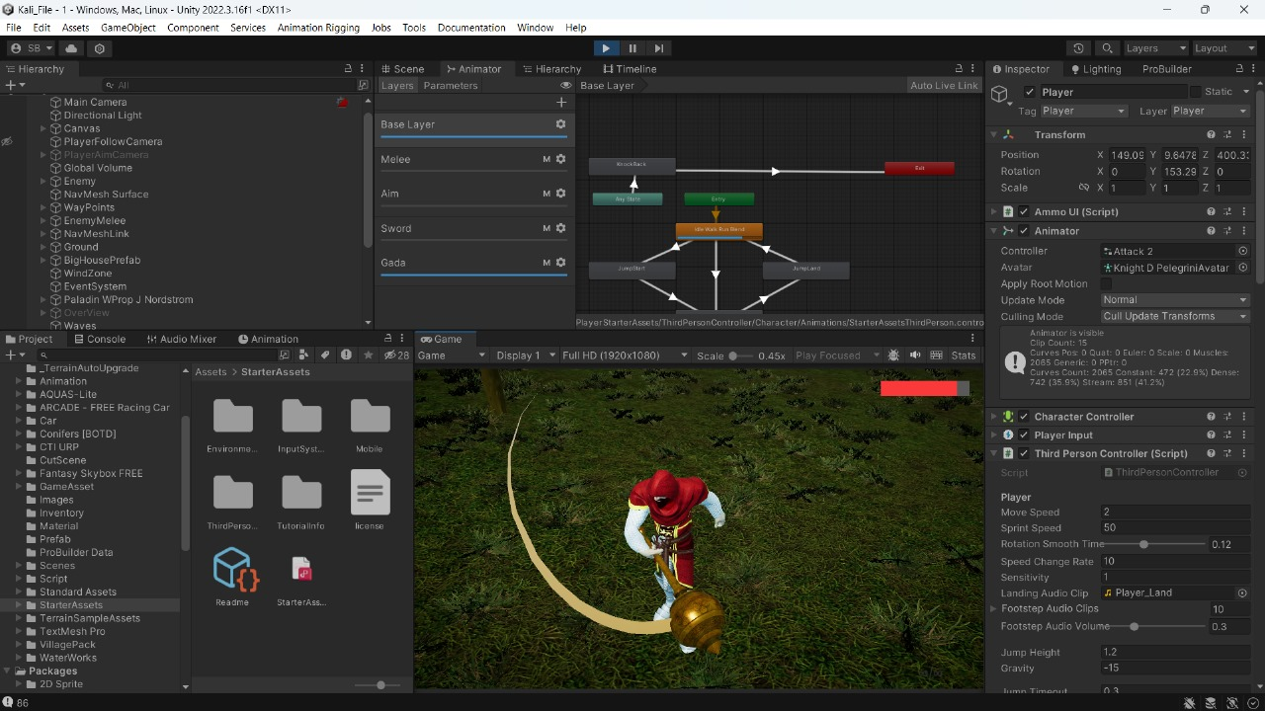
Results and Outputs(contd.)

Slide 11
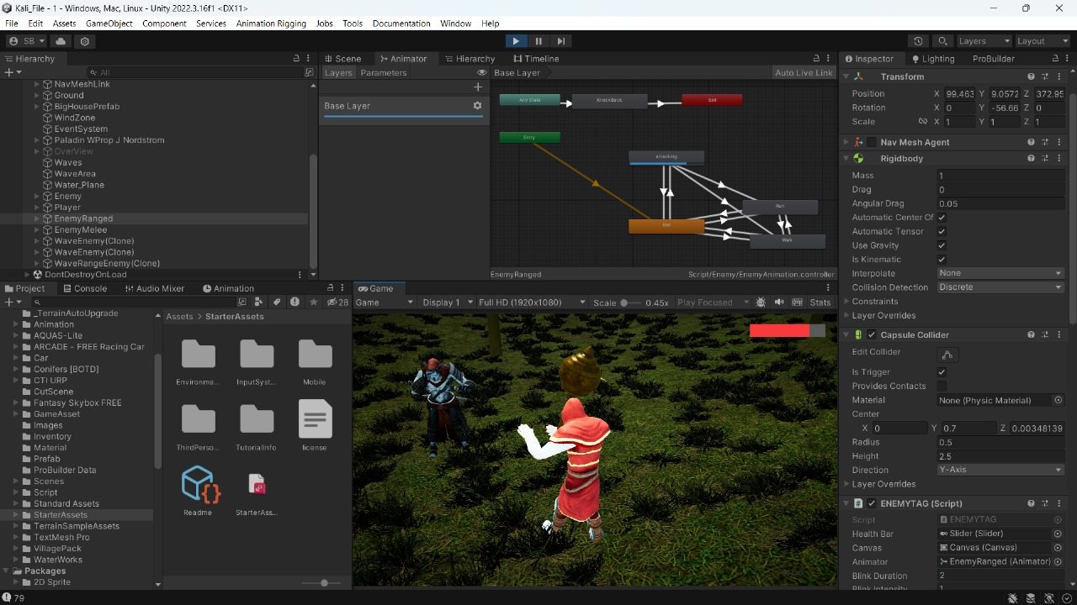
Results and Outputs(contd.)

Slide 12
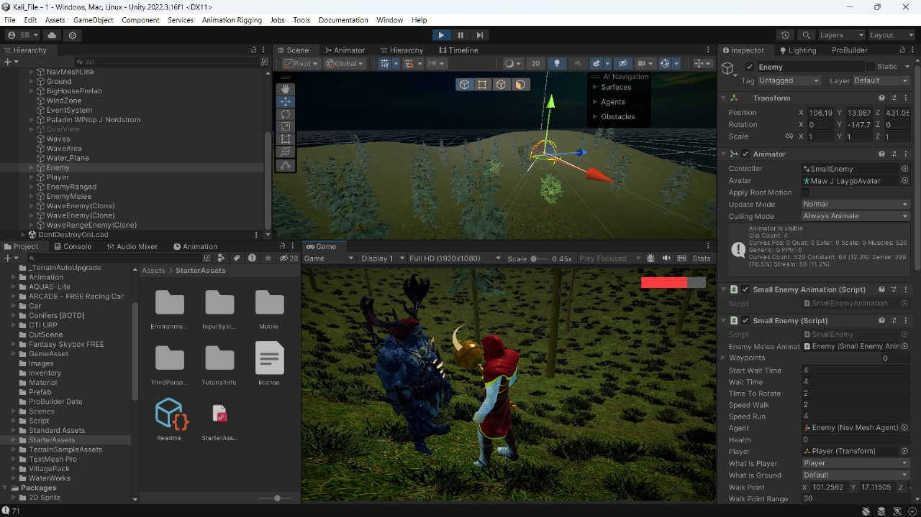
Results and Outputs(contd.)

Slide 13
Conclusion
"Indra vs Vritra" represents the culmination of our journey in game development.
We've combined dedication, creativity, and technical skill to create an engaging game.
A Game that is enjoyable and teaches about ancient knowledge.
An Authentic and well-rooted adaptation of ancient Indian epics.
This project has equipped us with valuable skills for our future endeavors.

Slide 14
Future Scope
Introduce additional story arcs and quests to enrich gameplay.
Implement cooperative and competitive gameplay experiences.
Explore VR technology for a more immersive experience.
Expand accessibility by localizing the game and ensuring compatibility.
Foster a vibrant player community for feedback and ideas.
Collaborate with educational institutions to integrate the game into curricular.
Explore opportunities for merchandise and media adaptations.

