Slide 1
Implement Git
Tutorial: https://www.leshenko.net/p/ugit
Project: https://github.com/ReZeroS/zit

Slide 2
Dependency
MAIN
Lombok https://projectlombok.org code enhancer
Guava https://github.com/google/guava common tools
Picocli https://picocli.info command line parser
Others
Logback logs library
Gson JSON converter
JNR-POSIX cd command

Slide 3
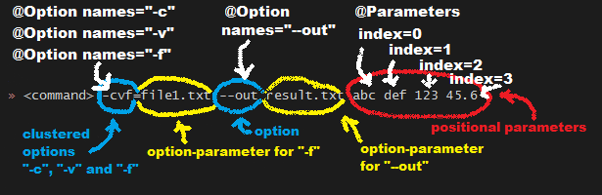
Arguments parser
Command line arguments can be separated into options and positional parameters.
Options have a name, positional parameters are usually the values that follow the options, but they may be mixed.

Slide 4
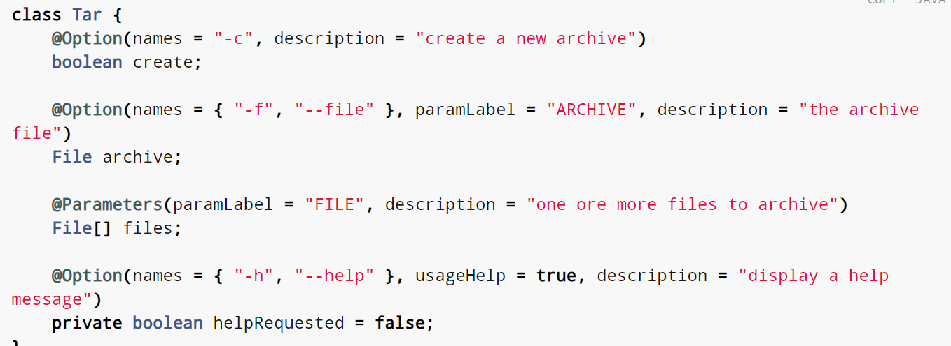
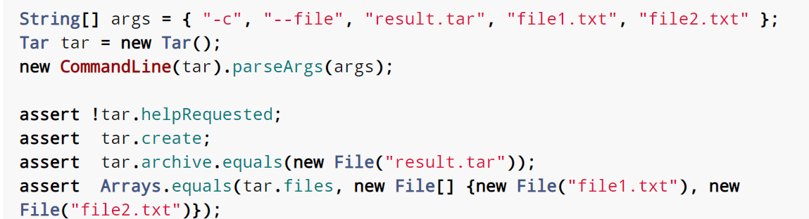
Example:
options with one or more names
options that take
an option parameter,
and a help option.

Slide 5
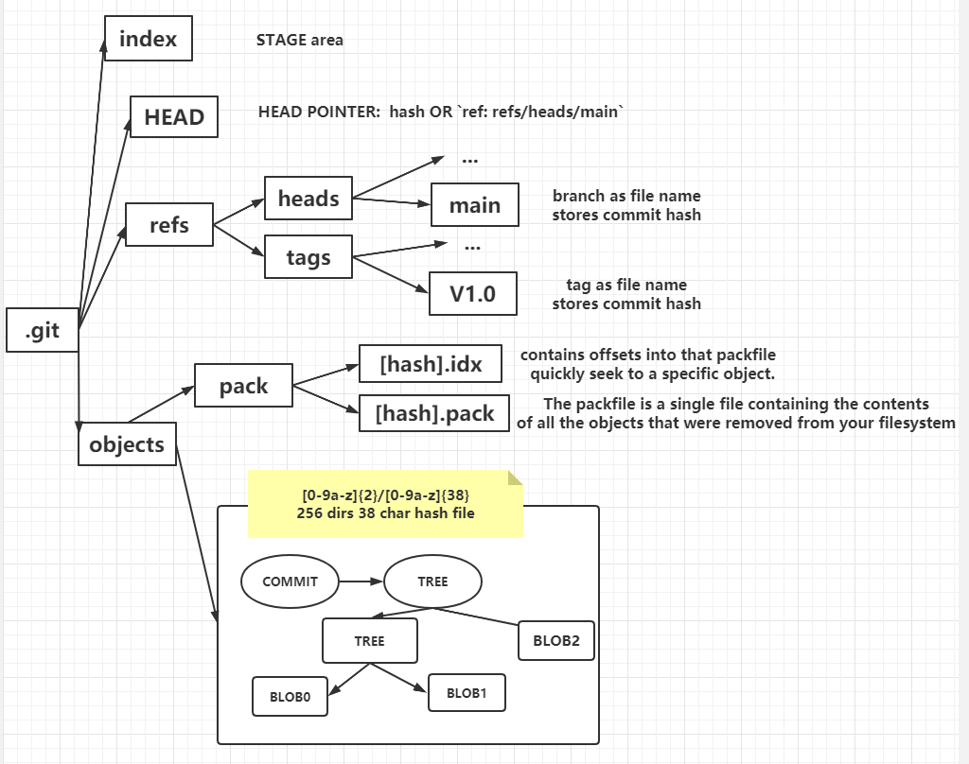
file system
Others:
remotes: remote repository
refs/remotes/remote-branch
hooks: hooks script
.git/hooks
config, description and …

Slide 6
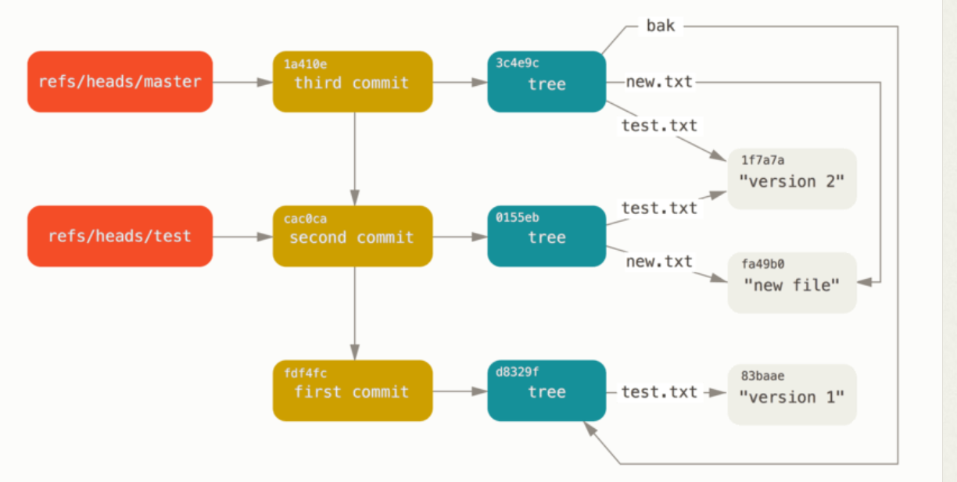
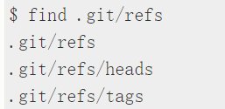


Git Objects & References
Detached HEAD

Slide 7

basic command
hash-object
Write file into object database and return hash address
cat-file
Read file from object database by the hash address
write-tree
Do hash-object blob with files
Execute hash-object tree according to the stage
read-tree
Read the tree information given by <tree-id> into the index
Does not actually update any of the files it "caches“

Slide 8
Git add
do hash-object
rewrite INDEX
Git update-index --add file
Add blob into index file
Git ls-stages
check the stages file
INDEX file format

Slide 9
Git gc (push)
Zlib to compress
Loose object format
Git verify-pack –v .git/objects/pack/pack-[hash].index
The new version of the file is the one that is stored intact
whereas the original version is stored as a delta
this is because you’re most likely to need faster access to the most recent version of the file.

Slide 10
Git commit
call write-tree
Set current commit which is HEAD pointed as parent commitId
Save typed words about the commit as commit message
Do hash-object with the content (commit, tree, parent) with type called ‘commit’
Update head pointer to the new commit
Update ref[branch] file content
commit --amend [gc] since old commit won’t be used
Git commit-tree treeId msg
Every commit has a single tree
Generate a commit by the provided tree id

Slide 11
Git branch
List all branch
List all files in the heads directory.
Create new branch
Create new branch with a target commit
If the target commit not provided, then set current commit as target commit.
Git checkout ref
Get the ref’s hash-id
Get the commit tree by the above hash-id
Read tree to update Index and reset the working directory
Update HEAD file to set content as branch ref or hash(detached HEAD)
Git reset
Update HEAD as the target commit id

Slide 12
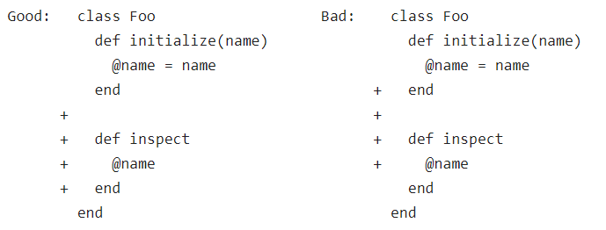
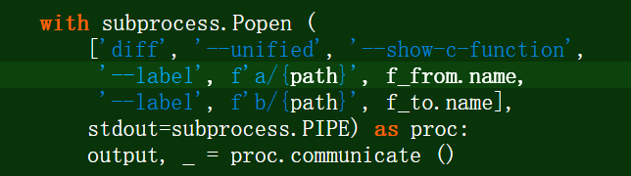
Myers’ algorithm is just one such strategy, but it’s fast and it produces diffs that tend to be of good quality most of the time.
It does this by being greedy, that is trying to consume as many lines that are the same before making a change (therefore avoiding the “wrong end” problem), and also by preferring deletions over insertions when given a choice, so that deletions appear first.

Slide 13
Diff Definition：Shortest Edit Scripts
Definition: A text and B text
Requirements: Convert A text to B text
The smallest edit range：single line
Edit script
Delete line from A text
Add line from B text
Sync the same line at A and B
Weight：sync consume 0 while each of delete and add consume 1

Slide 14
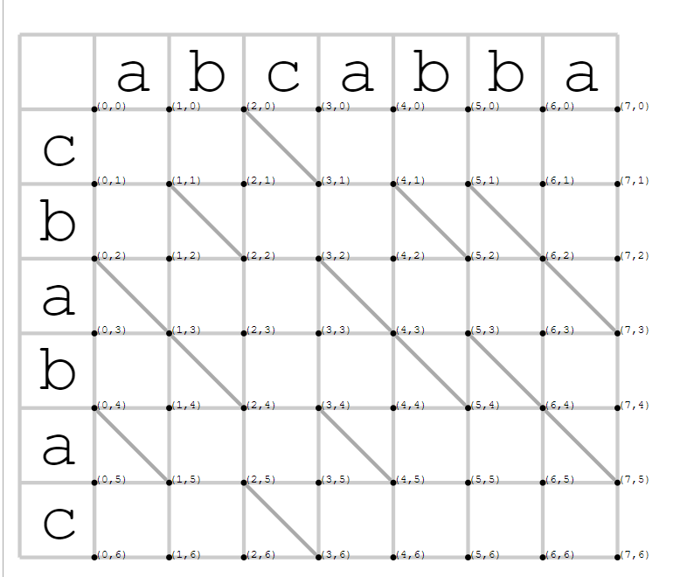
Requirements:
convert A to B with SES
Initial:
String A: abcabba
String B: cbabac
Diagonal lines:
represent items that match

Slide 15
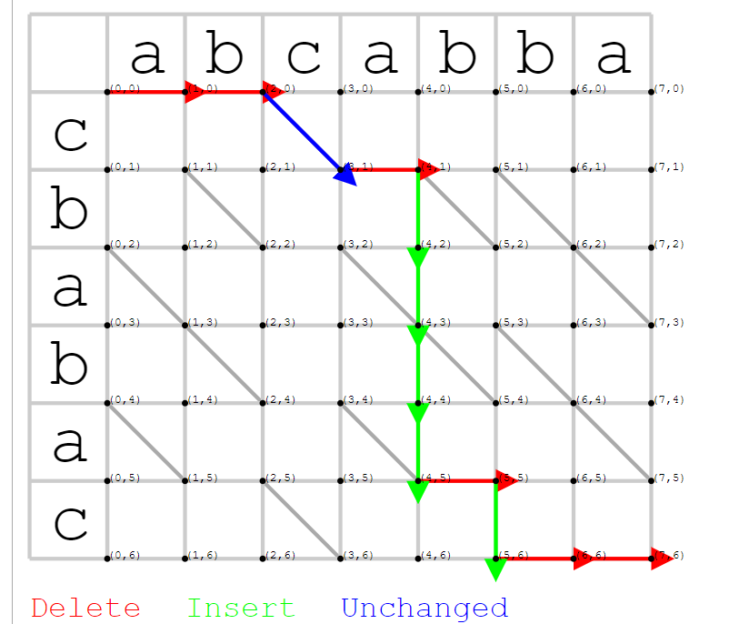
Snake Define
a single deletion or insertion
followed by zero or more diagonals.
Longest Common Subsequence ( LCS )
Finding the SES is equivalent to finding
the Longest Common Subsequence of the two files.

Slide 16
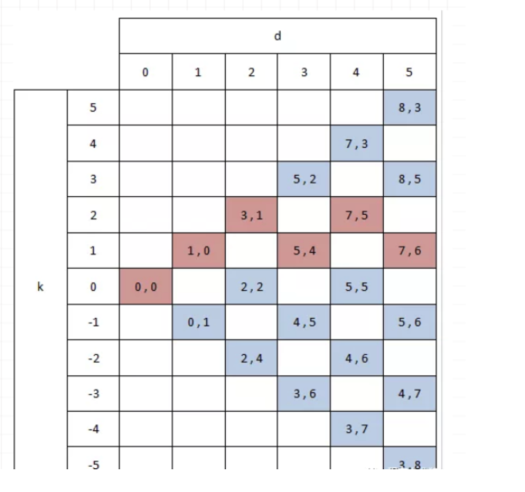
d => (i + diagonal, j + diagonal)
diagonal parameter is the count of diagonal passed
define k = x – y = i – j
then the even or odd quality of k depends on d
Explain:
If d is odd, then i + j will be odd since 2*diagonal is even)
So i – j will be odd => d odd => k odd
Any point arrived at k diagonal line
must have gone through at least |k| operations

Slide 17
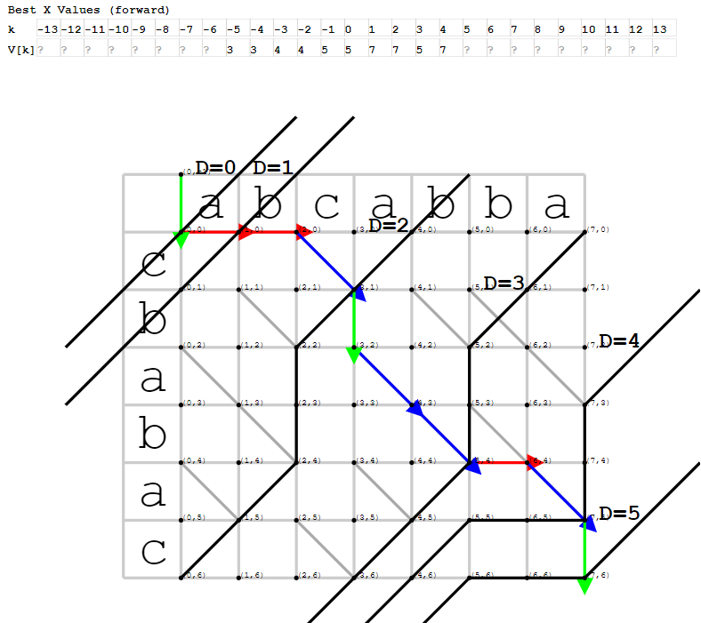
Visualize

Slide 18
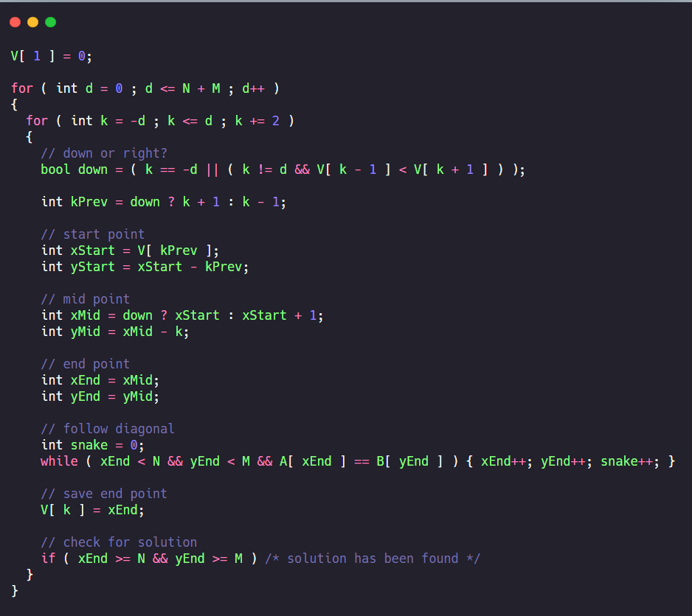
V[k] = x
=> y = x -k
Outter loop to limit steps
【What is the status at any step?】
Inner loop decide the choice
【We are from the up or the left?】
When you know where are you from
You will get Snake’s start point and initial middle point
And this time middle point also is end point, they are at the same position
Then if there are many diagonal ways after the middle point, the end point will move around the way

Slide 19
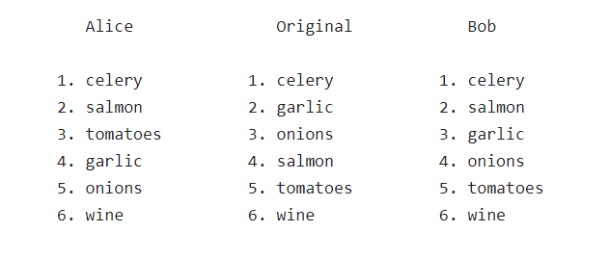
merge

Slide 20
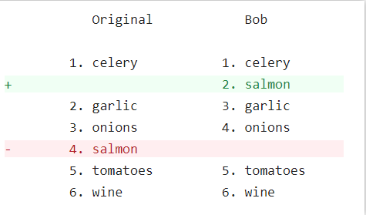
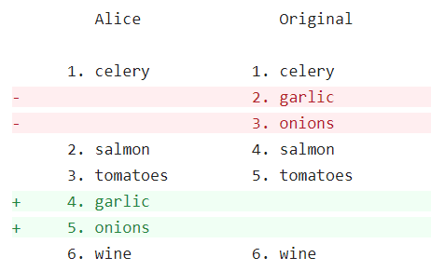
Initial with diff

Slide 21
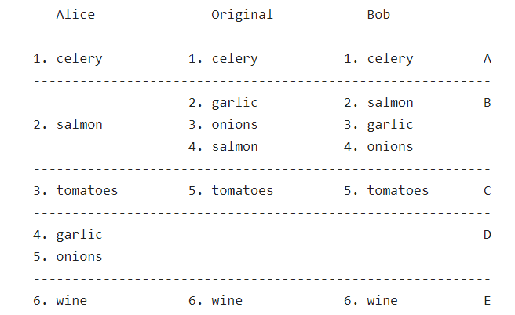
Build chunks

Slide 22
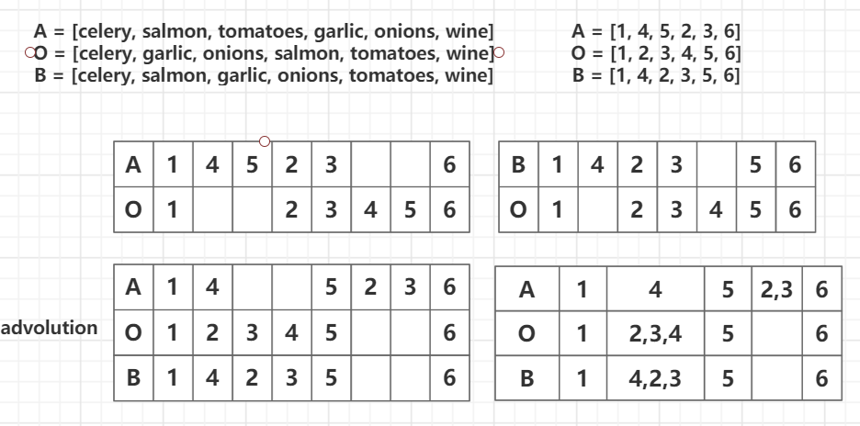
Ex, code

Slide 23
References
Nikita Thanks for this tutorial.
Nick Butler this post is short but enough to help you have a higher level to understand diff
jcoglan this posts make a detail description about the diff.
visualize if you wanna have a debugger or visualization about diff algorithm, this will be a good choice.
Real git if you wanna learn the real git, this would be a good introductory article

