Slide 1
Implement Git
Tutorial: https://www.leshenko.net/p/ugit
Project: https://github.com/ReZeroS/zit

Slide 2
Dependency
MAIN
Lombok https://projectlombok.org code enhancer
Guava https://github.com/google/guava common tools
Picocli https://picocli.info command line parser
Others
Logback logs library
Gson JSON converter
JNR-POSIX cd command

Slide 3
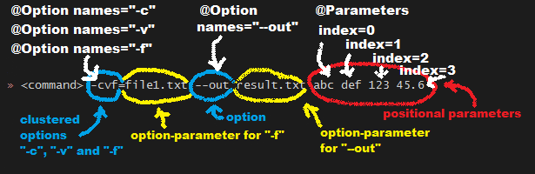
Arguments parser
Command line arguments can be separated into options and positional parameters.
Options have a name, positional parameters are usually the values that follow the options, but they may be mixed.

Slide 4
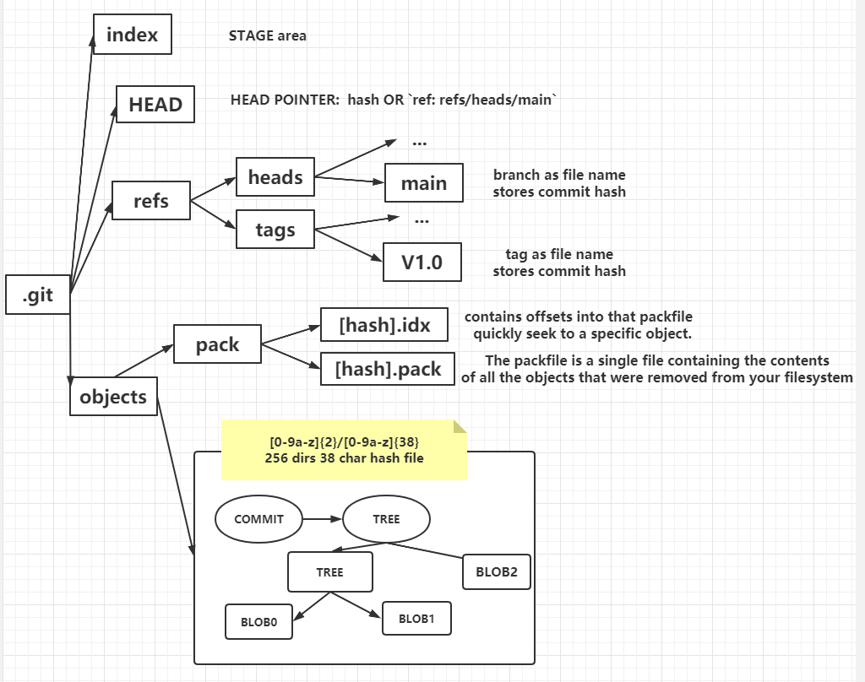
file system
Others:
remotes: remote repository
refs/remotes/remote-branch
hooks: hooks script
.git/hooks
config, description and …

Slide 5
basic command
Git hash-object
Write file into object database and return hash address
Git cat-file
Read file from object database with hash address
Git write-tree
批量版本的hash-object
会按照 stage 执行hash-object tree 和 blob
Git read-tree
批量版本的cat-file
根据给定的 tree id，重写 stage 区，并决定是否据此更新工作区

Slide 6
Git add
Index 格式
做 hash-object
重写 INDEX
Git update-index file
将文件加入暂存区
Git ls-stages
调用 write-tree针
1.

Slide 7
Git commit
调用 write-tree
设置当前head指向为当前commit的父commitId
将以上信息做一次 hash-object(commit, tree, parent)
更新head指针为当前指针

Slide 8
Git branch
查看当前所有分支
查看 heads 目录下的文件
创建 branch
创建一个文件设置个指定的hash，默认及当前head
Git checkout ref
获取当前ref的hash-id
根据 hash-id 获取对应的 commit
Read tree 从而 update Index 并 更新当前工作目录
根据获取commit的 tree id
更新当前head 为 branch 或者 commit id
Git reset
更新HEAD为指定的COMMIT id

Slide 9
Git gc (push)
https://git-scm.com/book/en/v2/Git-Internals-Packfiles
Zlib to compress
Loose object format
Git verify-pack –v .git/objects/pack/pack-[hash].index
What is also interesting is that the second version of the file is the one that is stored intact, whereas the original version is stored as a delta — this is because you’re most likely to need faster access to the most recent version of the file.

Slide 10
Diff 定义：Short Edit Scripts
定义 A B 两个文本
直接目标: A 转换成 B
最小编辑粒度：行
编辑操作
从 A 中删除一行
从 B 中删除一行
（隐性）同步 A 和 B
定义耗损：编辑操作除了同步为 0外，耗损权重皆为 1
算法要求：最少耗损的前提下找出这组操作将 A 转换成 B

Slide 11
Myers diff
Nick Butler
简洁易懂，能够帮助快速熟悉diff算法的实现
visualize
方便肉眼 debug, Diff 算法的可视化界面
jcoglan
作者出的书就是如何实现git的
较为详细博客，关于git的实现有着深入的介绍

Slide 12
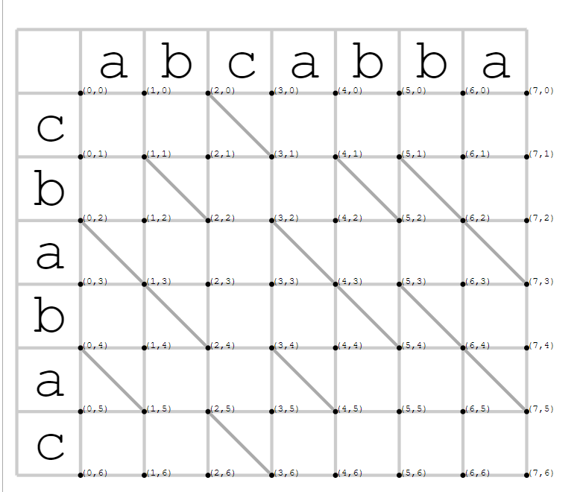
Requirements:
convert A to B with SES
Initial:
String A: abcabba
String B: cbabac
Diagonal lines:
represent items that match

Slide 13
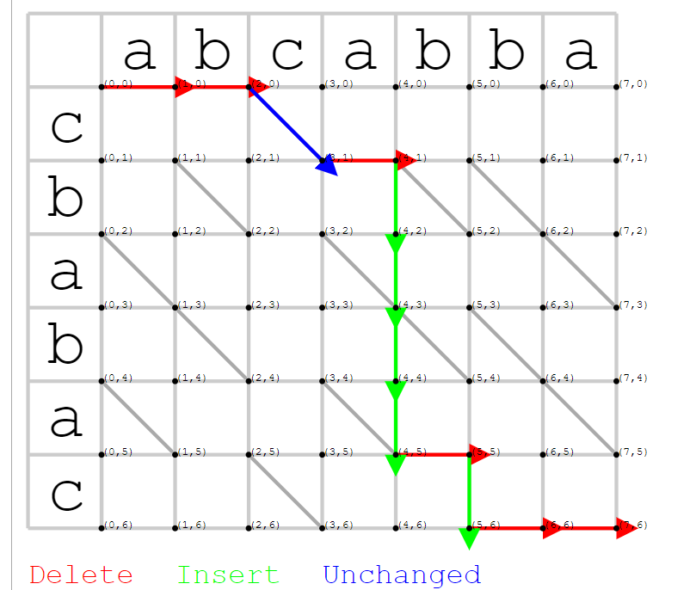
Snake Define

Slide 14
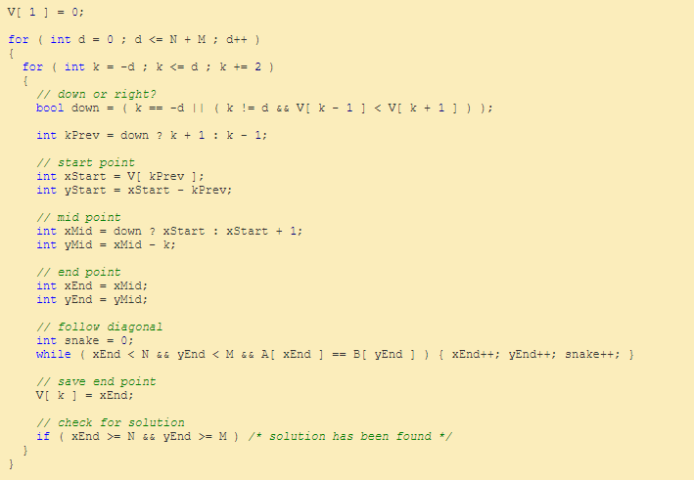
V[k] = x
=> y = x -k
外层循环限定步数
【每步得时候处在一个啥状态】
内层循环决定选择
【当前 k 是从上方来还是左方来】
确定来源方向即确定
Snake的 起点中点
此时 中点和终点重合
最终由是否走斜线
确定最远的 终点

Slide 15
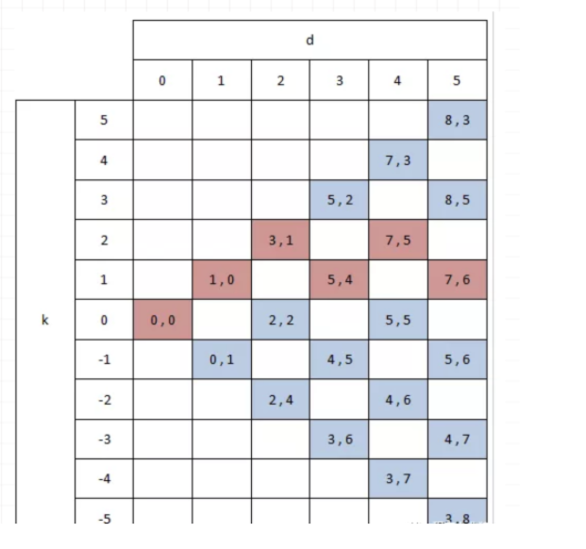
d => (i + diagonal, j + diagonal)
diagonal 为经过对角线的次数
设定 k = x – y = i - j 的奇偶性就依赖于 d
当 d 为奇数， i + j 就是奇数(2*diagonal偶)
自然 i-j 就是奇数 => d 奇 k 奇, d 偶 k 偶
k 这里有个重点意识：
任何抵达 k 线的点 必经过了至少 |k| 个 增或者删操作

Slide 16
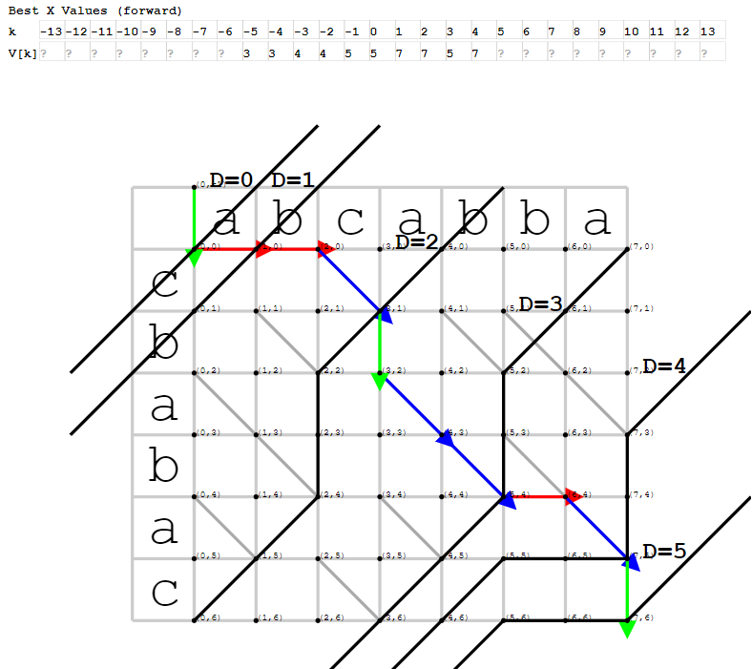
Visualize

Slide 17
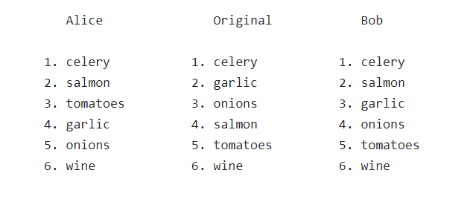
merge

Slide 18
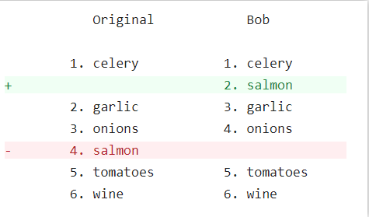
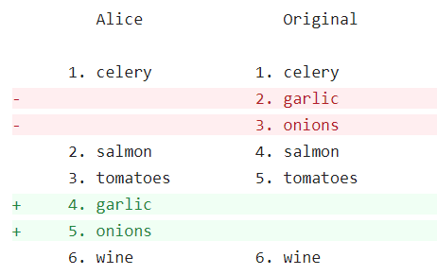
Initial with diff

Slide 19
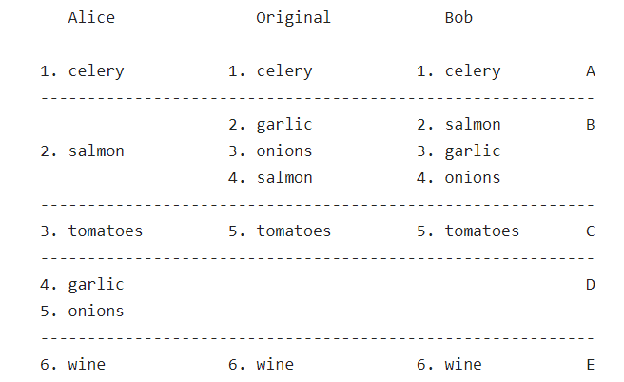
Build chunks

Slide 20
