Slide 1

Bash Next Steps
Ian Miell
Twitter: @ianmiell
Ian.miell@gmail.com

Slide 2
Bash and Me
Used throughout career
Never learned formally
Stumbled around, lots of mistakes
Slowly learned concepts and key points
Wrote a book (Learn Bash the Hard Way)

Slide 3
This Course
Follows on from Introduction to Bash course
Live Walkthroughs
Encourage you to follow - ‘Hard Way’ Method
Exercises
Group chat
Materials:
https://github.com/ianmiell/introduction-to-bash

Slide 4
Pre-Requisites
Familiar with command line
Bash version 4+
$ echo $SHELL
$ bash --version
<4 is still ok
Using zsh (eg on Mac)
Type ‘bash’ to get a bash shell
Basic shell utilities (eg grep, cat, ls)
Any editor (I use vim)

Slide 5
Why This Course?
Bash is everywhere
Shells are everywhere
Work with it every day
Taken for granted that it’s known
Studying it pays massive dividends
Gateway to deeper OS concepts

Slide 6
Structure of Course
Part I – Recap/Level-Set + Advanced Basics
Part II – Advanced Scripting
Part III – Advanced Bash Topics

Slide 7
Discussion
What do you want to achieve in bash?
Any specific goals?
What have you been frustrated by with bash?

Slide 8
Part I – Bash Recap
Variables
Globbing
Pipes and redirects
Functions
Tests
Loops
Command substitution
Scripts

Slide 9
Part II – Bash Scripting
Subshells
Process substitiution
Internal Field Separator
Here docs

Slide 10
Subshells - Recap
Variables
Working directories
Redirection

Slide 11
Process Substitution - Recap
Signals
man signal
‘kill’ and signals
trap signals
fg and bg

Slide 12
Here Docs - Recap
Here docs
Here strings
Here docs and variables

Slide 13
Internal Field Separator - Recap
Problem - files with spaces
The IFS shell variable
The null byte as separator

Slide 14
Part III – Advanced Scripting
Job Control
Traps and Signals
cheapci / bashtop

Slide 15
Job Control - Recap
Single jobs
Killing jobs
Waiting for jobs
Jobs, waiting, and exit codes

Slide 16
Traps and Signals - Recap
Signals
man signal
‘kill’ and signals
trap signals
fg and bg

Slide 17
Debugging - Recap
bash -n, -v, -x
nounset, xtrace, errext
shellcheck

Slide 18
Wrapup
https://github.com/ianmiell/bash-next-steps
@ianmiell
ian.miell@gmail.com

Slide 19
Bash Next Steps
Ian Miell
@ianmiell

Slide 21
3.1 Scripts and Startup
What shell scripts are
What happens on bash startup
This has cost me many hours!
Executable files
‘source’ vs ‘./’

Slide 22
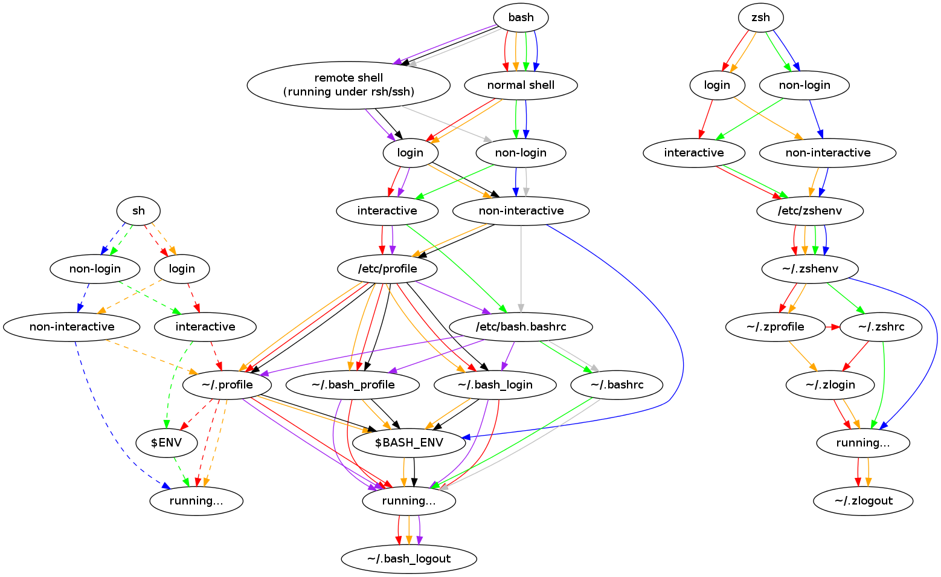
Walkthrough – Startup Explained

Slide 23
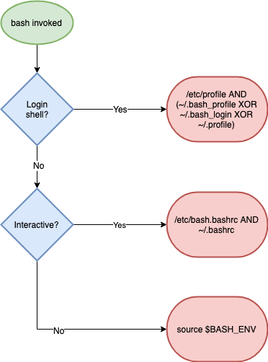
Walkthrough – Startup Explained (simpler)

Slide 24
Recap - Scripts and Startup
What shell scripts are
How complex bash startup can be
Keep diagram handy!

Slide 25
3.2 The ‘set’ builtin
Setting options in bash
What POSIX is
Most useful options:
nounset
xtrace
errexit
‘set’ vs ‘shopt’

Slide 26
Recap - ‘set’
Options: + off, - on
POSIX
Most common options
shopt and set
xtrace, nounset, errexit

