Slide 1
How I have (mostly) kept my data safe from evil hax0rs
Charles N Wyble
Known Element Enterprises
http://www.knownelement.com
Presented to MediaTemple
February 17th 2011

Slide 2
Wordpress
MediaTemple?
Wordpress is awesome.
Let's set it up by hand
  Cfengine is a joke
  Puppet is for muppets
  Bcfg?2?

Slide 3
Just Kidding!

Slide 4
A tribute
Let's give it up for Jordan Schwartz

Slide 5
Who am I?
Charles N Wyble
  My own little corner of the net is at http://www.knownelement.com
  I have a blog at http://blog.knownelement.com
  And for the ADD generation I have a microblog at http://mblog.knownelement.com (mirrors to twitter @charlesnw)

Slide 6
What have I done?
Lots and lots of system/security/network operations work.
  Large scale e-commerce / web operations
    Disneyparks.com and associated properites (30 million uniques per month, 2billion per year revenue)
    Evite.com (300 million uniques per month, 2 million e-mails per day)
    FoxAudienceNetwork (thousands of servers, millions of daily users, billions of daily ads
Lots of contract/consulting/startup work
Heading off to new gig next week

Slide 7
In 2010 I...
Took ownership of my data with several floss systems.
Had a lot of fun!
Learned a whole lot about building a service provider network
Started ongoing efforts in the digitial currency and parallel programming spaces

Slide 8
How did I do that?
I mapped out where existing data is and determined what can be migrated
Evaluated replacement systems
Assembled hardware/software infrastructure for hosting
Migrated data
Hosted data in sustainable fashion

Slide 9
Evaluate Replacement Systems (existing proprietary systems)
  News (google news/google reader)
  Photos (flickr)
  Microblogging (twitter)
  Blogging (blogspot)
  Issue tracking and software configuration/project management (github, lighthouse)
  Invocing clients (freshbooks)
  URL shortener (tinyurl/bit.ly)
  Knowledge/data management (google docs and text files/notes on my bb)
  Centralized login (facebook connect/claimid)
  Colloboration (webex/skype)
  CRM (salesforce.com)
  E-mail (gmail)
  Note taking (end note/microsoft one note)
  Fleet tracking (latitude)

Slide 10
Floss systems to sustain data ownership (for a professional services company)
Applications I have been using in production:
  News (rss2email, Dashboard, Tattler, Thinkup)
  Photos (gallery3)
  Microblogging (status.net)
  Blogging (wordpress)
  Issue tracking and software configuration/project management (git and redmine)
  Invocing clients (Dolibarr)
  URL shortener (Casimir)
  Knowledge/data management (mediawiki)
  Centralized login (FreeRADIUS/389 Server/OTP magic bits)
  Colloboration (BigBlueButton/PbxInAFlash)

Slide 11
Physical Infrastructure in March 2010
Current setup
  1 dell optiplex (main-server) hosts all production services
  1 whitebox system (dev-server) to test changes before going to prod
  Motorolla DSL modem in bridge mode → Cisco 1841 router → Cisco 3548 switch
  2 external USB drives for backups (rotated)
  2 APC UPS units (one for dev-server, one for main-server)
Future plans
  1 dell optiplex (mythfe-livingroom) secondary server (dns/mysql/apache)
  Ec2 instance (activated if internet link fails)
  Redundant routers/switches (I am pursuing various cisco certs so need this anyway)
  Whole house UPS/generator
More inormation on the current setup, and future plans available on the wiki. Feel free to ask questions as well.

Slide 12
Physical Infrastructure from August 2010 to Feb 15th 2011
Current setup
  1 dell poweredge 2850 server hosting production virtual machines
  1 dell optiplex 750 server hosting development virtual machines
  Ec2/Rackspace/Mediatemple active/active instances
  Pfsense router (firewall/vpn/snort/mod_security/load balancer)
  Cisco 3560 l3 switch with multiple internet uplinks
Exhaustive details about systems/network/security setup/configuration available on the wiki. I'll cover some here today.

Slide 13
Pictures
The audience wanted pictures the last time. I didn't have em. :(
Now I do. :)
So what's it look like in my Data Center?

Slide 14
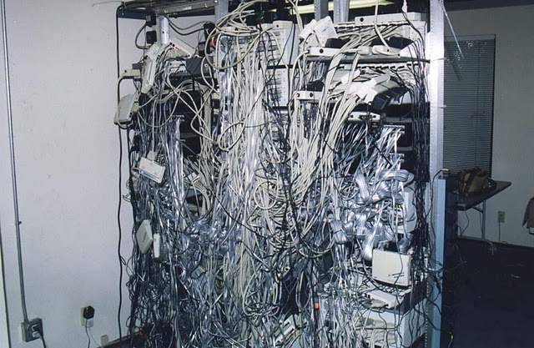

Slide 15
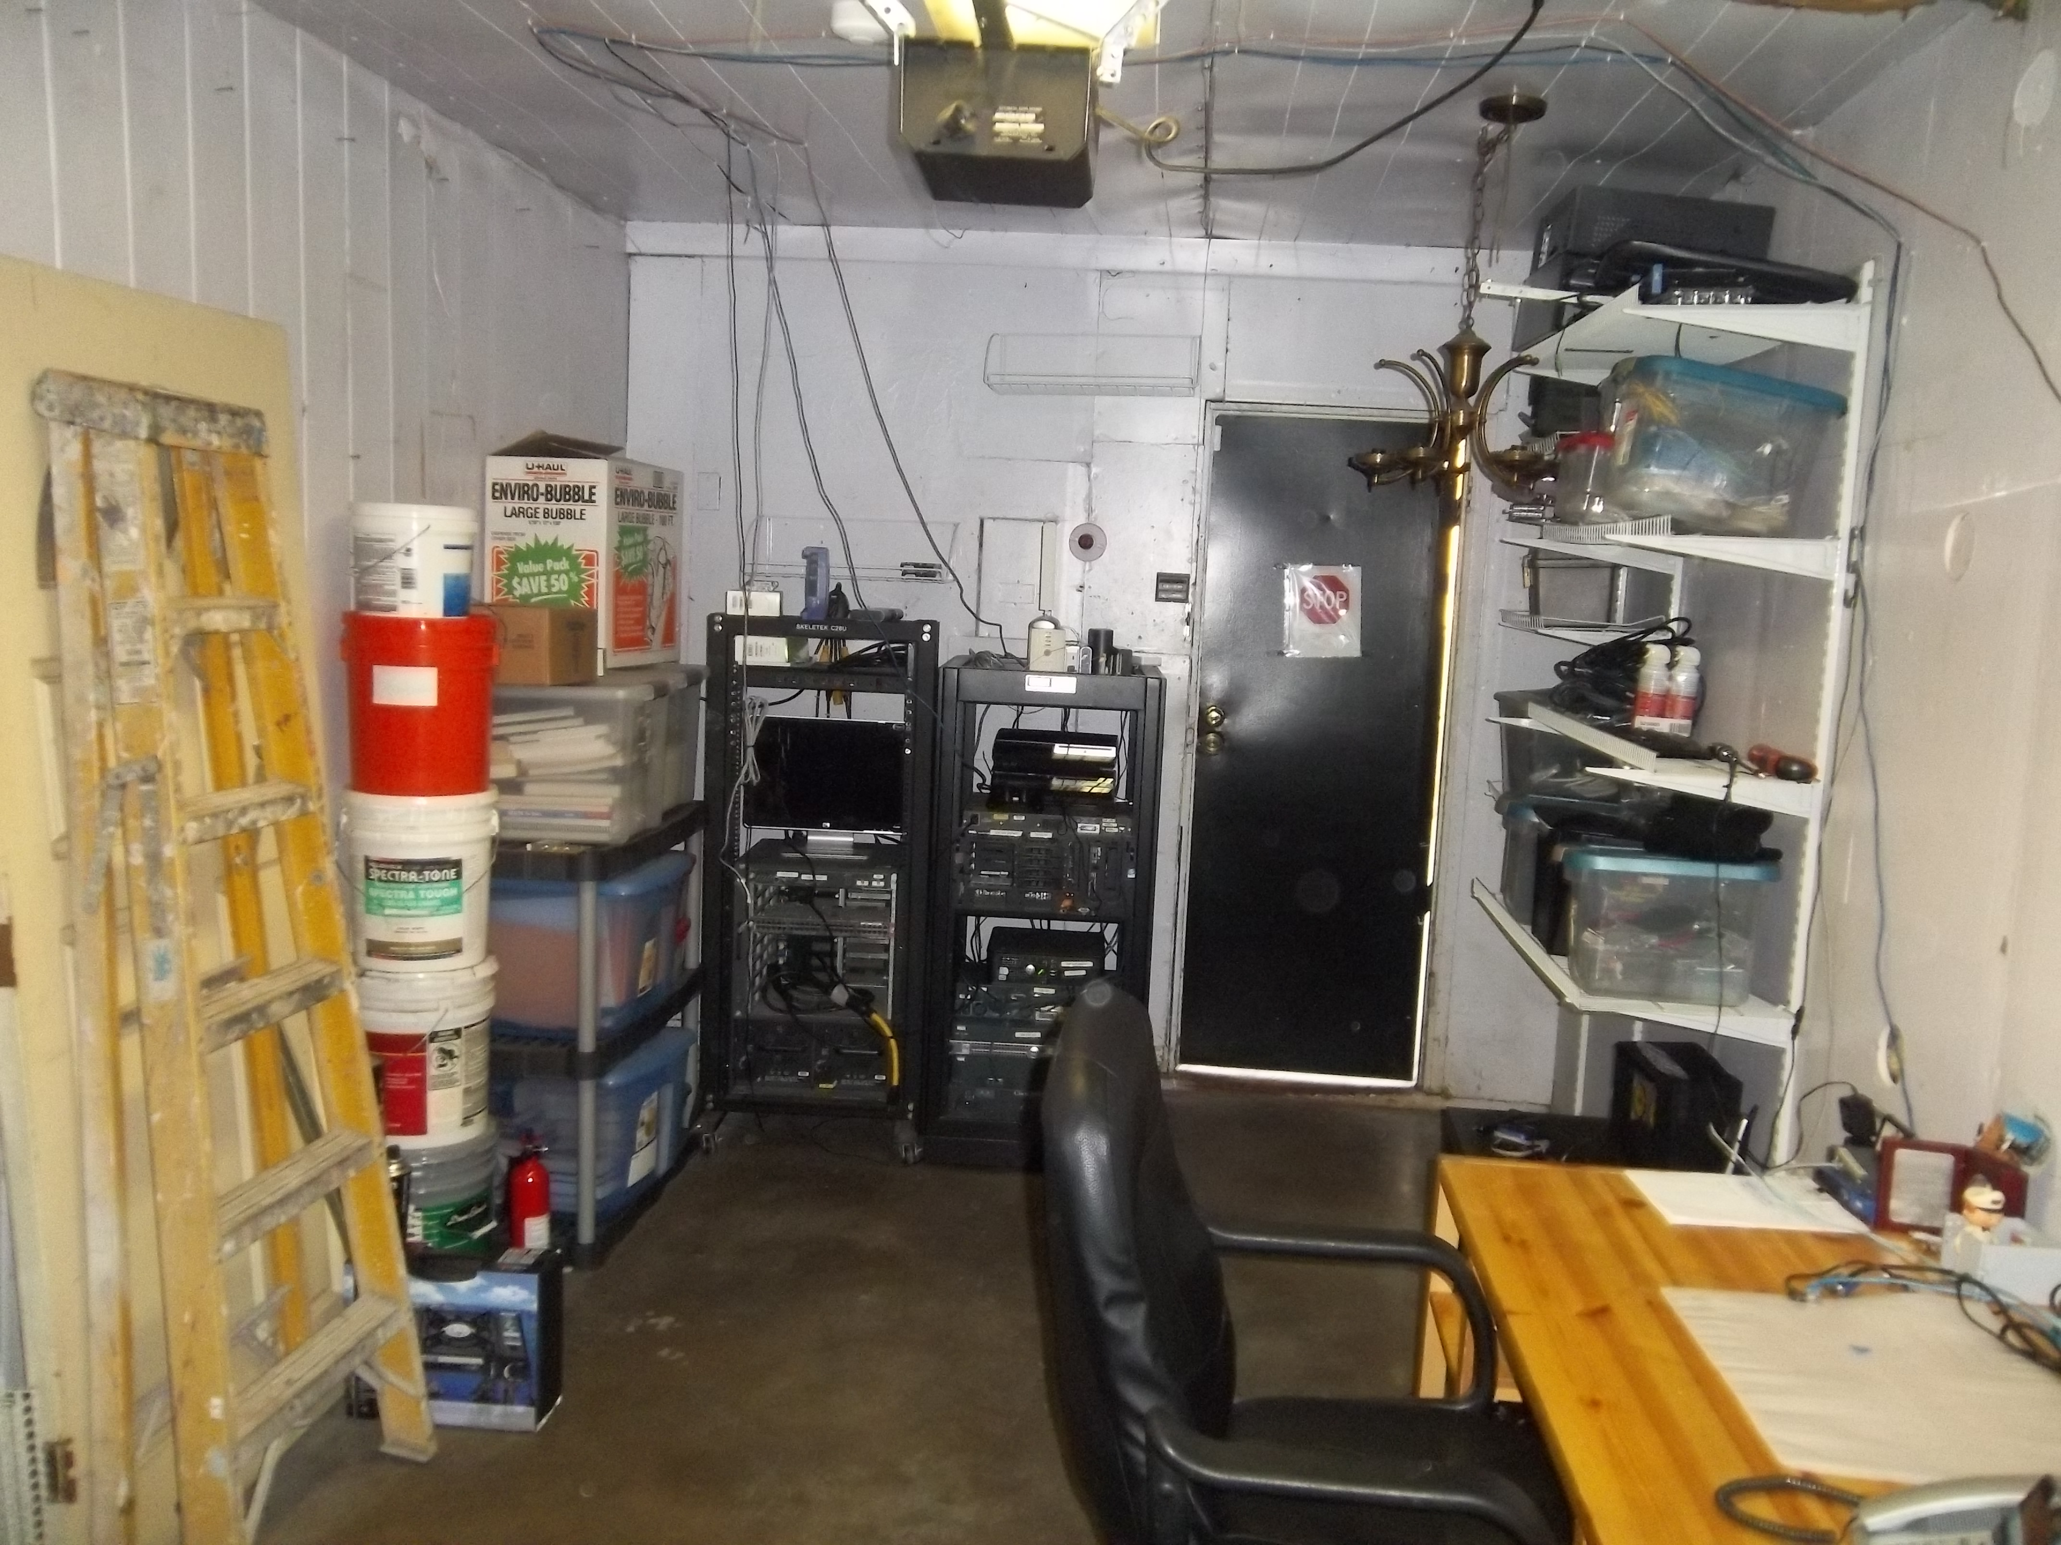
Whole data center (garage)...

Slide 16
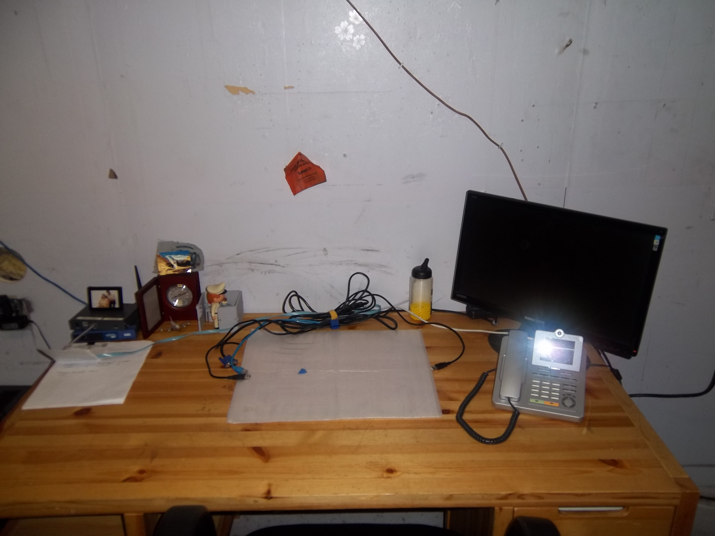
My desk

Slide 17
My Home Data Center/Office
Racks (with very clean cabling)
  Took 4 tries (2 complete overhauls) to get everything where it is today

Slide 18
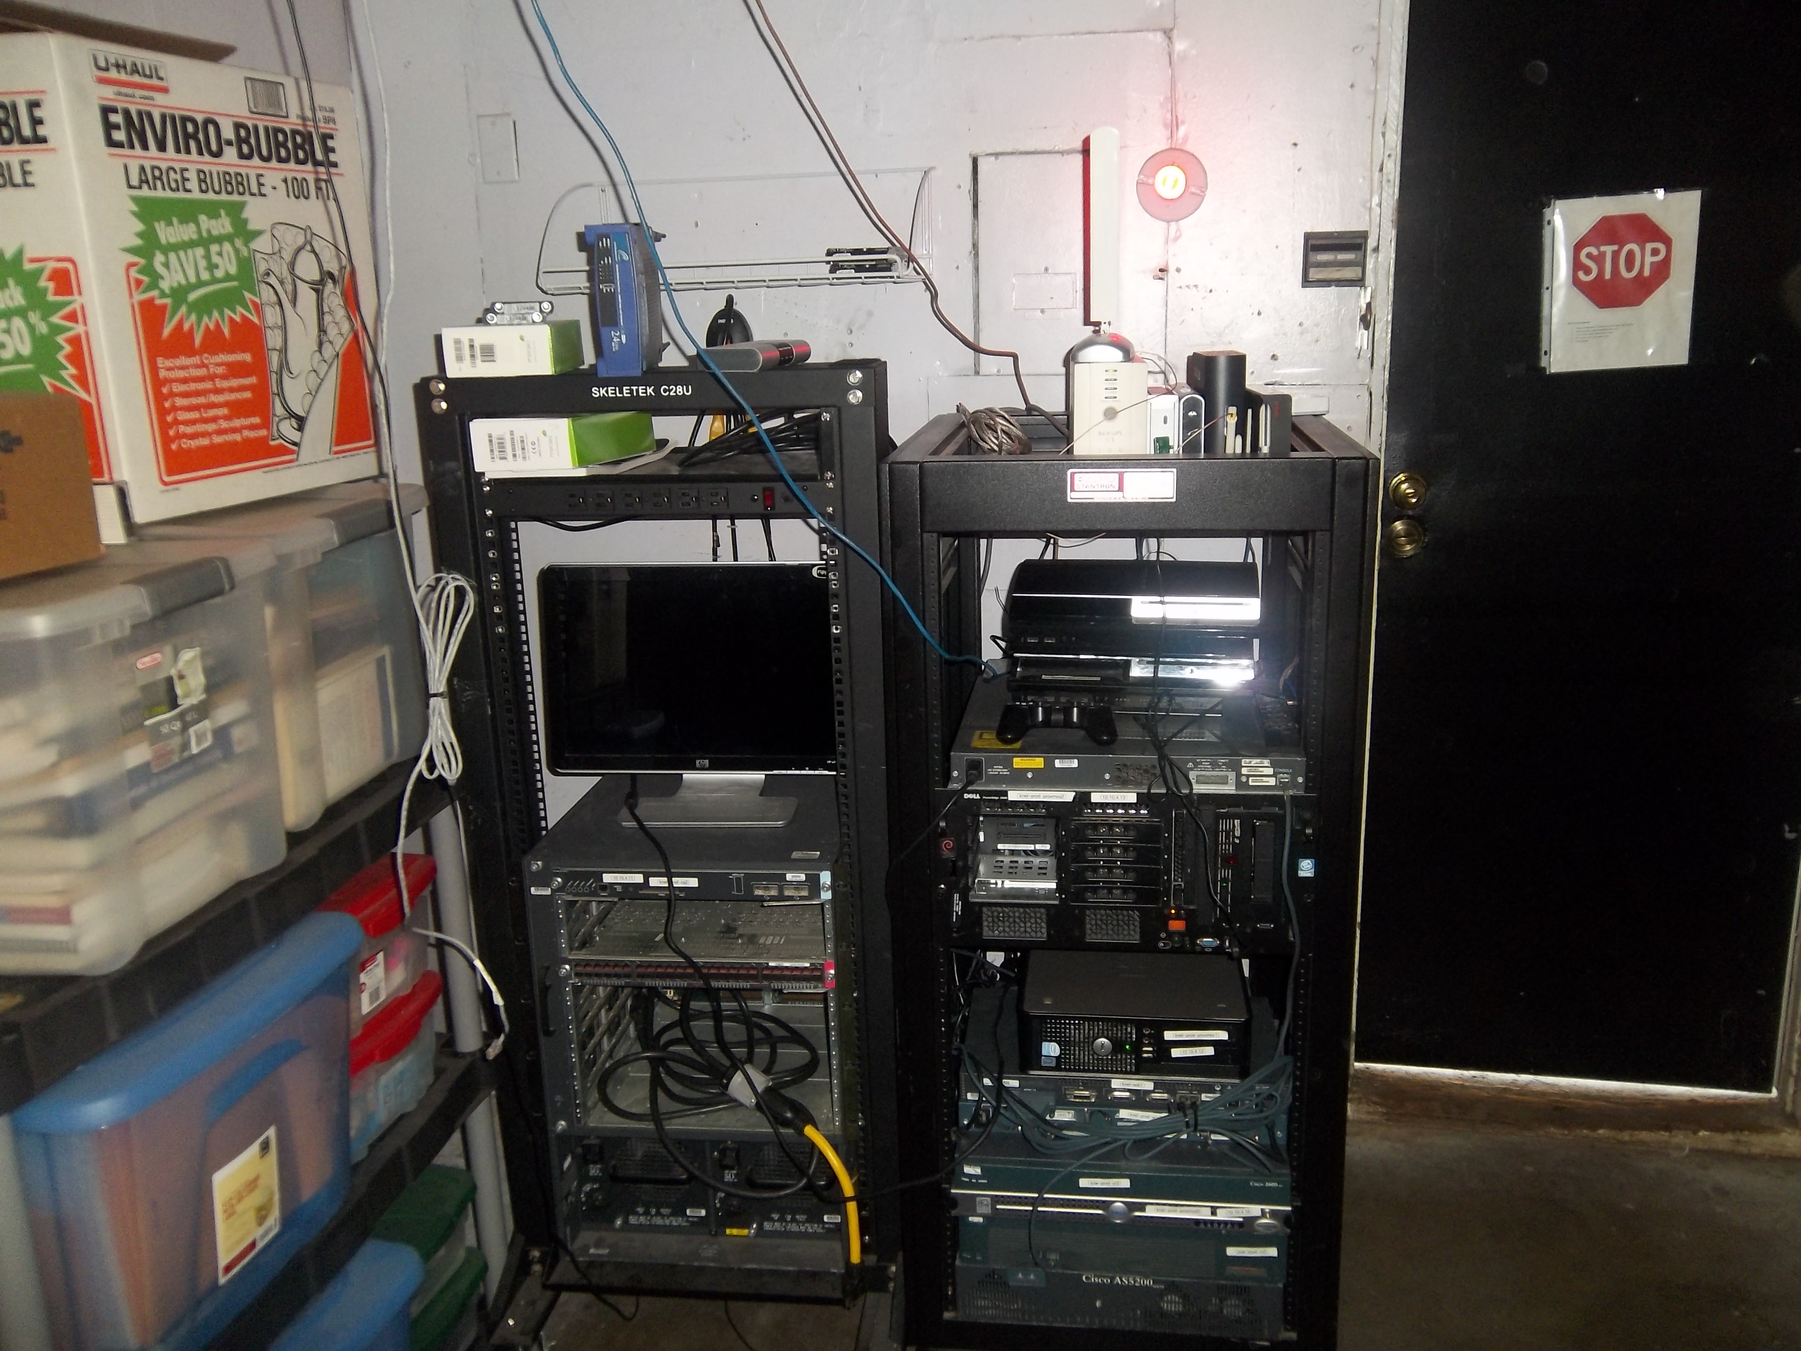

Slide 19
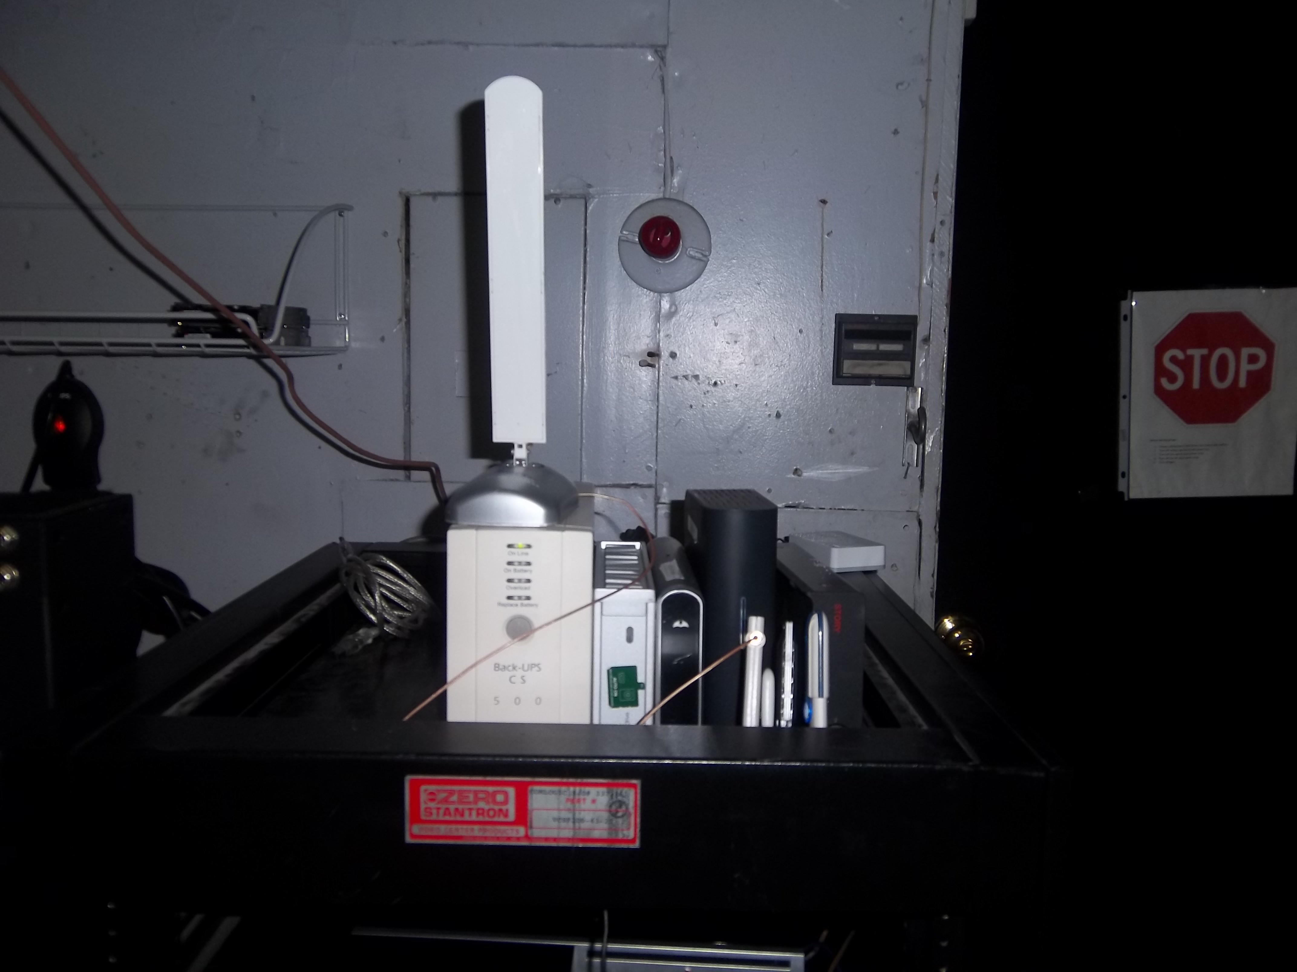
Closeup top of prod rack

Slide 20
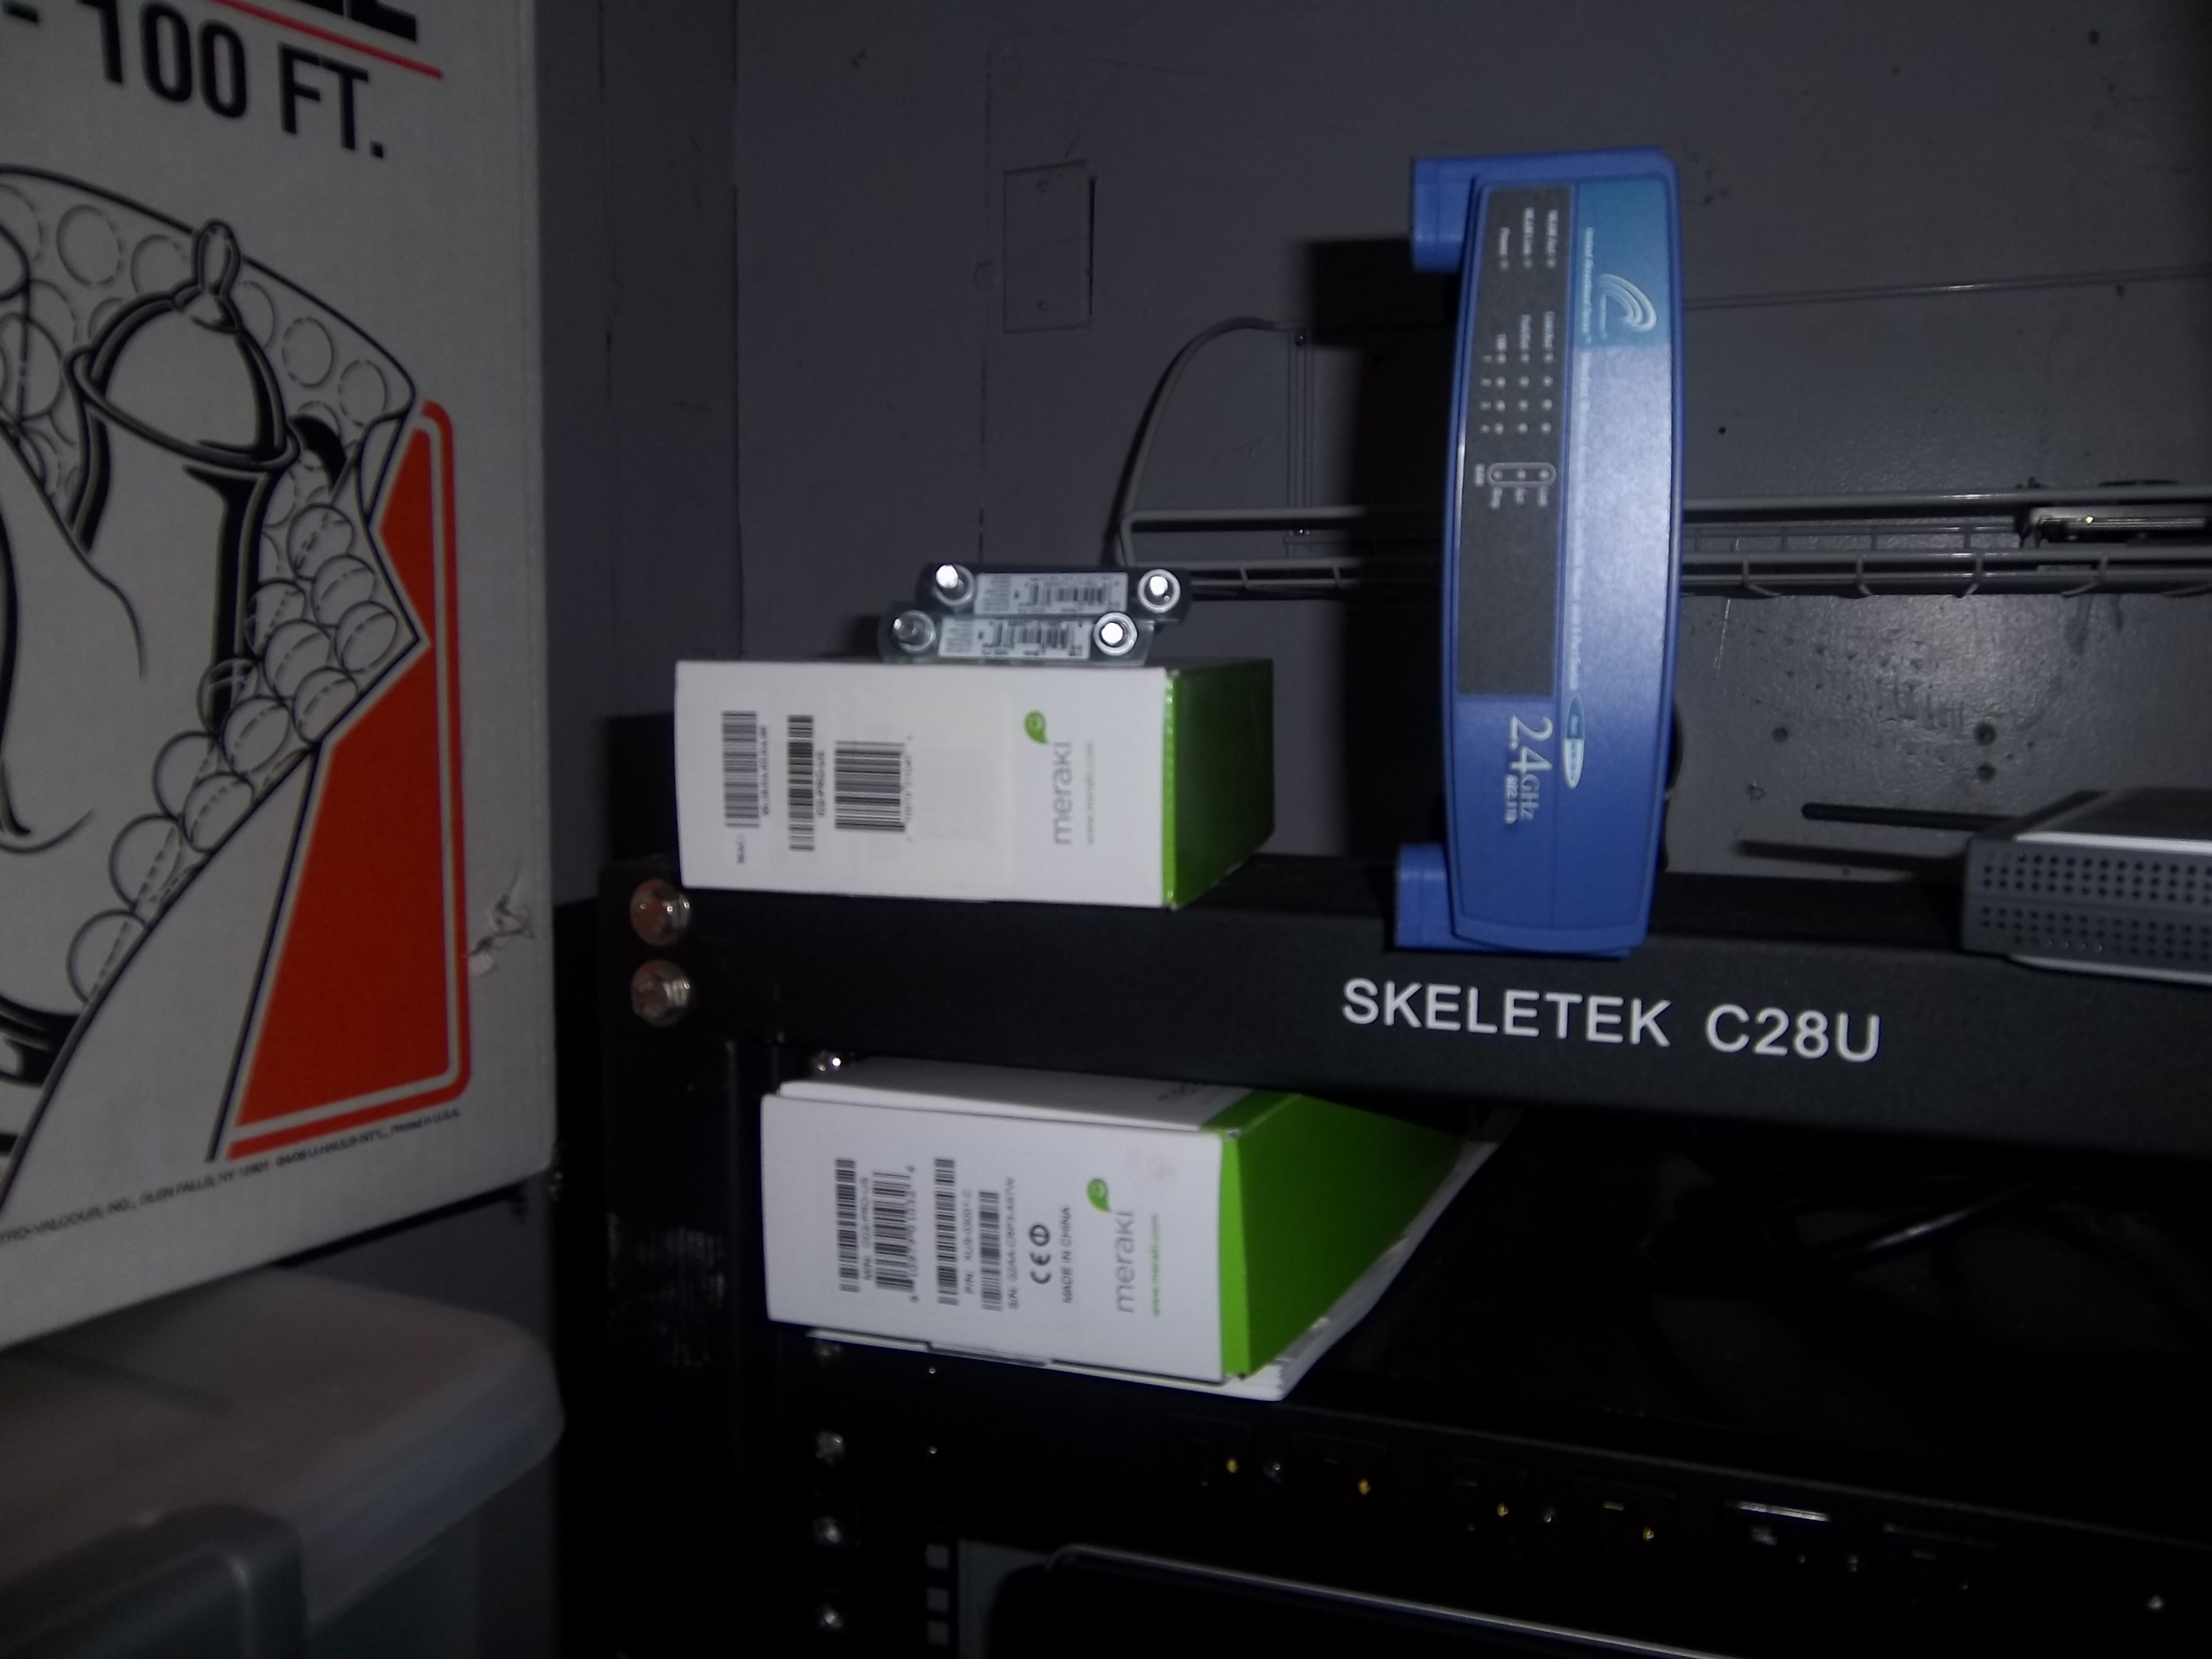
Closeup top dev rack...

Slide 21
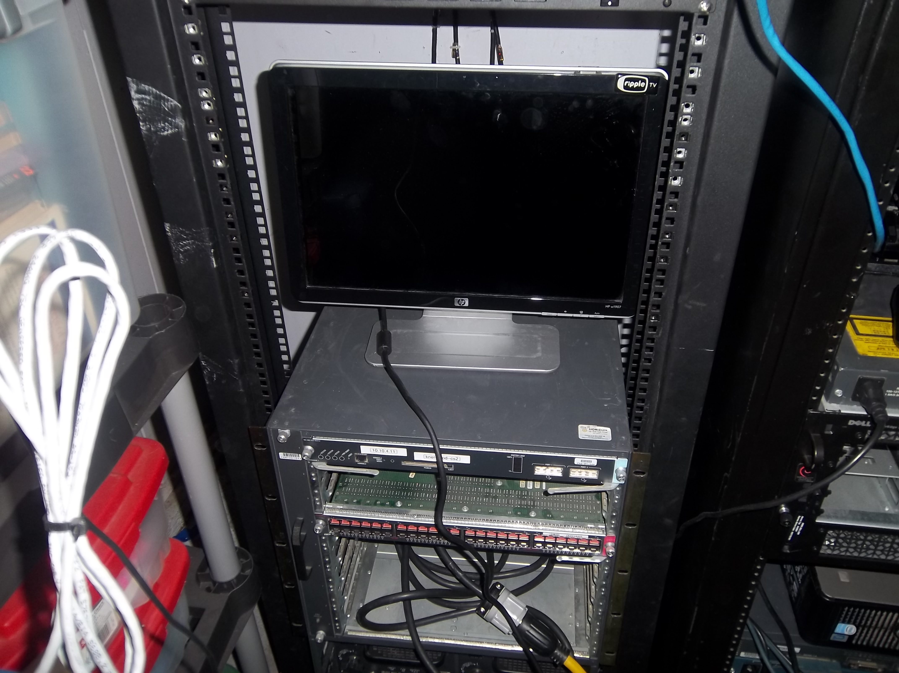
Closeup Dev rack...

Slide 22
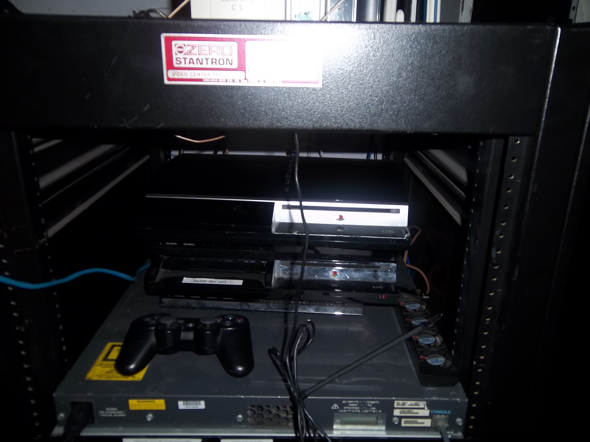
Closeup prod rack...

Slide 23
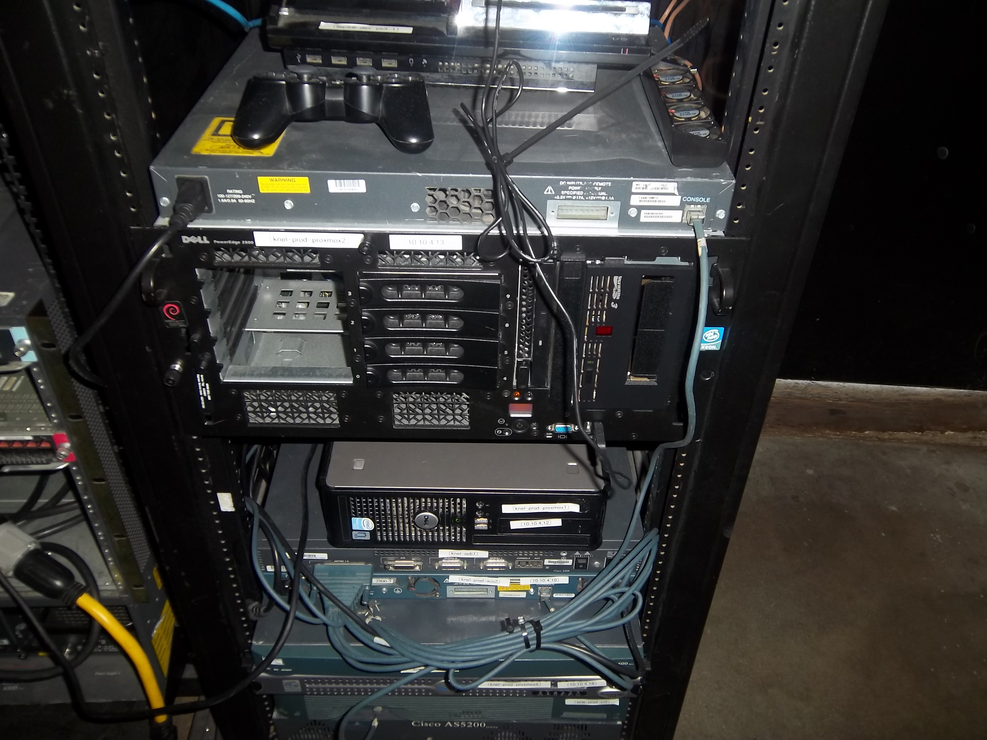
Closeup prod rack..

Slide 24
Software Infrastructure
Past Setup:
  Operating System: Ubuntu 9.10 server
  E-mail (postfix/dovecot)
  Voice/data/text communication (bigbluebutton/Jabber/Freeswitch/Asterisk/WWW/LDAP
  All on one VLAN
Current Setup:
  Operating System: Proxmox
  Everything runs in it's own Ubuntu OpenVZ guest
    Except for LAMP apps which share a VM
  I'll have a demo later on that shows the proxmox awesomeness.

Slide 25
How do I protect the software/hardware investment?
4 major areas
  Local and offsite backups / disaster recovery
  Application/OS security
  Availability/performance monitoring/alerting/reporting
  Documentation!!!
This has been the hardest part of the project

Slide 26
  Local and offsite backups / disaster recovery
local storage (usb)
  cost effective
  want off site and rotation? just buy a few drives
  easy to implement
  restores very nicely

Slide 27
  Local and offsite backups / disaster recovery
s3
  cost effective
  off site
  easy to implement
  you wanted to actually restore those backups? :)
Rackspace
  Same as above really.
How do they perform?
  Come to my MediaTemple presentation at LOPSA-LA in February to find out. Maybe I'll have it figured out by BarCamp SanDiego?

Slide 28
  Local and offsite backups / disaster recovery
Replication / active active architecture
o mysql
o dns
o apache
o linux ha
UNDER CONSTRUCTION
  Come to my MediaTemple presentation at LOPSA-LA in February to find out. Maybe I'll have it figured out by BarCamp SanDiego?

Slide 29
Security
Software/logical
  snort/mod_security
  greensql
  logwatch
  openvas
Physical
  alarm system
  dogs
  bolting the gear to the rack
  Other stuff

Slide 30
Monitoring
Internal
  OpsView
  Netdisco
  Rancid
  Apt-get install snort logwatch (nice daily summarys of system activity)
External
  Nothing at the moment. Evaluating Pingdom and Keynote

Slide 31
Will it blend?
Was/is it sustainable/secure/green (money and energy wise)?
  Did I get hacked (yes actually. More details later in deck)
  Was my data shared how/where/when I want with (only) those that I wish to? Did I maintain integrity?
  How much did it cost (if you have to ask you can't afford it. ;)

Slide 32
Did it blend?
Eh not really.
Power usage ~200.00 per month

Slide 33
While we are being green..
How much does this cost (at home)
  Power
  Cooling
  Security
  Connectivity

Slide 34
While we are being green..
How much does this cost (not at home)
  Power
  Cooling
  Security
  Connectivity

Slide 35
The mostly part
Still using skype but have a migration path
Still using linkedin but have a migration path (foaf/web of trust)
  XMLResume is awesome!
  People find me based on resume searches/referall now.

Slide 36
Mostly...
Still using bing.com for search, g00g maps for directions.
  Expensive to solve in a centralized fashion.
  Cheap to solve in a distributed fashion
Still using the completely insecure public GSM network (have a migration path – socalwifi.net)
  This is getting much closer to reality.
  Watch my twitter stream for updates

Slide 37
Resources
Lots more info at http://wiki.knownelement.com/index.php/Data_Ownership
Keep an eye on www.knownelement.com as I find, implement and use even more data ownership systems.

Slide 38
Oh yeah... I got hacked
Lessons learned
  HTTP proxys really need to be properly configured
  Open mail relays? Those get found fast

Slide 39
DEMO TIME
Lets see some data ownership support activity in action
  Provision a vm
  Setup firewall rules
  Deploy services
    Sorry no fancy cfengine/puppet/chef/bcfg yet.
  Security
  Sunset

Slide 40
I'll be back
I'll have some more to talk about
  Getting paid to work on some really cool stuff in the area of Linux networking (wired and wireless). Trying to find an answer to the question ”Is it possible to run a network 100% on open source hardware/software?”
  Working on some security research (honeynets/honeypots/parallel cracking and fuzzing)
  High finance hacking anyone? ;) (see me after to discuss (away from the cameras)

Slide 41
Parking Lot Sale
Lots of gear in my car for sale. CHEAP CHEAP CHEAP

Slide 42
Austin Bound
See ya Los Angeles!
Oh yes. 42 slides in this deck. Oh yeah!

