Slide 1

State Management With Context API
Is the React Context API killing Redux ?

Slide 2
Road Map
Origin of Context
Fundamentals
Basic Implementation
Centralized Store
How to choose a state management solution for your app
Context vs Redux

Slide 3

Where is Context API ?
React API
Been around since 2013
Designed to Alleviate “Prop Drilling”

Slide 4
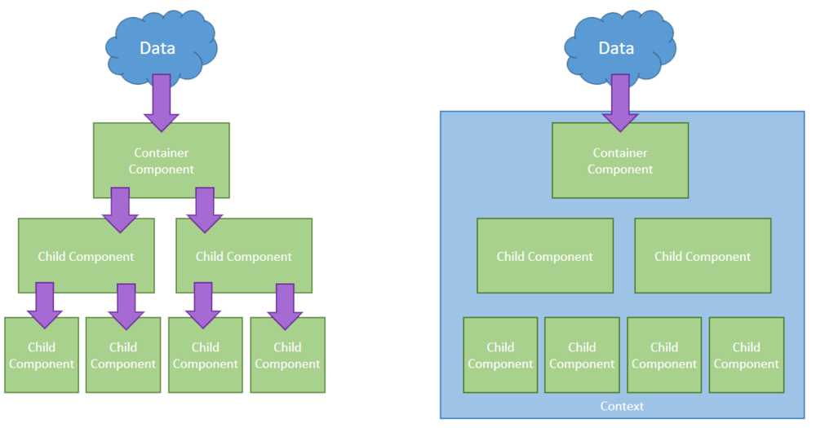
Prop Drilling
Context

Slide 5
Fundamentals
Context Instance
const MyContext = React.createContext();

Slide 6
Fundamentals
Provider
<MyContext.Provider value={/* some value */}>
{this.props.children}
</MyContext.Provider>

Slide 7
Fundamentals
Consumer
<MyContext.Consumer>
{contextValue => (
<div>I’m the context’s value:{contextValue}</div>)}
</MyContext.Consumer>

Slide 8

Basic Implementation
const MyContext = React.createContext();
const App = () => ( <MyContext.provider value={/* some value */}> <MyContext.consumer> {contextValue => (<div>
{contextValue}</div>)}
</MyContext.consumer> </MyContext.provider>);
);

Slide 9
Creating a Central Store With Context
Create a context
Declare a class that returns the Context Provider
Define the value prop as an object with properties such as :
a. The class’s state
b. Any functions that allow components at a lower level to modify state
Wrap that class around your top level component is ambiguous

Slide 10
const MyContext = React.createContext();
class CentralStore extends Component {
state = { name : ‘’ }
changeName = (name) => {
this.setState({ name });
}
render() {
return (
<MyContext.provider value = {{
...this.state,
changeName: this.changeName}}>
{this.props.children}
</MyContext.provider>
);
}
}

Slide 11

<CentralStore>
<TopComponent />
</CentralStore />
Central Store

Slide 12
Will Context API replace Redux ?
Local state or Global state ?
Do other parts of the application care about this data?
Do you want to cache the data (ie, use what's in state if it's already there instead of re-requesting it)?

Slide 13



React Context API
Flexible
Included in React Library
Minimum Setup
Newer / Smaller ecosystem
Redux
Opinionated
Import Outside library
Developer tools
Substantially more boilerplate

Slide 14
Thank you
Tahere Gholami FrontEnd Developer @SnappGroup

