Slide 1
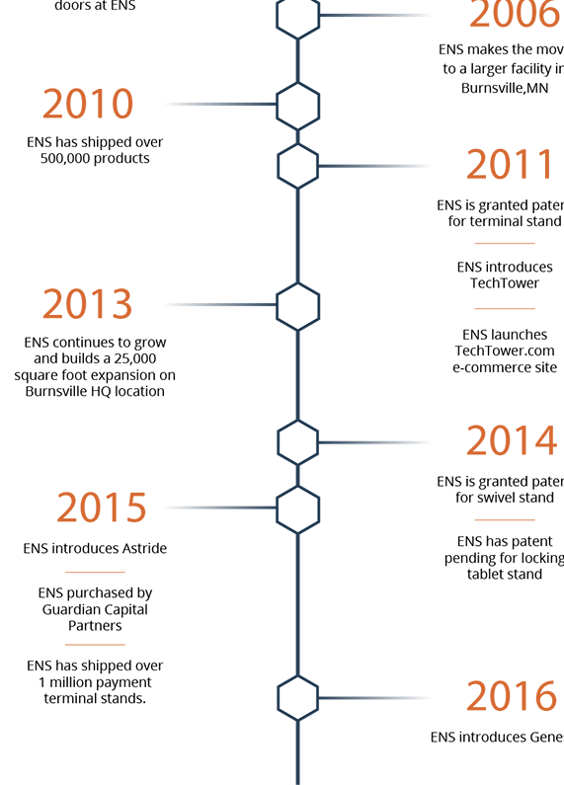
1990
HTML, CSS and JavaScript are invented
1995
Standardization efforts begin. Browser compliance is terrible. Browser wars ignite.
2000
CSS frameworks begin to emerge. jQuery is born. Frontend package management.
2005
2010
W3C specification compliance is met. Chrome browser takes the lead. Responsive designs and frameworks are introduced.
JavaScript Frameworks are born i.e. Backbone, Ember, AngularJS, React, Angular, Vue. HTML5 is announced.
2016
GraphQL emerges. Native HTML, CSS & JavaScript become more powerful. New platforms built on-top existing JavaScript frameworks emerge: StoryBook, Motion UI, Gatsby, Next.js.
Increasing Complexity

Slide 2
Complexity Origins
* Diversification
* Higher Quality Bar
* Massive Market Growth

Slide 3

Diversification

Slide 4
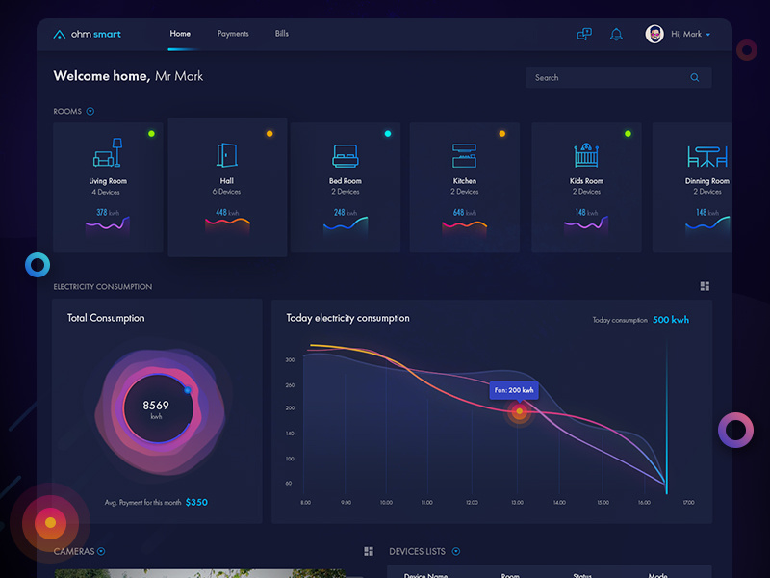
Higher Quality Bar

Slide 5
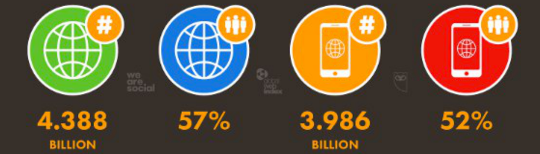
Massive Market Growth

Slide 6
Frontend development
* Soft Real-Time
* Distributed
* Asynchronous
* Reactive

Slide 7
Library
Is essentially a set of functions that you can call, these days usually organized into classes. Each call does some work and returns control to the client.

Slide 8
Framework
Embodies some abstract design, with more behavior built in. In order to use it you need to insert your behavior into various places in the framework either by subclassing or by plugging in your own classes. The framework's code then calls your code at these points.

Slide 9
Library is a tool.
A Framework is a way of life.

Slide 10
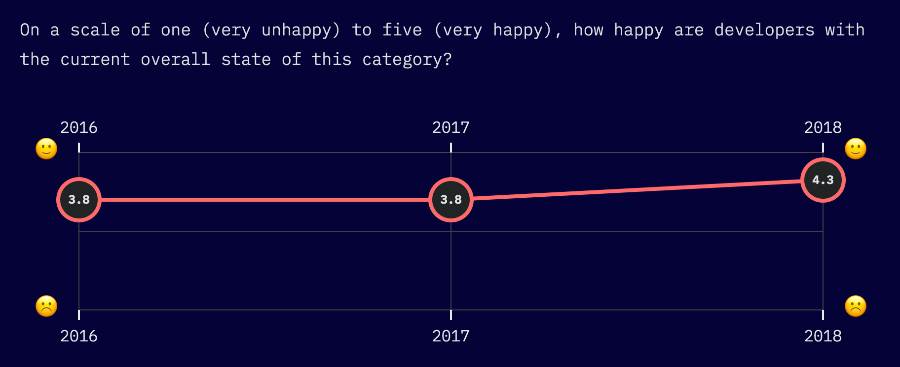

Slide 11
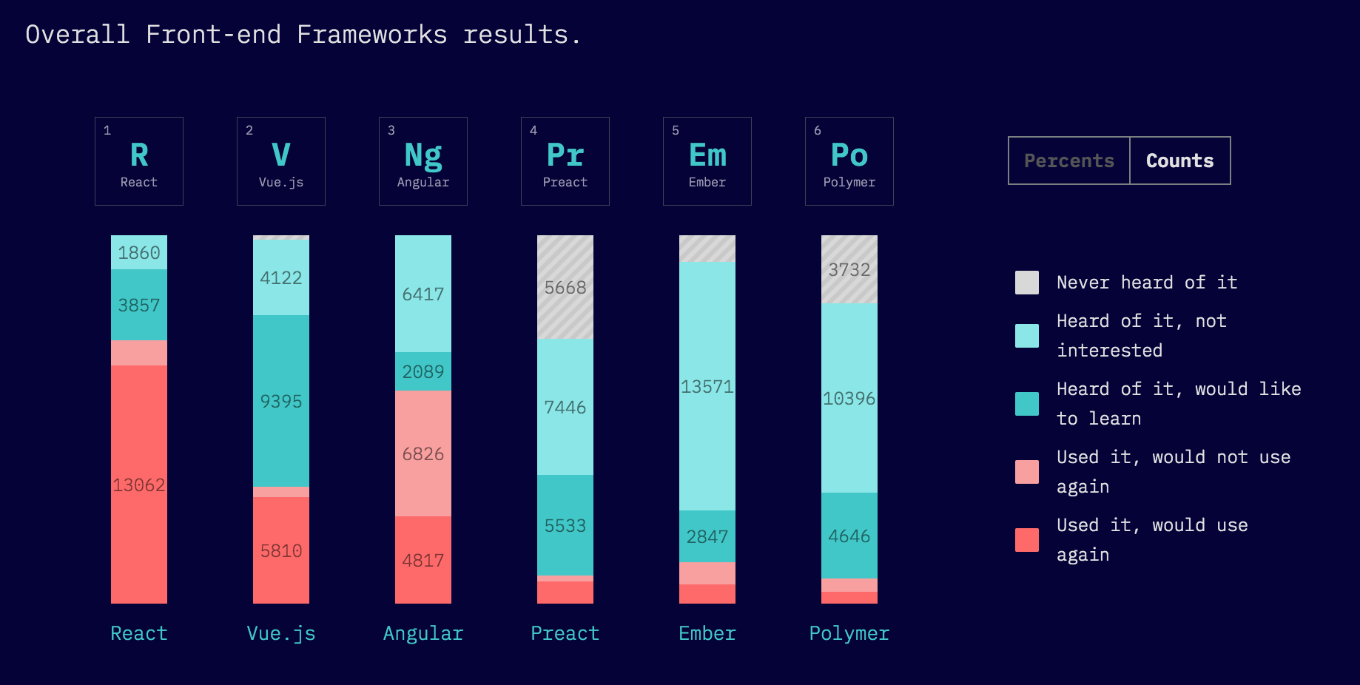

Slide 12
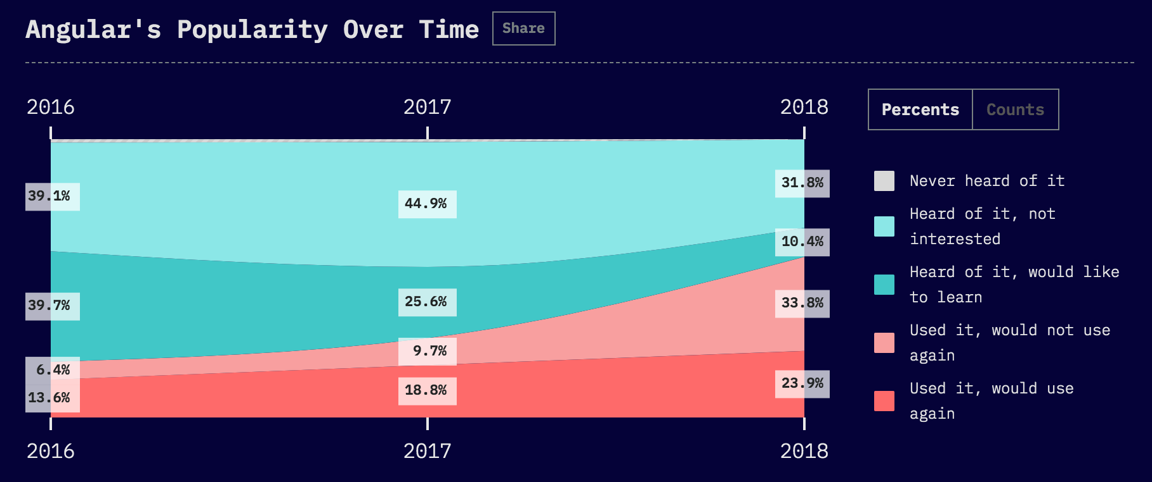

Slide 13
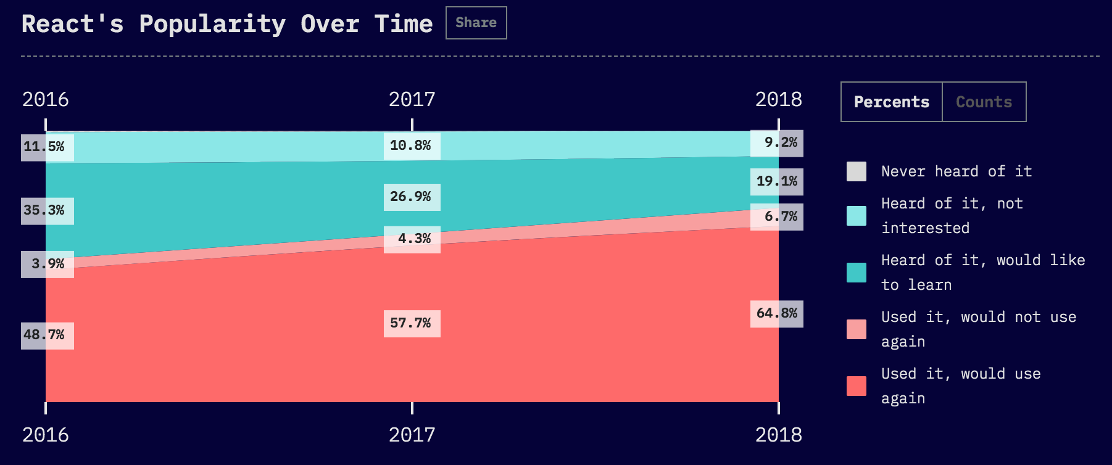

Slide 14
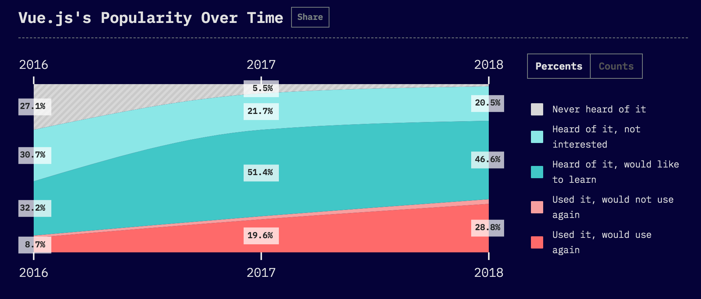

Slide 15
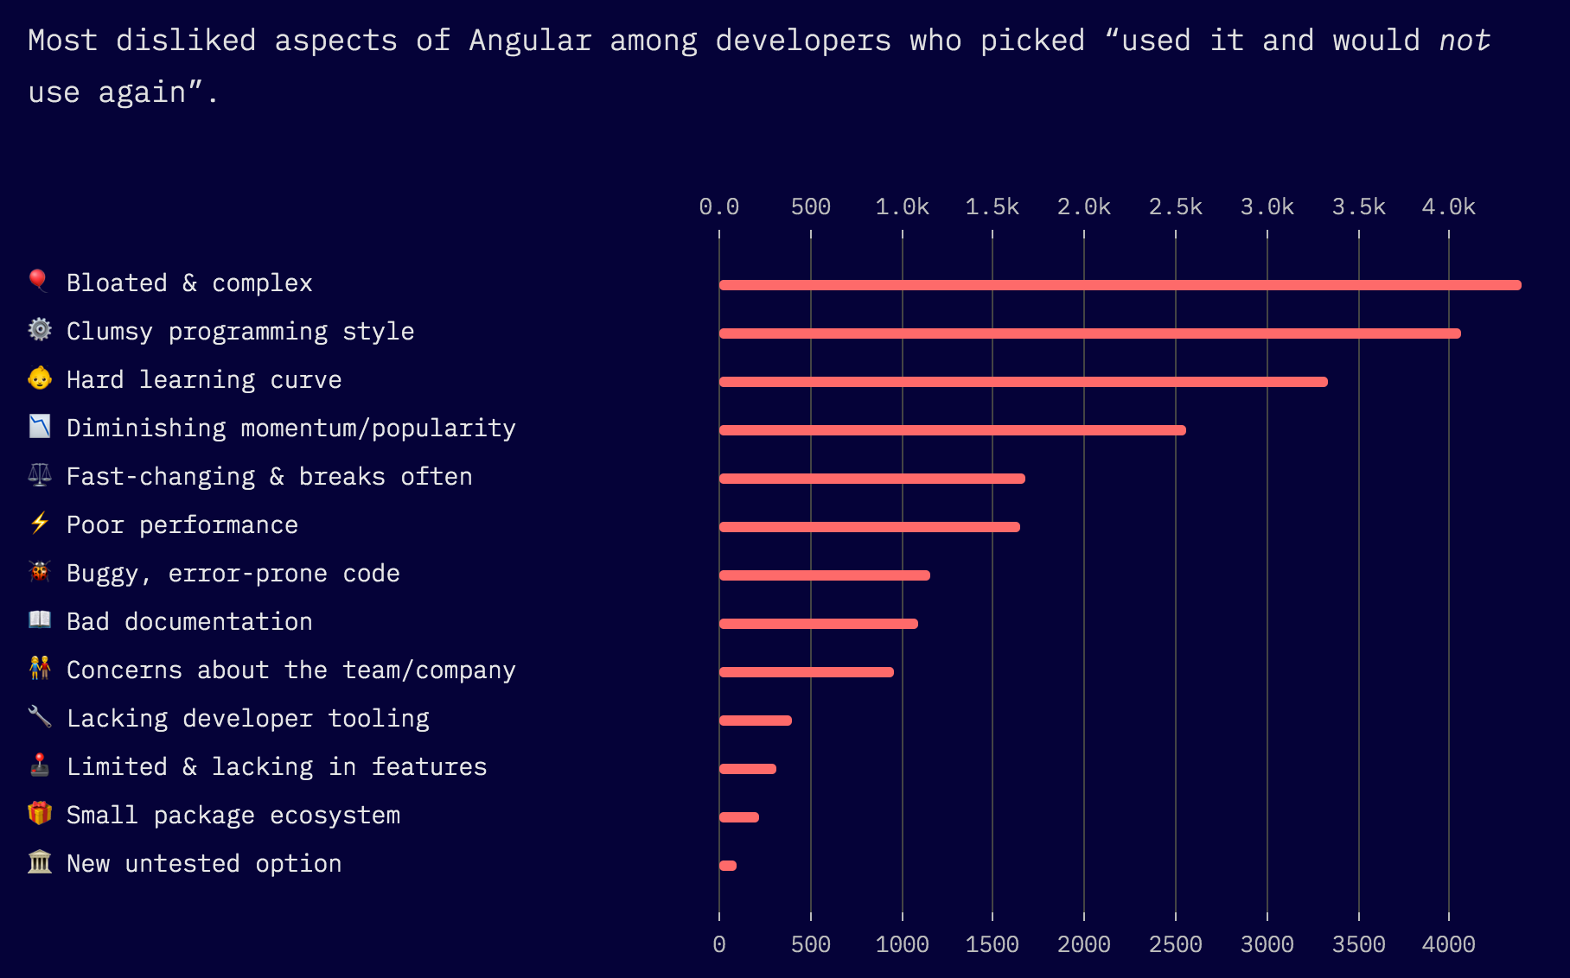

Slide 16
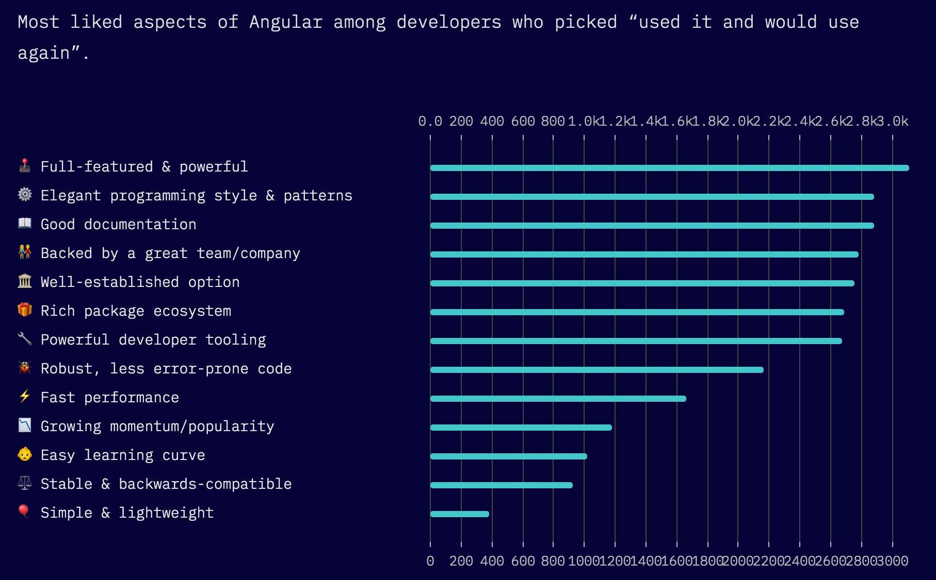

Slide 17
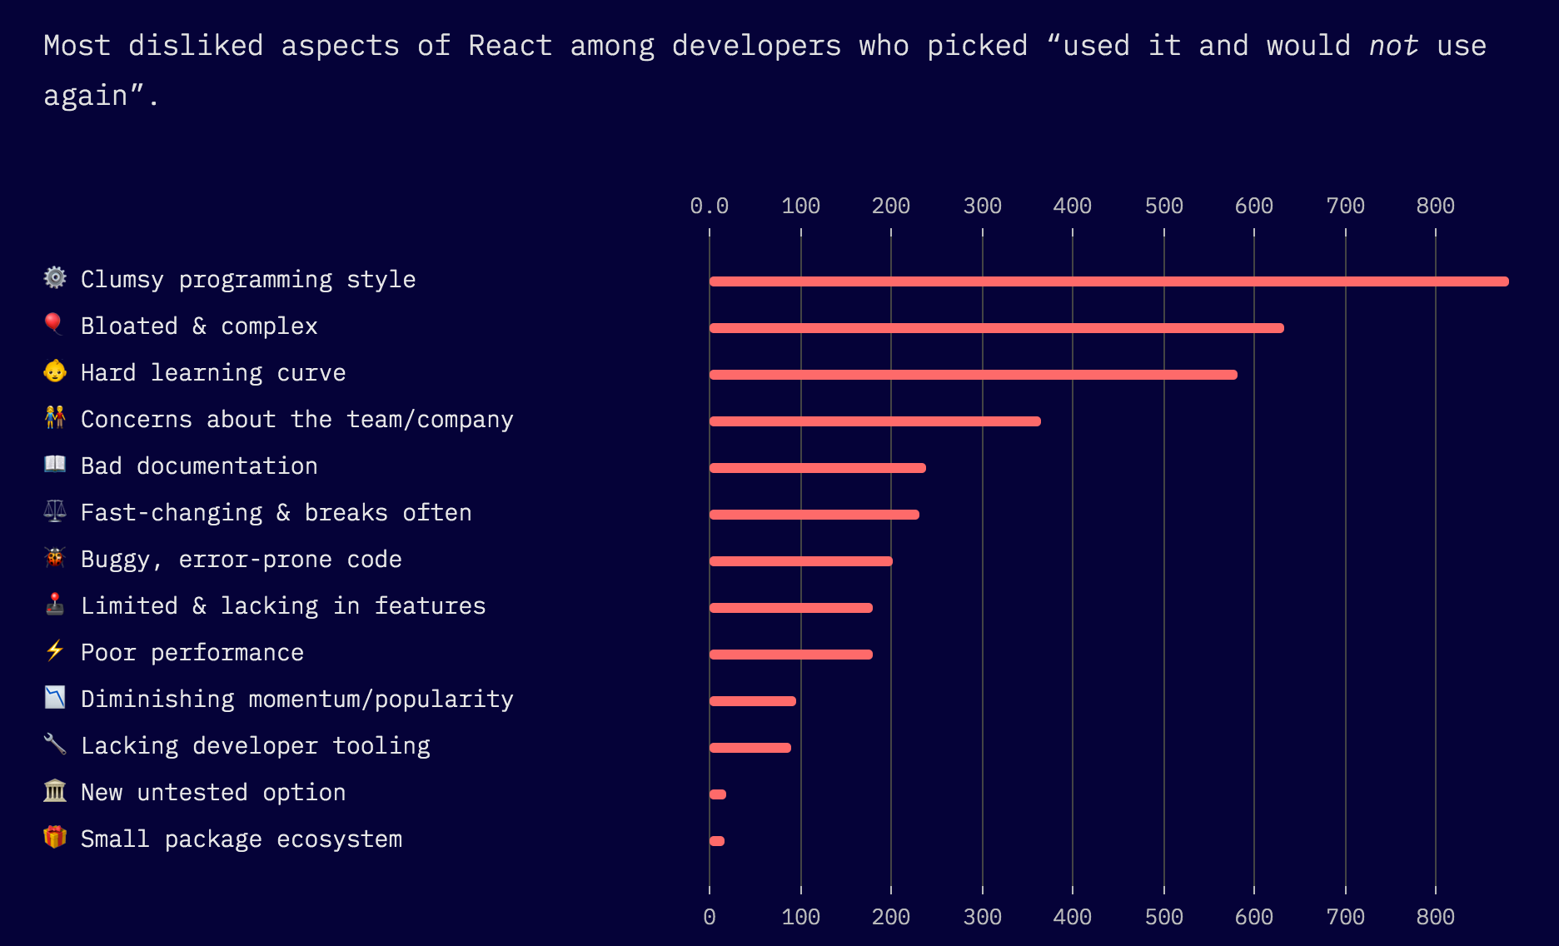

Slide 18
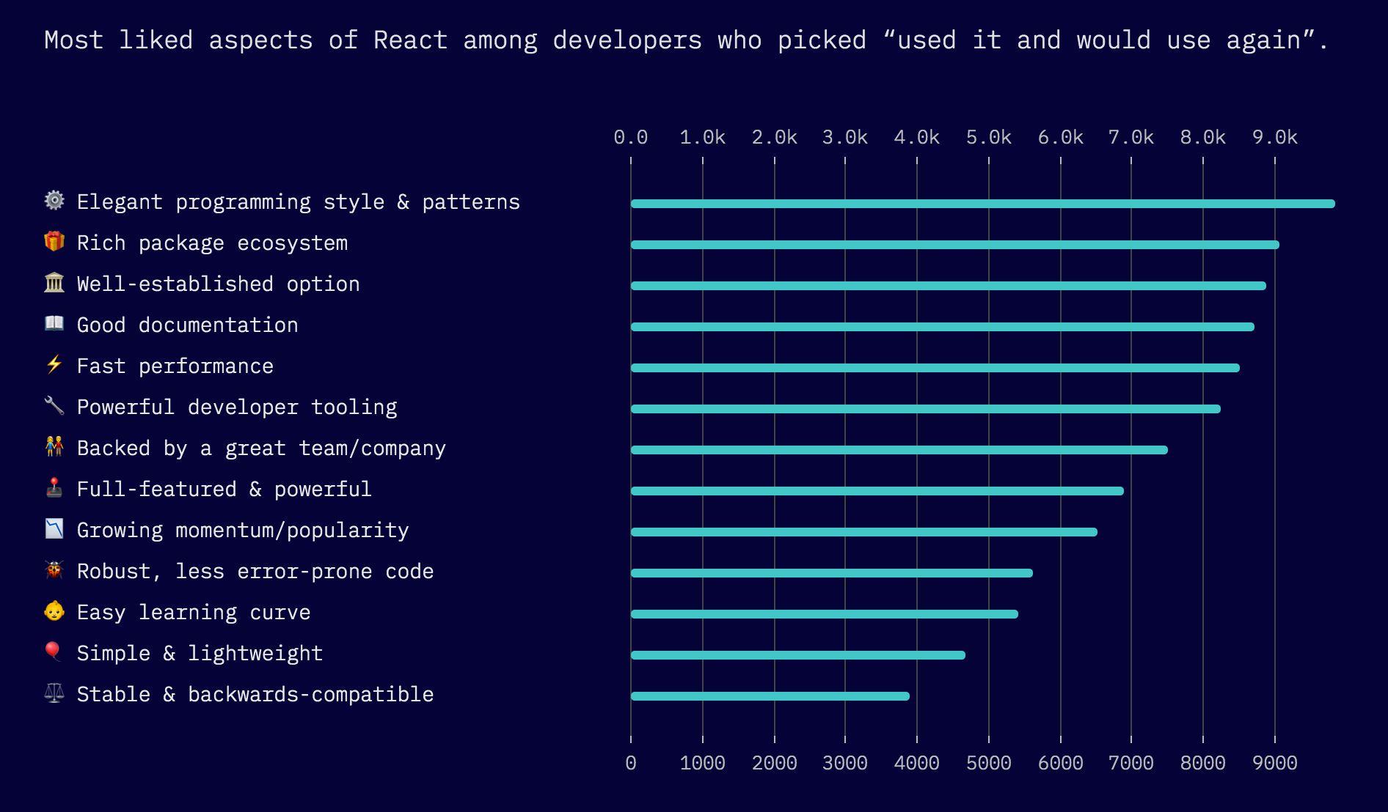

Slide 19
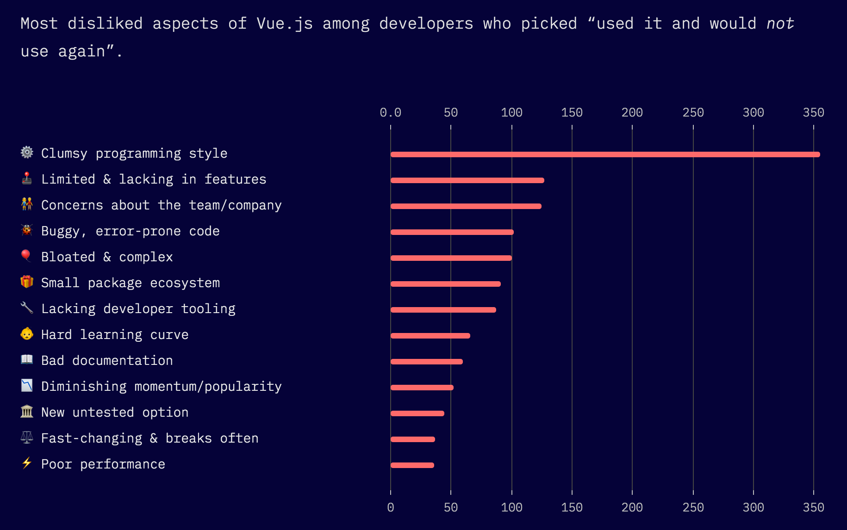

Slide 20
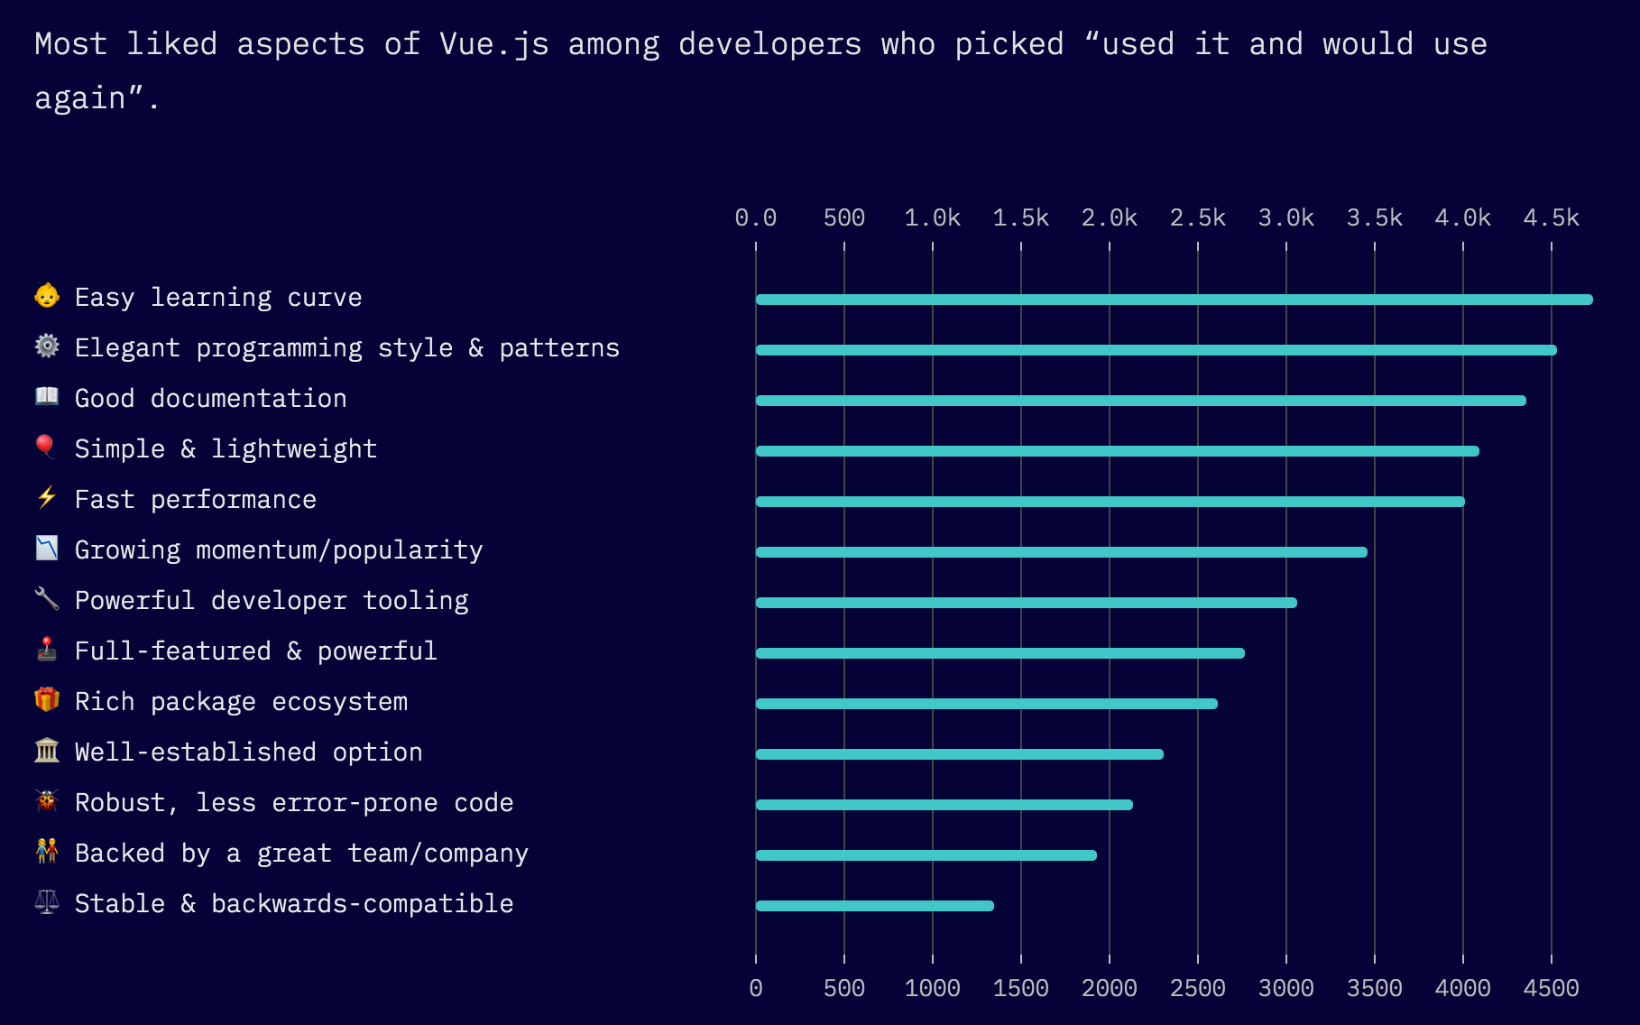

Slide 21
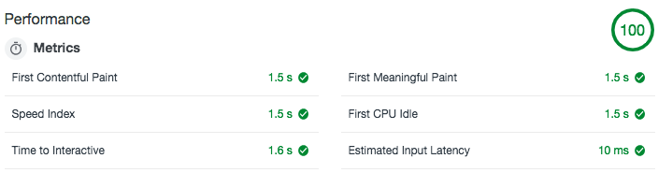
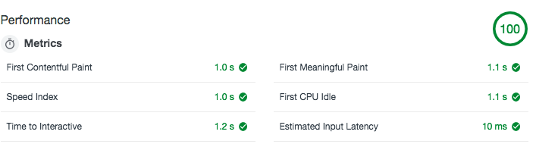

Angular
React
Vue.js

Slide 22
Bundle Size:
Angular: 218 React: 112 Vue: 83

Slide 23
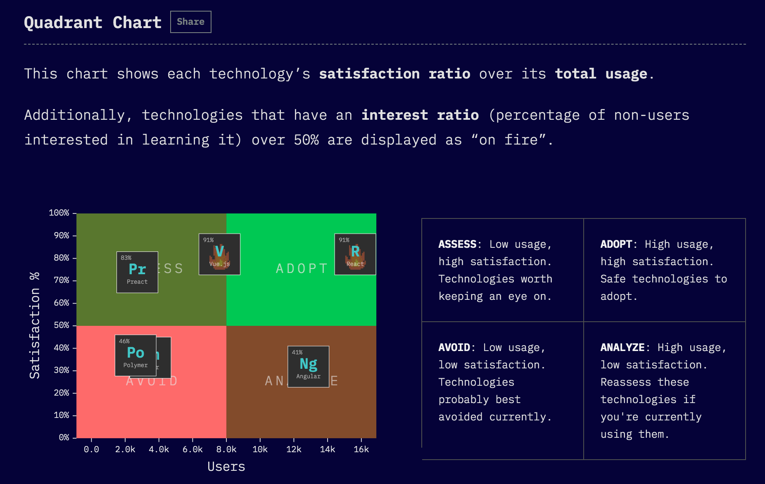

Slide 24
Script Runner
Bundle Manager
Type System
Styling
Data Fetching
Routing
Forms
Testing
State/Data Management
SSR
Two Way communication
Bad migim origins: diversification, higher quality bar, massive market growth
harvested framework
Tools

Slide 25
Framework
foundation framework
harvested framework

Slide 26
Script Runner & Bundle Manager
Grunts
Gulp
Browserify
Webpack

Slide 27
Type System
Typescript
Flow

Slide 28
Styling
CSS Modules
Styled component
Emotions

Slide 29
State Management
Mobix
Redux

Slide 30
Data Fetching
Axios
Fetch api
Superagent

Slide 31
Routing
React Router
Reach Router

Slide 32
Forms
Redux-forms
Formik

Slide 33
Test
Enzyme
React-testing-library

