Slide 1

Autocatalytic Cycle Patterns and Chemical Network Statistics
Jessica Ray
Mentor: Dr. Jim Cleaves

Slide 2
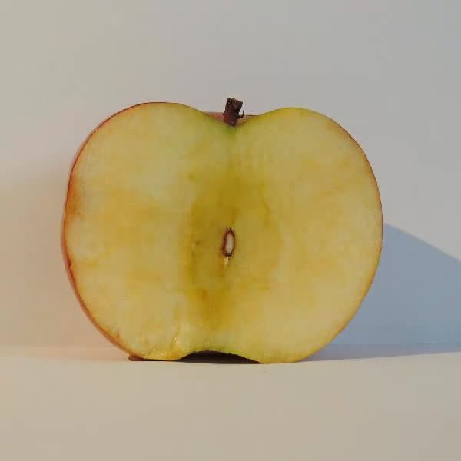
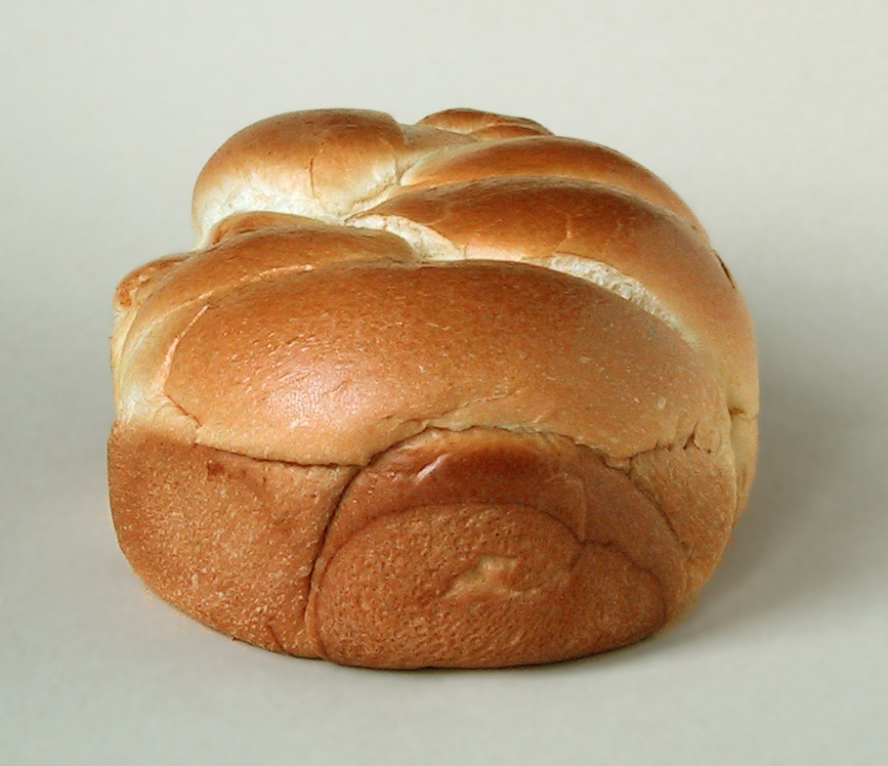
Background: Our Goal with Interesting Reactions
Formose Reaction
Maillard Reaction
What if we had software where we could give it a list of input molecules and reactions, the software would generate an entire chemical network filled with chained reactions? Then, the software would analyze the network to give the user a high-level report to describe the network?

Slide 3
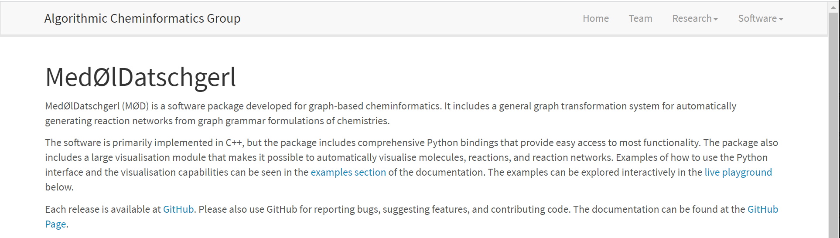
Background: Generating the Network
Creator: Dr. Jakob Andersen
https://cheminf.imada.sdu.dk/mod/

Slide 4
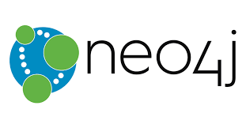
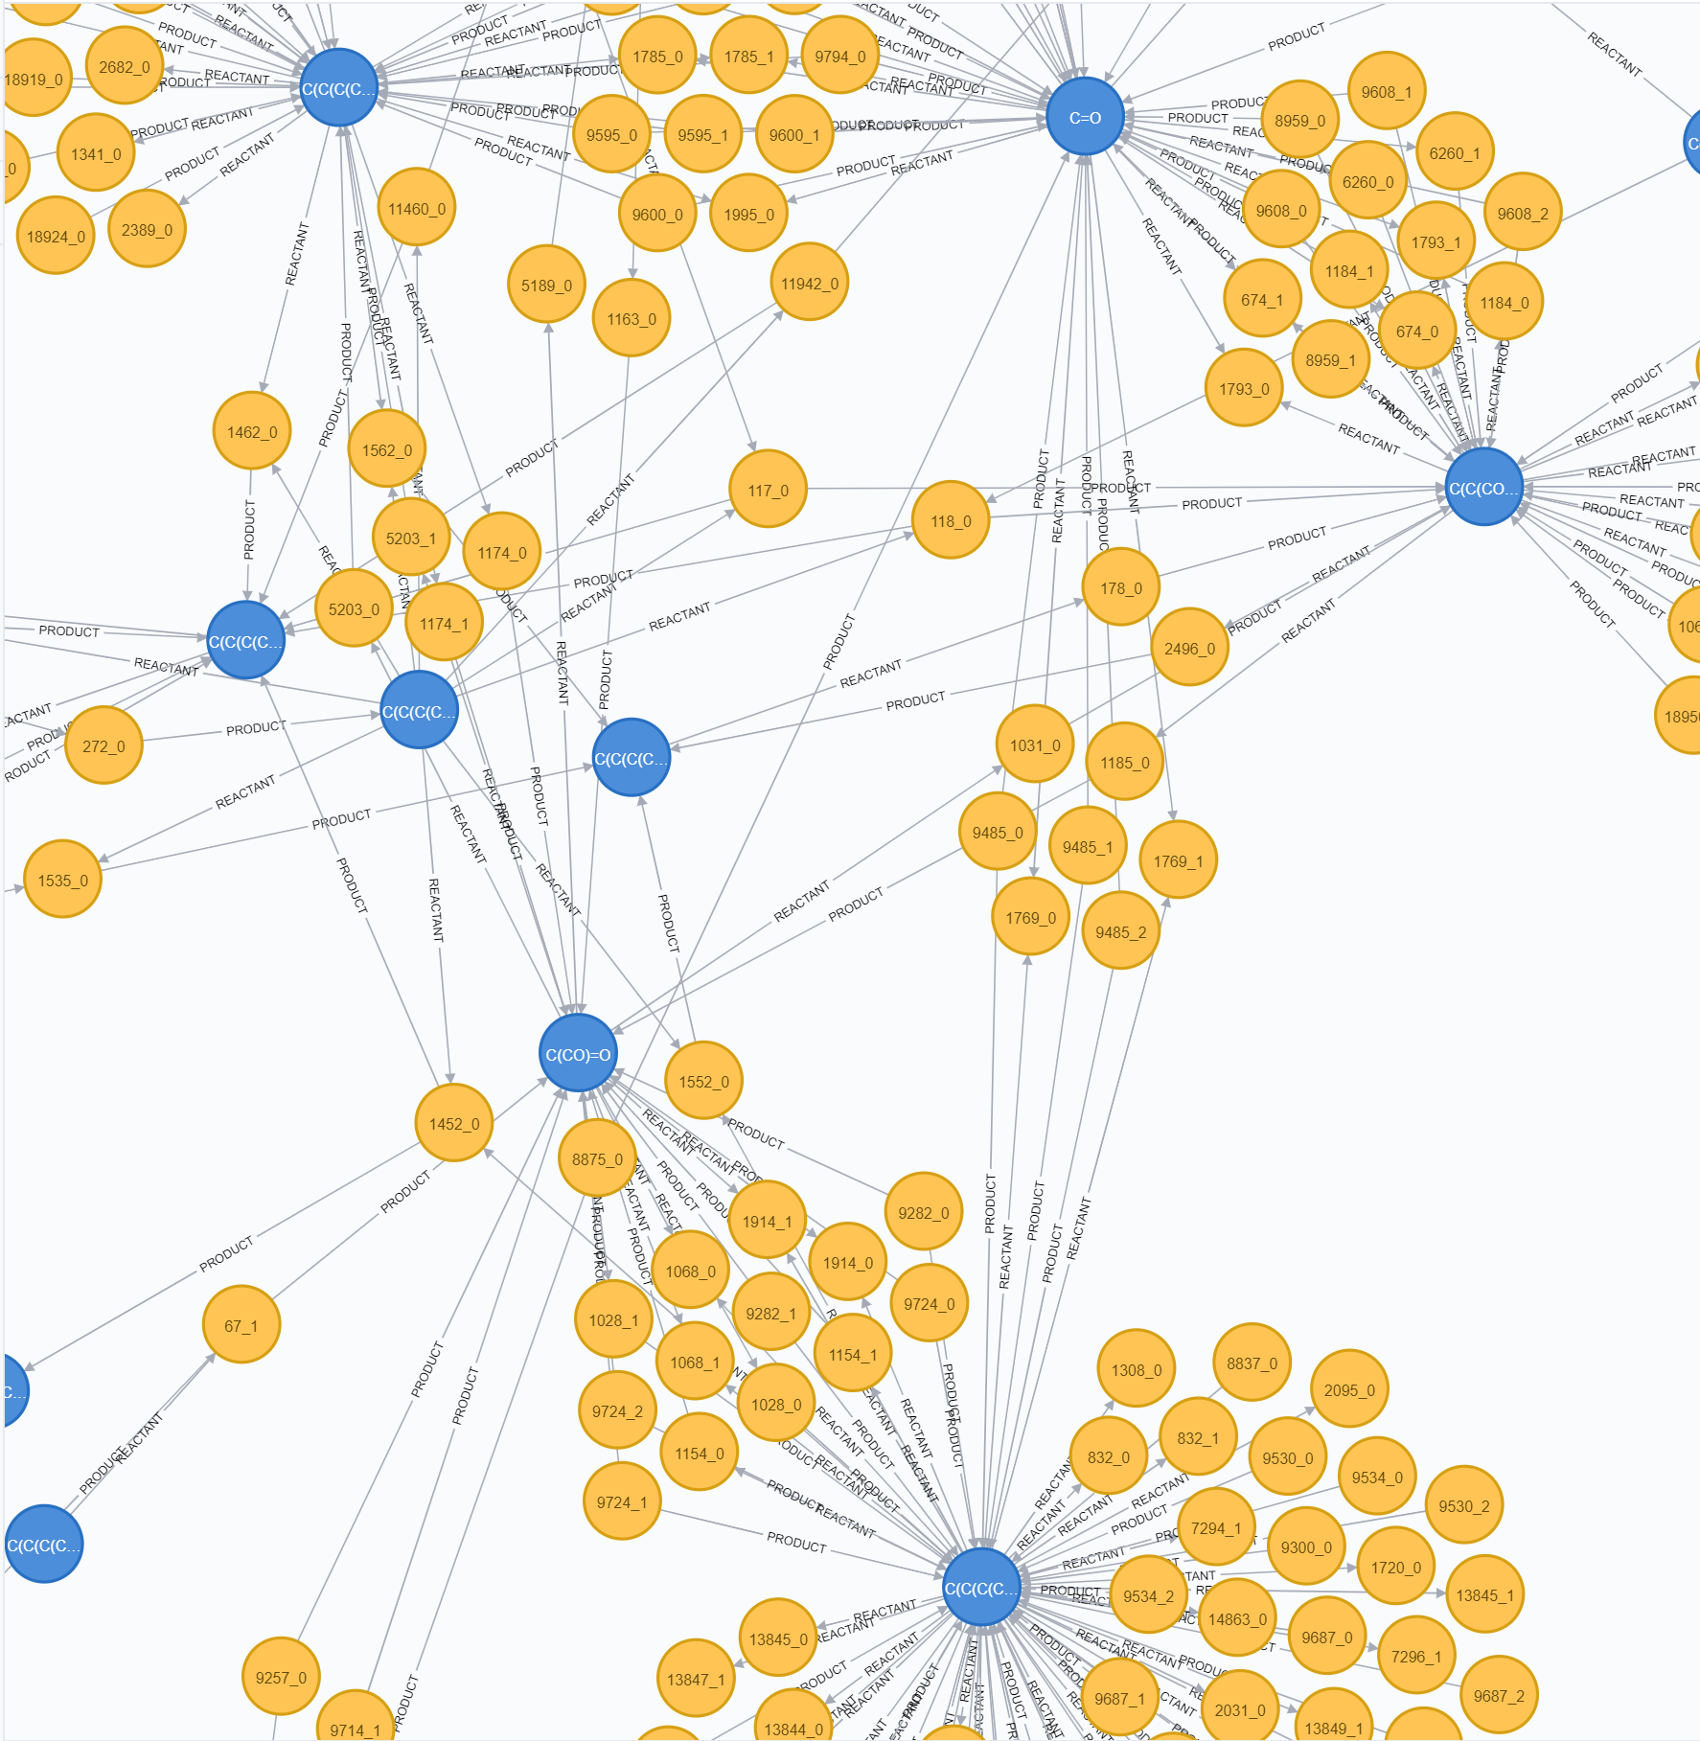
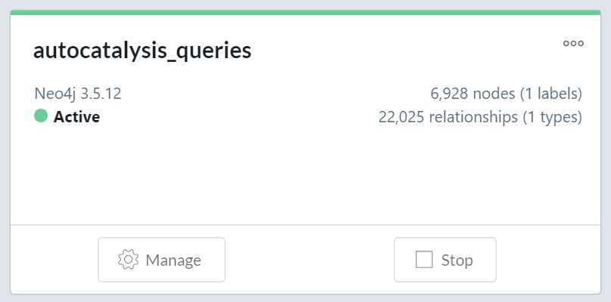
Analyzing the Network
Load the network into a graph database
Get some summary statistics on the network
Query for cycle patterns

Slide 5
Meta Graph Schema
PRODUCT
Molecule is a reactant of a reaction
Molecule is a product of a reaction
Molecule
Reaction
REACTANT

Slide 6
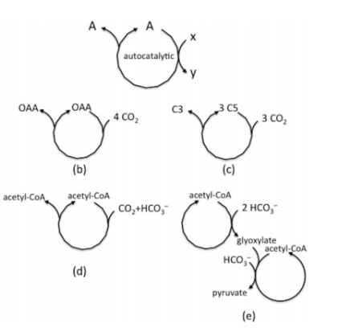
Autocatalytic cycle definition
Pereto et. al.

Slide 7
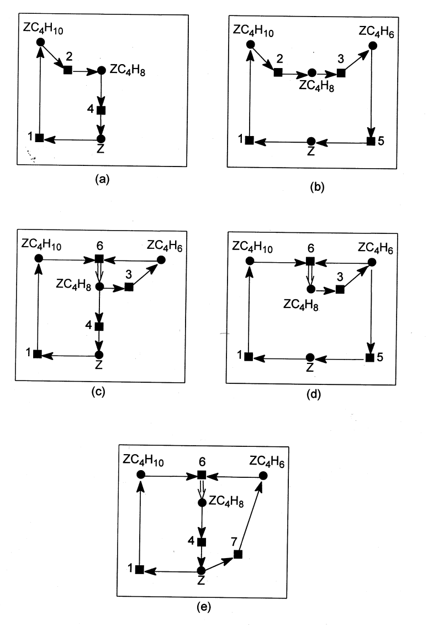
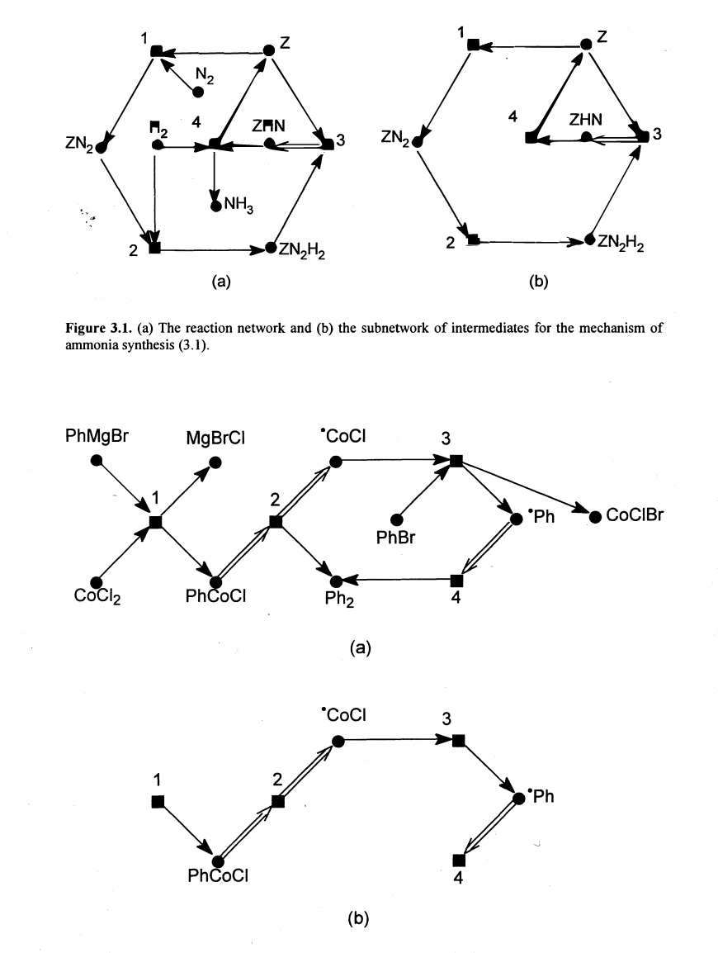
Autocatalytic cycles can come in many patterns
Temkin et. al.

Slide 8
Approaches for finding patterns in chemical network
Imperative approach:
Write a routine in a programming language to implement a graph algorithm to find patterns of interest
I.e. Ford-Fulkerson algorithm (implemented by Romulo)
Declarative approach:
Write a query to have a graph query engine come up with a graph algorithm to find patterns of interest
I.e. Neo4j and Cypher Query Language (CQL)
Linear algebra approach:
Come up with a current matrix and evaluate for flows (i.e. currents) in network
I.e. Clarke and Cupic-Belgrade papers

Slide 9
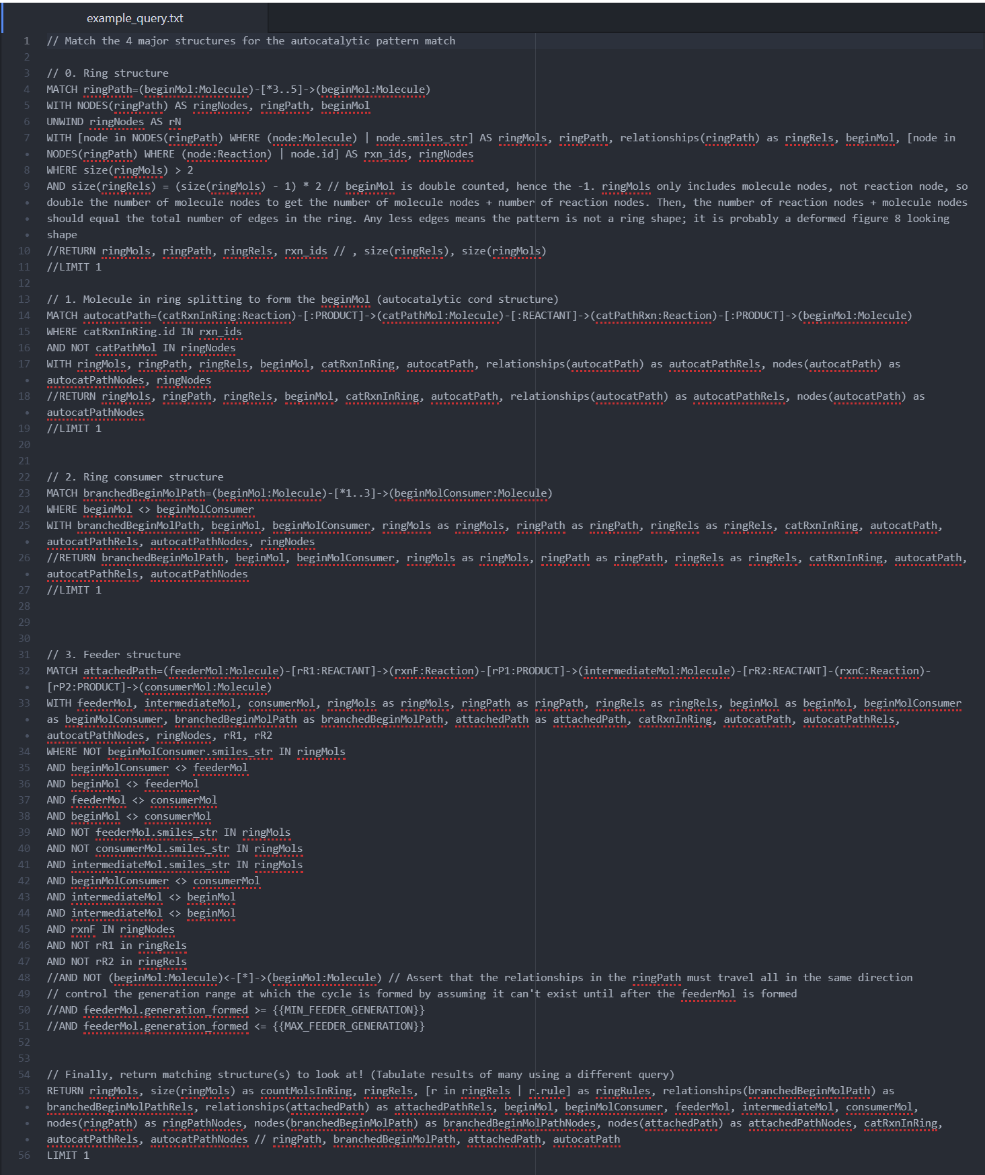
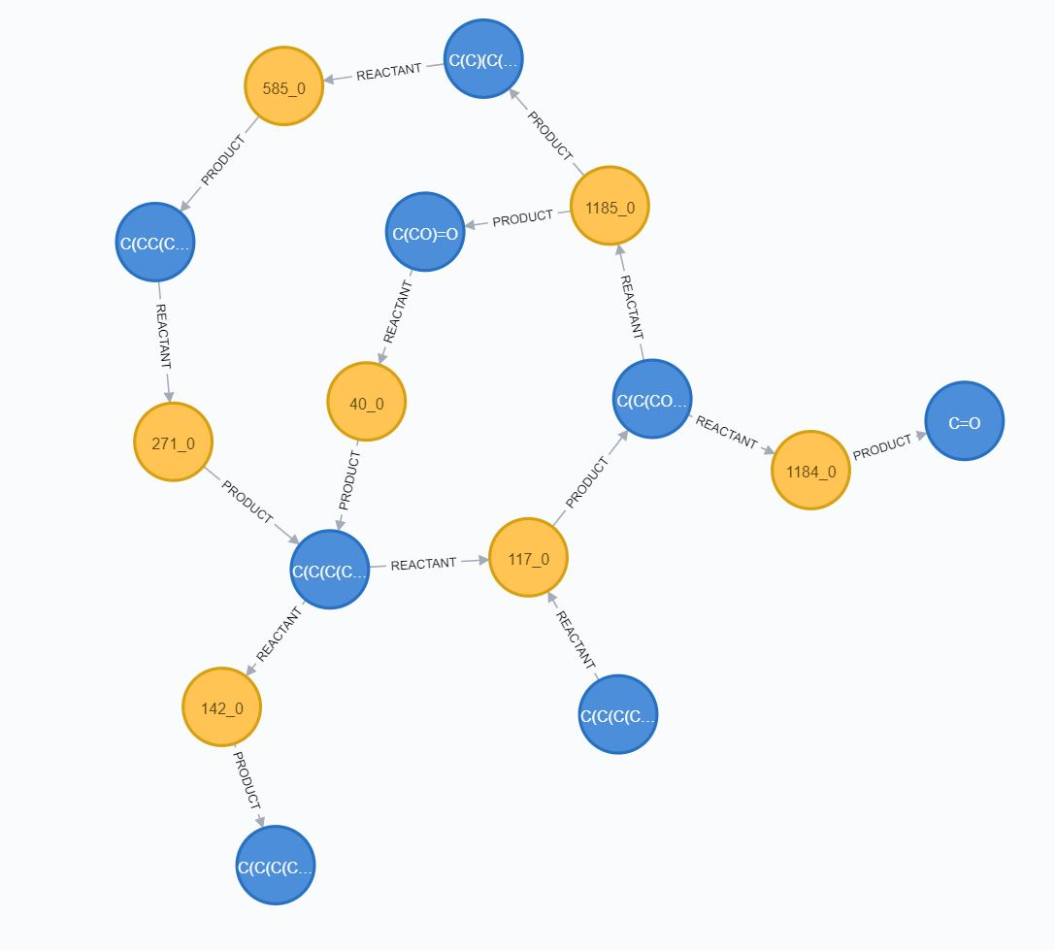
Declarative approach: A very specific query
Run in Neo4j

Slide 10
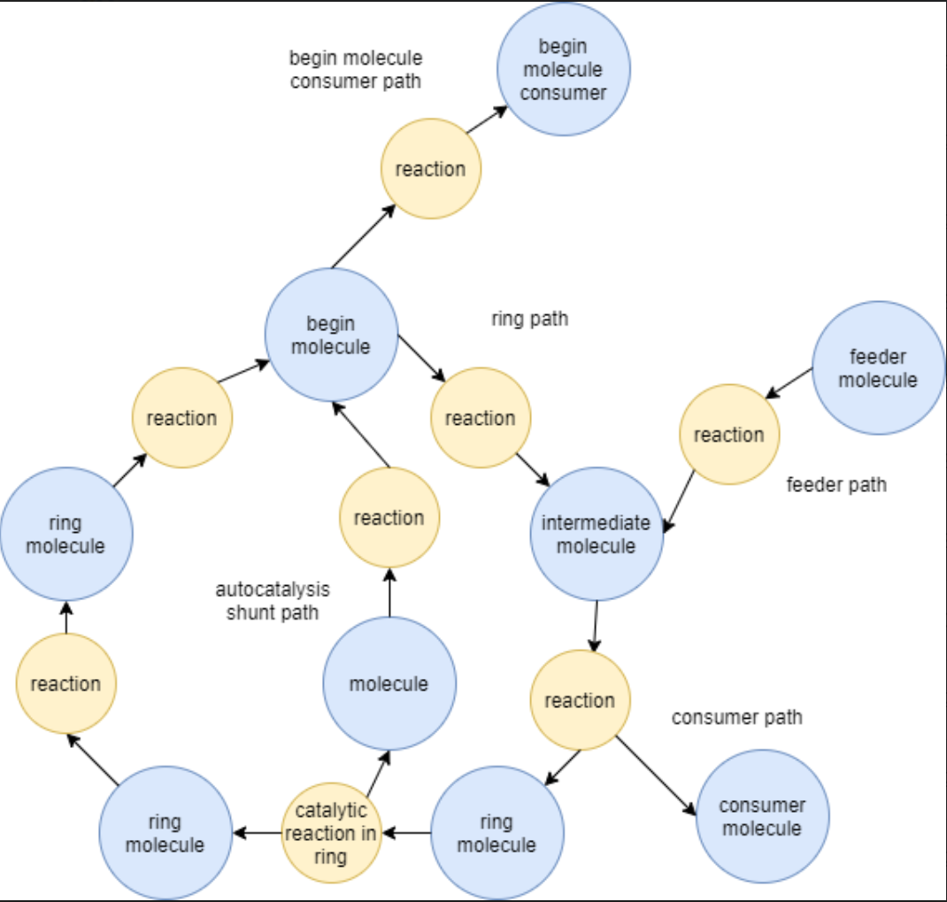
Target pattern definition that we explored
This pattern doesn’t guarantee that the cycle is an autocatalytic cycle
Certain structures were added to make the pattern more complex and interesting to test the limits of the pattern match
To improve upon this, in order to find true cycles, include energetic information reaction pathways to filter only for cycles with the lowest overall energy

Slide 11
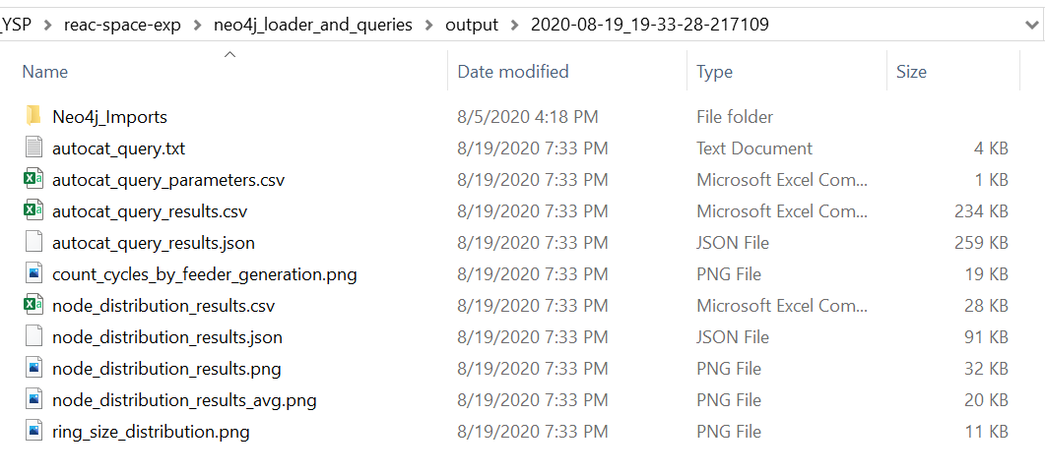
Results
Created several queries
Autocatalytic pattern query
Get count of cycles by feeder generation
Get ring size distribution
Node summary query
Get node degree distribution plot
Input conditions and resulting data/plot images are saved to a timestamped output folder (see right)

Slide 12
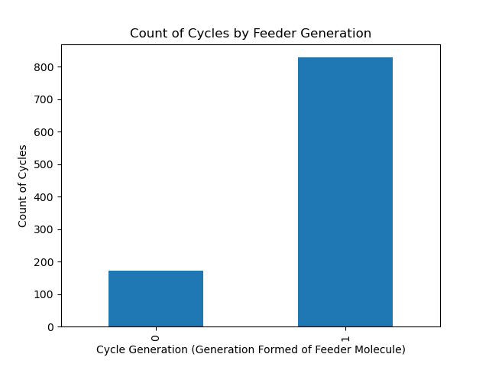
Results: Count Cycles by Feeder Generation

Slide 13
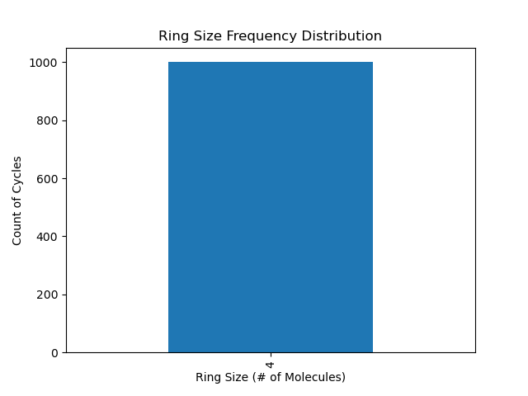
Results: Ring Size Distribution

Slide 14
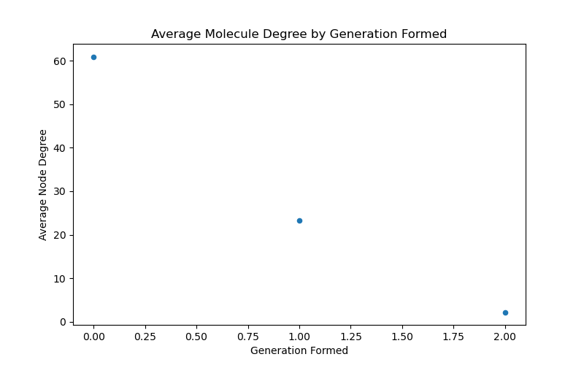
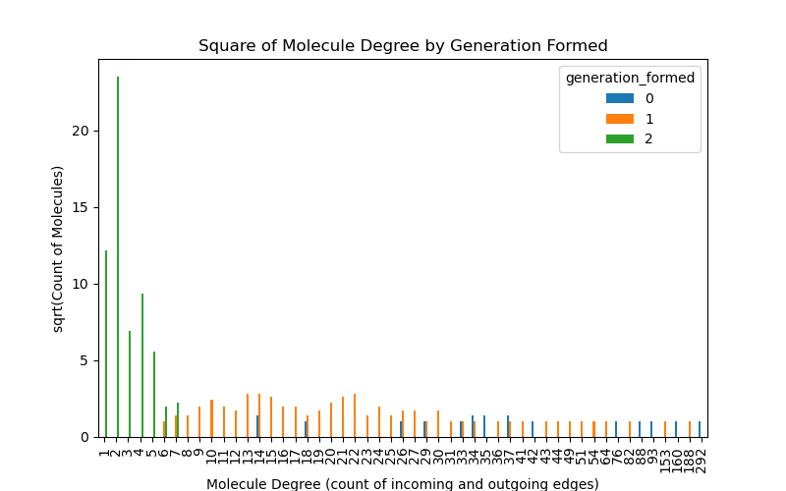
Results: Node Degree Distribution: Incoming and Outgoing Relationships

Slide 15
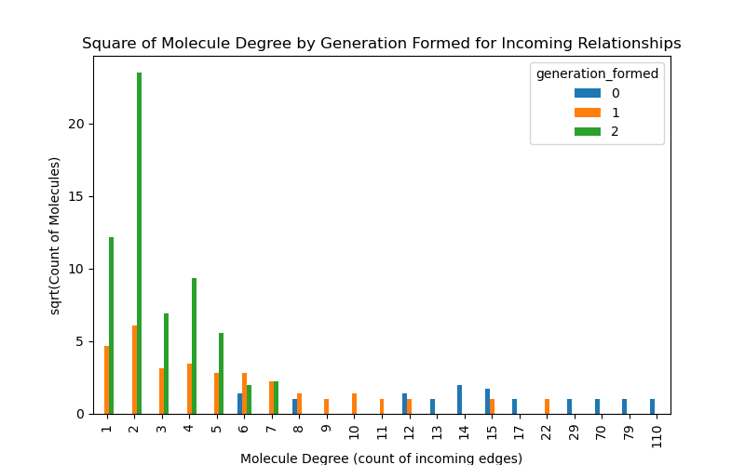
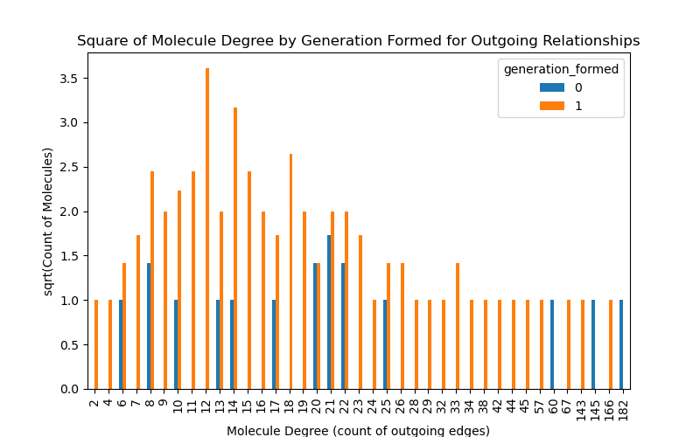
Results: Node Degree Distribution: Incoming OR Outgoing Relationships

Slide 16
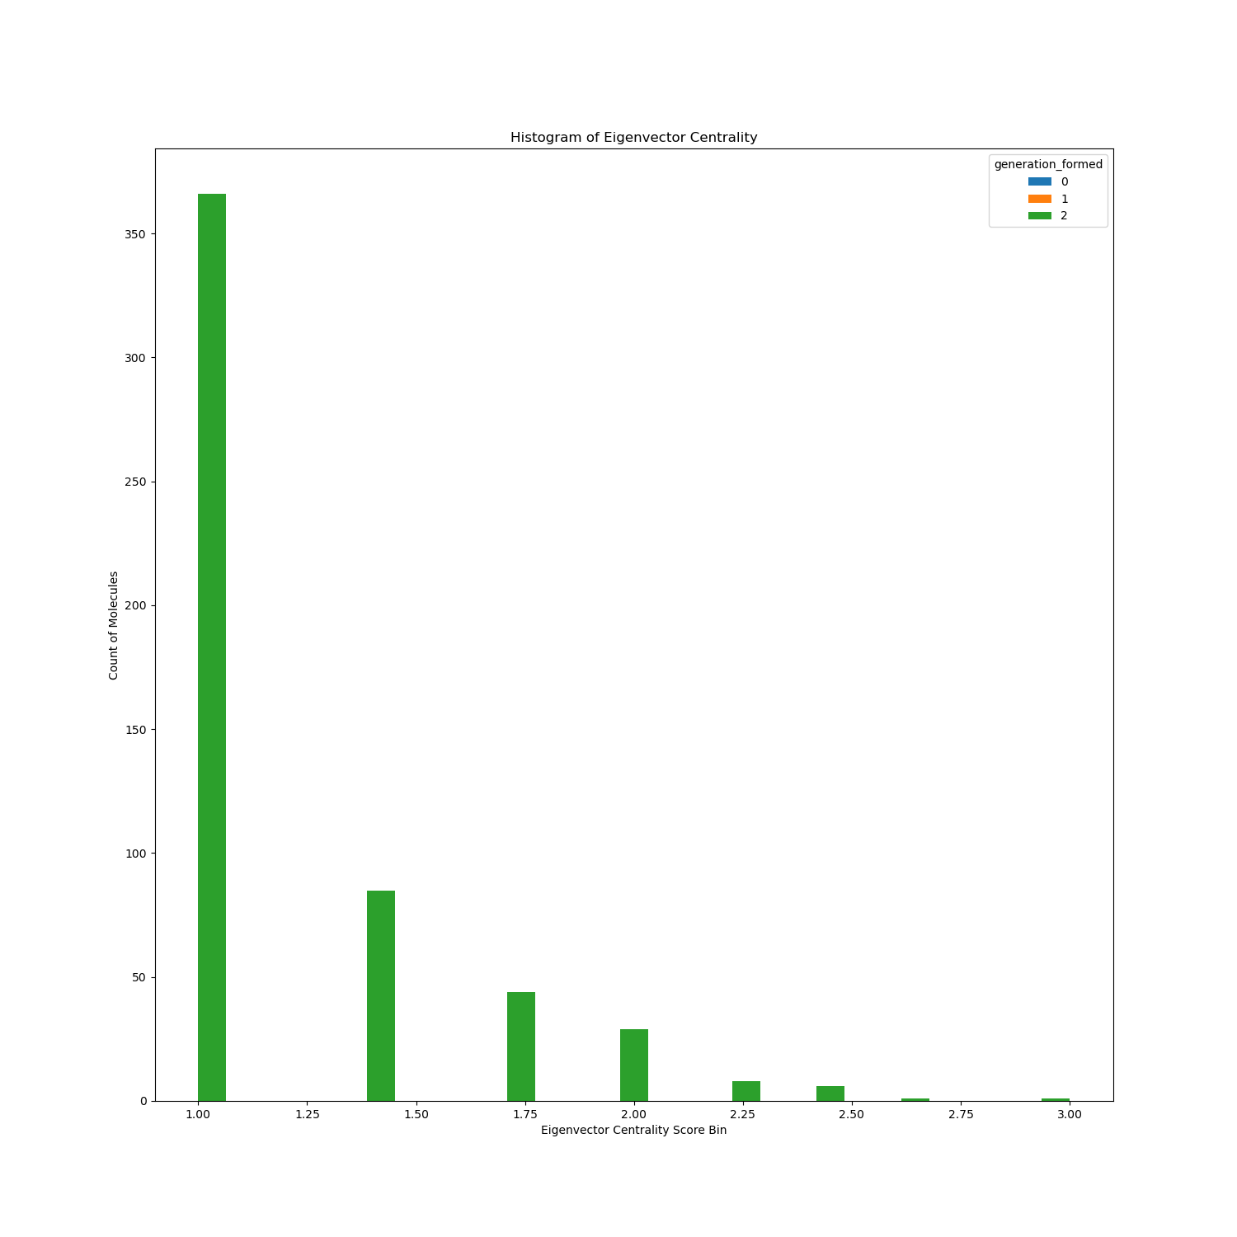
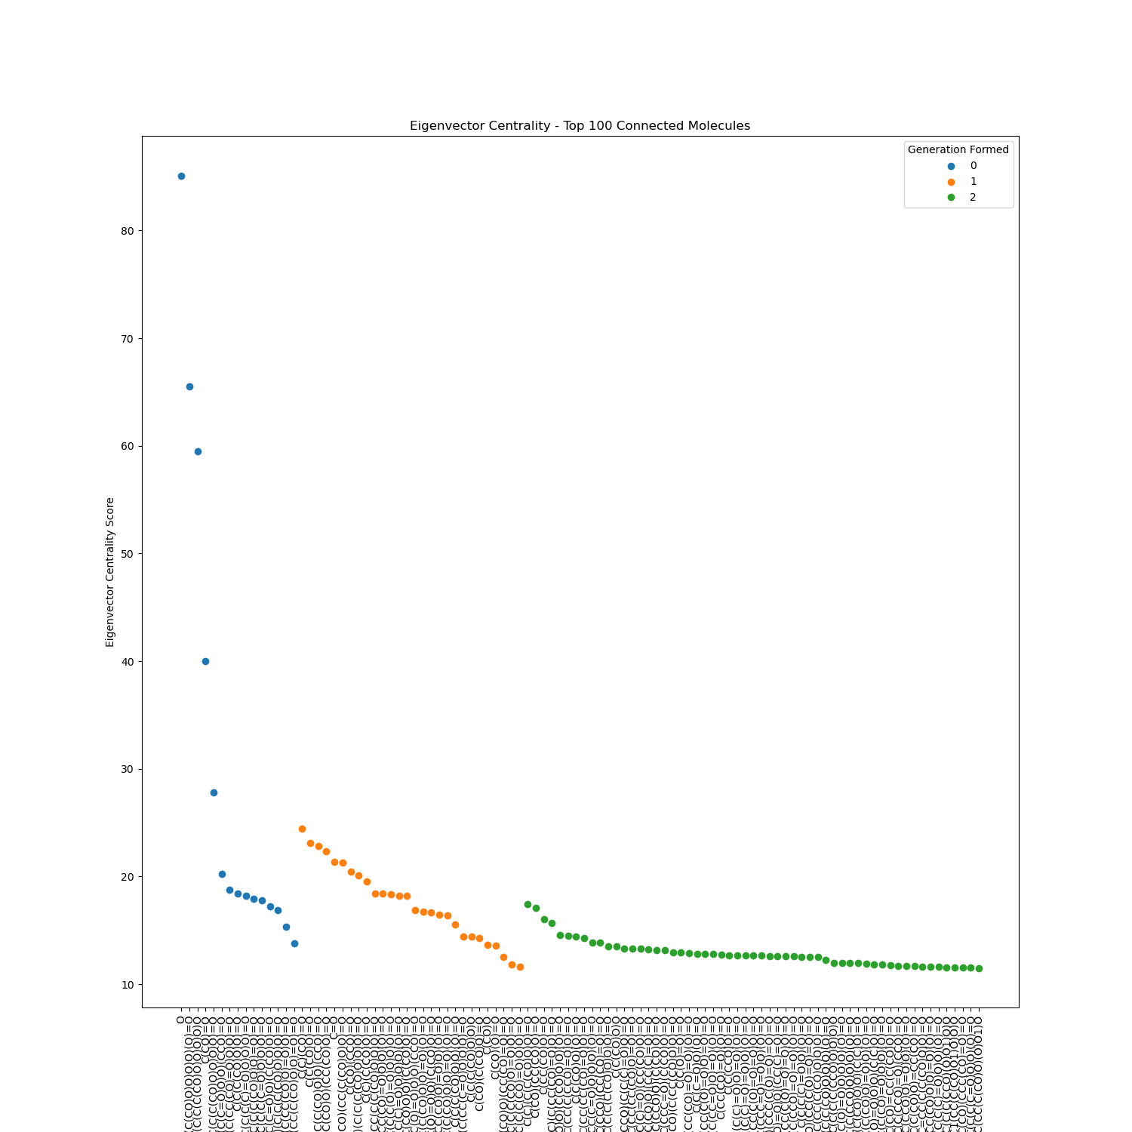
Results: Eigenvector Centrality

Slide 17
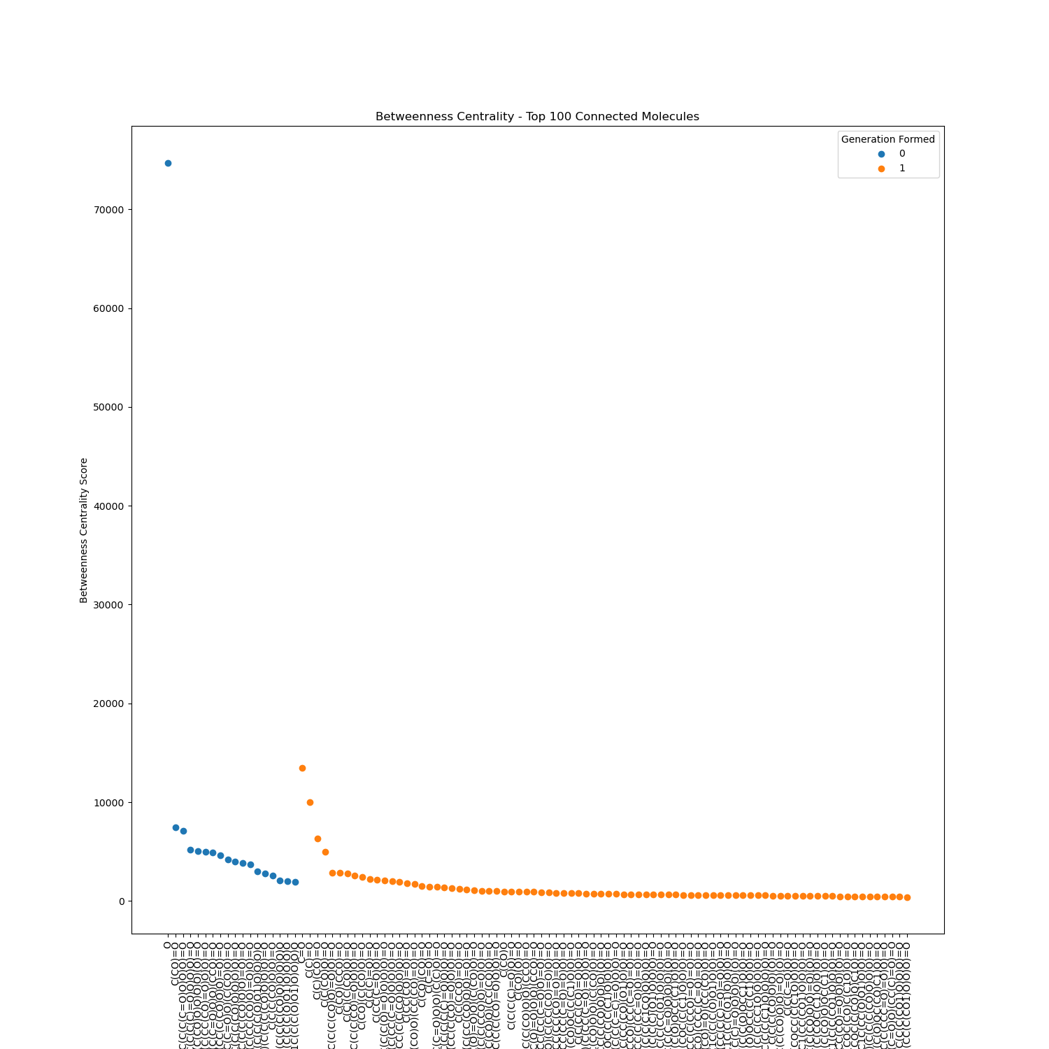
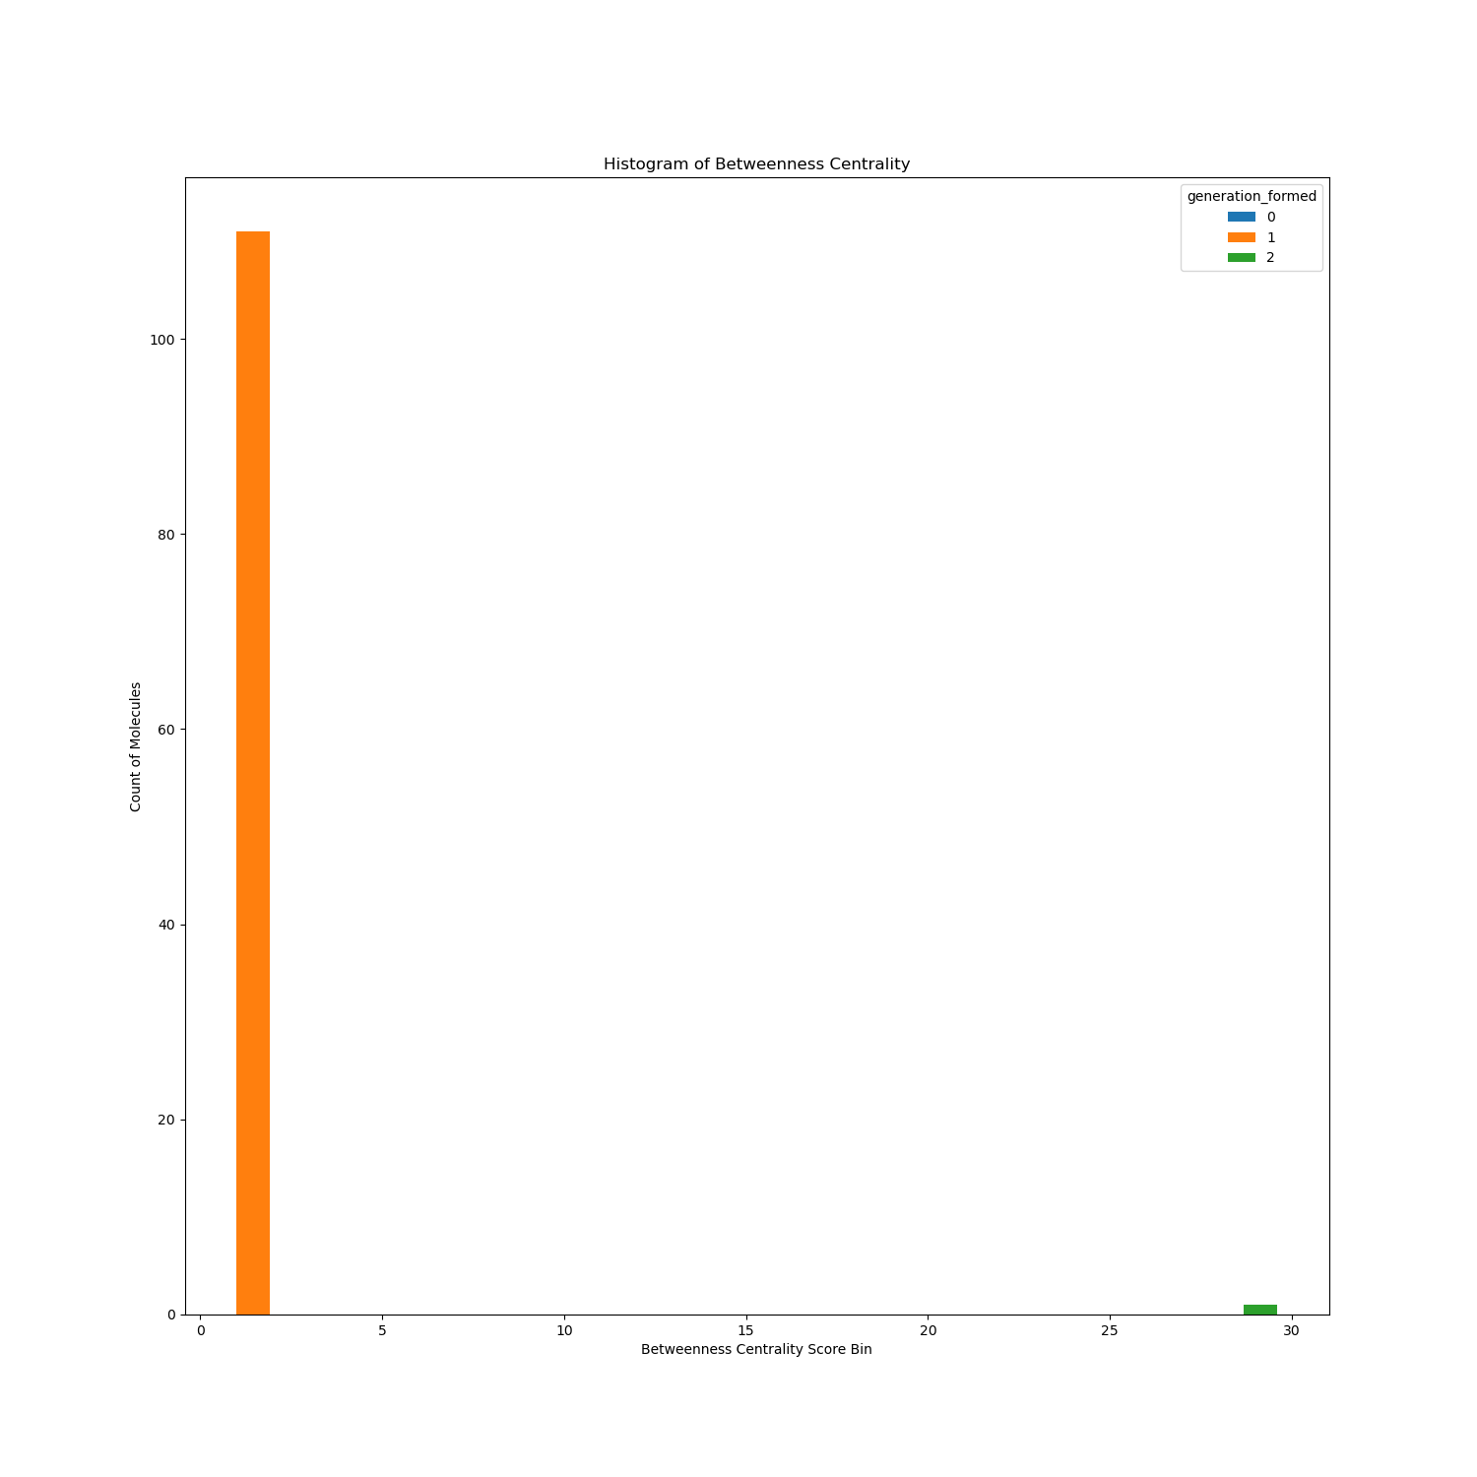
Results: Betweenness Centrality

Slide 18
Conclusion
Graph database platforms are useful tools to find specific structures/patterns in a chemical reaction network
Storing the network in a graph database allows for easy retrieval and pattern matching / statistics across the network
Larger rings were more likely in the network, due to there being more combinations possible
In general, the older the molecule in the network, the more edges it accumulates with each generation
As the network generation increases, the number of autocatalytic patterns increases. Generation 0 to 1 saw a ~5x increase in patterns matched. However, this ratio is not exact, because only a portion of the graph was sampled.
Betweenness Centrality and Random Walk Betweenness Centrality were both evaluated, and the network was small enough such that the Random Walk result was the same
Molecules in the network tend to have many more incoming than outgoing edges, suggesting that molecules in the network are more likely to be products than reactants

Slide 19
Future Considerations
Weigh each edge with information on energetic favorability (such as Gibbs Free Energy)
Query for cycles ordering by overall highest energetic favorability
Need to optimize autocatalysis pattern matching query so that more generations can be loaded into the database
Query time/complexity significantly increases with each added generation
Use a cloud hosted solution to offload the compute to a more powerful machine / cluster

Slide 20
Thank you!
Thank you to Dr. Jim Cleaves, Dr. Jakob Andersen, Alejandro, Aayush, Romulo, and Siddhant!

