Slide 1
DevConnect
A Job Portal for Developers

Slide 2
Table of contents (i)
01
02
03
04
05
06
Introduction
Project Organization
Requirements
What is DevConnect?
and its purpose
Our Team and
Project Milestones
Hardware and Software Requirements
System Architecture
Class Diagrams
Project Demo
High-level view of the system
Class Interactions and Relationships
User Interaction Flow

Slide 3
Table of contents (ii)
07
08
09
Testing
Limitations
Conclusion
Manual Testing of APIs and UI
Project Limitations and Future Work

Slide 4
01
Introduction
What is DevConnect and its purpose?

Slide 5
What is DevConnect?
A web-based platform connecting Employers and Job Seekers.
Built using Laravel and offers essential job board features.
It's aimed at creating a user-friendly environment where employers can post job opportunities, and job seekers can apply for those jobs directly by submitting their resumes.

Slide 6
Who is the Target Audience?
Employers
Job Seekers
Small to medium-sized businesses looking for a platform to post job listings.
Startups or individual employers looking for affordable ways to attract qualified candidates.
Developers, designers, and tech professionals, with adaptability for other fields.
Fresh graduates and young professionals seeking a simple job search and application platform.

Slide 7
Benefits DevConnect Aims to Offer
For Employers
For Job Seekers
Easy job posting and applicant tracking.
Direct communication with candidates.
Low-cost promotion of their jobs via “Featured Jobs.”
Centralized job search and simple resume submission.
Privacy-focused platform ensuring secure resume storage.

Slide 8
02
Project Organization
Team Structure and Project Milestones

Slide 9
Team Structure
Akibul Islam
Tainur Rahaman
210401020 2299
Backend
210401020 2291
Frontend
Mahidul Islam
Md. Mobasser Hossen
210401020 2300
Frontend
210401020 2277
Frontend

Slide 10
Completed Milestones
Planning
Gathered project requirements, identified user needs, and outlined overall goals to set the foundation for development.
Development
Core features were built, including job posting for employers, application submission for job seekers, and profile management.
Testing
Conducted thorough testing to identify and resolve bugs, including functionality testing and user acceptance testing to ensure smooth operation.

Slide 11
03
Requirements
Hardware and Software Requirements

Slide 12
Requirements
Hardware Requirements
Software Requirements
A normal PC with sufficient amount of RAM and Storage
Laravel
MySQL
HTML, CSS, JavaScript
Tailwind CSS
Git and GitHub

Slide 13
04
System Architecture
High-level view of the system

Slide 14
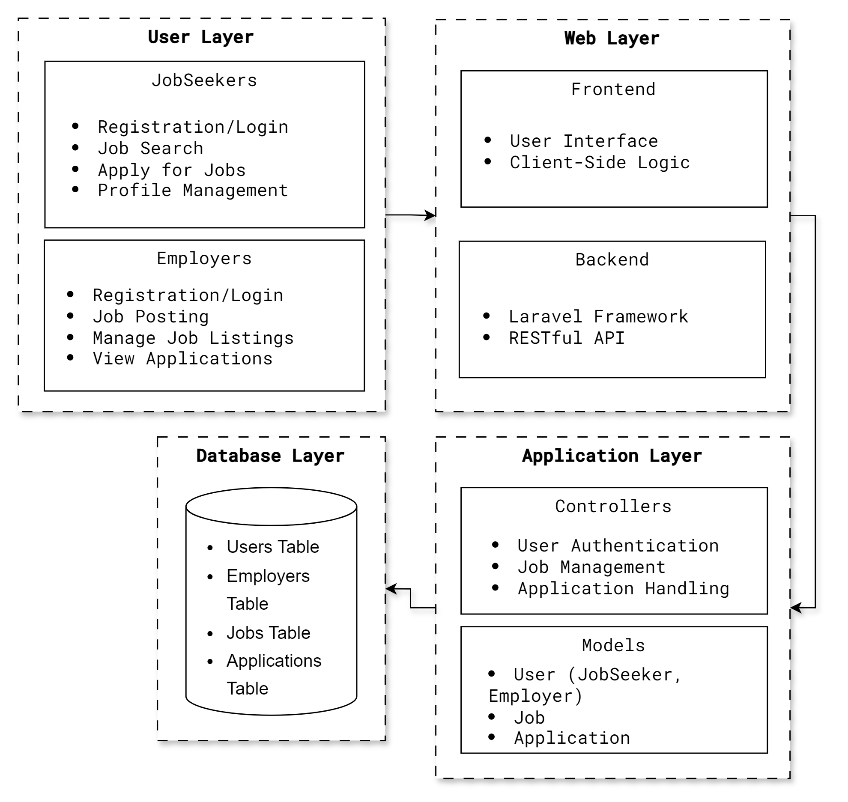
System Architecture Overview
User Layer interfaces job seekers and employers for actions like registration, job search, and application management.
Web Layer provides a frontend UI using HTML/CSS/JavaScript and a backend built with Laravel and a RESTful API for data exchange.
Application Layer manages user authentication and job operations through controllers, represents data with models, and ensures security with middleware.
Database Layer stores all structured data in a MySQL database with tables for users, jobs, and applications.

Slide 15
05
Class Diagrams
Class Interactions and Relationships

Slide 16
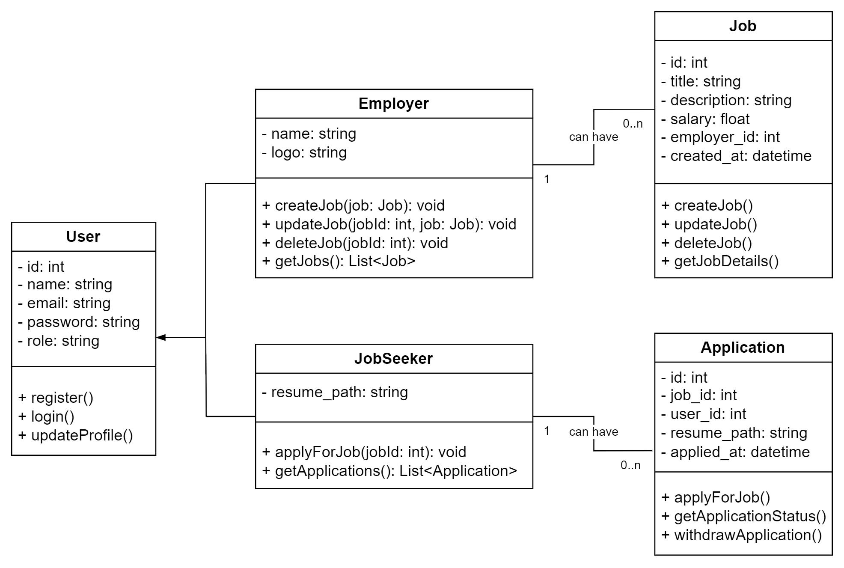
Class Diagram

Slide 17
Class Interactions and Relationships
User defines common attributes and methods for all users, enabling registration and login.
JobSeeker extends User, allowing job seekers to apply for jobs and manage their applications, with a one-to-many relationship to Application.
Employer extends User, enabling employers to create and manage job postings, with a one-to-many relationship to Job.
Job represents job postings, detailing title, description, and salary, linked to an Employer with a one-to-many relationship to Application.
Application connects JobSeekers and Jobs, representing job applications submitted by seekers, establishing a many-to-one relationship with both.

Slide 18
06
Project Demo
User Interaction Flow

Slide 19
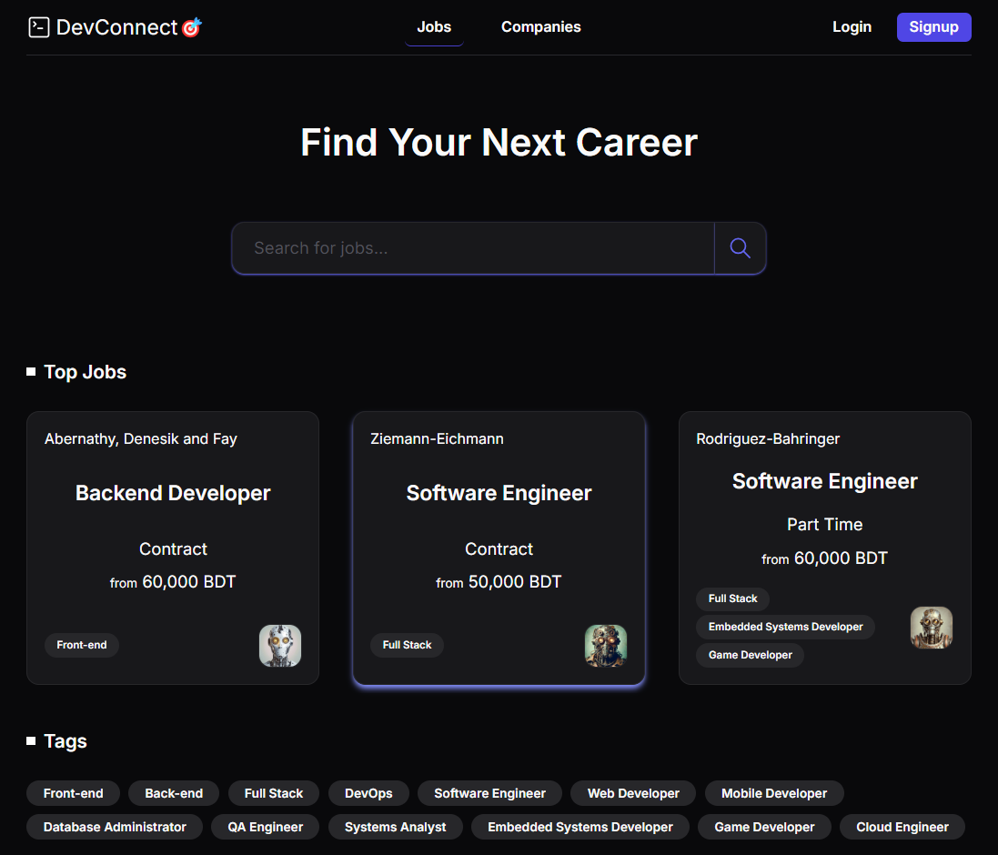
Landing Page (i)
Navbar provides links to Jobs (landing page), Companies, and a Login/Signup button for easy access.
Search Area allows users to quickly find job listings based on their criteria.
Featured Jobs highlights the top 3 jobs sponsored by companies for increased visibility.
Tags showcases available tags for users to efficiently filter job listings by their interests.

Slide 20
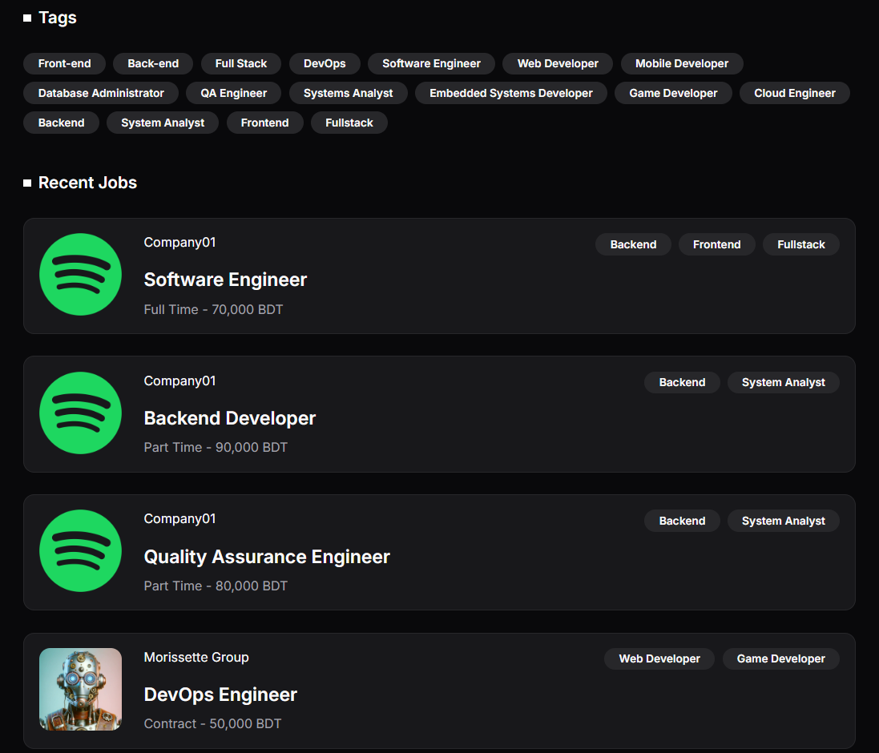
Landing Page (ii)
Recent Jobs section lists all the most recent jobs posted to the platform.

Slide 21
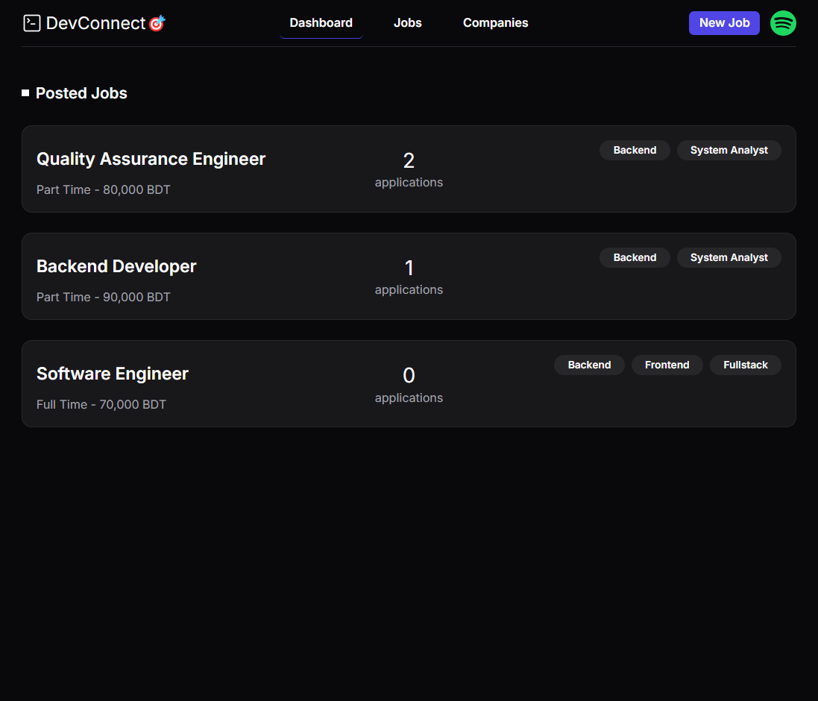
Employer Dashboard
Navbar adds a company logo section that provides links to the Profile and Logout options after login.
Posted Jobs section displays all jobs posted by the logged-in employer, with each listing featuring the job name and the count of applications received.

Slide 22
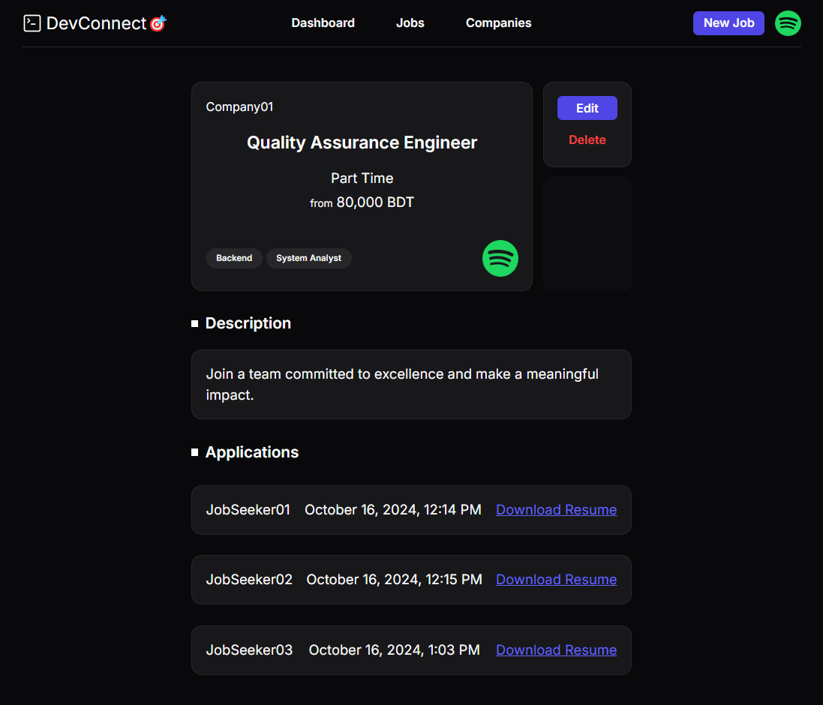
Jobs (Employer View)
Jobs Section displays job details, including the job name, salary, and job type, alongside Edit and Delete buttons for management.
Description Section presents the full job description for employers to review.
Applications Section lists job applicants, with each item featuring the applicant's name, application date and time, and an option to download the resume.

Slide 23
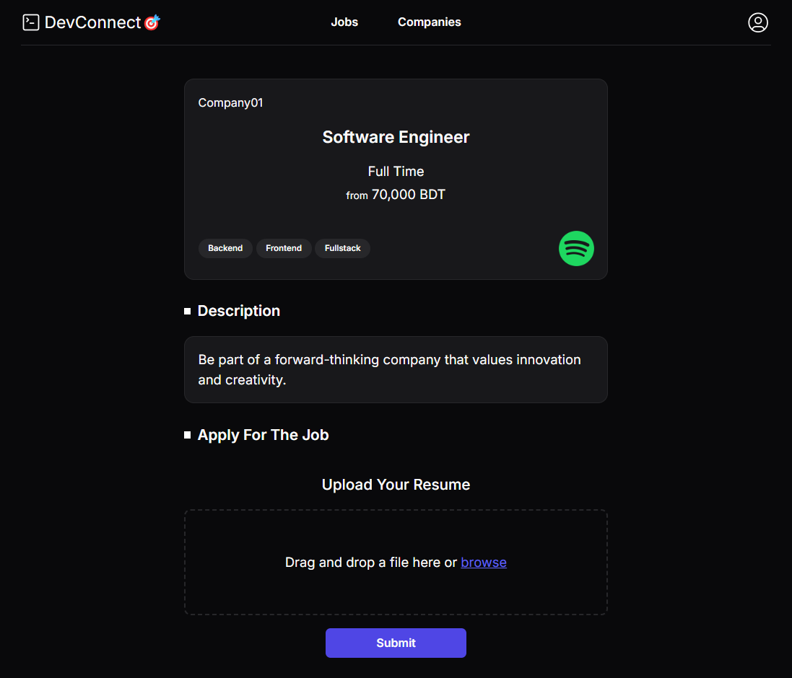
Jobs (JobSeeker View)
Jobs Section displays job details, including the job name, salary, and job type.
Description Section presents the full job description.
Application Section includes an Upload Resume option with a drag-and-drop area for easy resume submission.

Slide 24
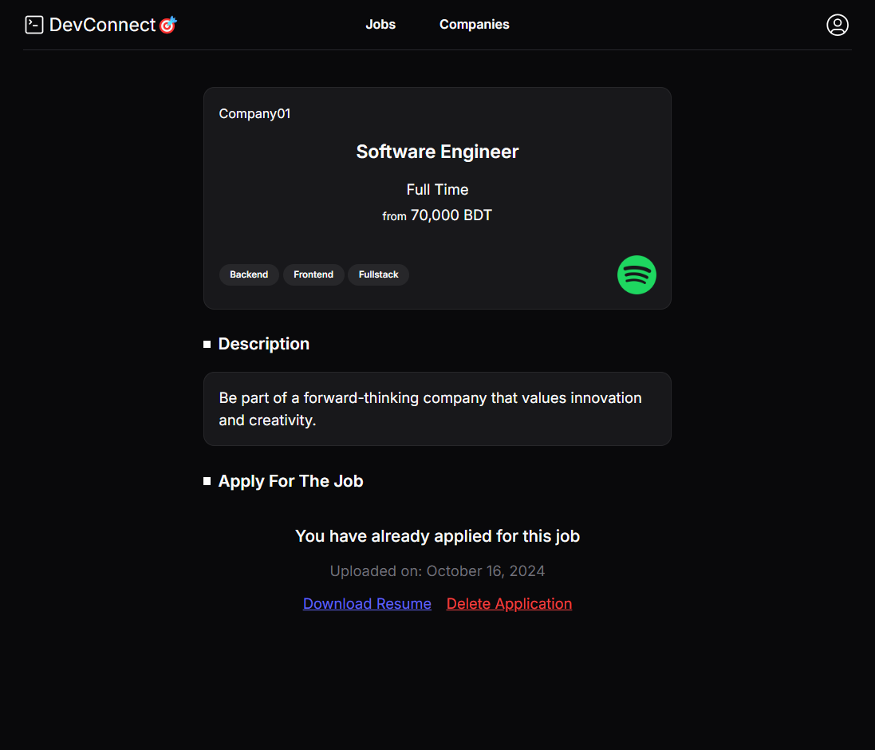
Jobs (Submission Status)
After submission, the Application Section updates to indicate the user has already applied, showing the upload date and providing options to download or delete the application.

Slide 25
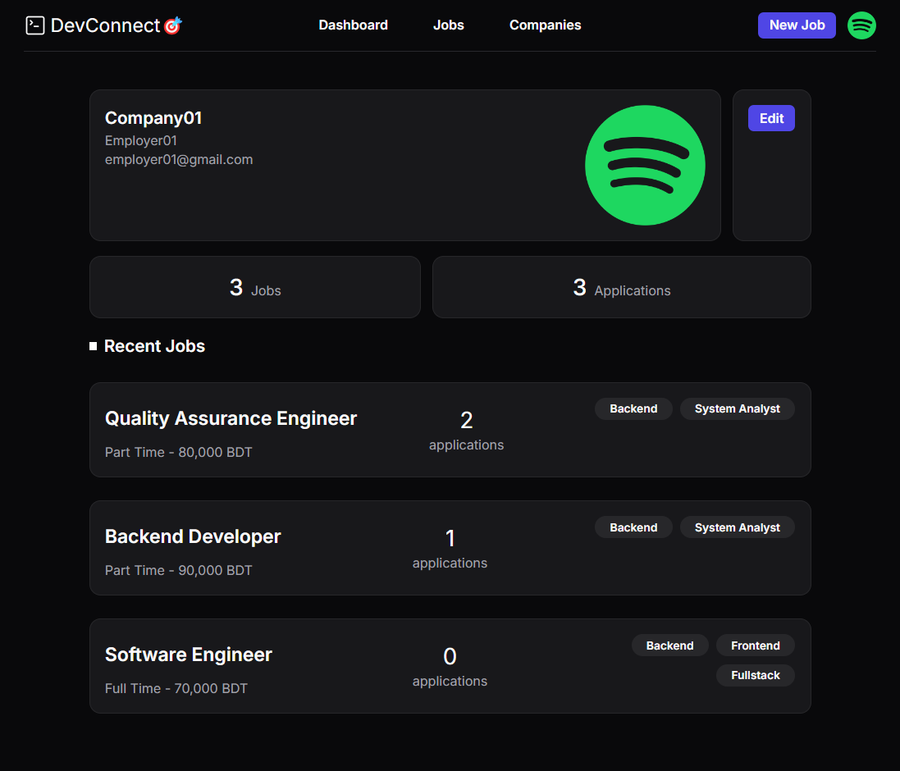
Employer Profile
Profile Section displays the employer's personal information along with an Edit Profile button for updates.
Job Statistics section shows the total number of jobs posted by the employer and the total number of applications received for all their jobs.
Recent Jobs section lists the jobs that the employer has posted.

Slide 26
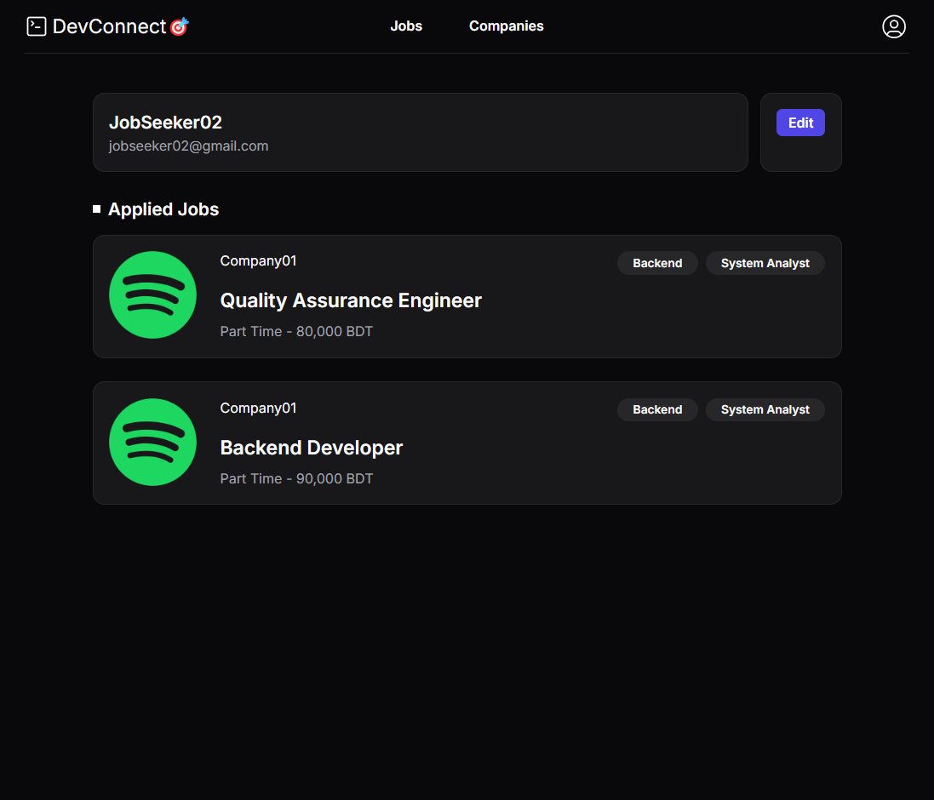
JobSeeker Profile
Profile Section displays the job seeker's personal information along with an Edit Profile button for updates.
Applied Jobs section lists all jobs that the currently logged-in job seeker has applied to.

Slide 27
07
Testing
Manual Testing of APIs and UI

Slide 28

API Testing
Tested key APIs using Postman/Bruno to ensure correct data responses and request handling.
Verified that the API endpoints return expected outputs for various scenarios (e.g., successful login, job creation).
Focused on API responses, error handling, and status codes to ensure backend functionality aligns with the application's requirements.

Slide 29
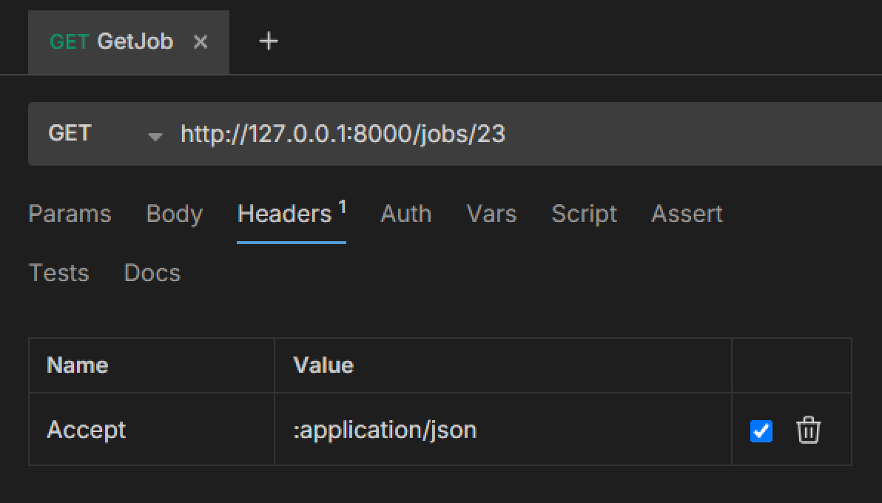
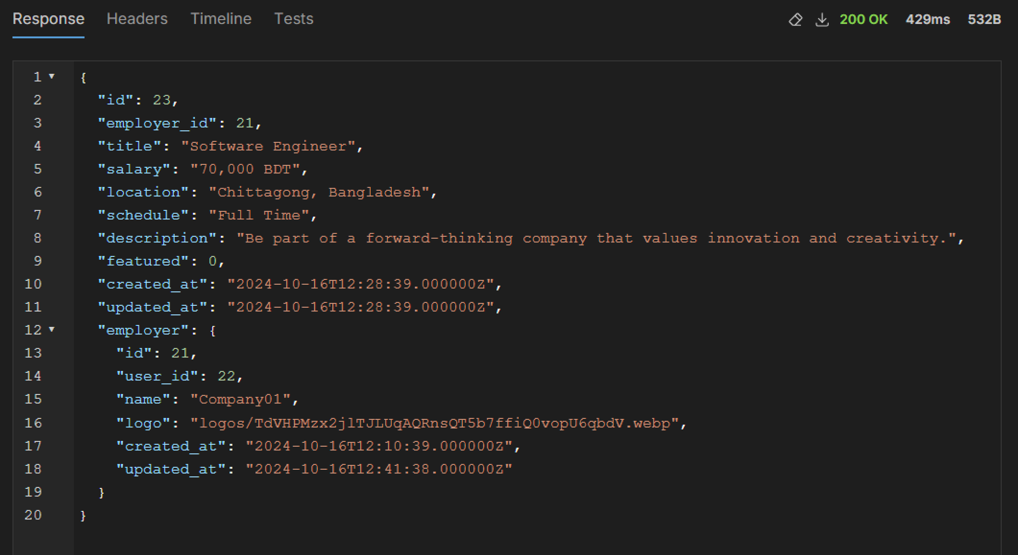
Request Testing
GET Request
Response
Data Verified
Sent a GET request to the endpoint http://127.0.0.1:8000/jobs/23
Received a JSON response containing details of the job with ID 23.
Confirmed that the API correctly retrieves and returns the specified job's information.

Slide 30
Manual UI Testing
Conducted hands-on testing of the user interface to ensure all features and interactions work smoothly.
Tested input validations to make sure data entered by users is properly validated (e.g., forms, fields).
Focused on overall usability and user experience, addressing any issues that were identified.

Slide 31
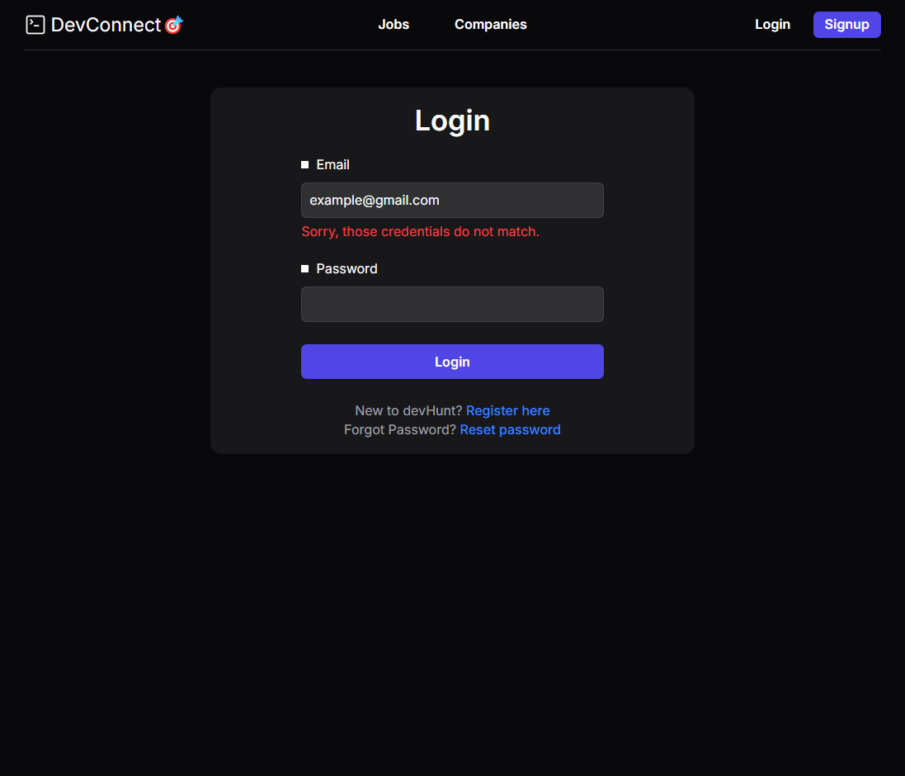
Input Validation
Login Page: Displays the login interface where users input their credentials.
Error Handling: When incorrect credentials are provided, an error message is shown.
Validation Tested: Ensures that the system appropriately alerts users to authentication issues and prompts them to re-enter correct information.

Slide 32
07
Limitations
Project Limitations and Future Work

Slide 33



Project Limitations
Lack of Admin Features
No dedicated admin functionalities for managing users or content.
No Payment and Featuring System
There is no payment processing implemented for job post promotion options, limiting visibility for employers.
Limited Features for Employers
Employers can only contact selected applicants using the information provided in their resumes, as there is no direct communication feature available through the app.

Slide 34
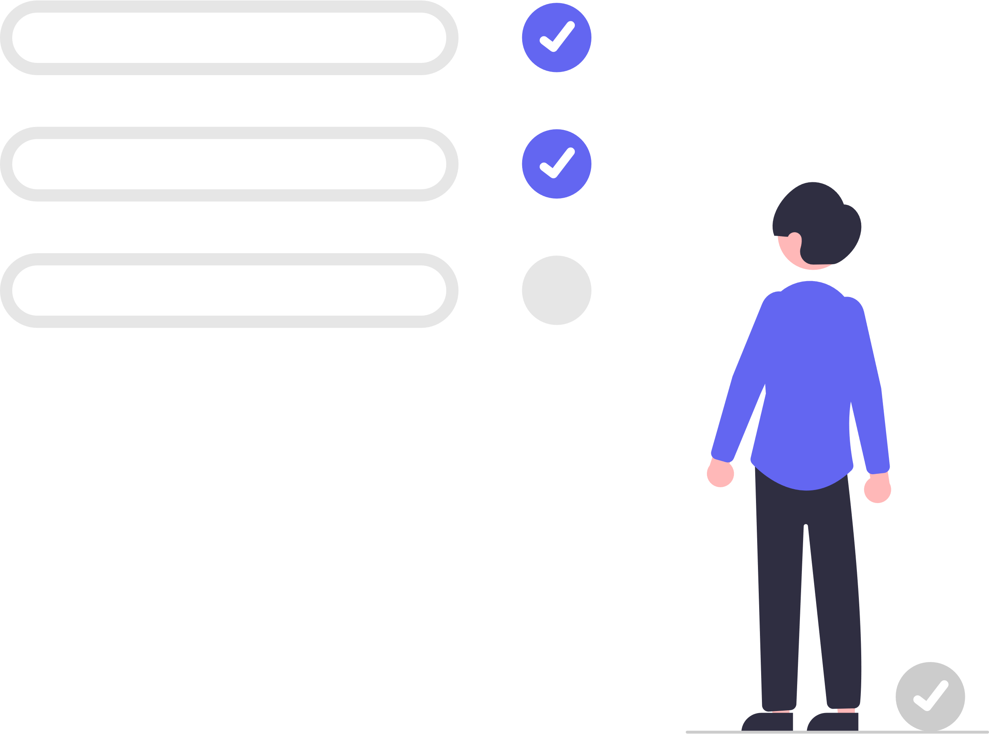
Future Work
Implement Admin Features: Introduce admin functionalities for better user and content management.
Add Payment Processing: Integrate payment processing to allow employers to promote job posts and access premium features.
Enhance Communication: Develop direct communication tools for employers and applicants to facilitate better interactions.
Expand Feature Set: Add advanced features like applicant tracking systems and real-time notifications to improve user experience.

Slide 35
Team Structure
Akibul Islam
Tainur Rahaman
Backend
Backend
Controllers, Landing Page, Job Application
Mahidul Islam
Md. Mobasser Hossen
Frontend
JobSeeker Profile, Job (JobSeeker View)
Frontend
Employer (Dashboard, Profile)

Slide 36
Thanks!
Thank you for your attention and support!
We appreciate your feedback.

