Slide 1
On Picard Groups and Jacobians of Directed Graphs
JAIUNG JUN
MATTHEW PISANO

Slide 2
Preliminaries

Slide 3
The Chip Firing Game
When a game is started, each vertex on a graph is assigned a certain number of chips.
During play, chips can be lent or borrowed at each node where one or more chips are either sent or received along each outgoing edge equally.
In the case of a directed graph, vertices can only interact with another along an outgoing or bidirectional edge.
The game is won once every vertex has a zero or greater number of chips (i.e. this vertex is not in debt).

Slide 4
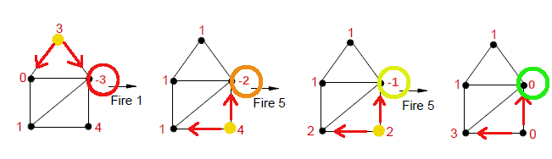
The Chip Firing Game

Slide 5
Applications
By further understanding how to analyze the possible moves and winning strategies of more complex graphs, Chip-Firing games become more easily usable in different applications.
A notable usage of these games is in economics, where these games, especially the directed variants can be used to model the flow of money.
A more entertaining usage is through map-based board games such as RISK where armies are sent to neutralize neighboring enemies until the game is won when no other enemies are on the board.

Slide 6
Divisors and Equivalence Relations
In the study of this game a Divisor of a graph G, Div(G), is an integer vector v ∈ ℤ^{n} where n is the number of vertices in the graph. The i^{th} element of v is the number of chips on the i^{th} vertex of the graph.
Two divisors have an Equivalence Relation (∼) if one divisor can be obtained from the other by a finite series of lending or borrowing moves.
An Equivalence Class, [D], is the set of all divisors that are equivalent to each other.

Slide 7
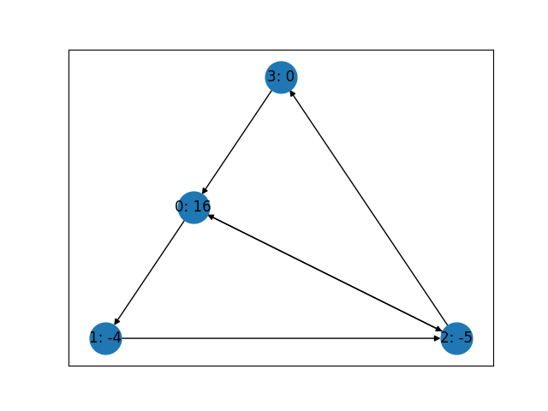
Divisors
Where divisor
D=[16, -4, -5,0]
G=

Slide 8
The Picard Group and The Jacobian
The Picard Group of a graph, Pic(G), is the set of all equivalence classes that the divisors of that graph G can be a part of. The larger the size of the Picard Group, the more ways a game can be played.
The degree of a divisor, deg(D), is the sum of each of the divisor’s elements.
The Jacobian of a graph, Jac(G), is a special subset of Pic(G) such that every divisor in each equivalency class has a degree of 0. If a divisor is in one of the Jacobian’s classes, it can be made winning after a finite series of moves. The larger the size of the Jacobian, the more configurations exist where the vertices are debt free.

Slide 9
The Laplacian and The Smith Normal Form
The Laplacian of a graph of size n is an n x n matrix representing all valid lending or borrowing moves that graph can make. Multiplying the transpose of the i^{th} row of the Laplacian by a divisor results in the divisor of the graph after making a move at the i^{th} vertex. It helps to serve as a bridge between the conceptual game and the mathematics behind those concepts.
The Smith Normal Form (SNF) of a Laplacian is a diagonal matrix obtained from a series of row and column operations preformed on the Laplacian of a graph, similarly to Gaussian elimination. While the Laplacian itself encodes information about lending or borrowing moves, the SNF encodes information about the Picard Group and the Jacobian in its diagonal elements. Calculating the SNF allows us to know more information on the possible ways a game can be played out.

Slide 10
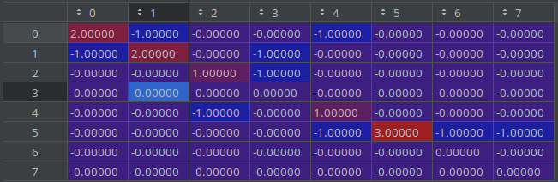
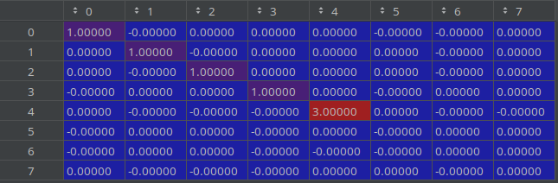
The Laplacian and The Smith Normal Form
Laplacian
Smith Normal Form
Pic(G) = ℤ3 x ℤ³
From 3 at M4,4 and from 3 empty rows
Jac(G) = ℤ3
From 3 at M4,4

Slide 11
Trees, Cycles, and Pseudo-Trees
A Tree Graph is a graph where there is only one path between vertices and contains no cycles.
A Cycle Graph is a graph that only has one cycle, or a line graph with another connection between the first and last vertices.
A Pseudo-Tree Graph is a combination of these two. This graph is created by gluing a tree to one of the vertices of a cycle graph.

Slide 12
Research

Slide 13
Objectives
The overarching objective of this project is to develop techniques to calculate the Picard group and Jacobian of cycle graphs and trees.
These techniques can possibly then be used on pseudo-trees to more easily calculate their Picard Groups and Jacobians as they are less trivial.

Slide 14
Finding The Rank of a Tree’s Picard Group
The Picard group is commonly written in the form Pic(G) = Jac(G) x ℤ^{n}, where n is the rank of the Picard group.
We have noticed that this rank for a tree graph can be easily calculated inductively. By reconstructing an arbitrary tree edge by edge, its rank can be determined by following two rules.
If the next arrow drawn is pointing towards the graph or if it is bidirectional, the rank does not change.
If the next arrow is pointing towards the new vertex, the rank increases by one.
The rank of a tree corresponds to the number of terminal strong components of that tree, sections that are only connected to the rest of the graph by an incoming edge and have a path between all of its member vertices.

Slide 15
Finding The Jacobian of a Tree or Cycle Graph
The Jacobian of a tree is simple, it is always the trivial group.
The Jacobian of a Cycle graph is more complex, but easily calculable if the cycle has two paths, or sections of oriented edges with the same orientation.
We have discovered that, for this special type of cycle graph, all Jacobians, ℤ1 to ℤn exist for some combination of directed edge orientations.

Slide 16
Finding The Jacobian of a Cycle Graph
Beginning with a non-oriented cyclic graph, Jac(G) = ℤn.
Orienting one edge (x, x+1) in the counter-clockwise direction yields a trivial Jacobian of {0} (ℤ1).
Orienting the edge (x-1, x) to clockwise and (x+1, x+2) to counter-clockwise yields a Jacobian of ℤn-1.
Orienting one edge (x, x+1) in the counter-clockwise direction, another edge (x-1, x) to clockwise, and (x+1, x+2) to counter-clockwise yields Jac(G) = ℤn-2.
Adding onto either of the two paths by orienting the next or preceding bidirectional arrow yields Jac(G) = ℤn-3.
Continuing this pattern until the two paths meet yields all invariant factors down to ℤ2. Going further to orient the entire graph to one direction results in a trivial Jacobian of {0}.
This pattern should hold for all cycle graphs C3 to Cx and has been proven for graphs C3 to C80.

Slide 17
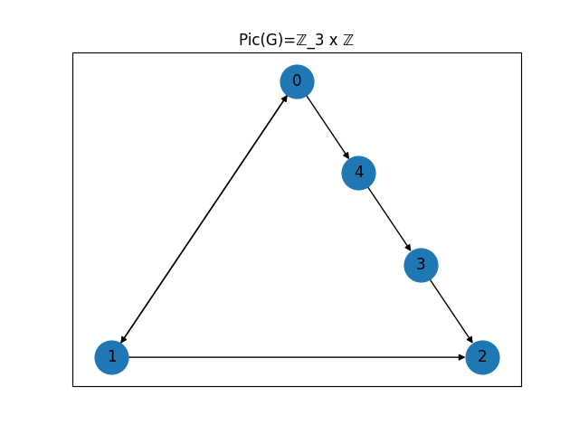


Finding The Jacobian of a Cycle Graph

Slide 18
Creating a Pseudo-Tree
A Pseudo-tree can be created by gluing a tree to a cycle graph in one of two ways.
By Vertex – Here, whichever vertices will be glued together will be merged into one vertex. With this way of gluing, one vertex will be shared between the two glued graphs.
By Edge – With this method, the two graphs are joined by an additional edge. This helps to preserve the attributes of the original graphs into the resulting glues pseudo-tree, such as the Jacobian often being Jac(cycle) x Jac(tree).

Slide 19
Further Research
Going forward, we plan to consolidate the findings we already have and extend our reasoning to other graphs. This includes
Finalizing our methods for cycle graphs and trees.
Expanding those methods to pseudo trees to notice a more concrete pattern.
Expanding our research to include complete and wheel graphs.

Slide 20
Credits
Image of chip firing game: https://www.wikiwand.com/en/Chip-firing_game

