Slide 1
On Picard Groups and Jacobians of Directed Graphs
JAIUNG JUN
MATTHEW PISANO

Slide 2
Preliminaries

Slide 3
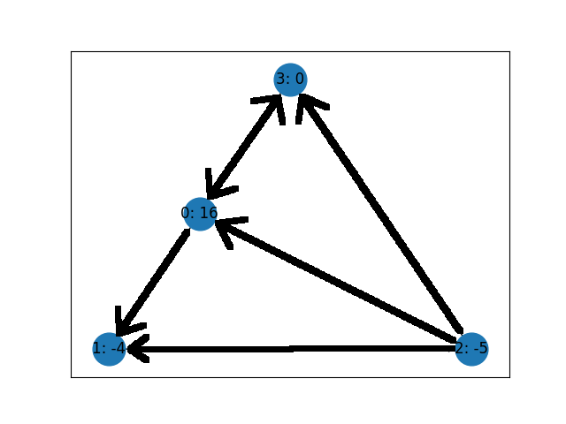
Graph Theory
In our research, we focus on chip firing games. A game played on graphs, based upon graph theory.
In graph theory, a graph is represented be a series of nodes, or vertices, connected by edges.
Edges can be directed in one of two directions or on both directions.

Slide 4
The Chip Firing Game
When a game is started, each vertex on a graph is assigned a certain number of chips.
During play, chips can be lent or borrowed at each node where one or more chips are either sent or received along each edge equally.
In the case of a directed graph, vertices can only interact with another along an outgoing or bidirectional edge.
The game is won once every vertex has a zero or greater number of chips (i.e. this vertex is not in debt).

Slide 5
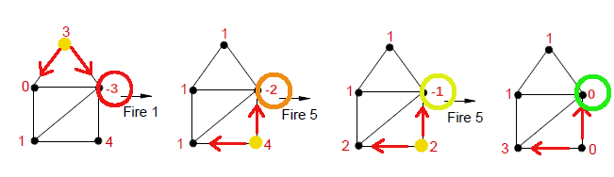
The Chip Firing Game

Slide 6
Applications
By further understanding how to analyze the possible moves and winning strategies of more complex graphs, Chip-Firing games become more easily usable in different applications.
A notable usage of these games is in economics, where these games, especially the directed variants can be used to model the flow of money or assets from one entity to another.
A more entertaining usage is through map-based board games such as RISK where armies are sent to neutralize neighboring enemies until the game is won when no other enemies are on the board, similarly to how the game is won once all negative values of chips are eliminated.

Slide 7
Divisors and Equivalence Relations
In the study of this game a Divisor of a graph G, Div(G), is an integer vector (a list of integers) n integers long where n is the number of vertices in the graph. The i^{th} element of this vector is the number of chips on the i^{th} vertex of the graph. Divisors are a simple way to represent the state of a game mathematically.
Two divisors have an Equivalence Relation (∼) if one divisor can be obtained from the other by a finite series of lending or borrowing moves.
An Equivalence Class, [D], is the set of all divisors that are equivalent to each other. For example, the set of all divisors that can be gotten from the initial starting state of a game.

Slide 8
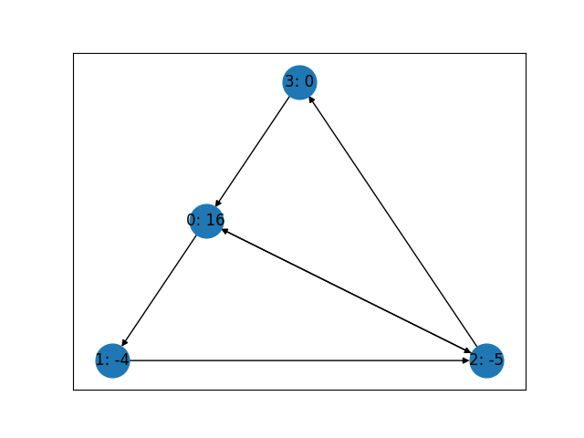
Divisors
Where divisor
D=[16, -4, -5,0]
V3 = 0
G=
V0 = 16
V1 = -4
V2 = -5

Slide 9
The Picard Group and The Jacobian
The Picard Group of a graph, Pic(G), is the set of all equivalence classes that the divisors of that graph G can be a part of. It describes every state of the game that can arise from every initial distribution of chips. The larger the size of the Picard Group, the more ways a game can be played.
The Jacobian of a graph, Jac(G), is a special subset of Pic(G) such that every divisor in each element of Jac(G) has a distribution of chips that sum to zero; the positive and negative chips balance out. If a divisor is in one of the Jacobian’s classes, it can be made winning after a finite series of moves. The larger the size of the Jacobian, the more configurations exist where the vertices are debt free.

Slide 10
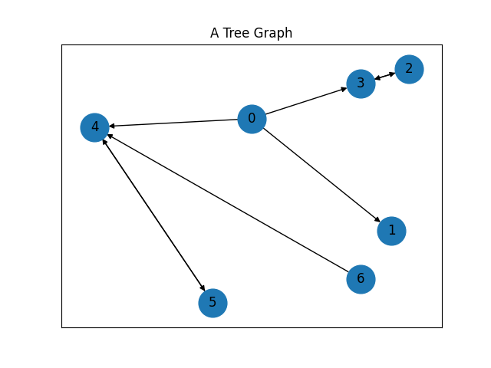
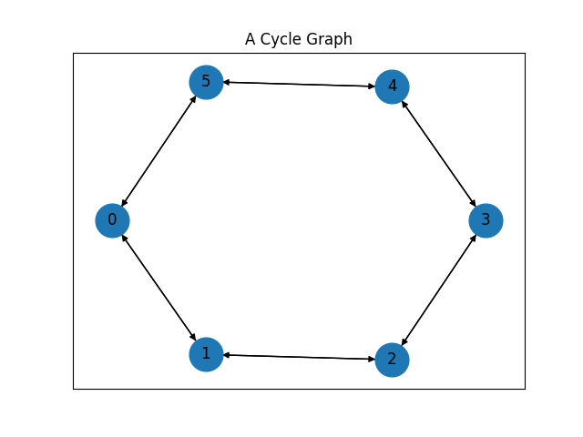
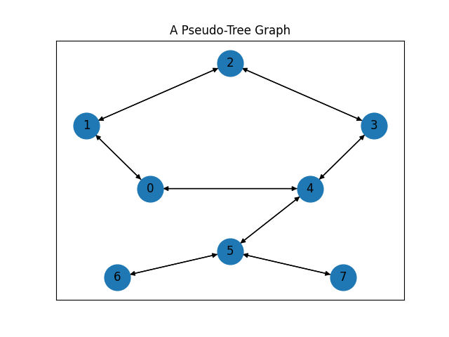
Trees, Cycles, and Pseudo-Trees
For our research, we concentrate on three main types of graphs.
A Tree Graph is a graph where there is only one path between vertices and contains no cycles.
A Cycle Graph is a graph that only has one cycle, or a line graph with another connection between the first and last vertices.
A Pseudo-Tree Graph is a combination of these two. This graph is created by gluing a tree to one of the vertices of a cycle graph.

Slide 11
Research

Slide 12
Objectives
The undirected cases for these graphs are well understood. The directed case, however has very little research in it. This is something we hope to change.
Our goal is to explore techniques that we can use to describe trees and cycle graphs. These can then be used on pseudo-trees to more easily calculate their Picard Groups and Jacobians as they are less trivial than those of their components.
The overarching objective of this project is to develop techniques to calculate the Picard group and Jacobian of the directed cases of these three classes of graphs and beyond.

Slide 13
Finding The Jacobian of Trees and Cycle Graphs
The Jacobian of a tree is simple, it is always the trivial group. In other words, the winning configurations of a tree can be described very simply.
The Jacobian of a Cycle graph is more complex, but easily calculable if the cycle has two paths, or sections of oriented edges with the same orientation. It is often simply ℤn+2 , where n is the number of zeroes on one size of these paths.
We have discovered that, for these two path cycle graphs, all Jacobians, from trivial to ℤn, exist for some combination of directed edge orientations. For these types of graphs, Jac(G) can be calculated very quickly.
For all other numbers of paths, we expect them to be primarily confined to the trivial group and ℤ2. If this conjecture is true, we will be able to completely describe the Jacobian of all Cycle graphs.

Slide 14
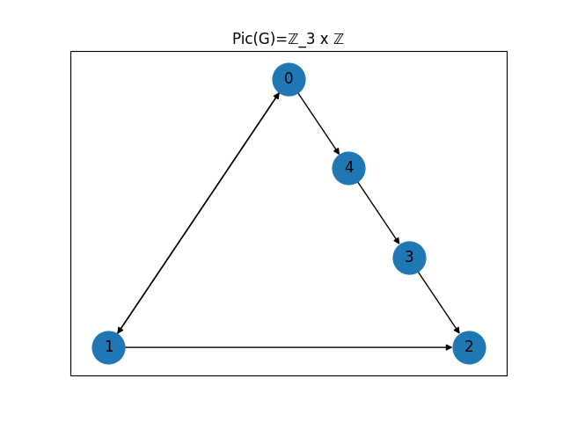


Finding The Jacobian of a Cycle Graph

Slide 15
Finding The Picard Group of Trees and Cycle Graphs
After finding the Jacobian, we only have to find the Picard Group’s rank to complete our description of it.
The Picard group is commonly written in the form Pic(G) = Jac(G) x ℤ^{n}, where n is the rank of the Picard group. Here, ℤ^{n} represents the different ways the chips are initially placed on the graph. The larger n is, the more ways a game can be initially set up.
We noticed that the rank of any graph corresponds to the number of terminal strong components in it. These are sections of a graph that are connected within, but only have one-way entrances coming from the rest of the graph.
For trees, we can prove this inductively, reconstructing the tree vertex by vertex to prove our theory. For all other graphs, this is strongly suggested experimentally.

Slide 16
Creating a Pseudo-Tree
The next step in applying our findings to further graphs is by constructing a pseudo-tree. A Pseudo-tree can be created by gluing a tree to a cycle graph in one of two ways.
By Vertex – Here, whichever vertices will be glued together will be merged into one vertex. With this way of gluing, one vertex will be shared between the two glued graphs.
By Edge – With this method, the two graphs are joined by an additional edge. This helps to preserve the attributes of the original graphs into the resulting glues pseudo-tree, such as the Jacobian often being Jac(cycle) x Jac(tree). This is the method most useful to us.

Slide 17
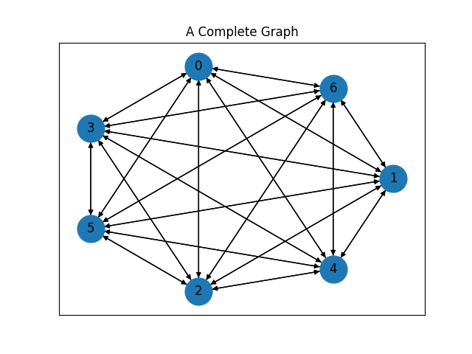
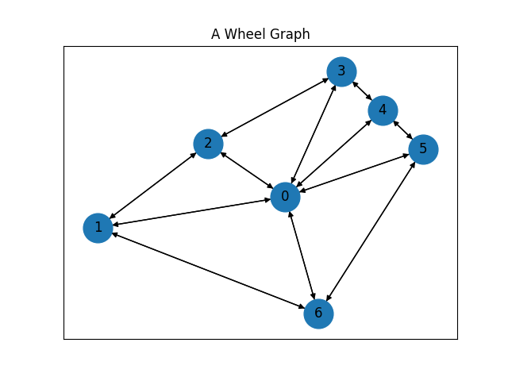
Further Research
Going forward, we plan to consolidate the findings we already have and extend our reasoning to other graphs. This includes
Proving mathematically our methods for cycle graphs and trees.
Expanding those methods to pseudo trees to notice a more concrete pattern.
Expanding our research to include complete and wheel graphs. For example, so far we have shown that the size of the Jacobian of some wheel graphs os size n is proportional to ϕ^{n}, where ϕ is the golden ratio.

Slide 18
Credits
Image of chip firing game: https://www.wikiwand.com/en/Chip-firing_game

