Slide 1
ON PICARD GROUPS OF DIRECTED GRAPHS
JAIUNG JUN
MATTHEW PISANO

Slide 2
Preliminaries

Slide 3
The Chip Firing Game
When a game is started, each vertex on a graph is assigned a certain number of chips
During play, chips can be lent or borrowed at each node where one or more chips are either sent or received along each outgoing edge equally.
In the case of a directed graph, vertices can only interact with another along an outgoing or bidirectional edge.
The game is won once every vertex has a positive number of chips (i.e. this vertex is not in debt).

Slide 4
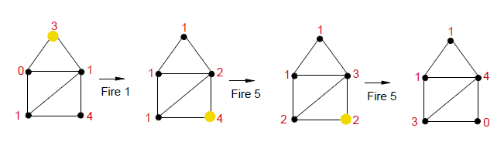
The Chip Firing Game

Slide 5
Divisors and Equivalence Relations
In the study of this game a Divisor of a graph G, Div(G), is an integer vector v∈Zn where n is the number of vertices in the graph. The i^{th} element of v is the number of chips on the i^{th} vertex of the graph.
Two divisors have an Equivalence Relation (∼) if one divisor can be gotten from the other by a finite series of lending or borrowing moves.
An Equivalence Class, [D], is the set of all divisors that are equivalent to each other.

Slide 6
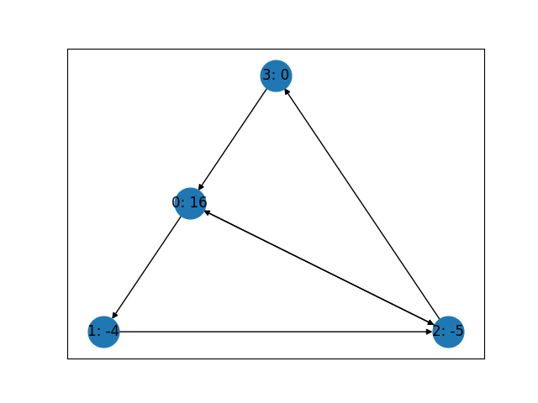
Divisors
Where divisor
D=[16, -4, -5,0]
G=

Slide 7
The Picard Group and The Jacobian
The Picard Group of a graph, Pic(G), is the set of all equivalence classes that the divisors of that graph G can be a part of.
The degree of a divisor, deg(D), is the sum of each of the divisor’s elements.
The Jacobian of a graph, Jac(G), is a special subset of Pic(G) such that every divisor in each equivalency class has a degree of 0. If a divisor is in one of the Jacobian’s classes, it can be made winning after a finite series of moves.

Slide 8
Trees, Cycles, and Pseudo-Trees
A Tree Graph is a graph where there is only one path between vertices and contains no cycles.
A Cycle Graph is a graph that only has one cycle, or a line graph with another connection between the first and last vertices.
A Pseudo-Tree Graph is a combination of these two. This graph is created by gluing a tree to one of the vertices of a cycle graph.

Slide 9
Finding The Rank of a Tree’s Picard Group
The Picard group is commonly written in the form Pic(G) = Jac(G) x Z^{n}, where n is the rank of the Picard group. [Grounded meeting of rank]
This rank for a tree graph can be easily calculated inductively. By reconstructing an arbitrary tree edge by edge, its rank can be determined by following two rules.
If the next arrow drawn is pointing towards the graph or if it is bidirectional, the rank does not change.
If the next arrow is pointing towards the new vertex, the rank increases by one.
The rank of a tree corresponds to the number of terminal strong components of that tree, sections that are only connected to the rest of the graph by an incoming edge and have a path between all of its member vertices.

Slide 10
Finding The Jacobian of a Tree or Cycle Graph
The Jacobian of a tree is simple, it is always the trivial group. [Reasoning]
The Jacobian of a Cycle graph is more complex, but easily calculable if the cycle has two paths, or sections of oriented edges with the same orientation.
For this special type of cycle graph, all Jacobians, Z1 to Zn exist for some orientation.

Slide 11
Finding The Jacobian of a Cycle Graph
Beginning with a non-oriented cyclic graph, Jac(G) = Zn.
Orienting one edge (x, x+1) in the counter-clockwise direction yields a trivial Jacobian of {0} (Z1).
Orienting the edge (x-1, x) to clockwise and (x+1, x+2) to counter-clockwise yields a Jacobian of Zn-1.
Orienting one edge (x, x+1) in the counter-clockwise direction, another edge (x-1, x) to clockwise, and (x+1, x+2) to counter-clockwise yields Jac(G) = Zn-2.
Adding onto either of the two paths by orienting the next or preceding bidirectional arrow yields Jac(G) = Zn-3.
Continuing this pattern until the two paths meet yields all invariant factors down to Z2. Going further to orient the entire graph to one direction results in a trivial Jacobian of {0}.
This pattern should hold for all cycle graphs C3 to Cx and has been proven for graphs C3 to C80.

Slide 12
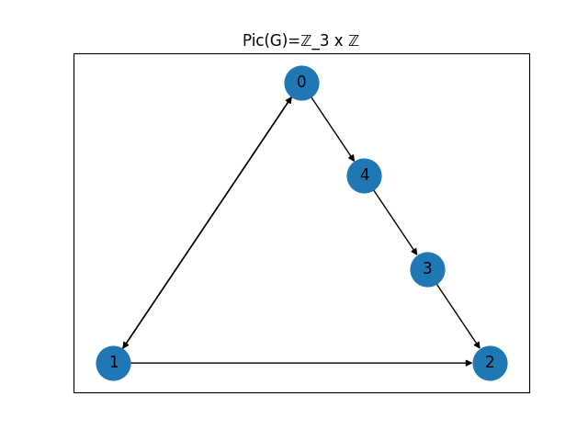


Finding The Jacobian of a Cycle Graph

Slide 13
Credits
Image of chip firing game: https://www.wikiwand.com/en/Chip-firing_game

