Slide 1
Source Code Quality Enhancer
Tristan Percy Read
001151378

Slide 2
Introduction
This project seeks to present a solution to the problem of software source code quality by creating a tool that can analyze source code and reformat it to a user defined style with support for object oriented programming principles in correlation with design patterns to create a well structured and higher quality codebase from a pre-existing codebase or to aid in the development of a new project with enforced coding standards.

Slide 3
Design philosophy
The continuous integration pipeline was used as the development process in this project and as such the ”todo” task and feature list was updated as new features were thought of which would then get marked off when started, completed or dropped from the project pipeline as the project progresses.
The product that was developed was split into various modules. Each module was designed to be independent from one another. This has multiple advantages, such as making the code easier to maintain and allowing for easier debugging and modification. This was achieved through the use of various design patterns from the object oriented programming paradigm.
Code would be parsed into an abstract syntax tree which would then be used to analyze and update the program structure.

Slide 4
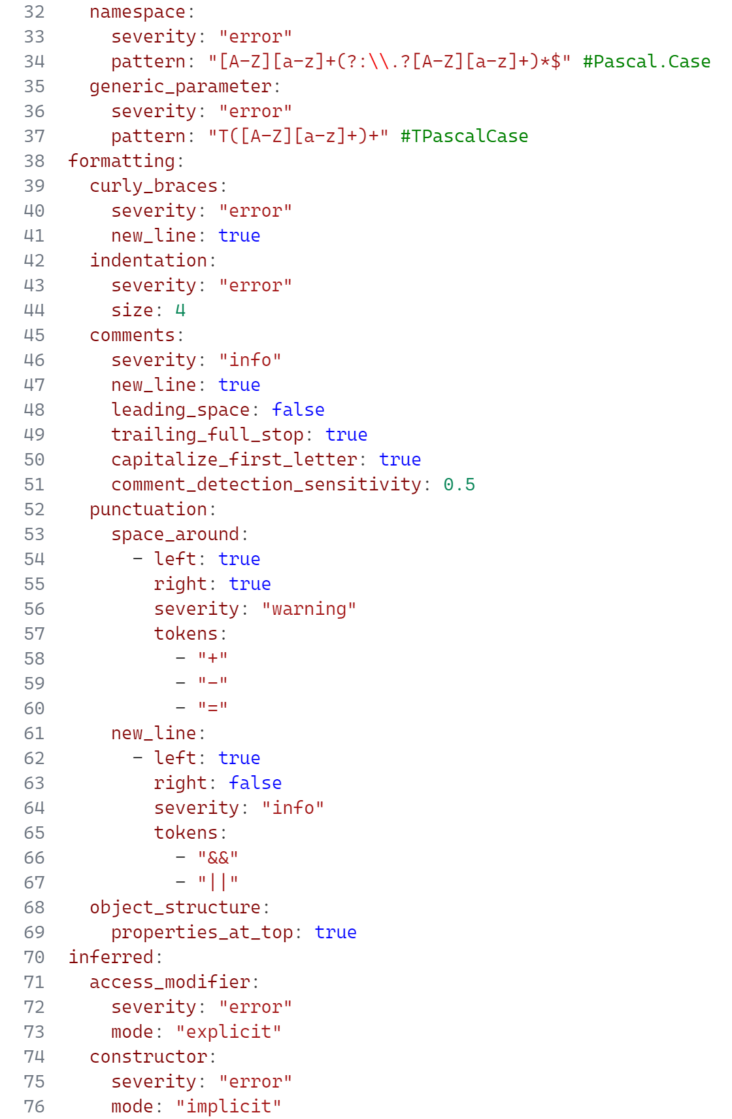
User defined configuration
As there is a lack of standardization in code formatting has lead to a key aim of this tool to be able to be configured by the user.
YAML was chosen as the configuration language due to its human readability, as well as being very easy to implement and understand by the end user. A custom schema was created for the configuration to aid the user in creating the configuration file by providing IDE hints and validation on their configuration.
By default, all modules are disabled and the severity is set to ’info’. Depending on how strict the work environment to be made, the severity can be set to cause an error which will result in not allowing the program to compile. This can be beneficial in a large team where you want to enforce a strict code style to improve readability and maintainability of the codebase.
Notes:
Show an example of this configuration in the works.

Slide 5
Naming engine (1/3)
One of the major goals of this project was to create a module for the program that would correct the naming of objects, members and variables to match a user-defined style, the point of this is to ensure consistency of the schema throughout the program and because of this importance it is once of the major goals of the project.
While there are many regex tools available, the majority of them are only capable of testing if a string matches a pattern and performing simple replacements on matches within a string based on group constructs.
Because of this a new type of regex engine had to be created from scratch to be able to convert an input string to match a pattern automatically.

Slide 6
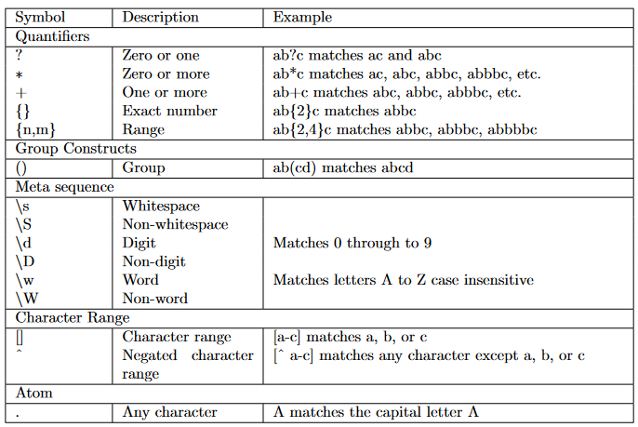
Naming engine (2/3) – Pattern parsing
A simplified token set was created that would be used for the new regex engine. This simplified expression set was picked to be simple to implement and easy to read.
An advanced language set is not necessarily needed for matching single strings on object names, however there are cases where it could be useful.
When processed, the tokens are parsed into an abstract syntax tree. he choice for representing the pattern data in a tree structure was made to allow for easy manipulation of the pattern. For example, if a quantifier token is found, it makes it significantly easier to determine what the quantifier token is linked to as one can either navigate up the tree or back one token to find the relevant token or set that needs to be quantified.
Notes:
Show the simplified regex tokens in the YAML config file.

Slide 7
Naming engine (3/3) – Input conforming (1/3)
With the input string, various options can be passed to the convert function to allow for fine-tuning of the conversion process.
One such configuration option allows for dropping mismatched tokens, for example in the cenario of renaming code objects, one will, more often than not, want to remove mismatched literals with a blank. To provide an example of this, if we want to conform the input __my_variable to the pattern ([A-Z][a-z]+)+, it should produce a desired output of MyVariable.
The conversion process is a recursive process that starts at the root token of the tree structure. Each implementation of the abstract conform method takes a single parameter of the ConformParameters object which contains information about the current state of the conversion process, the input string, the current index in the input string, the current state of the newly generated output string and other options specific to other tokens.

Slide 8
Naming engine (3/3) – Input conforming (2/3)
Using the Quantifier class as an example, this classes implementation of the parse method will first determine if the quantifier is greedy or not.
A greedy quantifier is one that matches a pattern up to infinity times. Within the conform parameters a value can be set to configure a greedy quantifier to break under certain conditions. The method will then attempt to run the conform method on its children, if the conform method fails the quantifier will break and return the current index in the input string if the quantifier was configured in the zero-or-more mode.
Notes:
Show this as a demo through the unit tests using step-by-step debugging.

Slide 9
Naming engine (3/3) – Input conforming (3/3)
To give an example of how an implementation of the conform method generates a corrected string, we can look at the CharacterRange class.
The character range class is used to match a single character to a range of valid characters.
The character at the current index in the input string is checked to see if it is within the range of valid characters, which is achieved by comparing the characters Unicode value to the Unicode values of the start and end characters of the range.
If the character is within the range, the character is added to the output string and the index is incremented. If the character is not within the range the method will attempt to see if the character can be converted to a valid character by changing the case of the character.
Notes:
Show this as a demo through the unit tests using step-by-step debugging.

Slide 10
Document formatting (1/5) – Comments (1/2)
Comments can be styled in various ways. The tool provides options to force comments to be on their own lines, or inline with code and additionally choose whether comments should have a leading space or a trailing full stop.
If the user has configured comments to be on a new line then this can be navigated backwards through the AST to check if there are any non-whitespace tokens on the same line as the comment.
Within the user configuration file, an additional option can also be specified to set the sensitivity of the comment detection. By default this value is set to 50% meaning that if the number of characters matched in the pattern is greater than 50% of the total number of characters in the comment token string, it is to be considered a comment.

Slide 11
Document formatting (2/5) – Comments (2/2)
Before styling comments, the tool will check to see if the comment token contains a mostly-text based comment or a commented out line of code. This is achieved by using a regex pattern on the token which captures words but not code.
The regular expression pattern used, (?<![.])\b(?:[A-Z][a-z]*|[a-z]+|)\b(?![.(][A-z]), can be broken down as follows:
(?<![.]) Don’t capture when the text follows a full-stop;
\b Limit the search to be between word boundaries (i.e. is a letter followed by a non-letter);
(?: Capture everything inside as a single match;
[A-Z][a-z]* Capture a Capital and optionally unlimited lowercase letters, or...
[a-z]+ Capture one or more lowercase letters, or...
Include spaces in the search captures.
(?![.(][A-z]) Don’t capture when the sequence ends with either a . or ( as these are common code tokens that often directly proceed text, so long as it is followed by another A-z character.
Notes:
Show this as a demo through the standalone tool with various configuration files.

Slide 12
Document formatting (3/5) – Indentation
To help with consistency, an indentation correction module was created. Instances where the indentation may need changing could be if a document is configured with an indentation level of 2 spaces but the developer wants to change this to 4 spaces.
To determine indentation levels for a given line the document is navigated line-by-line. A last-in-first-out (LIFO) stack is created to hold information about the current context level. A context level is determined by the following tokens: { } ( ) [ ].
The indentation level is then determined by the number of items in the stack multiplied by the user-defined indentation size, allowing for the tool to determine the correct indentation level for each line in the document. A simple text search for the tokens cannot be relied upon as they may be part of a string or comment, therefore the AST has to be navigated to find the tokens.

Slide 13
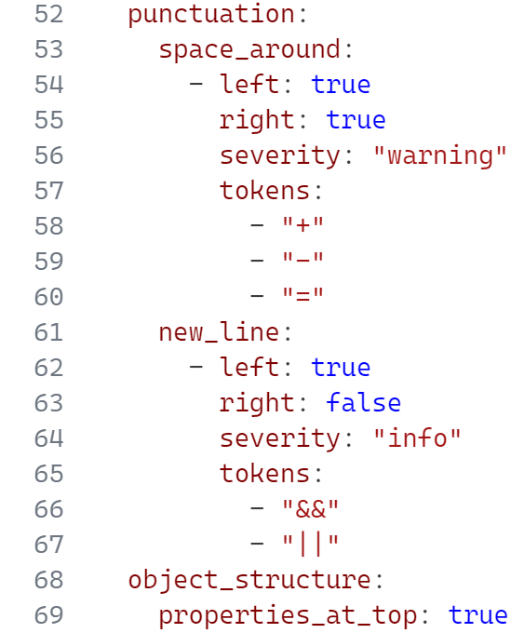
Document formatting (4/5) – Punctuation
Depending on a developers background, they may have different preferences for the formatting of certain language punctuation.
In C#, punctuation is any token that is not a keyword or object variable, for example ; + - etc. The punctuation sub-module allows the user to configure the spacing around punctuation, and whether punctuation this should be on the same line as the previous token or on a new line.
Within the YAML configuration file the user has the ability to define as many punctuation rules as they’d like.
The tool will then navigate the AST to find any matching punctuation and adhere it to the configuration. For each of these options within the YAML file, the user should provide an array of configurations.
Notes:
Show this as a demo through the standalone tool with various configuration files.

Slide 14
Document formatting (5/5) – Object structure
The object structure sub-module is rather minimal but can have a major impact on code readability. It provides the user with the option to force object properties and fields to be at the top of the object declaration with all methods at the bottom.
This has a significant impact on readability and debugging as it contributes to reducing the amount of spaghetti code.
By separating out the methods and properties it makes it far easier to understand what members a class has as there is no need to randomly dig through a class or struct to find potentially tucked away properties and fields between large method bodies
Notes:
Show this as a demo through the VSIX integration.

Slide 15
Language features (1/2) - Access modifiers
In C#, when a top level class or struct is declared, it is assigned a default access modifier of internal, while any nested declarations within the class or struct are assigned a default access modifier of private.
To many it is likely not known what the default access modifiers are, so by providing the option to require explicit access modifiers, it can help to improve the readability of the codebase by making it clear what the access modifier is for a given declaration.
If enabled in the YAML configuration, a check is run to determine what modifiers the node has. If the node is missing access modifiers a diagnostic is created and returned to the user with an automated code fix. The code fix will insert the missing access modifier into the list of modifiers for the node. The access modifier to be inserted is determined by the level of the node.
Notes:
Show this as a demo through the VSIX integration.

Slide 16
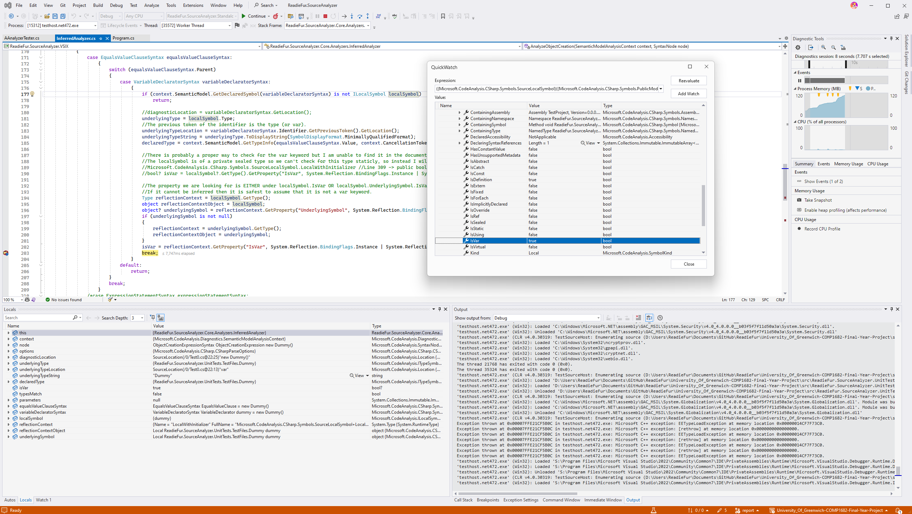
Language features (2/2) - Object initialization
Introduced in C# 9.0, the implicit object initialization syntax allows for the omission of the object type when initializing an object whose underlying type is already known at compile-time. This can help to reduce the amount of code written and can help to improve readability by reducing the amount of boilerplate code that is written.
The underlying type can be determined in one of two ways: the first is by checking if the object creation expression belongs to a variable declaration; and the second is by checking if the object creation expression is being assigned to a variable.
During the development of this module, there was a significant lack of documentation and resources online to aid in this area, so a debugging research process conducted to help with this.
Notes:
Demonstrate this via the debugging research process

Slide 17
Unit tests (1/3)
Unit tests were the primary method of testing the project. Unit tests are particularly useful for an algorithmic system as it allows for the testing of individual components in isolation.
To ensure that the custom regex engine was robust, a comprehensive set of unit tests were written. These tests were designed to test the engine under a variety of conditions, including invalid inputs and a plethora of inputs to be converted to various output formats.
For testing the code analyzers and fix providers the MSBuild testing framework was used. This framework provides the basic functionality to compile input source files, run the analyzers and fix providers on the compiled source files and then compare the generated diagnostics and fixes to expected results provided by the test. The work put into making this testing framework more streamlined and easier to use was a significant development in ensuring the reliability of this tool.
Notes:
Demonstrate this via the debugging research process

Slide 18
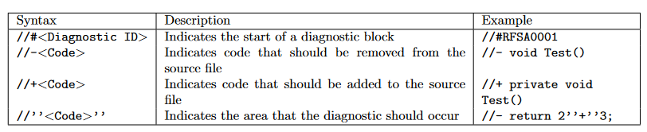
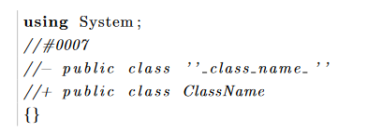
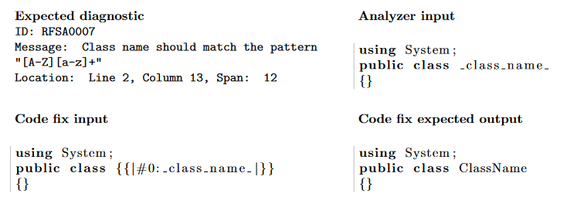
Unit tests (2/3) – File parser
The MSBuild testing framework requires a custom format which is not ideal as it produces a lot of duplicated code, so to reduce this a custom source file parser was created to drastically cut down the amount of code that was required to write the tests.
The file interpreter creates three copies of the source file in memory for the analyzer input, code fix input and expected output. The source file is then parsed for diagnostic comments using a regular expression.
For example, if a single source file had the following content (see figure 1) the file interpreter will then parse this to produce three files with the required syntax and data for each of MSBuild inputs as well as the diagnostics to be expected from the analyzer (see figure 2).
Using this system the test data can be written in a more human-readable format with much less code duplication. This system also allows for the easy addition and modification for new and existing tests.
Notes:
Demonstrate this via the debugging research process

Slide 19
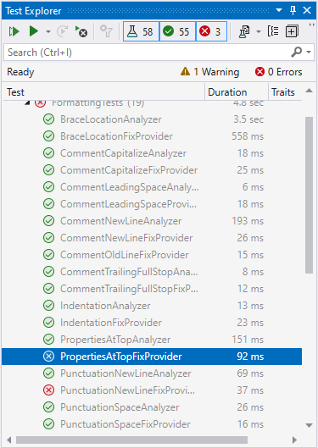
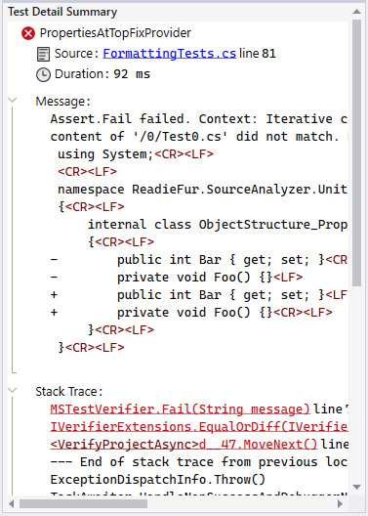
Unit tests (3/3) – Results
Of the automated tests conducted, fifty-eight were created of which fifty-five were successful. The three
tests that failed were due to the line ending issue mentioned above. The tests that failed were not fixed as
they were not major issues, would not affect the functionality of the tool and also due to a lack of time to
resolve the issue. The tests that passed were able to validate the functionality of the tool and ensure that
the tool was functioning correctly and as expected. Given the success rate of 94.8%, it can be concluded
that the tool is functioning well within a passable margin of error and is ready enough for real-world use.

Slide 20
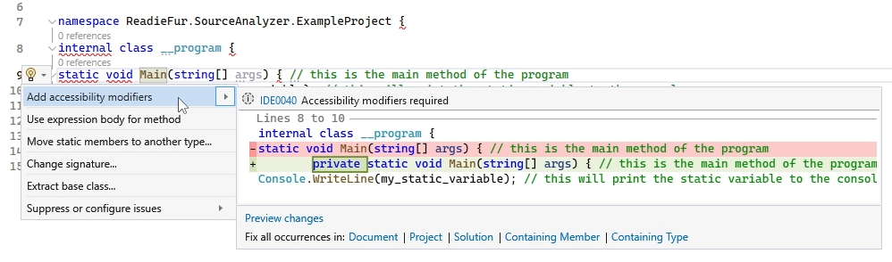
VSIX plugin
Using the VSIX build of the project, a plugin compatible with the Visual Studio IDE gets created.
This plugin allowed for the tool to be interacted with via IDE hints. In order to examine this a test project was loaded up into Visual Studio with the plugin loaded.
After compiling the project the IDE would gather diagnostics from the build tool and display them in the error list and the code editor.
Notes:
Show this in action in Visual Studio

Slide 21
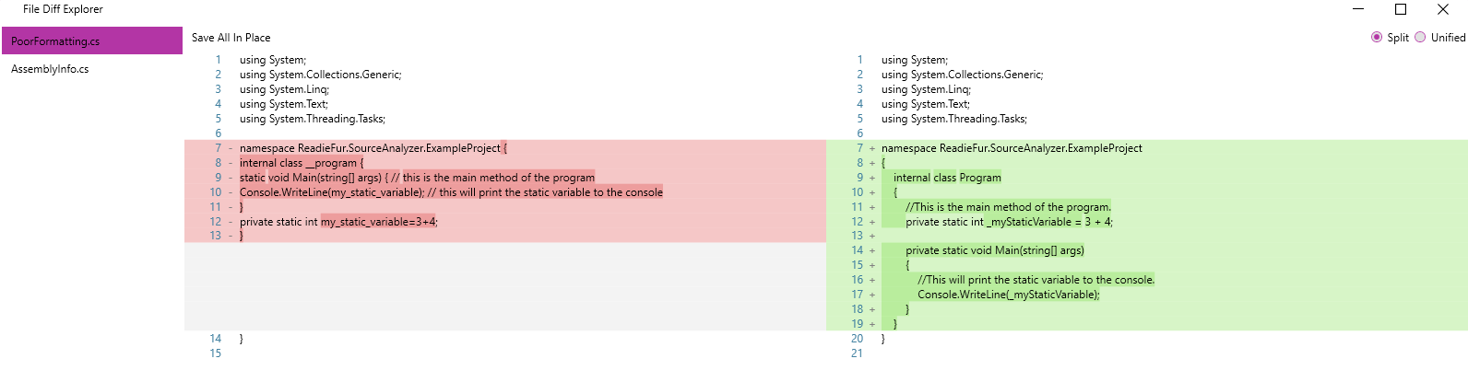
Standalone tool
The standalone package was built to provide a way to run the tool without the need for the Visual Studio IDE. The standalone program is simplistic and takes a C# solution file from which the analysis can be run on. Any files that can have fixes applied will be displayed in a graphical window with a file differential view.

Slide 22
Evaluation
With more time and resources further benefits and efficiencies may have been achievable but given the constraints, the project has been a success and has achieved the goals that were set at the set out.
From the research conducted and the results that were obtained, it can be seen that the project has been successful in achieving the goals that were set out. The project has been able to create a tool that can restructure source code in a way that is easy to use and can be integrated into a user’s workflow.
In the future with more time the aim would be to continue working on the project, to further develop the tool and add new features and functionality.
The primary goal that would be desirable would be for this tool is to make it multi-language compatible, as this would greatly increase the usefulness of the tool and make it more accessible to a wider range of users. An idea of how such a change could be implemented would be to provide a language schema in the configuration that would then be used to parse to source code into a universal AST that could then be used to restructure the code. This would also allow for a more flexible tool that could be used on multiple languages and platforms, as currently the tool is limited to only working with C# code via the MSBuild pipeline which is limited to the Windows platform.

