Slide 1
组 会 汇 报
论文分享:
论文1（时间和出处）
论文2（时间和出处）
进展:
做了什么事
想跟大家讨论什么
后续计划
汇报：张雪松 2023.05.18

Slide 2
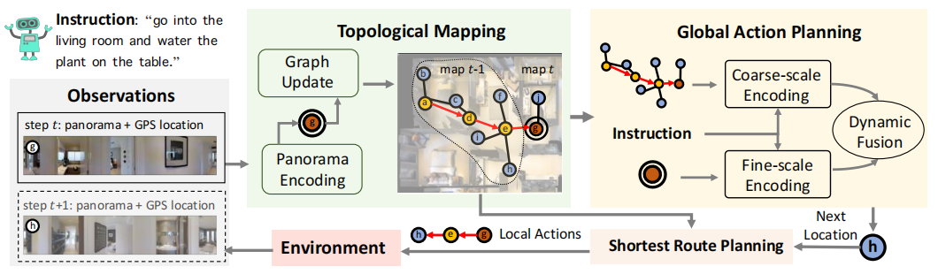
Retrospect
对之前的工作进行简单的回顾
文献引用
Notes:
下面简单介绍一下本文任务的主要流程
首先，agent的输入是当前位置的全景图和位置信息，以及周围其他可导航点的位置信息
一方面保留当前位置的视觉和位置信息进行细粒度的局部行为预测
另一方面将当前的位置的输入，从0开始构建拓扑图，从而进行全局的动作空间预测
最后将局部和全局的预测进行动态融合之后，预测下一个全局的可导航的位置
最后通过弗洛伊德算法进行最短路径规划到达下一个预测点，（注意，step t是g，而step t+1是h）

Slide 3
Lunwenbiaoti Kefenlianghang
动机（可能也要详细介绍相关工作）
方法
实验结果
值得借鉴的地方
局限或疑问

Slide 4
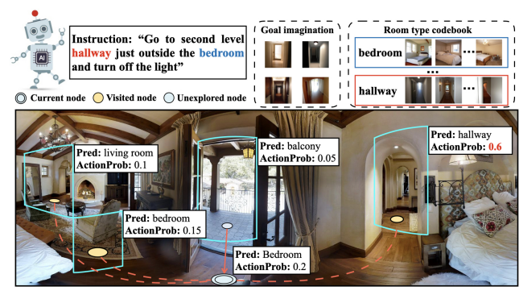
Related work
Related work
1，Embodied Referring Expression Grounding（VLN）
2，Map-based Navigation(online metric map & topological maps)
3，Visual Common Sense Knowledge（GLIDE[6], the text-to-image model）
Contribution
The Layout Learner learns to infer the room category
distribution of neighboring unexplored areas along the
path for coarse layout estimation
The Goal Dreamer imagines the destination beforehand

Slide 5
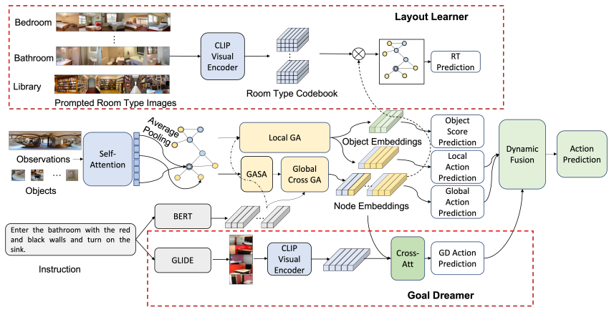
Methodology
先介绍总体流程图，再介绍细节

Slide 6

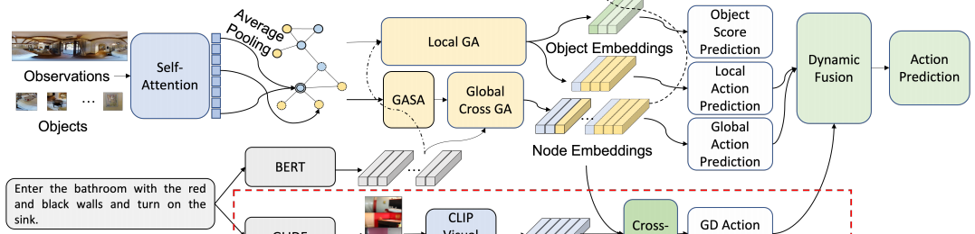


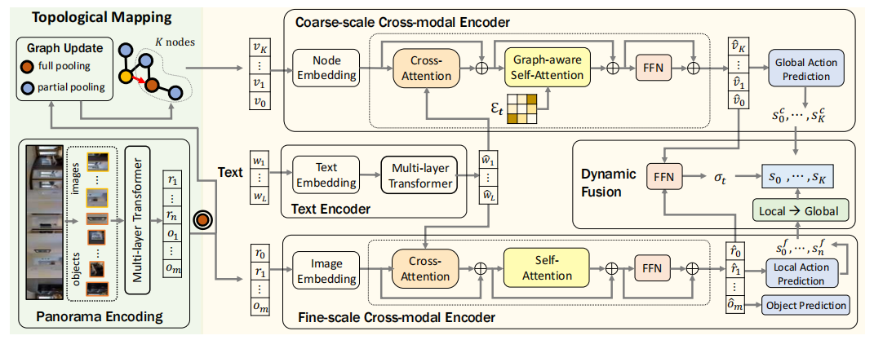
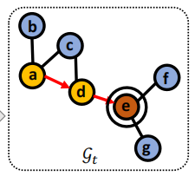
Methodology
Base architecture
Global Node Self-Attention.
Cross Graph Encoder.
Notes:
这一页主要介绍一些本文中的符号定义
VLN环境可以用图表示，其中v表示可导航节点，e表示边，论文里面通常使用含有下标t的符号，表示第t步得到的环境图
对象特征是使用注释的object bounding box或者自动的object检测器

Slide 7
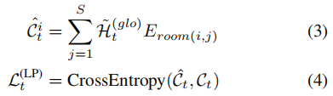

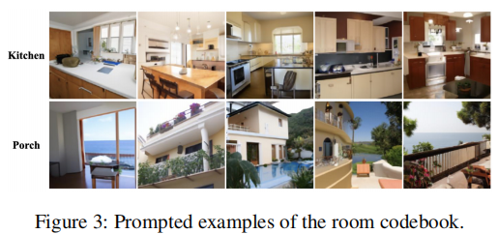
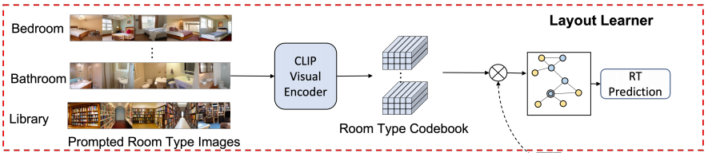

Layout Learner
Building Room Type Codebook.
Extract room type annotations
Create room type template
“A dining room with table and chairs” for room type “dining room”
Generate room type images
Environment Layout Prediction.
i 表示第i个房间类型，s\j表示第s\j个每个房间类型的images数量，Ct是k类，k个房间类别，即预测每个节点属于哪个房间类型
Notes:
这一部分介绍拓扑图是如何构建的，以及途中的节点是怎么表示的
代理做出一个action之后，得到新节点的视觉信息，agent向graph中添加节点，并更新节点表示
图中黄色的节点是访问过的节点，蓝色的节点是与访问过的节点相邻的节点，红色的节点是当前的节点
黄色和红色的节点都是访问的节点因此可以接收全景图，但是蓝色节点的信息只能接收黄/红节点能访问到的那个view，所以他们的视觉表示不同
在每个节点，可以接收到当前的全景图，他包括图像特征和对象特征，使用自注意进行编码，
为了方便表示，编码后的Rt仍表示为Rt，也就是红色加圈的节点的视觉表示
红色不加圆圈的是Rt和Ot平均池化视觉表示
对于蓝色可导航的点，只能接收从访问的位置观察到的view，如果可以从多个访问过的位置被观察到就累加这些view
对于蓝色的节点编码和上面的一样，但是他的输入没有object之后部分观察到的view
vi表示节点Vi池化后的视觉表示

Slide 8


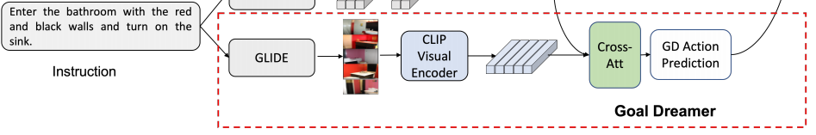


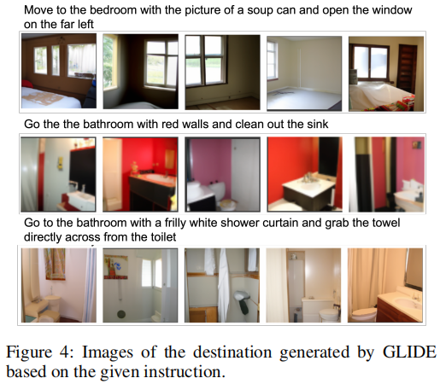



Goal Dreamer
Goal Dreamer
Notes:
在得到上面的节点视觉表示之后，
当前构建的map用来与指令结合进行全局预测，也就是对map上所有的节点打分
当前节点用来与指令编码结合进行细粒度的局部动作预测，同样也会预测一个object
由于局部预测空间是全局预测空间的子集，所有可以将局部预测和全局预测结果动态融合进行全局预测
下面将分别介绍全局和局部预测编码，以及动态融合

Slide 9





Decision Maker
回顾整个流程
Notes:
在得到上面的节点视觉表示之后，
当前构建的map用来与指令结合进行全局预测，也就是对map上所有的节点打分
当前节点用来与指令编码结合进行细粒度的局部动作预测，同样也会预测一个object
由于局部预测空间是全局预测空间的子集，所有可以将局部预测和全局预测结果动态融合进行全局预测
下面将分别介绍全局和局部预测编码，以及动态融合

Slide 10
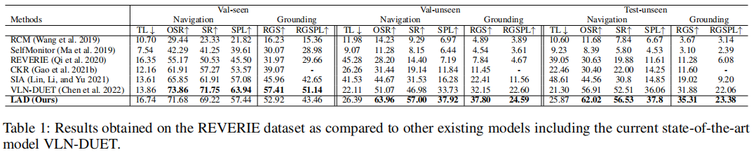
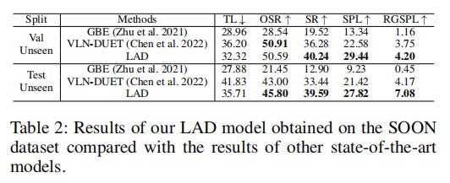
Experiments
Comparison with State of the Art

Slide 11
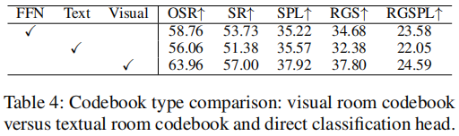
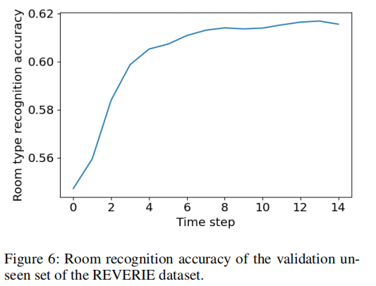
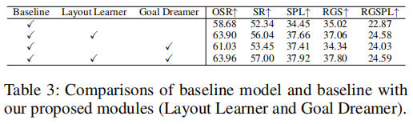
Experiments
Ablation Study
Layout Learner and Goal Dreamer(Table3)
Visual or textual common sense(Table4)
Room type prediction accuracy(Figure6)

Slide 12
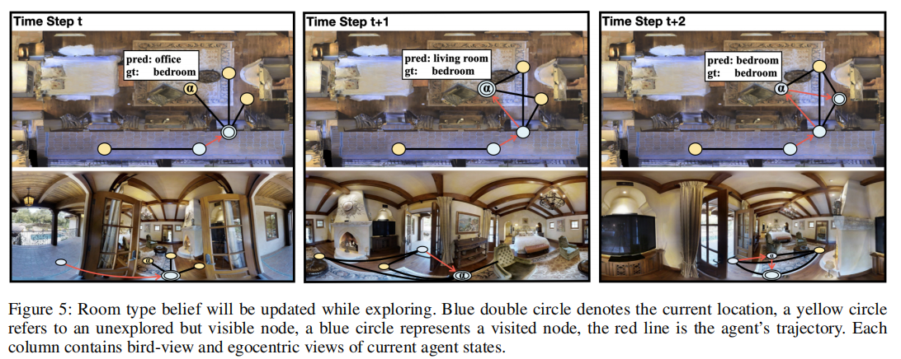
Visualization

Slide 13
借鉴参考
Reference
[1]Chen S, Guhur P L, Tapaswi M, et al. Think global, act local: Dual-scale graph transformer for vision-and-language navigation[C]//Proceedings of the IEEE/CVF Conference on Computer Vision and Pattern Recognition. 2022: 16537-16547.
[2]Wang H, Wang W, Shu T, et al. Active visual information gathering for vision-language navigation[C]//Computer Vision–ECCV 2020: 16th European Conference, Glasgow, UK, August 23–28, 2020, Proceedings, Part XXII 16. Springer International Publishing, 2020: 307-322.
[3]Zhao Y, Chen J, Gao C, et al. Target-driven structured transformer planner for vision-language navigation[C]//Proceedings of the 30th ACM International Conference on Multimedia. 2022: 4194-4203.
[4]Li J, Bansal M. Improving Vision-and-Language Navigation by Generating Future-View Image Semantics[J]. arXiv preprint arXiv:2304.04907, 2023.
[5]Li M, Wang Z, Tuytelaars T, et al. Layout-aware Dreamer for Embodied Referring Expression Grounding[J]. arXiv preprint arXiv:2212.00171, 2022.
[6]Nichol A Q, Dhariwal P, Ramesh A, et al. GLIDE: Towards Photorealistic Image Generation and Editing with Text-Guided Diffusion Models[C]//International Conference on Machine Learning. PMLR, 2022: 16784-16804.
Q&A

Slide 14
局限或疑问讨论
Current works & challenges
Objects recognition
Trajectory length
Reference
[1]Chen S, Guhur P L, Tapaswi M, et al. Think global, act local: Dual-scale graph transformer for vision-and-language navigation[C]//Proceedings of the IEEE/CVF Conference on Computer Vision and Pattern Recognition. 2022: 16537-16547.
[2]Wang H, Wang W, Shu T, et al. Active visual information gathering for vision-language navigation[C]//Computer Vision–ECCV 2020: 16th European Conference, Glasgow, UK, August 23–28, 2020, Proceedings, Part XXII 16. Springer International Publishing, 2020: 307-322.
[3]Zhao Y, Chen J, Gao C, et al. Target-driven structured transformer planner for vision-language navigation[C]//Proceedings of the 30th ACM International Conference on Multimedia. 2022: 4194-4203.
[4]Li J, Bansal M. Improving Vision-and-Language Navigation by Generating Future-View Image Semantics[J]. arXiv preprint arXiv:2304.04907, 2023.
[5]Li M, Wang Z, Tuytelaars T, et al. Layout-aware Dreamer for Embodied Referring Expression Grounding[J]. arXiv preprint arXiv:2212.00171, 2022.
[6]Nichol A Q, Dhariwal P, Ramesh A, et al. GLIDE: Towards Photorealistic Image Generation and Editing with Text-Guided Diffusion Models[C]//International Conference on Machine Learning. PMLR, 2022: 16784-16804.
Q&A

Slide 15
论文分享:
论文1（时间和出处）
论文2（时间和出处）
进展:
做了什么事
想跟大家讨论什么
后续计划

Slide 16
最近进展
Reference
[1]Chen S, Guhur P L, Tapaswi M, et al. Think global, act local: Dual-scale graph transformer for vision-and-language navigation[C]//Proceedings of the IEEE/CVF Conference on Computer Vision and Pattern Recognition. 2022: 16537-16547.
[2]Wang H, Wang W, Shu T, et al. Active visual information gathering for vision-language navigation[C]//Computer Vision–ECCV 2020: 16th European Conference, Glasgow, UK, August 23–28, 2020, Proceedings, Part XXII 16. Springer International Publishing, 2020: 307-322.
[3]Zhao Y, Chen J, Gao C, et al. Target-driven structured transformer planner for vision-language navigation[C]//Proceedings of the 30th ACM International Conference on Multimedia. 2022: 4194-4203.
Q&A

Slide 17
想讨论的问题
Reference
[1]Chen S, Guhur P L, Tapaswi M, et al. Think global, act local: Dual-scale graph transformer for vision-and-language navigation[C]//Proceedings of the IEEE/CVF Conference on Computer Vision and Pattern Recognition. 2022: 16537-16547.
[2]Wang H, Wang W, Shu T, et al. Active visual information gathering for vision-language navigation[C]//Computer Vision–ECCV 2020: 16th European Conference, Glasgow, UK, August 23–28, 2020, Proceedings, Part XXII 16. Springer International Publishing, 2020: 307-322.
[3]Zhao Y, Chen J, Gao C, et al. Target-driven structured transformer planner for vision-language navigation[C]//Proceedings of the 30th ACM International Conference on Multimedia. 2022: 4194-4203.
[4]Li J, Bansal M. Improving Vision-and-Language Navigation by Generating Future-View Image Semantics[J]. arXiv preprint arXiv:2304.04907, 2023.
[5]Li M, Wang Z, Tuytelaars T, et al. Layout-aware Dreamer for Embodied Referring Expression Grounding[J]. arXiv preprint arXiv:2212.00171, 2022.
[6]Nichol A Q, Dhariwal P, Ramesh A, et al. GLIDE: Towards Photorealistic Image Generation and Editing with Text-Guided Diffusion Models[C]//International Conference on Machine Learning. PMLR, 2022: 16784-16804.
Q&A

Slide 18
后续计划
Reference
[1]Chen S, Guhur P L, Tapaswi M, et al. Think global, act local: Dual-scale graph transformer for vision-and-language navigation[C]//Proceedings of the IEEE/CVF Conference on Computer Vision and Pattern Recognition. 2022: 16537-16547.
[2]Wang H, Wang W, Shu T, et al. Active visual information gathering for vision-language navigation[C]//Computer Vision–ECCV 2020: 16th European Conference, Glasgow, UK, August 23–28, 2020, Proceedings, Part XXII 16. Springer International Publishing, 2020: 307-322.
[3]Zhao Y, Chen J, Gao C, et al. Target-driven structured transformer planner for vision-language navigation[C]//Proceedings of the 30th ACM International Conference on Multimedia. 2022: 4194-4203.
[4]Li J, Bansal M. Improving Vision-and-Language Navigation by Generating Future-View Image Semantics[J]. arXiv preprint arXiv:2304.04907, 2023.
[5]Li M, Wang Z, Tuytelaars T, et al. Layout-aware Dreamer for Embodied Referring Expression Grounding[J]. arXiv preprint arXiv:2212.00171, 2022.
[6]Nichol A Q, Dhariwal P, Ramesh A, et al. GLIDE: Towards Photorealistic Image Generation and Editing with Text-Guided Diffusion Models[C]//International Conference on Machine Learning. PMLR, 2022: 16784-16804.
Q&A

Slide 19

Thanks!

Slide 20
素材
一些素材

