Slide 1

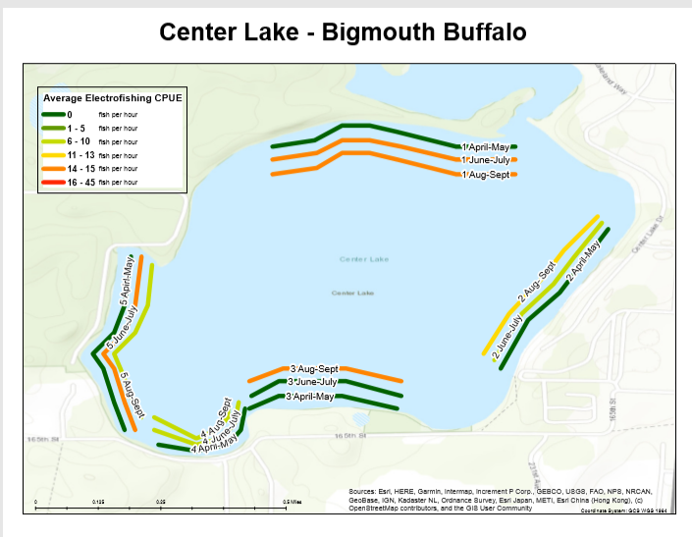
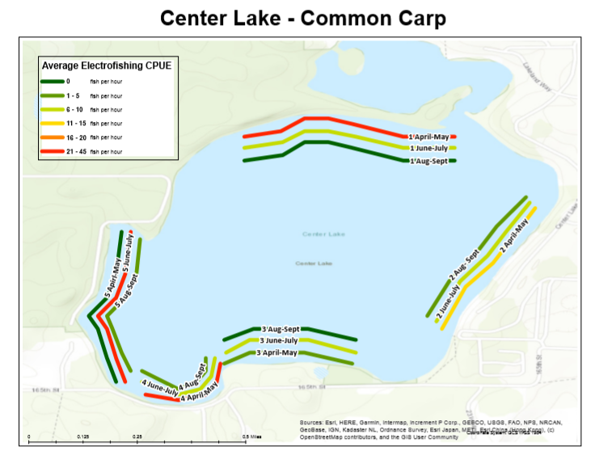
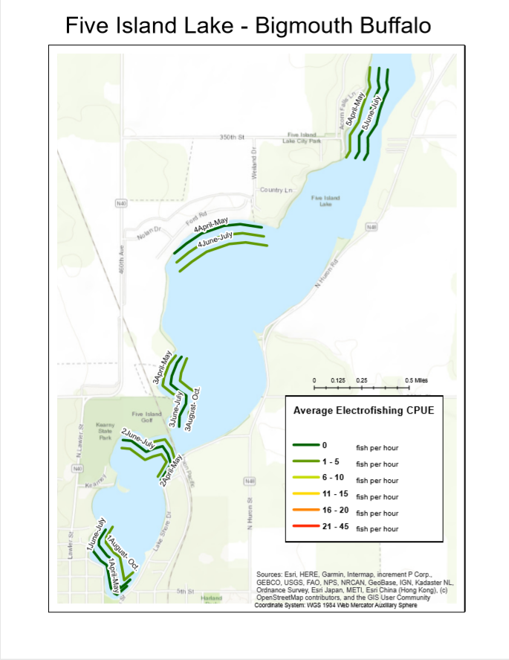
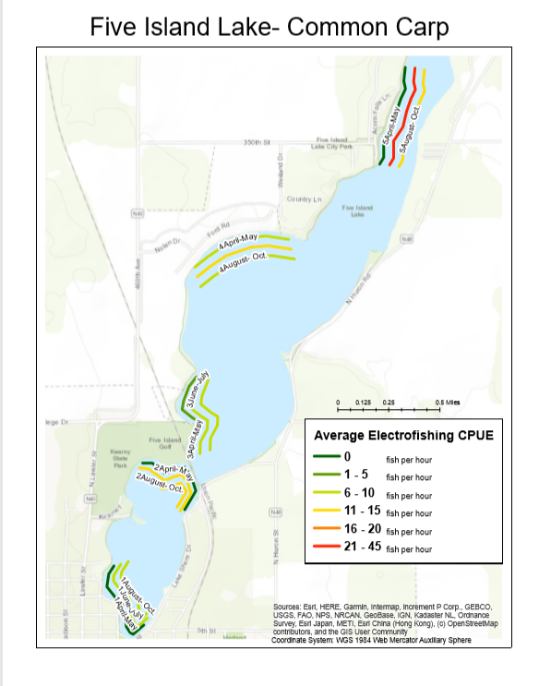
Temporal Analysis of Common Carp and Bigmouth Buffalo Electrofishing CPUE in Shallow Lakes of Northwest Iowa
Sarah Hanna¹, Martin Simonson², Michael Weber²
1: Department of Biology, University of Northern Iowa 2: Department of Natural Resource Ecology and Management, Iowa State University
Introduction
Results
Conclusions
Understanding the temporal and spatial behavior of fishes is important for management. Seasonal variation in weather and daylight influence fish behavior and location, affecting catch rates in sampling gears. Accurate estimates of fish abundance help inform appropriate fish management techniques, especially for Common Carp and Bigmouth Buffalo populations where their abundance can adversely affect water quality in shallow lakes. Our objective was to evaluate how catch rates change within a lake as the sampling season progresses. Due to differences in behavior and catchability between species, we predicted that average Carp catch rates would decrease from April through September while Buffalo catch rates would remain relatively constant. In 2019, electrofishing was used to sample fishes along five standard shoreline transects in Center Lake (Dickinson County) and Five Island Lake (Palo Alto County). Using GIS software, average CPUE for April-May, June-July, and August-September were mapped. At Center Lake, average CPUE for Common Carp was variable by transect as the summer months progressed, CPUE peaked in summer at some transects while other transects decreased to zero fish per hour in August and September. Inversely, the average CPUE for Bigmouth Buffalo increased as the months progressed in almost all areas of the lake. At Five Island Lake, average CPUE for Common Carp at each transect increased as the season progressed from spring to summer. CPUE increased in the fall months at some transects, while other transects remained the same. CPUE for Bigmouth Buffalo was variable by transect. As summer progressed CPUE increased at some transects, others decreased to zero during June-July than increased in the fall, and others decreased to zero in summer and fall months. Understanding these temporal shifts in catch rates for Carp and Buffalo can be used by fisheries management to focus sampling efforts during months with higher catch rates.
This section might not be needed, if you can fit a few bullet points about results below the maps
Discussion
Objective
Methods
Data Collection methods
Electrofishing sampling occurred at five standard transects in Center Lake, and Five Island Lake.
GIS Mapping Methods
Standard transects X, Y coordinates were uploaded into a geodatabase and plotted onto a topological base map. Points to Line tool was used to create a line feature class connecting appropriate coordinates to create the transect lines. This feature class was stored in the geodatabase. Each transect was duplicated twice resulting in three lines for each transect. Corresponding specie, transect, and average CPUE data was entered in to the attribute table of this feature class. This data was calculated prior using R. Feature class symbology was manipulated to display a quantity color gradient heat map with six classes. Map elements were added including legend, coordinate system, and scale bar. This process was used for both Center Lake and Five Island Lake maps.
What maps show us about fish catch rates.
Overall trends, similarities, discrepancies between lakes, within lakes.
Implications for fisheries management.
Center:
Focus efforts during early season for carp in later in season for buffalo
Buffalo were
Acknowledgements
References

