Slide 1
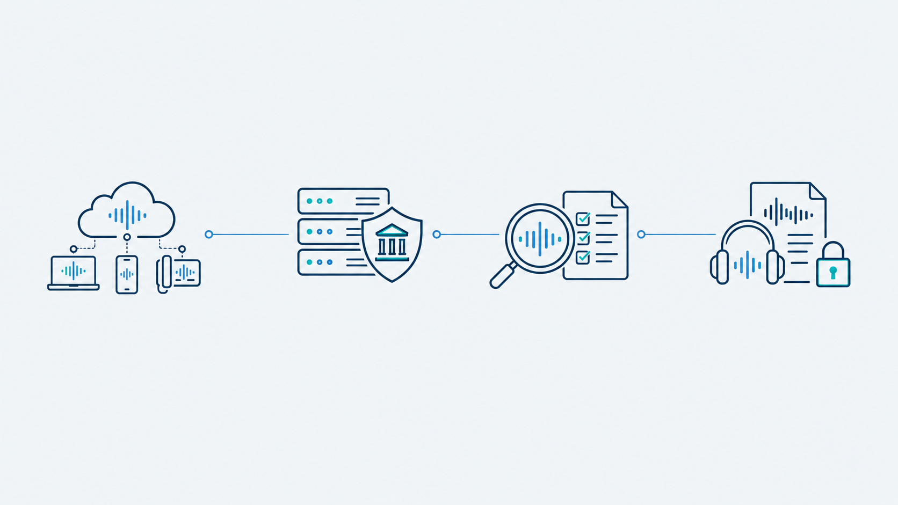
TECHNICAL PRE-READ
Voice AI evaluation architecture
A provider-neutral harness connects to hosted voice services through adapters, runs common banking scenarios and separates model behaviour from the effectiveness of harness controls.
Hosted service APIs
Execution controls
Evaluation
Traceable evidence
OpenAI and xAI endpoints, ElevenLabs Agents, Nova via Bedrock and Gemini via Vertex AI.
We do not self-host the models.
40 scenarios use synthetic banking tools. Guardrails control actions and audio release. A blocked unsafe action remains a model failure.
Deterministic checks, independent transcription and advisory AI judges. Reports cover outcomes, latency, estimated cost and confidence intervals.
Hash-chained event records, signed evidence exports and retained-audio playback. Reports disclose configuration differences and evidence gaps.
Next: rerun scenarios in our target architecture to assess the impact of platform integration.
Current results describe configured services within the harness. They do not establish production readiness.
In the demonstration: inspect execution, compare verdicts and trace findings back to the conversation.
Notes:
A provider-neutral harness connects to hosted voice services through adapters, runs common banking scenarios and separates model behaviour from the effectiveness of harness controls.
OpenAI and xAI endpoints, ElevenLabs Agents, Nova via Bedrock and Gemini via Vertex AI.
We do not self-host the models.
40 scenarios use synthetic banking tools. Guardrails control actions and audio release. A blocked unsafe action remains a model failure.
Deterministic checks, independent transcription and advisory AI judges. Reports cover outcomes, latency, estimated cost and confidence intervals.
Hash-chained event records, signed evidence exports and retained-audio playback. Reports disclose configuration differences and evidence gaps.
Next: rerun scenarios in our target architecture to assess the impact of platform integration.
Current results describe configured services within the harness. They do not establish production readiness.
In the demonstration: inspect execution, compare verdicts and trace findings back to the conversation.
Sources: repository README.md and docs/ARCHITECTURE.md, inspected 30 October 2026. Implementation: src/voice_harness/adapters/, bakeoff_stats.py, bakeoff_metrics.py and judges/backends.py. Provider hosting alone does not guarantee equivalent configurations. AI judges remain advisory. Playback requires retained audio. Illustrations generated using the built-in image generation tool.

