Slide 1

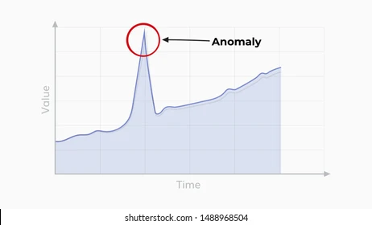
The Concept
Metrics
Fusion
Evidence
Time-Series
Statistics
Decision Trees
CNN
Classifier
Ingestion
...
Transformer
Transformer
...
...
Images
AI
AI
Prediction

