Slide 1


Emergency Intelligent Assistant Bot Cognizant EIA – She is an intelligent Text based AI Bot
Call For Code 2019 - TeamCPE
Sethuraja Chidambaram
Reagan Beangrand
Prasanna Ragavendran Sivakumar
Ganesh Senthil Kumar
Sudarshan S
E
I
A

Slide 2




Problem Statement
E
I
A
How to build AI enabled ChatBot using IBM Watson assistant that reads user text message over social media and mines it to understand the natural disaster emergency. It captures vital information like location and suggesting users for the Direction to nearest rescue center, First aid tips, routes to avoid?
Rescue Center
Evacuation Route
Trapped victims are removed and given medical aid as necessary. Removal of victims is designed to avoid further injury.
The affected users and rescue teams have many problems
and delays to find the short evacuation routes to reach rescue center.
First Aid Tips
Long Waiting Time
A first aid kit is a standard item to have when preparing for any type of emergency.
The affected users need to contact the emergency center and the long call waiting time leads to worst situation.

Slide 3
Cognizant EIA
Project Title
Emergency Intelligent Assistant Bot
E
I
A
Project Description
A software solution to safeguard the victims during natural or manmade disaster using the social media platform

Slide 4
Solution Description
E
I
A
User geolocation is send to IBM Cloudant GeoSpatial.
Tweets are collected from Twitter based on user’s geolocation and saved into a Cloudant database and imported to Object Storage.
Watson Studio ingests data from Object Storage and uses Spark for data curation, analysis.
The Watson Natural Language Understanding Service pulls out keywords and entities.
The Watson Assistant Service extracts the intents (verbs) from the tweets.
Based on disaster twitter handle and user location, Chatbot sends the information like route to avoid, direction to rescue center & First Aid Tips.

Slide 5





Component we used…
IBM Cloudant Geospatial
IBM Watson Studio
Social Media platform

Slide 6


Architecture Diagram: EIA
I’m EIA
How can I help you ?
IBM WATSON ASSISTANT
3
4
5
E
I
A
Evacuation Route
1
2
IBM Cloudant Geospatial
Mining Social Media
Rescue Centre
USER
APP UI
First Aid Tips
Emergency Intelligent Assistant
(EIA)
2

Slide 7
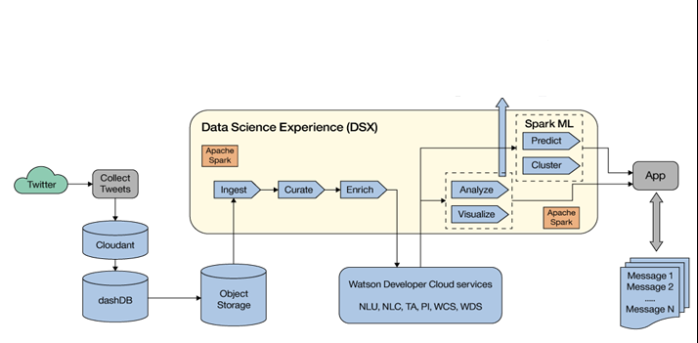
Technical Architecture Diagram – Mining Social Media
E
I
A
Tweets are collected from Twitter and saved into a Cloudant database.
The Cloudant database is saved into a Db2 Warehouse on Cloud warehouse , which is then imported into Object Storage.
The notebook in Watson Studio ingests data from Object Storage and uses Spark for data curation, analysis, and visualization.
Notebook connects to Watson services (Natural Language Understanding) to enrich the tweets and extract sentiment, keywords
Notebook uses Spark MLlib to cluster the disaster based on features including current geolocation of user.
The application can identify the right message to process.

Slide 8
Thank You

