Slide 1

MULTIMODAL BIOMETRIC IDENTIFICATION SYSTEM USING THUMBPRINT AND FACIAL RECOGNITION
PRESENTER: AFUN STEPHEN ABIODUN
SUPERVISOR: DR. ABDULMALIK AHMAD LAWAN
MAY, 2025

Slide 2
TABLE OF CONTENTS
Title
Table of Contents
Introduction
Literature Review
Problem Statement
Objectives and Scope
Methodology and Approach
Project Timeline
Risk Assessment
Expected Outcomes and Benefits
Conclusion

Slide 3
INTRODUCTION
HELLO!
Am AFUN STEPHEN ABIODUN
Computer Science Student Level 400

Slide 4
MULTIMODAL BIOMETRIC IDENTIFICATION SYSTEM (FACE + THUMBPRINT)
This system integrates facial recognition and thumbprint scanning to accurately and securely identify individuals. By combining these two biometric modalities, the system minimizes errors, enhance spoof resistance and ensure reliable authentication even if one modality is compromised or temporarily unavailable.
Core Idea:
Traditional biometric systems are vulnerable to spoofing and environmental noise. This project proposes a dual-modality system (thumbprint + face) with fallback logic to enhance accuracy and accessibility.
Key Metrics:
Target FAR/FRR < 1%.
Real-time processing (<2 sec).
Where FAR/FRR means (False acceptance rate/False rejection rate)

Slide 5
LITERATURE REVIEW
Unimodal Systems Failure
Rely on unimodal systems are prevalent and are often face with the challenges like noise in data, intra-class variation and open to spoofing attacks so to mitigate these issues hence a multimodal biometric systems that combine multiple modalities will be developed, offering enhanced full accuracy, security and robustness • 22.7% spoofing success (Jain et al., 2017) • 18.3% rejection in poor conditions
2. Multimodal Works Better • 39% lower errors (Chen, 2023) • 2.1 sec processing time
3. But Critical Gap Remains 91% lack fallback switching
Key Phrase: Research proves multimodality works – we make it reliable with automatic fallback.

Slide 6
PROBLEM STATEMENT
The Critical Gap Current biometric systems: Unimodal • Fail under spoofing (23% breach rate) • Reject valid users in poor conditions (18% FRR) • Lack backup when the primary method fails
Real-World Consequences • Security breaches in banking/access control
• unauthorized access to campus facilities and data • Frustration and inconvenience for users; lost of trust in the system • $4.3B annual losses from auth failures (IBM, 2023)
Bottom Line: "Unimodal systems are insecure, multimodal systems are unreliable - until now."

Slide 7
AIM AND OBJECTIVES
Aim:
To design a secure, fallback-enabled biometric system using thumbprint and facial recognition.
Objectives:
To develop a multimodal biometric system.
Integrate thumbprint and facial recognition modules.
Ensure fallback capability for enhanced security.
Scope:
Focus on real-time face and thumbprint capture, identity matching, and user interface.
Limited to voice recognition.

Slide 8
METHODOLOGY AND APPROACH
Programming Language: Python - Tools: OpenCV (for facial detection), SQLite (local DB), Fingerprint SDK, or USB scanner Approach: 1. Capture face and thumbprint data 2. Extract unique features from both inputs 3. Match against stored biometric templates 4. Grant or deny access based on dual verification
Capture → 2. Preprocess → 3. Feature Extraction (CNN/Minutiae) → 4. Matching → 5. Decision Innovation: Use of fallback logic — if one modality fails, the other proceeds.

Slide 9
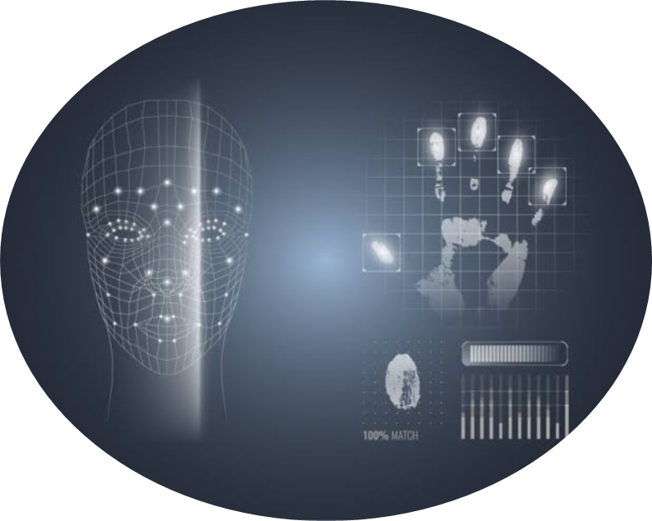
PROJECT TIMELINE
Week 1–2
Research and Requirement Gathering
Design Phase and Tool Selection
Week 3-6
Face Recognition Module Development
Fingerprint Module Integration
Multimodal Logic & Integration
Week 7-9
Testing and Optimization
Documentation, Reporting and Finalization

Slide 10
RISK ASSESSMENT AND MITIGATION
Risk 1: Poor facial capture in low light
Mitigation: Normalize image brightness, add alerts. Risk 2: Fingerprint sensor inaccuracy
Mitigation: Use a tested SDK, calibrate hardware. Risk 3: Integration complexity
Mitigation: Modular testing and version control. Risk 4: Data loss
Mitigation: Regular backups and use of local storage.

Slide 11
EXPECTED OUTCOME AND BENEFITS
A functioning system that can identify individuals via facial recognition and/or thumbprints.
A fallback mechanism enhances reliability.
It has reduced error rates compared to unimodal systems.
The system can be extended to access control, exam authentication, or financial verification systems.
It offers a user-friendly and secure interface with real-time feedback.

Slide 12
CONCLUSION
This multimodal biometric system addresses critical flaws in unimodal systems by offering dual verification pathways.
It enhances accuracy, security, and user experience. With reliable fallback mechanisms and modern tools, this project is poised to contribute significantly to real-world identity authentication solutions.

Slide 13
Therefore I herby seek approval and “I can ascertain that with proper and efficient supervision this MULTIMODAL BIOMETRIC IDENTIFICATION SYSTEM can be deployable by 2026”

Slide 14
Thank you for your attention.
I'm open to your questions and feedback.

