Slide 1
CSS Day-2
24 Jan 2021

Slide 2
Background Color
Syntax: .div { background-color: red; }
a valid color name - like "red"
a HEX value - like "#ff0000"
an RGB value - like "rgb(255,0,0)”

Slide 3
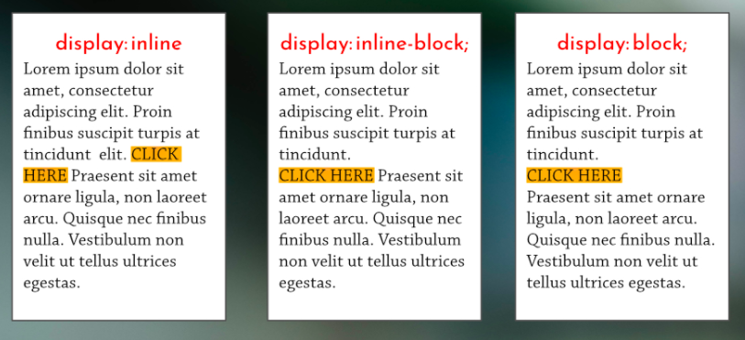
Inline-Block
Inline elements : <a> , <button> , <input> , <span> , <img> etc.
Block elements : <div> , <h1> , <section> , <ul> , <li> etc.

Slide 4
Display Properties
Synatx:
.div { display: property; }
Property can be :
Block
Inline( margin top and margin bottom properties don’t work)
Inline-block (mixture of inline and block elements)

Slide 5
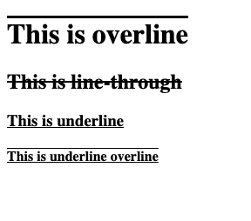
Text Decoration
Syntax:
.div{
text-decoration: ’property’; }
Property can be :
Overline
line-through
Underline
underline overline
To remove text decoration property set ‘property’ as ‘none’.

Slide 6
Fonts
In CSS, we use the font-family property to specify the font of a text.
Syntax:
.div { font-family: font1, font2, font-family; }
.div { font-family: Arial, Helvetica, sans-serif; }
Generic Font Families:
Font families contain various fonts
Example:
Sans-serif : Arial, Verdana, Helvetica
The font-family property should hold several font names as a "fallback" system, to ensure maximum compatibility between browsers/operating systems. Start with the font you want, and end with a generic family (to let the browser pick a similar font in the generic family, if no other fonts are available). The font names should be separated with comma.
.div { font-family: "Times New Roman", Times, serif; }

Slide 7
Google Fonts
If you do not want to use any of the standard fonts in HTML, you can use Google Fonts.
Google Fonts are free to use, and have more than 1000 fonts to choose from.
Link : https://fonts.google.com/
Copy and paste in head
<link rel="preconnect" href="https://fonts.gstatic.com"> <link href="https://fonts.googleapis.com/css2?family=Luckiest+Guy&display=swap" rel="stylesheet">
@import url('https://fonts.googleapis.com/css2?family=Luckiest+Guy&display=swap');

Slide 8
Float
The CSS float property specifies how an element should float.
The float property is used for positioning and formatting content e.g. let an image float left to the text in a container.
The float property can have one of the following values:
left - The element floats to the left of its container
right - The element floats to the right of its container
none - The element does not float (will be displayed just where it occurs in the text). This is default

Slide 9
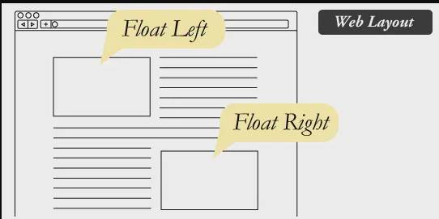

Slide 10
Background Images
background-image: url("image.jpg");
Background Image Properties:
background-repeat: no-repeat;
background-size: cover;
background-position: center;

Slide 11
The Position Property
The position property specifies the type of positioning method used for an element.
There are five different position values:
static
Relative (An element with position: relative; is positioned relative to its normal position.)
fixed
absolute
Sticky
Synatx :
.div { position: static; }

Slide 12
Box Sizing
The CSS box-sizing property allows us to include the padding and border in an element's total width and height.
By default, the width and height of an element is calculated like this:
width + padding + border = actual width of an element height + padding + border = actual height of an element
This means: When you set the width/height of an element, the element often appears bigger than you have set (because the element's border and padding are added to the element's specified width/height).

Slide 13
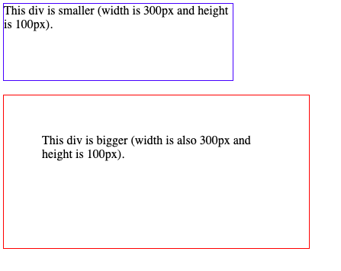
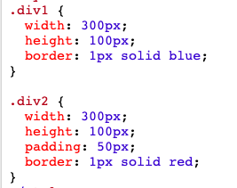

Slide 14
Box Shadow
Syntax:
.div { box-shadow: 10px 10px 8px #888888; }
The first value is the horizontal offset
The second value is the vertical offset.
The third value adds a blur effect to the shadow.
The fourth value is shadow color (if not provided will be inherited from the text color.)

Slide 15
Border
Syntax:
.div { border: 5px solid red; }
The first value is border width
Second value is border style
Border styles can be :
Dotted
Dashed
Groove
Ridge(etc)
Third value is border colour

Slide 16
:hover Selector
The :hover selector is used to select elements when you mouse over them.
Example :
.div:hover { background-color: yellow; }

Slide 17
Transition Duration
The transition-duration property specifies how many seconds (s) or milliseconds (ms) a transition effect takes to complete.
Synatx:
.div { transition-duration: 5s; }

Slide 18
@media Rule
The @media rule is used in media queries to apply different styles for different media types/devices.
Media queries can be used to check many things, such as:
width and height of the viewport
width and height of the device
orientation (is the tablet/phone in landscape or portrait mode?)
resolution
Using media queries are a popular technique for delivering a tailored style sheet (responsive web design) to desktops, laptops, tablets, and mobile phones.

Slide 19
Cont..
Syntax :
@media only screen and (max-width: 600px) { body { background-color: lightblue; } }

Slide 20
::after Selector
To remove float property for the underlying elements :
.row:after {
content: "";
display: table;
clear: both;
}

