Slide 1
ANNA
Team 6
Melek Altindis, Marlene Huber, Fabian Trurnit
altindis@hm.edu marlene.huber@hm.edu trurnit@hm.edu

Slide 2
Topics that concern refugees in Germany
Past
Present
Future
Work in Germany
Flight
Home
country
Learning German
Asylum process
Trauma
authorities
Everyday life
health care

Slide 3


Slide 4

We want to give as many as possible refugees the possibility to inform themselves easily at any time and give them more orientation to be more independent and autonomus
Our further goal is to relieve social workers so that they have more time to deal with individual problems

Slide 5

What makes us different from other solutions?
Our informations are valid
Our informations are easy to understand
Our informations are personalized
Our informations are accessible for illiterates
Notes:
Bildquelle: https://www.flaticon.com/de/kostenloses-icon/app_3616049

Slide 6
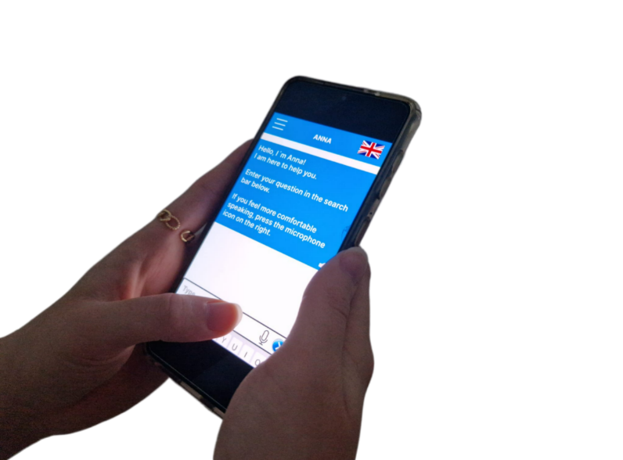

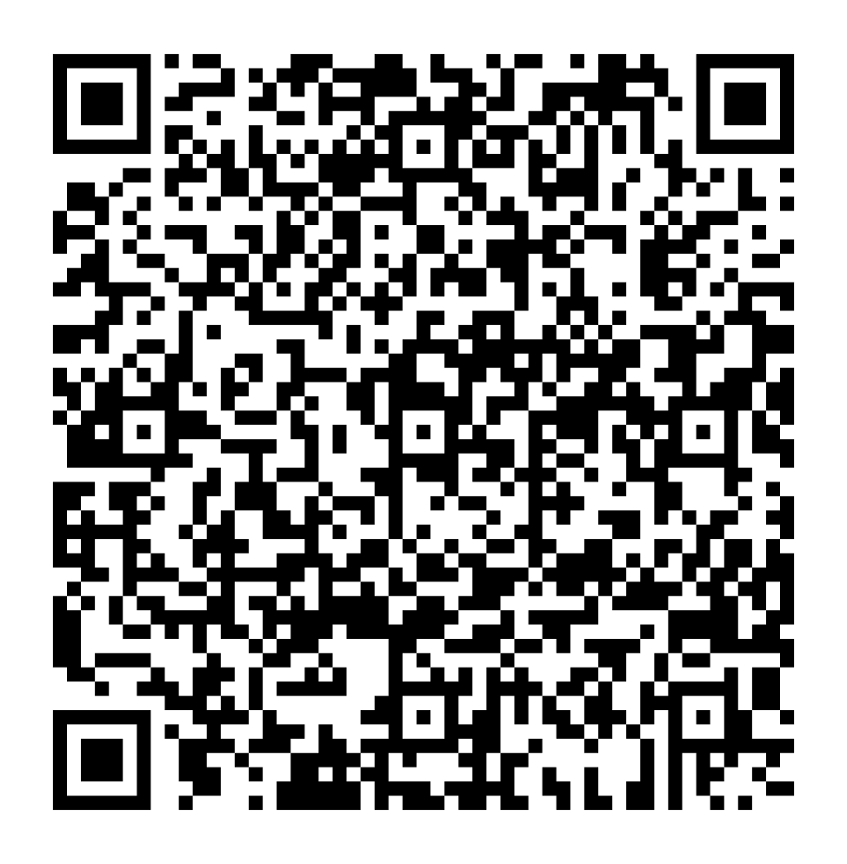
PROTOTYPE
Scan me!
https://www.figma.com/proto/XbzkLkKWHi29msgiZa1eYH/Prototype?type=design&scaling=scale-down&page-id=0%3A1&starting-point-node-id=1%3A159&node-id=1-159

Slide 7

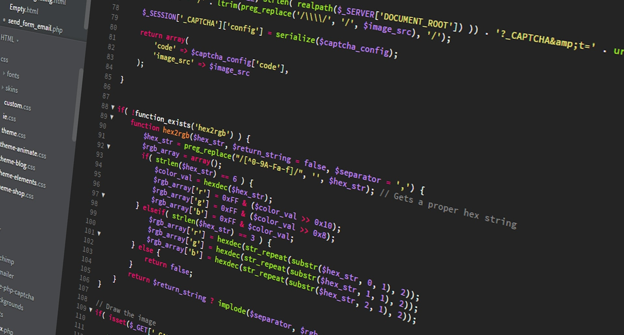

Business Model Canvas
Key Partners
BRK
Government
OpenAI
AWS
Key Activities
Development of ANNA
Validating data
Customising to meet needs of refugees
Marketing
Key Resources
BRK for Data Set and contact to refugees
Developer
OpenAI

Slide 8


Business Model Canvas
Value Proposition
All informations in one app
Many language options
Convenient for illiterates
Ask follow-up questions
Technical terms and special regional rules get explained
Relieve for BRK team
Channels
App Store for iOS and Google Play for Android
Arrival/state authorities
Handout from the BRK

Slide 9


Business Model Canvas
Cost Structure
Development of ANNA
Creating Data Base
Training ChatGPT
ChatGPT: 8 words = 0.00002 $
Revenue Streams
Government funding
Donations

Slide 10
THANK YOU! Questions?
altindis@hm.edu marlene.huber@hm.edu trurnit@hm.edu
Team 6 - ANNA

