Slide 1

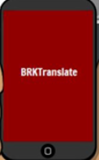
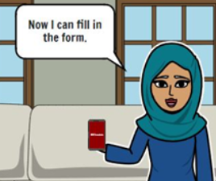
BRKTranslate
Elevator Pitch
SCHAIMA ARIBA
MAXIMILIAN DOLL
CHRISTOPH MOEMKES
ILAYDA IMAL
ADRIAN NACHTWEY
FOUNDED BY
Problem
Solution
We help
scanning…
translating…
tutorials…
Refugees and authority mail
The BRKTranslate app
Our aim is to help people
It is nearly impossible to manage official documents without German language knowledge.
It is an app which helps refugees understand all kind of official documents via scanning, translating and video tutorials.
We created a user-friendly digital tool that helps refugees to understand and work with the German authority mail.

