Slide 1

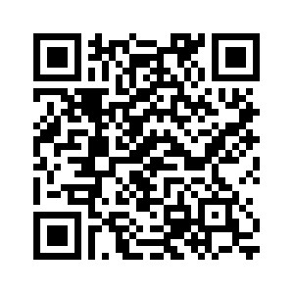
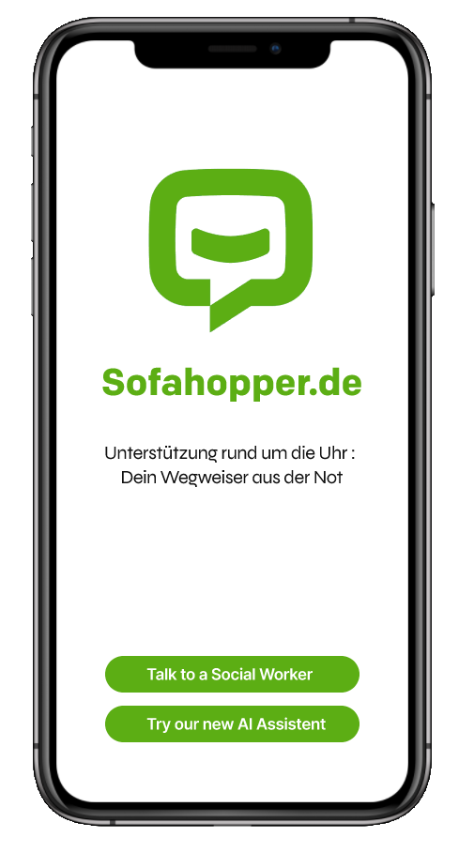
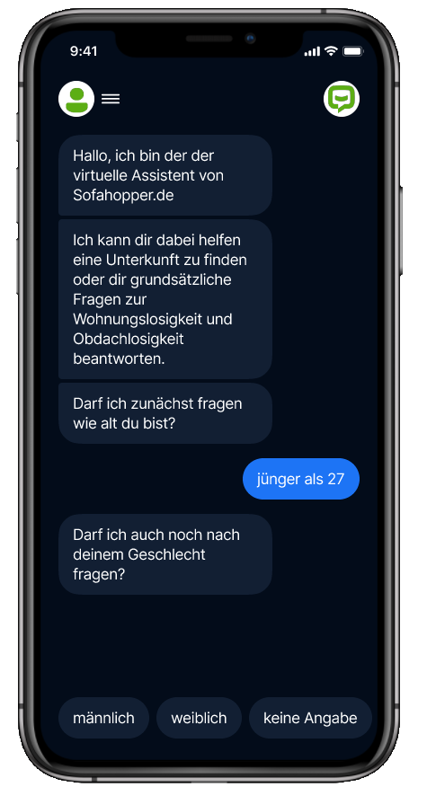


SOFAHOPPER.DE
AI CHATBOT
GitHub ⏎
More than 7000 Contacts
in need of Streetworker-attention
in the first 5 Months of 2023
may be reduced to 700…
..by answering repetitive questions via AI so that your experts have more time for meaningful work!
Bastian Andraschko – Mohammed Khalil – Jasmin Özalp – Arnold Römer – Felix Wilhelm

