Slide 1
ECE 445S Real-Time Digital Signal Processing Lab Spring 2023 Infinite Impulse Response Filters
Prof. Brian L. Evans and Dan Jacobellis
Dept. of Electrical and Computer Engineering
The University of Texas at Austin
Lecture 6 http://users.ece.utexas.edu/~bevans/courses/realtime

Slide 2
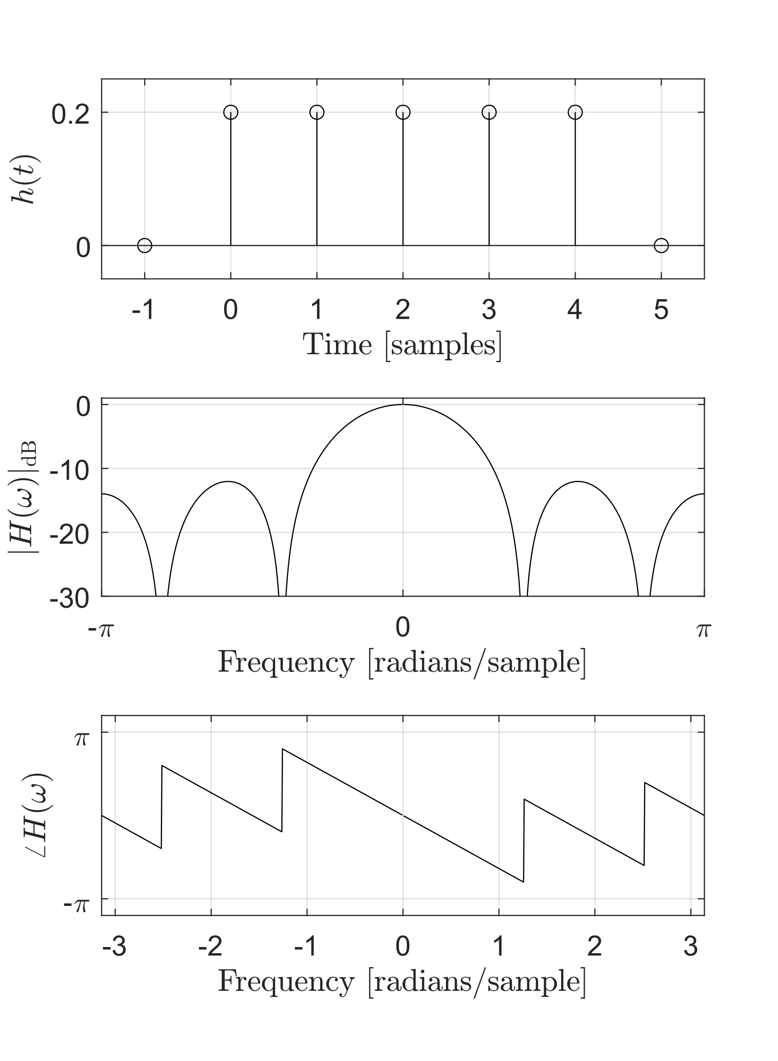
Outline
FIR
IIR
Comparison to FIR filters
Moving average vs EWMA
IIR biquad filter structures
IIR filter design
Applications
Chromagram
Vocoder
Σ
Σ
O
X
O
X

Slide 3
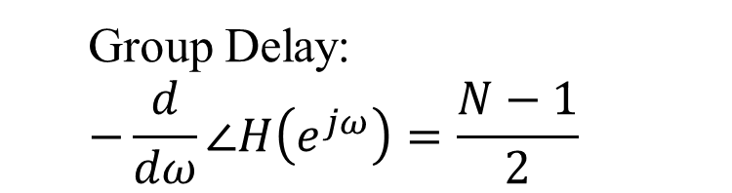
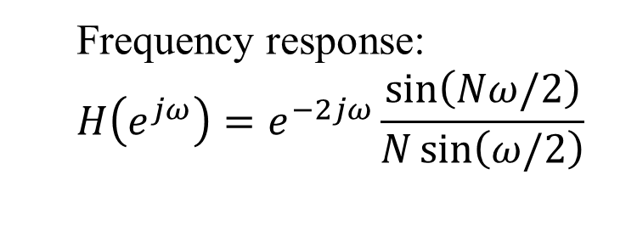
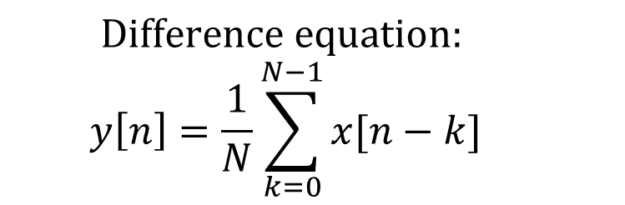
Discrete-Time Moving Average
$$Difference equation:$$
$$y\left[n\right]=\frac{1}{N}\sum_{k=0}^{N−1}{x[n−k]}$$
Frequency response:
$$H\left(e^{jω}\right)=e^{−2jω}\frac{\sin\left(Nω/2\right)}{N\sin\left(ω/2\right)}$$
Group Delay:
$$−\frac{d}{dω}∠H\left(e^{jω}\right)=\frac{N−1}{2}$$

Slide 4
Discrete-Time Moving Average

Slide 5
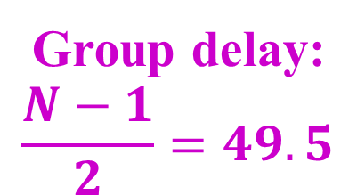
Discrete-Time Moving Average
Group delay:
$$\frac{N−1}{2}=49.5$$

Slide 6
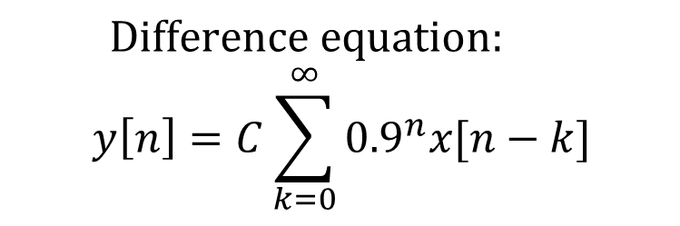
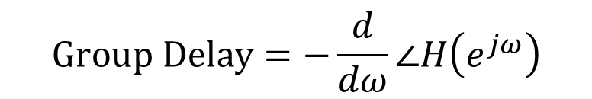
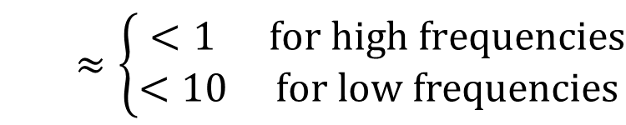
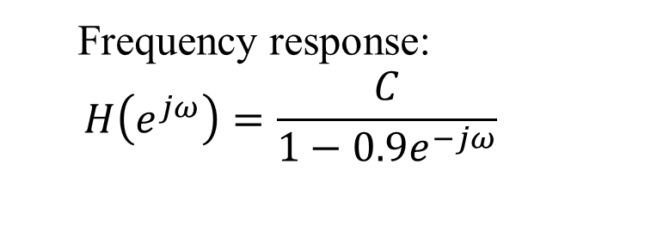
Exponential Moving Average
$$Difference equation:$$
$$y\left[n\right]=C\sum_{k=0}^{∞}{{0.9}^{n}x[n−k]}$$
Frequency response:
$$H\left(e^{jω}\right)=\frac{C}{1−0.9e^{−jω}}$$
$$Group Delay=−\frac{d}{dω}∠H\left(e^{jω}\right)$$
$$≈\left\{\begin{matrix}<1 & for high frequencies \\ <10 & for low frequencies\end{matrix}\right.$$
Notes:
$$h\left[n\right]={0.9}^{n}u\left[n\right]$$
$$H\left(z\right)=\frac{1}{1−0.9z^{−1}}, \left|z\right|>0.9$$

Slide 7
Exponential Moving Average

Slide 8
Exponential Moving Average

Slide 9
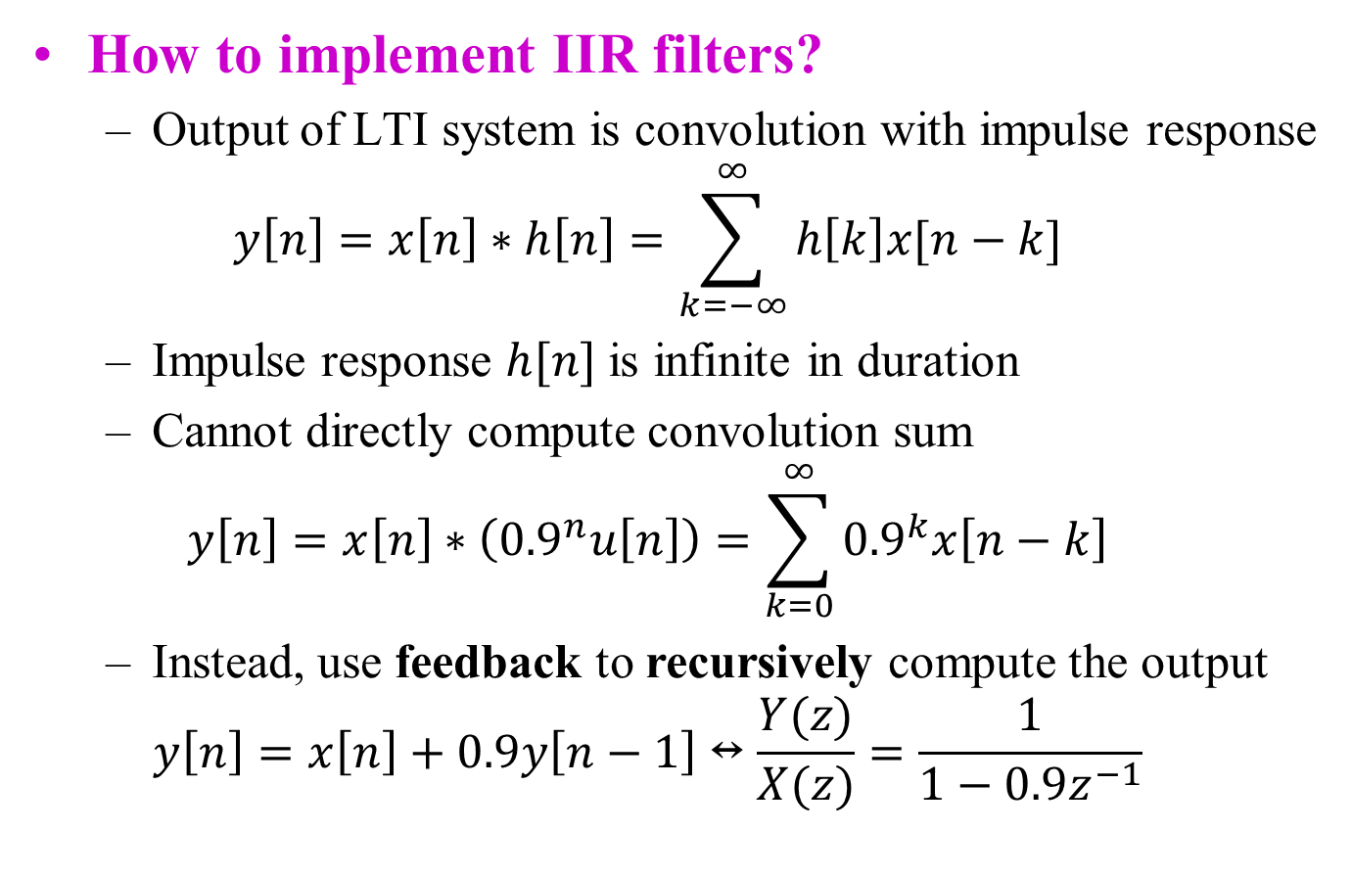
Discrete-Time IIR Filters
How to implement IIR filters?
Output of LTI system is convolution with impulse response
$$y\left[n\right]=x\left[n\right]∗h\left[n\right]=\sum_{k=−∞}^{∞}{h\left[k\right]x[n−k]}$$
Impulse response $h[n]$ is infinite in duration
Cannot directly compute convolution sum
$$y\left[n\right]=x\left[n\right]∗\left({0.9}^{n}u\left[n\right]\right)=\sum_{k=0}^{∞}{{0.9}^{k}x\left[n−k\right]}$$
Instead, use feedback to recursively compute the output
$$y\left[n\right]=x\left[n\right]+0.9y\left[n−1\right]↔\frac{Y(z)}{X(z)}=\frac{1}{1−0.9z^{−1}}$$

Slide 10

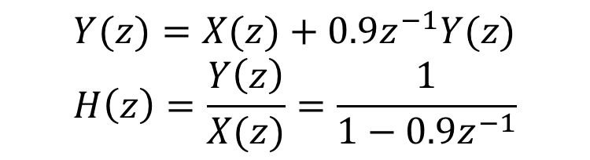
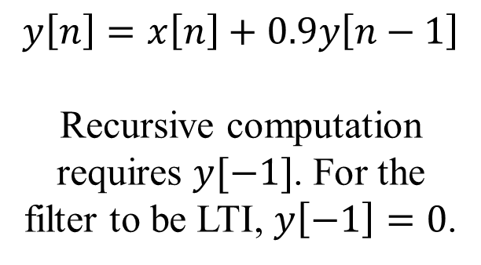
Many Equivalent Representations
Difference equation
Block diagram
$$y\left[n\right]=x\left[n\right]+0.9y\left[n−1\right]$$
Recursive computation requires $y[−1]$. For the filter to be LTI, $y\left[−1\right]=0$.
x[n]
Σ
y[n]
Unit Delay
0.9
y[n-1]
Poles and zeros in z-plane
Transfer function
Assumes LTI system
$$Y(z)=X(z)+0.9z^{−1}Y(z)$$
$$H\left(z\right)=\frac{Y\left(z\right)}{X(z)}=\frac{1}{1−0.9z^{−1}}$$
Pole at $z=0.9$

Slide 11
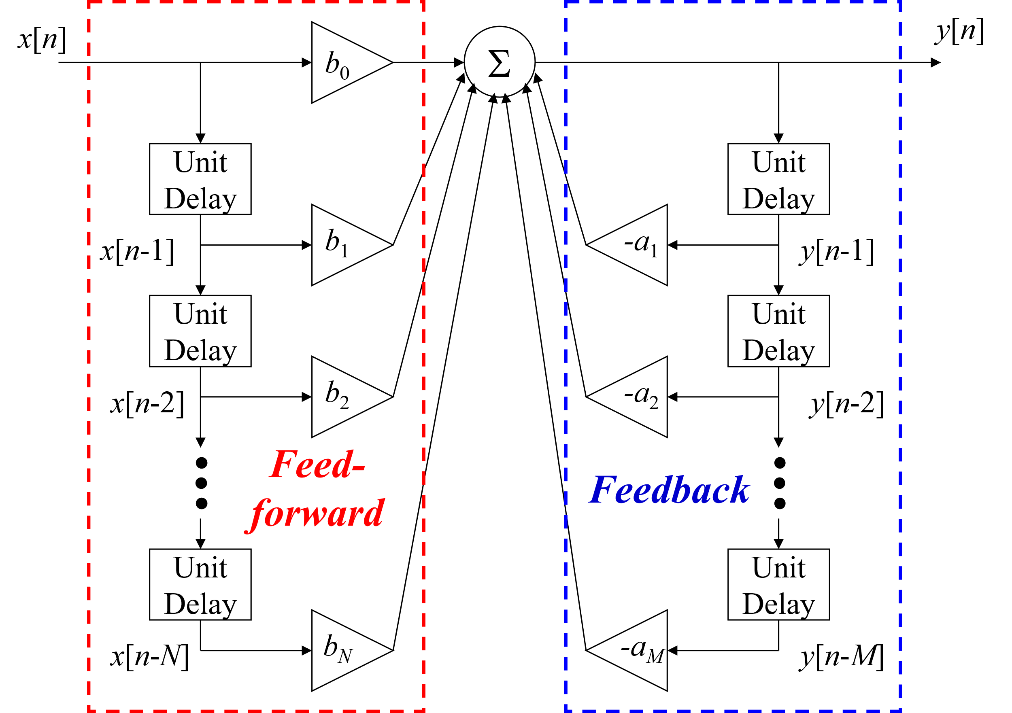
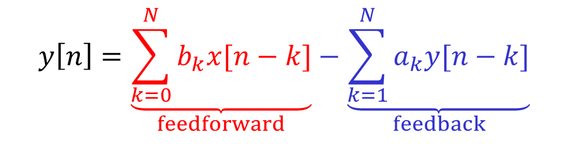
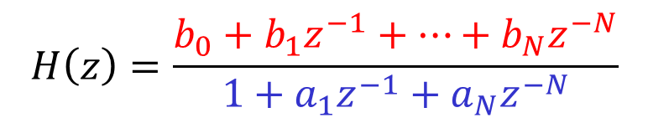
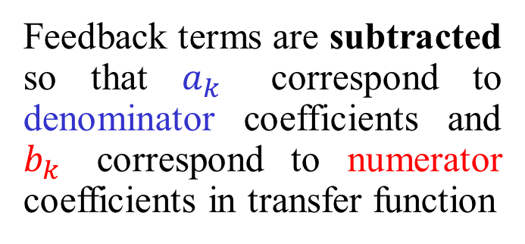
General Form of IIR Filter
$$y\left[n\right]=\underset{feedforward}{\underbrace{\sum_{k=0}^{N}{b_{k}x[n−k]}}}−\underset{feedback}{\underbrace{\sum_{k=1}^{N}{a_{k}y[n−k]}}}$$
Feedback terms are subtracted so that $a_{k}$ correspond to denominator coefficients and $b_{k}$ correspond to numerator coefficients in transfer function
$$H\left(z\right)=\frac{b_{0}+b_{1}z^{−1}+⋯+b_{N}z^{−N}}{1+a_{1}z^{−1}+a_{N}z^{−N}}$$

Slide 12
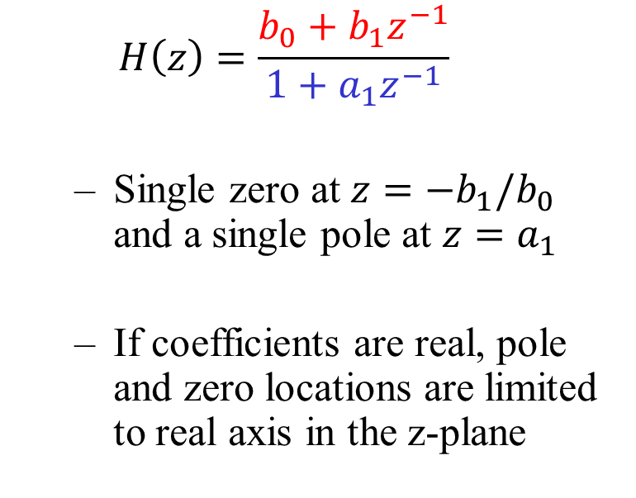
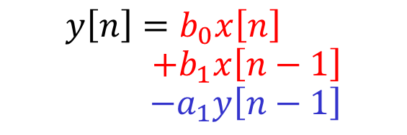
First Order IIR filter
x[n]
y[n]
b₀
Σ
$$y\left[n\right]=b_{0}x\left[n\right]$$
$$+b_{1}x\left[n−1\right]$$
$$−a_{1}y\left[n−1\right]$$
Unit Delay
Unit Delay
x[n-1]
b₁
-a₁
y[n-1]
$$H\left(z\right)=\frac{b_{0}+b_{1}z^{−1}}{1+a_{1}z^{−1}}$$
Single zero at $z=−b_{1}/b_{0}$ and a single pole at $z=a_{1}$
If coefficients are real, pole and zero locations are limited to real axis in the z-plane
Notes:
First order filter demo using matlab filterDesigner
Design method: IIR Butterworth Specify order 1
Units: normalized
Wc: 0.1
Design filter
Click pole-zero tab on left sidebar
Select poles and zeros and adjust magnitude
DSP first demos
https://dspfirst.gatech.edu/chapters/08feedbac/demos/3_domain/index.html

Slide 13
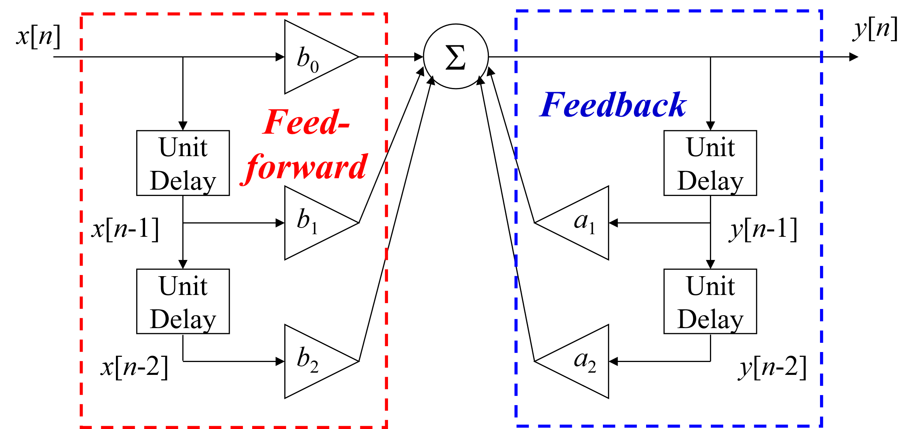
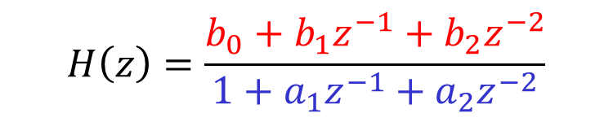
Second Order (Biquad) IIR Filter
Biquad: short for biquadratic
Transfer function is ratio of two quadratic polynomials
$$H\left(z\right)=\frac{b_{0}+b_{1}z^{−1}+b_{2}z^{−2}}{1+a_{1}z^{−1}+a_{2}z^{−2}}$$
Direct form I
-
-

Slide 14
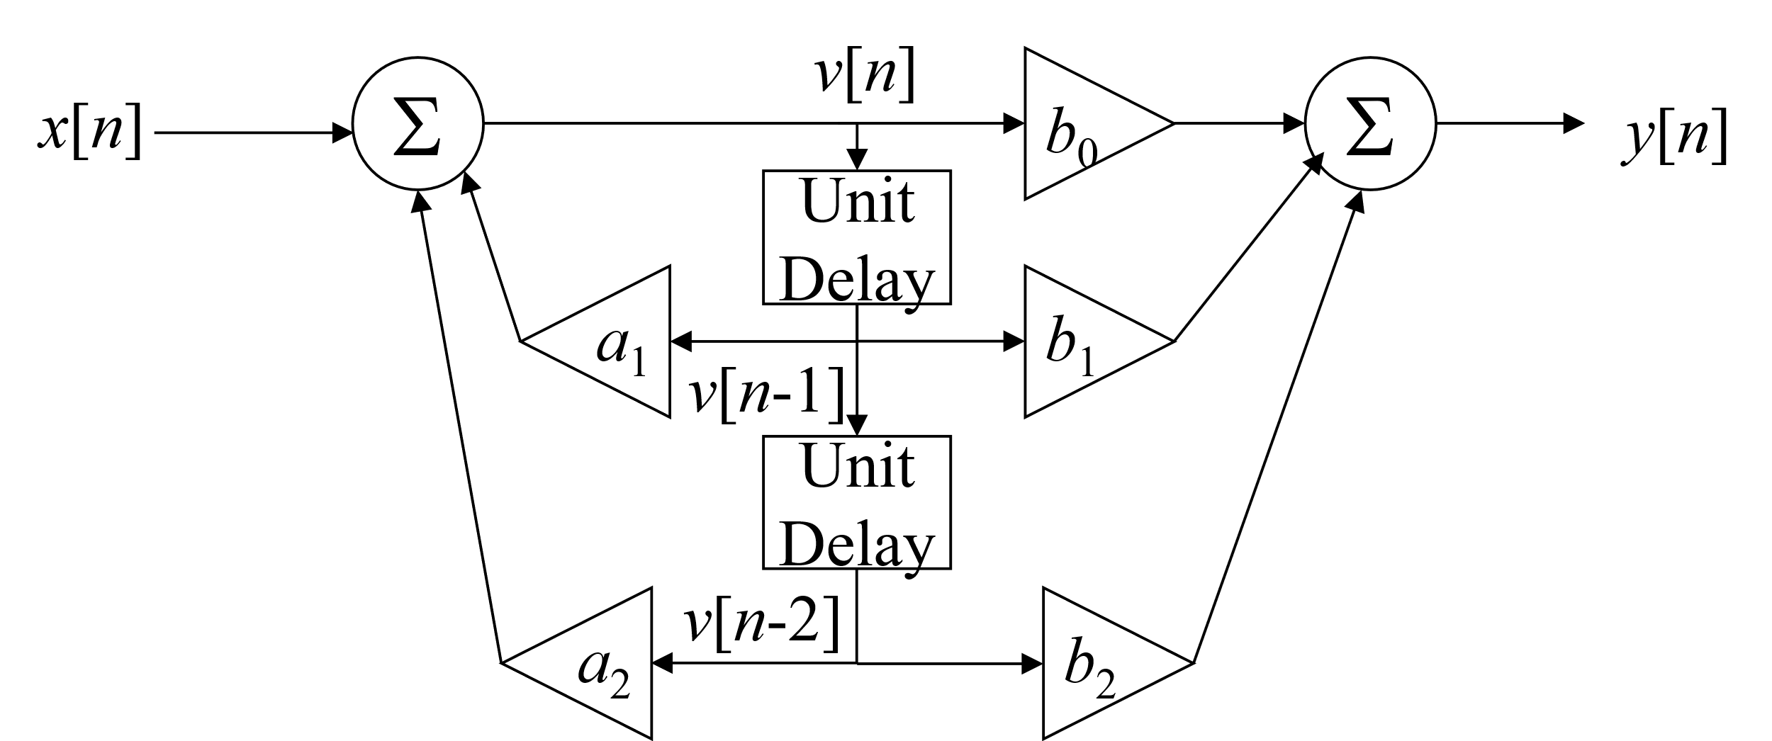
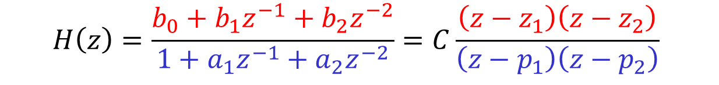
Biquad in Direct form II
$$H\left(z\right)=\frac{b_{0}+b_{1}z^{−1}+b_{2}z^{−2}}{1+a_{1}z^{−1}+a_{2}z^{−2}}=C\frac{\left(z−z_{1}\right)\left(z−z_{2}\right)}{\left(z−p_{1}\right)\left(z−p_{2}\right)}$$
-
All-pole IIR filter
FIR Filter
-
v[n]
x[n]
All-pole IIR Filter
FIR Filter
y[n]

Slide 15
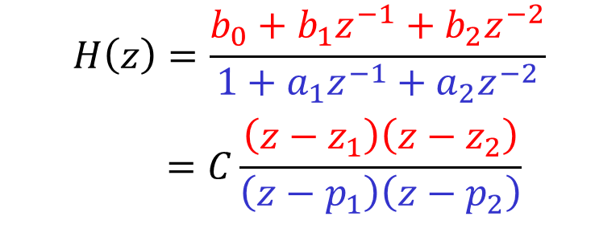
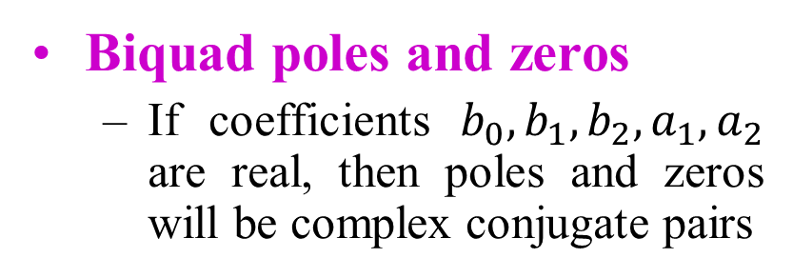
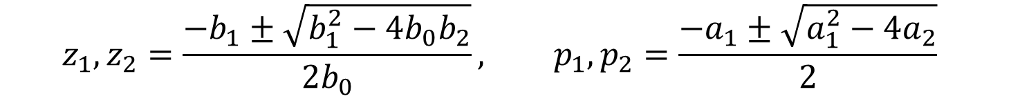
Second Order (Biquad) IIR Filter
Biquad poles and zeros
If coefficients $b_{0},b_{1},b_{2},a_{1},a_{2}$ are real, then poles and zeros will be complex conjugate pairs
$$H\left(z\right)=\frac{b_{0}+b_{1}z^{−1}+b_{2}z^{−2}}{1+a_{1}z^{−1}+a_{2}z^{−2}}$$
$$=C\frac{\left(z−z_{1}\right)\left(z−z_{2}\right)}{\left(z−p_{1}\right)\left(z−p_{2}\right)}$$
$$z_{1},z_{2}=\frac{−b_{1}±\sqrt{b_{1}^{2}−4b_{0}b_{2}}}{2b_{0}}, p_{1},p_{2}=\frac{−a_{1}±\sqrt{a_{1}^{2}−4a_{2}}}{2}$$
Allowing complex poles and zeros provides more flexibility for designing filters compared to single order IIR filter
Example: bandstop filter

Slide 16
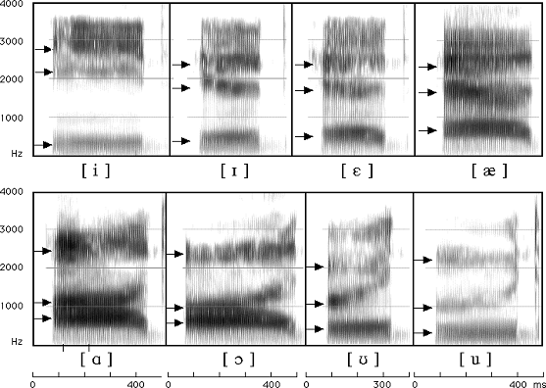
Vocoder
“Voice Encoder”
Originally developed for speech synthesis and for encoding speech for telecommunications
Video: speech synthesis (1939)
Use as a musical effect (lab #7)
Source-Filter model of speech production
Opening and closing of vocal folds produces many harmonically related frequencies
Model vocal tract (including lips, teeth, etc) as LTI filter
Poles are especially important since they model resonances
Instead of representing speech by signal amplitude, represent based on filter parameters

Slide 17
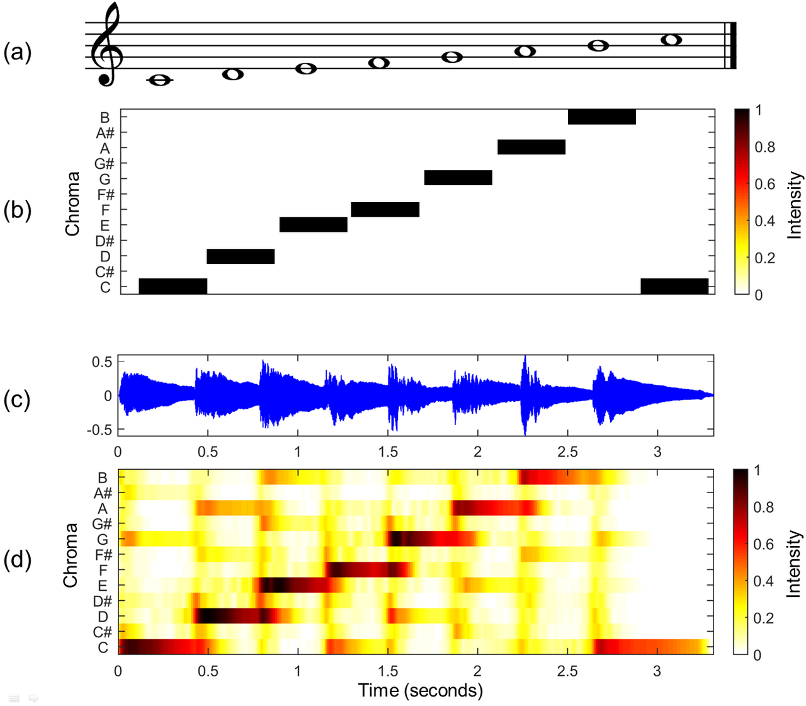
Chromagram
Map audio signal to notes
Musical notes are perceived as similar when their frequencies differ by an octave (factor of 2)
12-tone equal temperament divides each octave into 12 bins:
{C, C♯, D, D♯, E , F, F♯, G, G♯, A, A♯, B}
Use bank of IIR filters to extract each note
IIR filters provide much better frequency selection than FIR
Less delay on average compared to FIR
Only average energy is displayed, nonlinear phase is okay
MATLAB code (PDF, piano.wav)

Slide 18
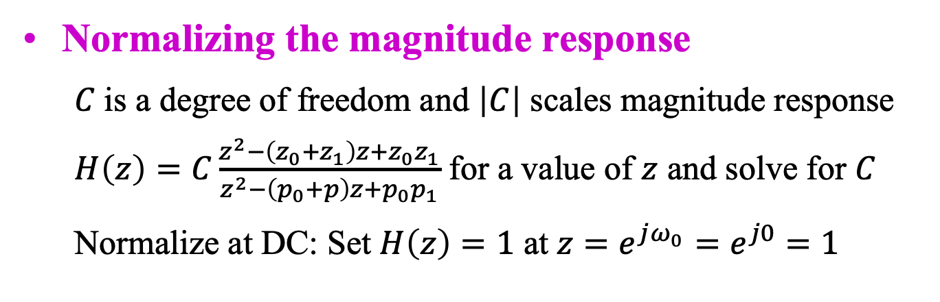
IIR Biquad Frequency Responses
IIR Biquad Filter Structures
Magnitude response
Zeros z₀ & z₁ and poles p₀ & p₁
|a – b| is distance between complex numbers a and b
|e^{jω} – p₀| is distance from point on unit circle e^{jω} and pole p₀

Slide 19
Frequency Response?
Poles have radius r Zeros have radius 1/r
handout
Im(z)
Im(z)
Im(z)
Zeros are on the unit circle
O
O
X
X
O
X
Re(z)
Re(z)
Re(z)
O
X
X
X
O
O
Lowpass, highpass, bandpass, bandstop, allpass, notch?
zeroAngle = pi/4;
rz = 1/0.8;
z0 = rz*exp(j*zeroAngle);
z1 = rz*exp(-j*zeroAngle);
numer = [1 -(z0+z1) z0*z1];
r = 1/rz;
poleAngle = pi/4;
p0 = r * exp(j*poleAngle);
p1 = r * exp(-j*poleAngle);
denom = [1 -(p0+p1) p0*p1];
%%% Normalize the DC response
%%% to 1 in linear units by
%%% setting H(z) evaluated
%%% at z = 1 to be 1
C = (denom * [1 1 1]') / (numer * [1 1 1]');
freqz(C*numer, denom);
zeroAngle = 15*pi/16;
z0 = exp(j*zeroAngle);
z1 = exp(-j*zeroAngle);
numer = [1 -(z0+z1) z0*z1];
r = 0.9;
poleAngle = pi/16;
p0 = r * exp(j*poleAngle);
p1 = r * exp(-j*poleAngle);
denom = [1 -(p0+p1) p0*p1];
%%% Normalize the DC response
%%% to 1 in linear units by
%%% setting H(z) evaluated
%%% at z = 1 to be 1
C = (denom * [1 1 1]’) / (numer * [1 1 1]');
freqz(C*numer, denom);
zeroAngle = pi/4;
z0 = exp(j*zeroAngle);
z1 = exp(-j*zeroAngle);
numer = [1 -(z0+z1) z0*z1];
r = 0.9;
poleAngle = pi/4;
p0 = r * exp(j*poleAngle);
p1 = r * exp(-j*poleAngle);
denom = [1 -(p0+p1) p0*p1];
%%% Normalize the DC response
%%% to 1 in linear units by
%%% setting H(z) evaluated
%%% at z = 1 to be 1
C = (denom * [1 1 1]') / (numer * [1 1 1]');
freqz(C*numer, denom);

Slide 20
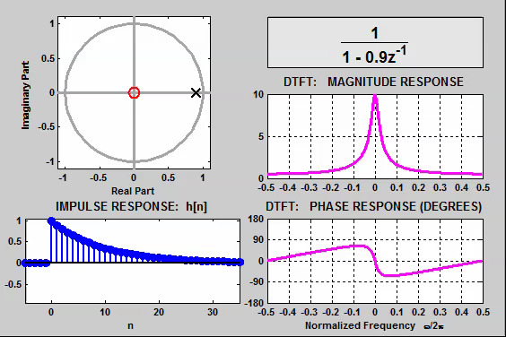
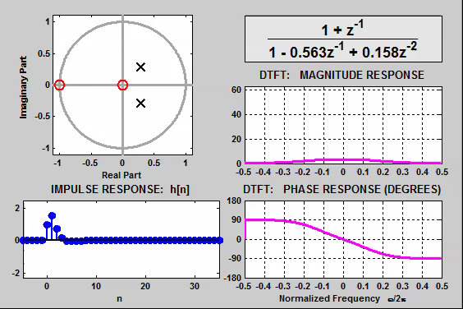
Demonstrations
IIR Biquad Filter Structures
DSP First, 2nd ed., ch. 10
IIR filtering tutorial (Link)
Connection between the Z and frequency domains (Link)
Time/frequency/z domain movies for IIR Filters (Link)
link
IIR filter with one pole and a zero at the origin
Movement of Poles

