Slide 1
ECE 445S Real-Time Digital Signal Processing Lab Spring 2023 Infinite Impulse Response Filters
Prof. Brian L. Evans and Dan Jacobellis
Dept. of Electrical and Computer Engineering
The University of Texas at Austin
Lecture 6 http://users.ece.utexas.edu/~bevans/courses/realtime

Slide 2
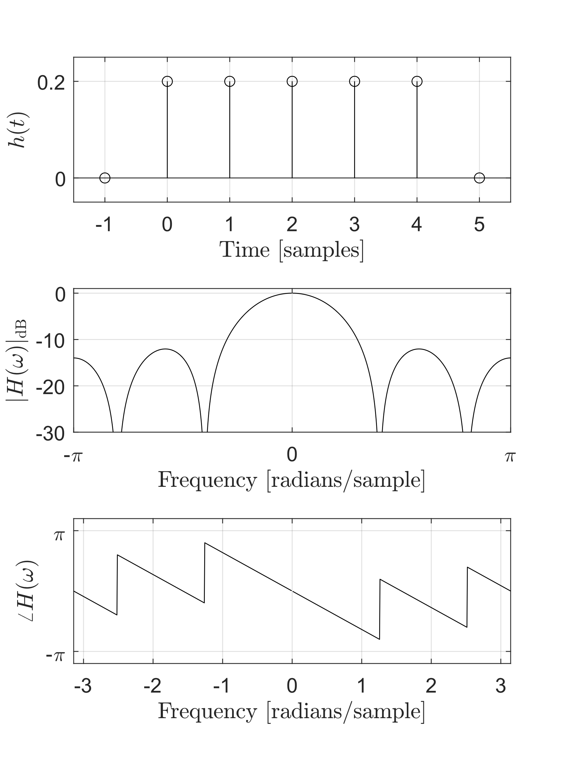
Outline
FIR
IIR
Comparison to FIR filters
Moving average vs EWMA
IIR biquad filter structures
IIR filter design
Applications
Chromagram
Vocoder
Σ
Σ
O
X
O
X

Slide 3
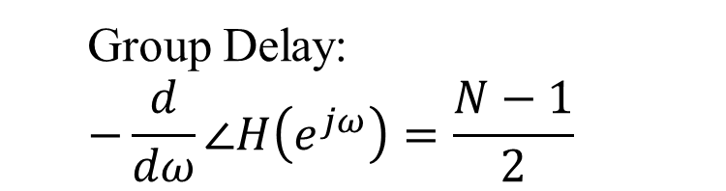
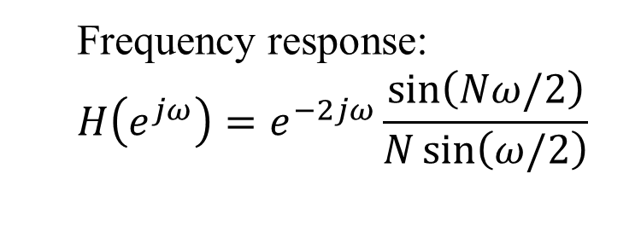
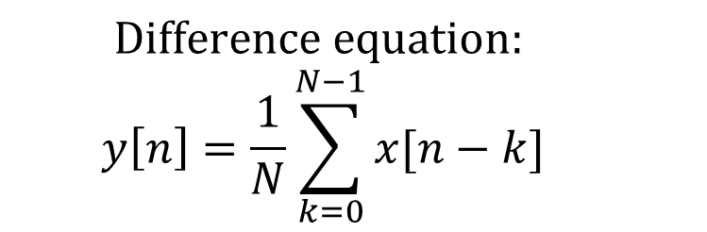
Discrete-Time Moving average
$$Difference equation:$$
$$y\left[n\right]=\frac{1}{N}\sum_{k=0}^{N−1}{x[n−k]}$$
Frequency response:
$$H\left(e^{jω}\right)=e^{−2jω}\frac{\sin\left(Nω/2\right)}{N\sin\left(ω/2\right)}$$
Group Delay:
$$−\frac{d}{dω}∠H\left(e^{jω}\right)=\frac{N−1}{2}$$

Slide 4
Discrete-Time Moving Average

Slide 5
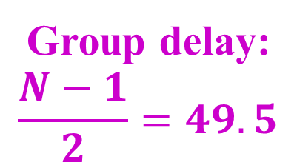
Discrete-Time Moving Average
Group delay:
$$\frac{N−1}{2}=49.5$$

Slide 6
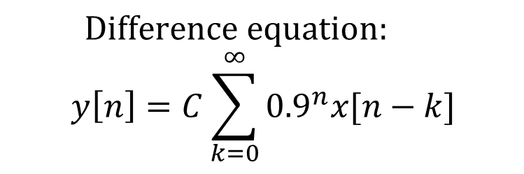
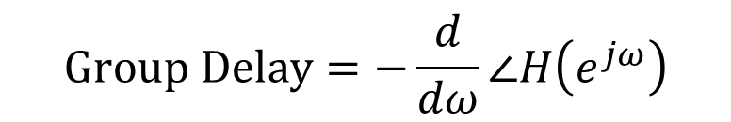
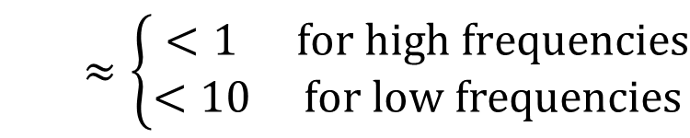
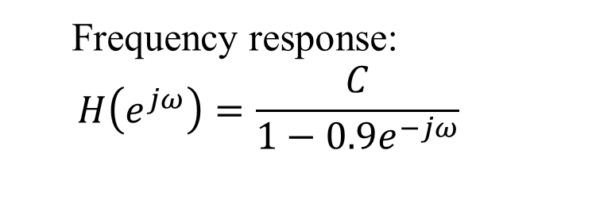
Exponential Moving Average
$$Difference equation:$$
$$y\left[n\right]=C\sum_{k=0}^{∞}{{0.9}^{n}x[n−k]}$$
Frequency response:
$$H\left(e^{jω}\right)=\frac{C}{1−0.9e^{−jω}}$$
$$Group Delay=−\frac{d}{dω}∠H\left(e^{jω}\right)$$
$$≈\left\{\begin{matrix}<1 & for high frequencies \\ <10 & for low frequencies\end{matrix}\right.$$
Notes:
$$h\left[n\right]={0.9}^{n}u\left[n\right]$$
$$H\left(z\right)=\frac{1}{1−0.9z^{−1}}, \left|z\right|>0.9$$

Slide 7
Exponential Moving Average

Slide 8
Exponential Moving Average

Slide 9
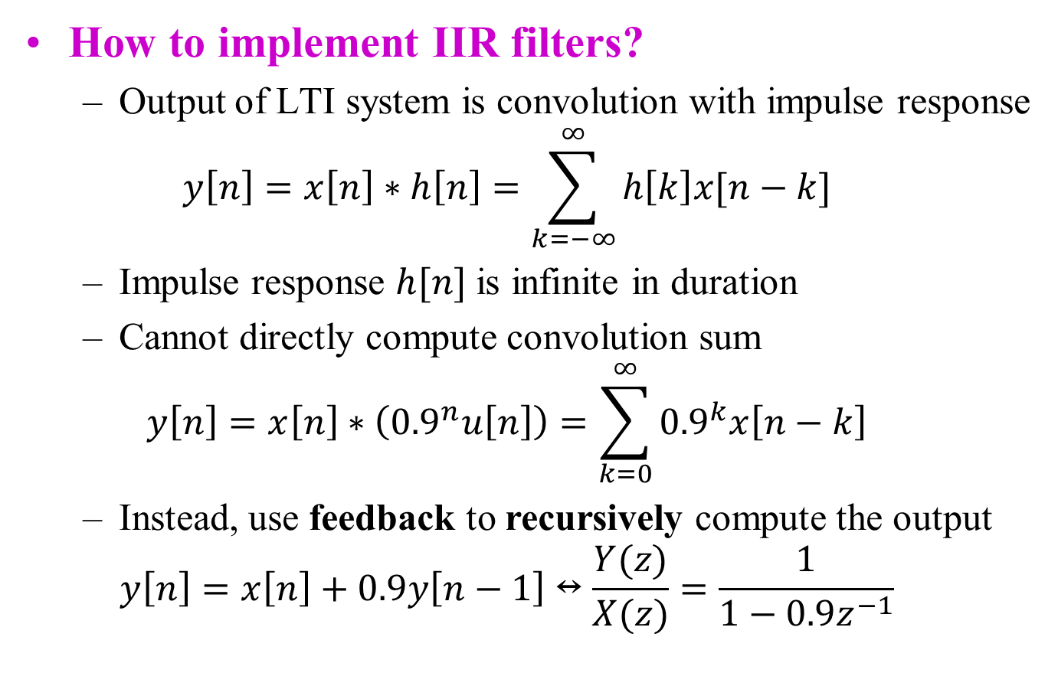
Discrete-Time IIR Filters
How to implement IIR filters?
Output of LTI system is convolution with impulse response
$$y\left[n\right]=x\left[n\right]∗h\left[n\right]=\sum_{k=−∞}^{∞}{h\left[k\right]x[n−k]}$$
Impulse response $h[n]$ is infinite in duration
Cannot directly compute convolution sum
$$y\left[n\right]=x\left[n\right]∗\left({0.9}^{n}u\left[n\right]\right)=\sum_{k=0}^{∞}{{0.9}^{k}x\left[n−k\right]}$$
Instead, use feedback to recursively compute the output
$$y\left[n\right]=x\left[n\right]+0.9y\left[n−1\right]↔\frac{Y(z)}{X(z)}=\frac{1}{1−0.9z^{−1}}$$

Slide 10

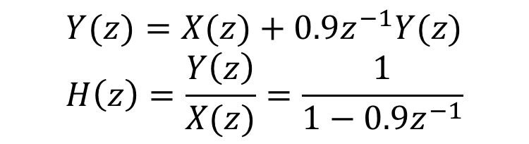
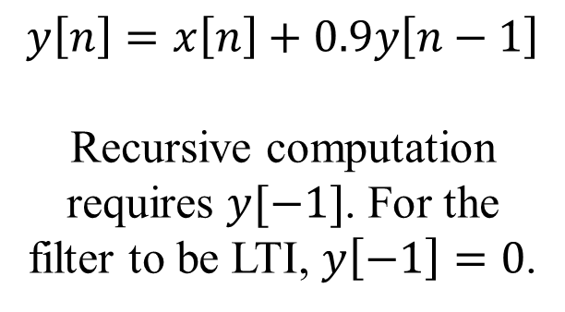
Many Equivalent Representations
Difference equation
Block diagram
$$y\left[n\right]=x\left[n\right]+0.9y\left[n−1\right]$$
Recursive computation requires $y[−1]$. For the filter to be LTI, $y\left[−1\right]=0$.
x[n]
Σ
y[n]
Unit Delay
0.9
y[n-1]
Poles and zeros in z-plane
Transfer function
Assumes LTI system
$$Y(z)=X(z)+0.9z^{−1}Y(z)$$
$$H\left(z\right)=\frac{Y\left(z\right)}{X(z)}=\frac{1}{1−0.9z^{−1}}$$
Pole at $z=0.9$

Slide 11
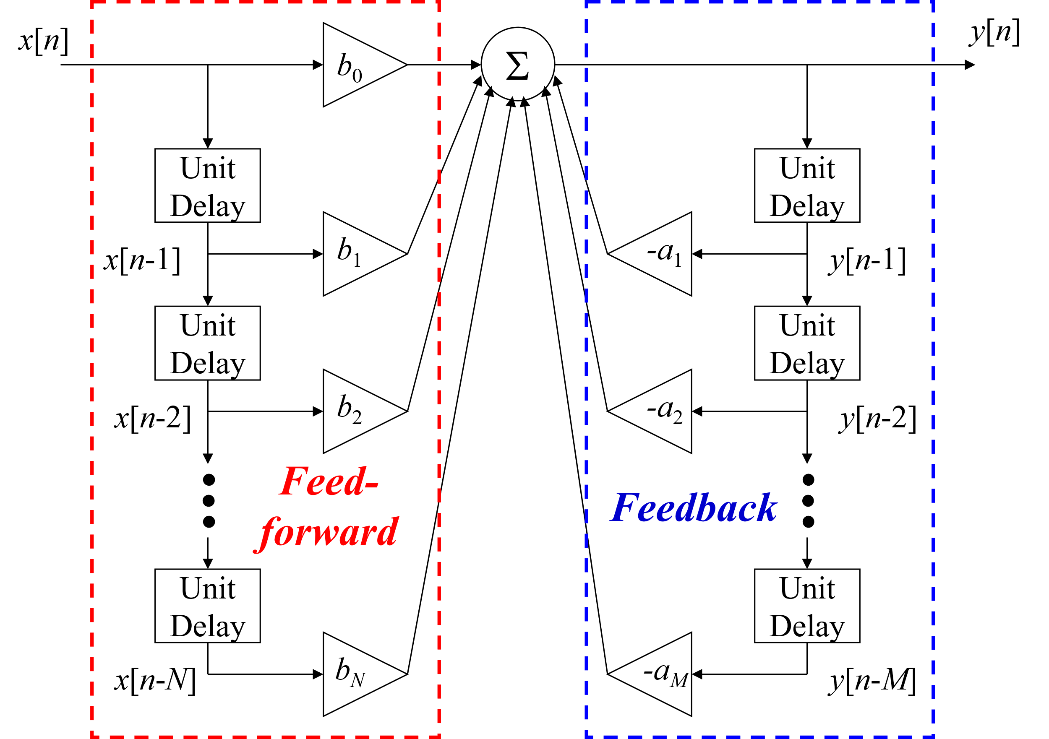
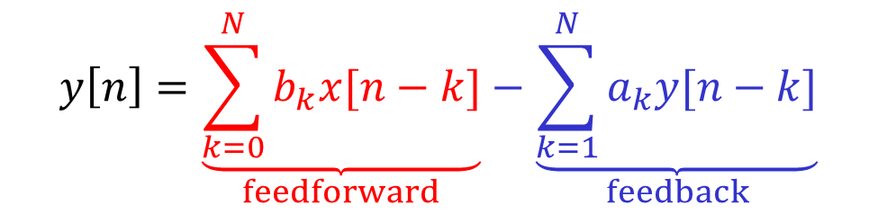
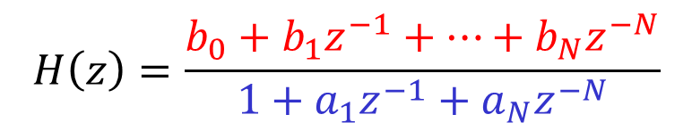
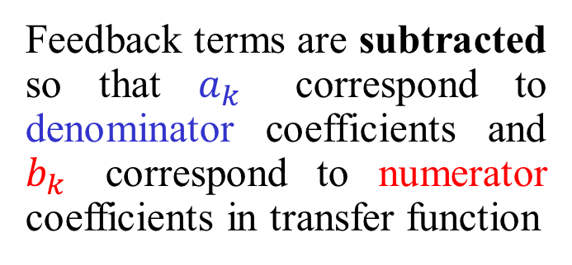
General Form of IIR Filter
$$y\left[n\right]=\underset{feedforward}{\underbrace{\sum_{k=0}^{N}{b_{k}x[n−k]}}}−\underset{feedback}{\underbrace{\sum_{k=1}^{N}{a_{k}y[n−k]}}}$$
Feedback terms are subtracted so that $a_{k}$ correspond to denominator coefficients and $b_{k}$ correspond to numerator coefficients in transfer function
$$H\left(z\right)=\frac{b_{0}+b_{1}z^{−1}+⋯+b_{N}z^{−N}}{1+a_{1}z^{−1}+a_{N}z^{−N}}$$

Slide 12
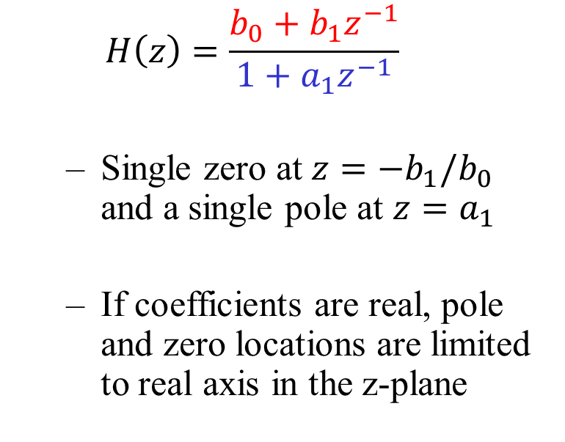
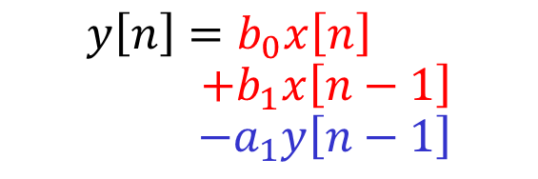
First Order IIR filter
x[n]
y[n]
b₀
Σ
$$y\left[n\right]=b_{0}x\left[n\right]$$
$$+b_{1}x\left[n−1\right]$$
$$−a_{1}y\left[n−1\right]$$
Unit Delay
Unit Delay
x[n-1]
b₁
a₁
y[n-1]
$$H\left(z\right)=\frac{b_{0}+b_{1}z^{−1}}{1+a_{1}z^{−1}}$$
Single zero at $z=−b_{1}/b_{0}$ and a single pole at $z=a_{1}$
If coefficients are real, pole and zero locations are limited to real axis in the z-plane
Notes:
First order filter demo using matlab filterDesigner
Design method: IIR Butterworth Specify order 1
Units: normalized
Wc: 0.1
Design filter
Click pole-zero tab on left sidebar
Select poles and zeros and adjust magnitude
DSP first demos
https://dspfirst.gatech.edu/chapters/08feedbac/demos/3_domain/index.html

Slide 13
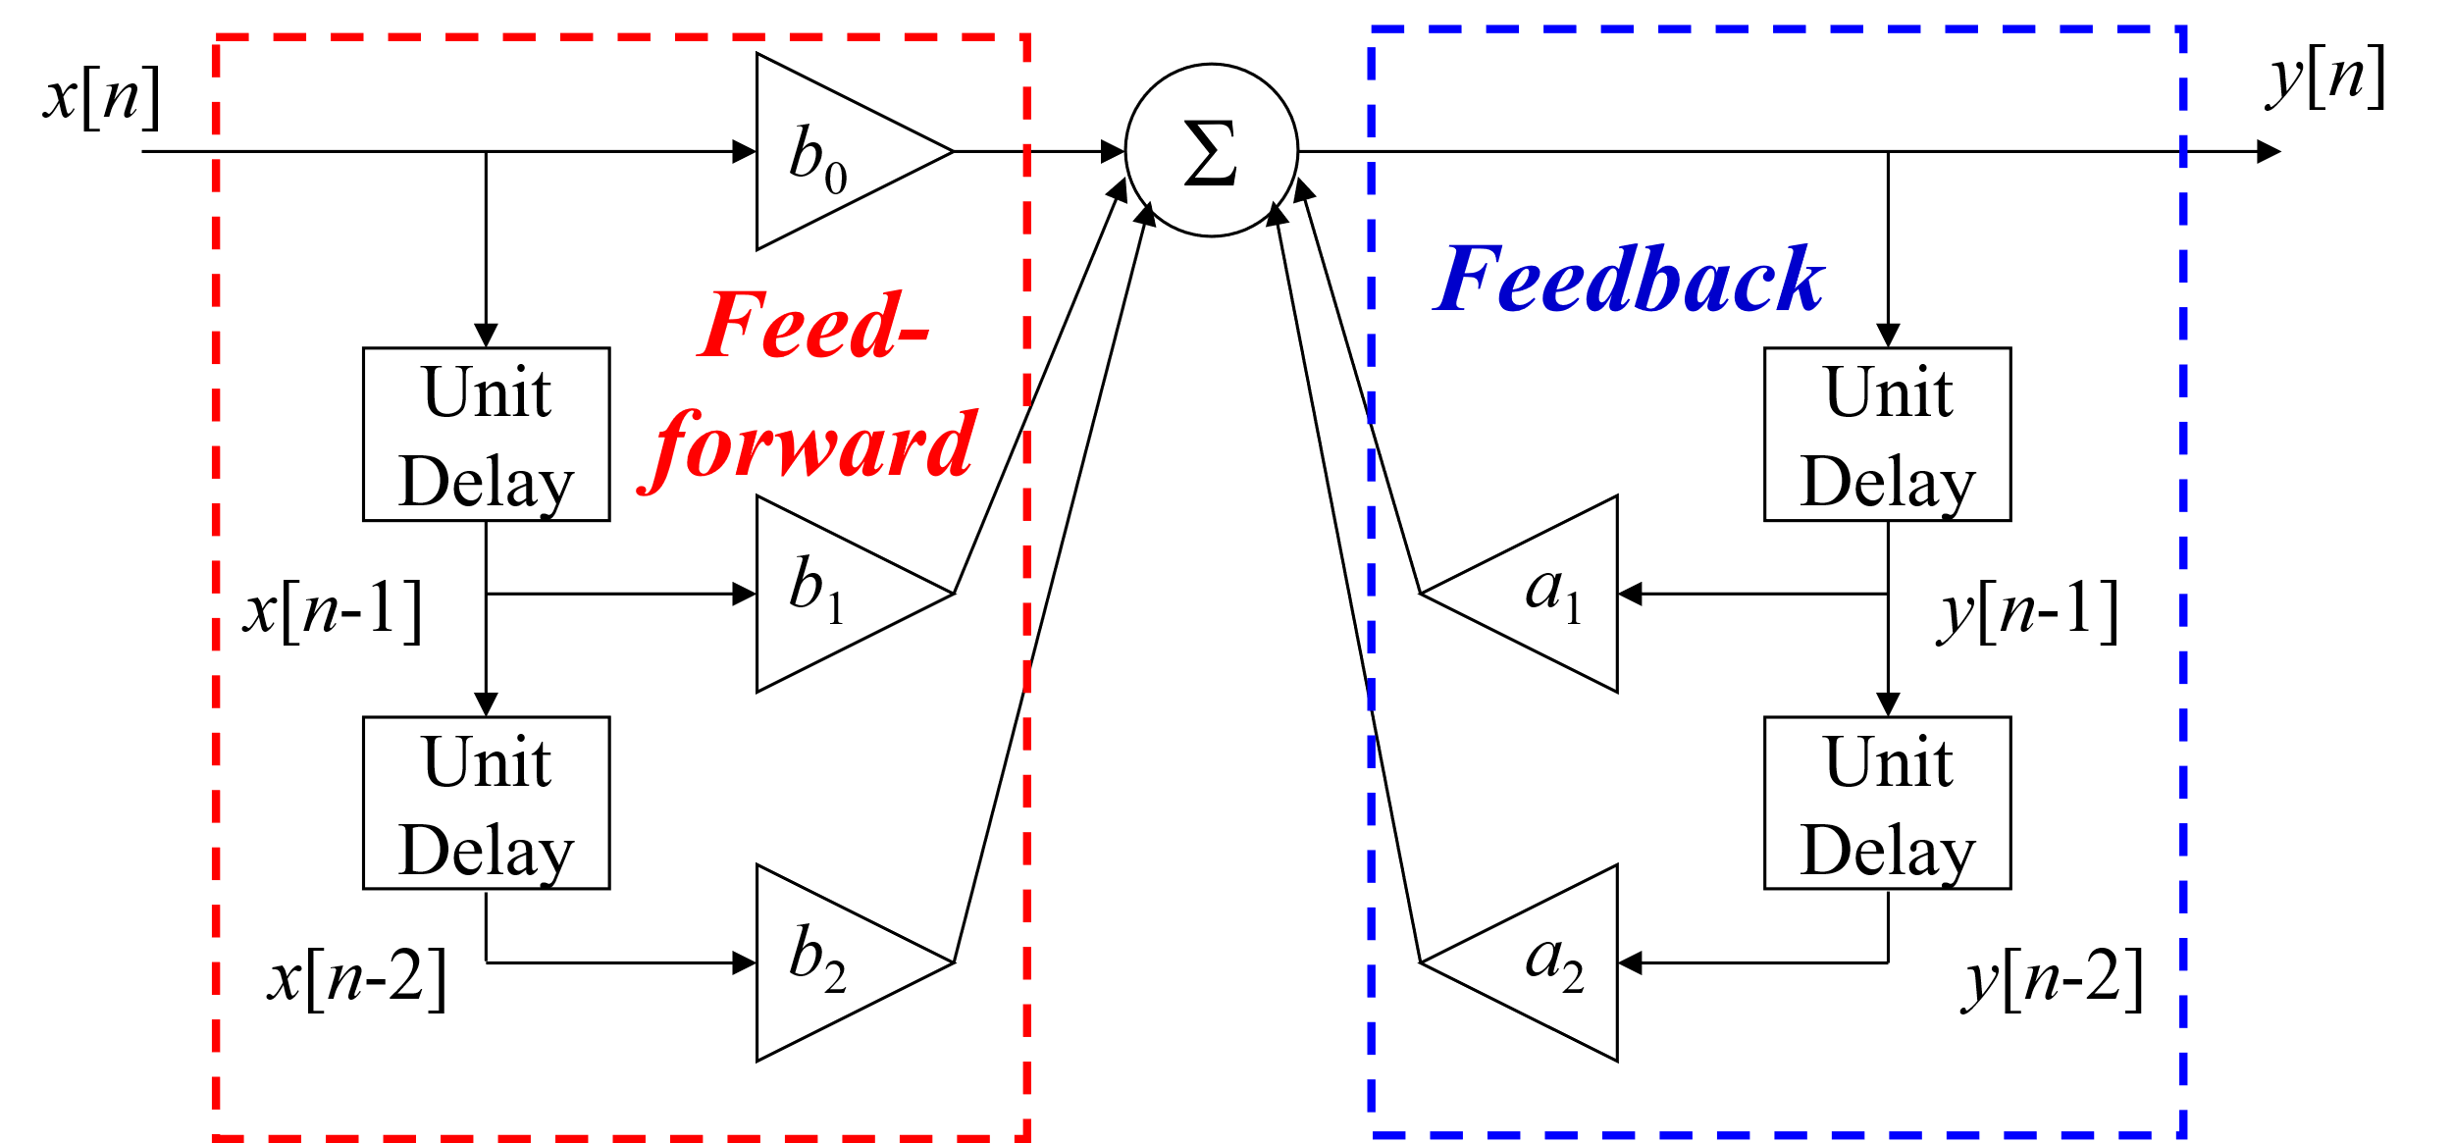
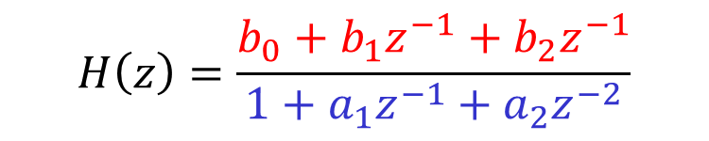
Second Order (Biquad) IIR Filter
Biquad: short for biquadratic
Transfer function is ratio of two quadratic polynomials
$$H\left(z\right)=\frac{b_{0}+b_{1}z^{−1}+b_{2}z^{−1}}{1+a_{1}z^{−1}+a_{2}z^{−2}}$$
Direct form I

Slide 14
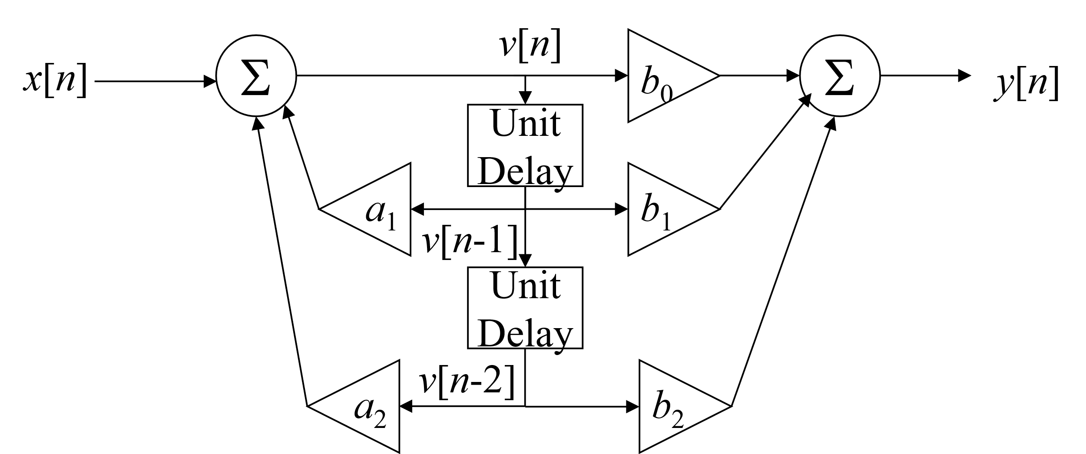
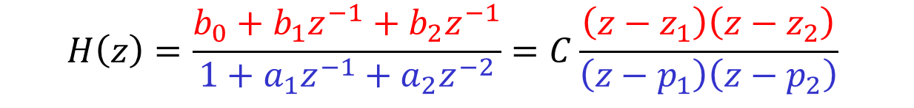
Biquad in Direct form II
$$H\left(z\right)=\frac{b_{0}+b_{1}z^{−1}+b_{2}z^{−1}}{1+a_{1}z^{−1}+a_{2}z^{−2}}=C\frac{\left(z−z_{1}\right)\left(z−z_{2}\right)}{\left(z−p_{1}\right)\left(z−p_{2}\right)}$$
All-pole IIR filter
FIR Filter
v[n]
x[n]
All-pole IIR Filter
FIR Filter
y[n]

Slide 15
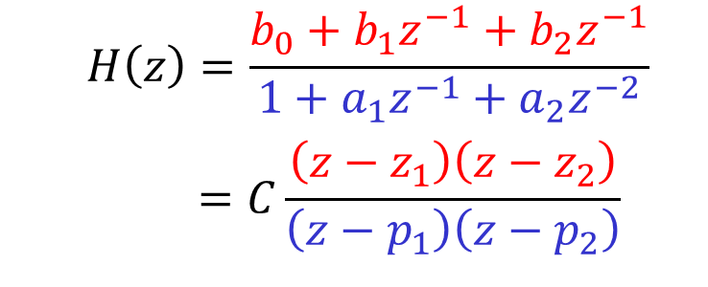
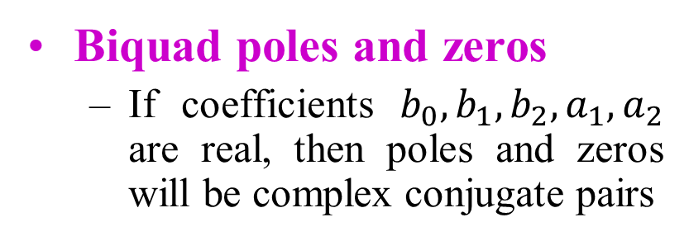
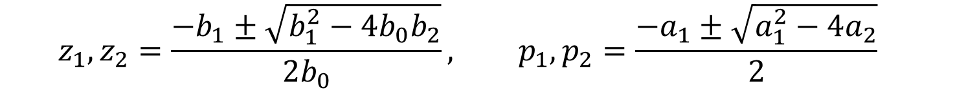
Second Order (Biquad) IIR Filter
Biquad poles and zeros
If coefficients $b_{0},b_{1},b_{2},a_{1},a_{2}$ are real, then poles and zeros will be complex conjugate pairs
$$H\left(z\right)=\frac{b_{0}+b_{1}z^{−1}+b_{2}z^{−1}}{1+a_{1}z^{−1}+a_{2}z^{−2}}$$
$$=C\frac{\left(z−z_{1}\right)\left(z−z_{2}\right)}{\left(z−p_{1}\right)\left(z−p_{2}\right)}$$
$$z_{1},z_{2}=\frac{−b_{1}±\sqrt{b_{1}^{2}−4b_{0}b_{2}}}{2b_{0}}, p_{1},p_{2}=\frac{−a_{1}±\sqrt{a_{1}^{2}−4a_{2}}}{2}$$
Allowing complex poles and zeros provides more flexibility for designing filters compared to single order IIR filter
Example: bandstop filter

Slide 16
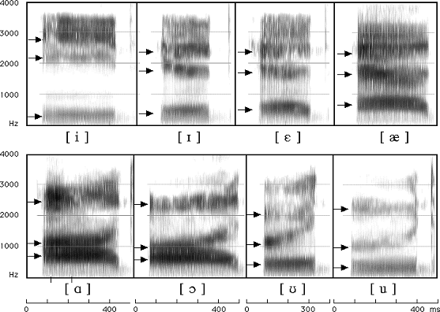
Vocoder
“Voice Encoder”
Originally developed for speech synthesis and for encoding speech for telecommunications
Video: speech synthesis (1939)
Use as a musical effect (lab #7)
Source-Filter model of speech production
Opening and closing of vocal folds produces many harmonically related frequencies
Model vocal tract (including lips, teeth, etc) as LTI filter
Poles are especially important since they model resonances
Instead of representing speech by signal amplitude, represent based on filter parameters

Slide 17
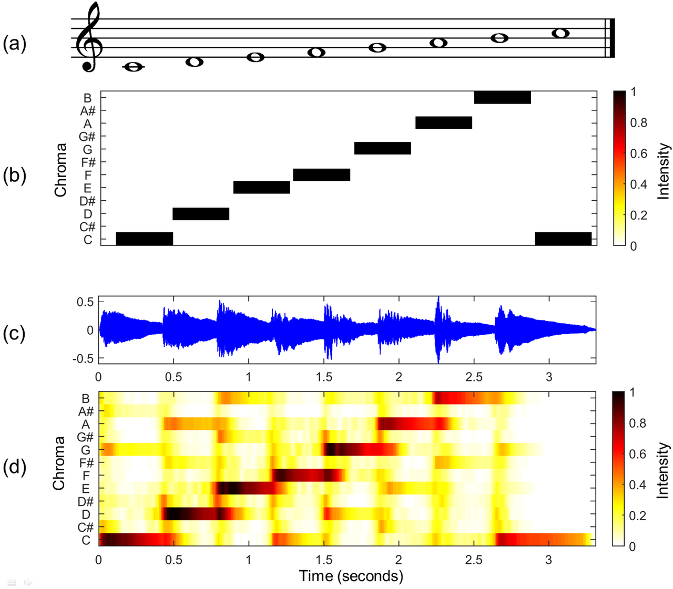
Chromagram
Map audio signal to notes
Musical notes are perceived as similar when their frequencies differ by an octave (factor of 2)
12-tone equal temperament divides each octave into 12 bins:
{C, C♯, D, D♯, E , F, F♯, G, G♯, A, A♯, B}
Use bank of IIR filters to extract each note
IIR filters provide much better frequency selection than FIR
Less delay on average compared to FIR
Only average energy is displayed, nonlinear phase is okay
MATLAB code (PDF, piano.wav)

Slide 18
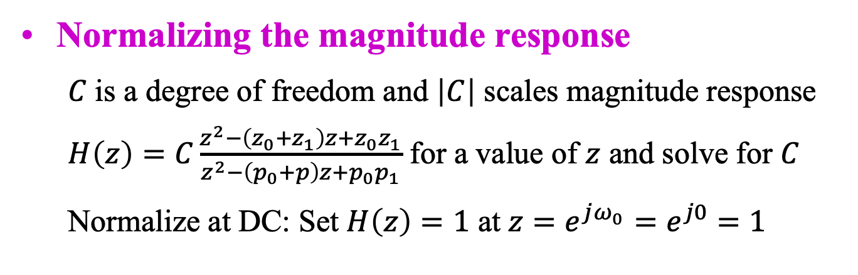
IIR Biquad Frequency Responses
IIR Biquad Filter Structures
Magnitude response
Zeros z₀ & z₁ and poles p₀ & p₁
|a – b| is distance between complex numbers a and b
|e^{jω} – p₀| is distance from point on unit circle e^{jω} and pole p₀

Slide 19
Frequency Response?
Poles have radius r Zeros have radius 1/r
handout
Im(z)
Im(z)
Im(z)
Zeros are on the unit circle
O
O
X
X
O
X
Re(z)
Re(z)
Re(z)
O
X
X
X
O
O
Lowpass, highpass, bandpass, bandstop, allpass, notch?
zeroAngle = pi/4;
rz = 1/0.8;
z0 = rz*exp(j*zeroAngle);
z1 = rz*exp(-j*zeroAngle);
numer = [1 -(z0+z1) z0*z1];
r = 1/rz;
poleAngle = pi/4;
p0 = r * exp(j*poleAngle);
p1 = r * exp(-j*poleAngle);
denom = [1 -(p0+p1) p0*p1];
%%% Normalize the DC response
%%% to 1 in linear units by
%%% setting H(z) evaluated
%%% at z = 1 to be 1
C = (denom * [1 1 1]') / (numer * [1 1 1]');
freqz(C*numer, denom);
zeroAngle = 15*pi/16;
z0 = exp(j*zeroAngle);
z1 = exp(-j*zeroAngle);
numer = [1 -(z0+z1) z0*z1];
r = 0.9;
poleAngle = pi/16;
p0 = r * exp(j*poleAngle);
p1 = r * exp(-j*poleAngle);
denom = [1 -(p0+p1) p0*p1];
%%% Normalize the DC response
%%% to 1 in linear units by
%%% setting H(z) evaluated
%%% at z = 1 to be 1
C = (denom * [1 1 1]’) / (numer * [1 1 1]');
freqz(C*numer, denom);
zeroAngle = pi/4;
z0 = exp(j*zeroAngle);
z1 = exp(-j*zeroAngle);
numer = [1 -(z0+z1) z0*z1];
r = 0.9;
poleAngle = pi/4;
p0 = r * exp(j*poleAngle);
p1 = r * exp(-j*poleAngle);
denom = [1 -(p0+p1) p0*p1];
%%% Normalize the DC response
%%% to 1 in linear units by
%%% setting H(z) evaluated
%%% at z = 1 to be 1
C = (denom * [1 1 1]') / (numer * [1 1 1]');
freqz(C*numer, denom);

Slide 20
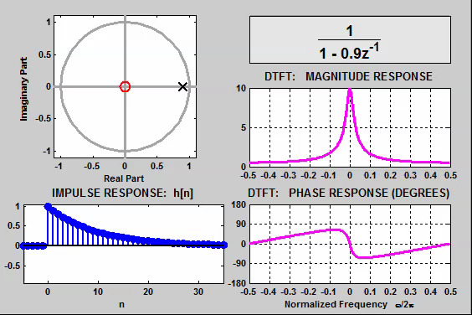
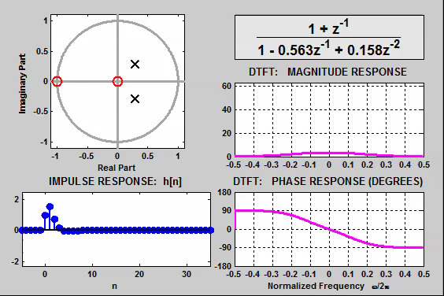
Demonstrations
IIR Biquad Filter Structures
DSP First, 2nd ed., ch. 10
IIR filtering tutorial (Link)
Connection between the Z and frequency domains (Link)
Time/frequency/z domain movies for IIR Filters (Link)
link
IIR filter with one pole and a zero at the origin
Movement of Poles

Slide 21
Stability
Stability
A discrete-time LTI system is bounded-input bounded-output (BIBO) stable if for any bounded input x[n] such that | x[n] | ≤ B₁ < ∞, then the filter response y[n] is also bounded | y[n] | ≤ B₂ < ∞
Proposition: A discrete-time filter with an impulse response of h[n] is BIBO stable if and only if
handout
Every finite impulse response LTI system (even after implementation) is BIBO stable
A causal infinite impulse response LTI system is BIBO stable if and only if its poles lie inside the unit circle

Slide 22
BIBO Stability
Stability
Rule #1: For a causal sequence, poles are inside the unit circle (applies to z-transform functions that are ratios of two polynomials) OR
Rule #2: Unit circle is in the region of convergence. (In continuous-time, imaginary axis would be in region of convergence of Laplace transform.)
Example:
pole at z=a
Stable if |a| < 1 by rule #1 or equivalently
Stable if |a| < 1 by rule #2 because |z|>|a| and |a|<1

Slide 23

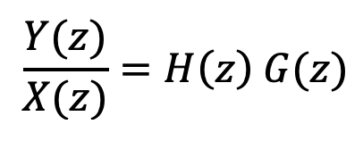

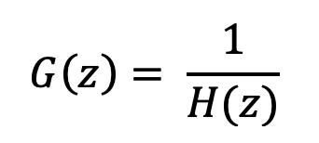
Equalization
Stability
Design equalizer to compensate frequency distortion
LTI
LTI
x[m]
System Model (Filter)
Equalizer
y[m]
h[m]
g[m]
Applications: Audio, image and communication systems
Goal: Make cascade all-pass:
notch
Im(z)
Example: H(z) is an FIR filter
O
X
cancellation
O
X
Re(z)
Stability issues?
O
X
O
all-pass
X
cancellation
Zeros of H(z) become poles of G(z)
X
O
notch

Slide 24
IIR Filter Design
Cascade of Biquads
Classical IIR filter design algorithms
Design Method | Passband | Stopband
Butterworth | Monotonic | Monotonic
Chebyshev type I | Monotonic | Ripples
Chebyshev type II | Ripples | Monotonic
Elliptic | Ripples | Ripples
Manual placement of poles and zeros
Automated adaptation of pole and zero locations
Center frequency of bandpass resonator HW 1.1(d) & 2.1(d)
Notch filter with parameterized notch frequency HW 3.1(c)

Slide 25
IIR Filter Implementation
Cascade of Biquads
Cascade of biquads for N poles
N even: N/2 conjugate pairs of poles. Cascade of N/2 biquads.
N odd: One real pole and (N-1)/2 conjugate pairs of poles. Cascade of first-order filter (real pole) and (N-1)/2 biquads
For M biquads, M! orderings of conjugate pairs of poles and for each ordering, M! orderings of conjugate pairs of zeros
Exhaustive search: simulate all combinations to pick best one
Quick pairing: Order biquads in ascending order of quality factors (see next slide) and for each each biquad, choose the conjugate zero pair that is closest in Euclidean distance
Single section (single difference equation)
Could make a BIBO stable filter become BIBO unstable

Slide 26
Quality Factors for Digital Biquads
Cascade of Biquads
Measures sensitivity in pole locations to perturbations
For poles at a ± j b = r e ^{± j θ}, where is pole radius (r < 1 for stability), with y = –2 a:
Real poles: b = 0 and −1 < a < 1, so r = |a| and y = ±2 a and Q = ½ (impulse response is C₀ a^{n} u[n] + C₁ n a ^{n} u[n])
Poles on unit circle: r = 1 so Q = ∞ (oscillatory response)
Imaginary poles: a = 0 so r = |b| and y = 0, and
Processors with 16-bit x 16-bit multipliers and 40-bit accumulators: Q_{max} ≈ 40
Filter design programs use r as approximation of quality factor

Slide 27
Quality Factors for Analog Biquads
Cascade of Biquads
Second-order filter section
Conjugate symmetric poles a ± j b, where a < 0
With no zeros, impulse response is
which is pure decay when b = 0 and pure sinusoid when a = 0
Quality factor: measures sensitivity of pole locations to perturbations
Real poles: b = 0 so Q = ½ (exponential decay response)
Imaginary poles: a = 0 so Q = ∞ (oscillatory response)
Maximum Q values: 25 for board-level RC circuits, 40 for switched capacitor designs, and 80 for analog IC designs
Classical designs have biquads with high Q factors

Slide 28
IIR Filter as Single Section
Common IIR Filter Structures
IIR filters have rational transfer functions
Direct form realization
Dot product of vector of N +1 coefficients and vector of current input and previous N inputs (FIR section)
Dot product of vector of M coefficients and vector of previous M outputs (“FIR” filtering of previous output values)
Computation: M + N + 1 multiply-accumulates (MACs)
Memory: M + N words for previous inputs/outputs and M + N + 1 words for coefficients

Slide 29
IIR Filter as Single Section
Common IIR Filter Structures
x[n]
y[n]
b₀
Σ
Unit Delay
Unit Delay
x[n-1]
b₁
a₁
y[n-1]
Unit Delay
Unit Delay
Full Precision Wordlength of y[0] is 2 words. Wordlength of y[n] increases with n for n > 0.
x[n-2]
b₂
a₂
y[n-2]
Feed-forward
Feedback
Unit Delay
Unit Delay
x[n-N]
b_{N}
a_{M}
y[n-M]
M and N may be different

Slide 30
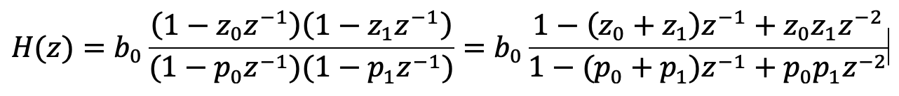
Stability As Single Section
IIR filter design to meet a specification
Manual or automatic placement of poles and zeros
Poles are inside unit circle for stability
Factored transfer function in poles, zeros and gain
Expanded to obtain coefficients for difference equation
Expansion for feedback coefficients can lead to instability
Second-order example: zeros z₀ & z₁, poles p₀ & p₁
Each addition and multiplication in 64-bit floating point
worst-case loss of one bit
worst-case loss of 53 bits

Slide 31
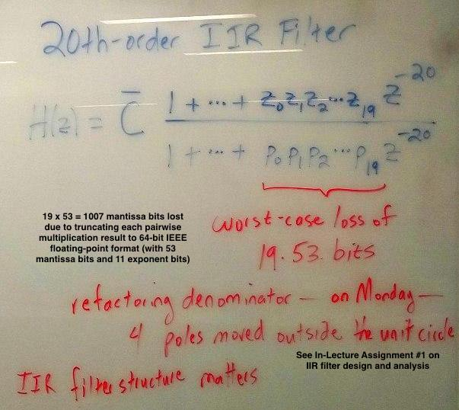
Stability As Single Section

Slide 32
MATLAB Filter Designer Demo #1
Cascade of Biquads
Filter design/analysis
Lowpass filter design specification (all demos)
fpass = 9600 Hz
fstop = 12000 Hz
fsampling = 48000 Hz
Apass = 1 dB
Astop = 80 dB
Under analysis menu
Show magnitude, phase and group delay responses
FIR filter – equiripple
Also called Remez Exchange or Parks-McClellan design
Minimum order is 50
Change Wstop to 80
Order 100 gives Astop 100 dB
Order 200 gives Astop 175 dB
Order 300 does not converge –how to get higher order filter?
FIR filter – Kaiser window
Minimum order 101 meets spec

Slide 33
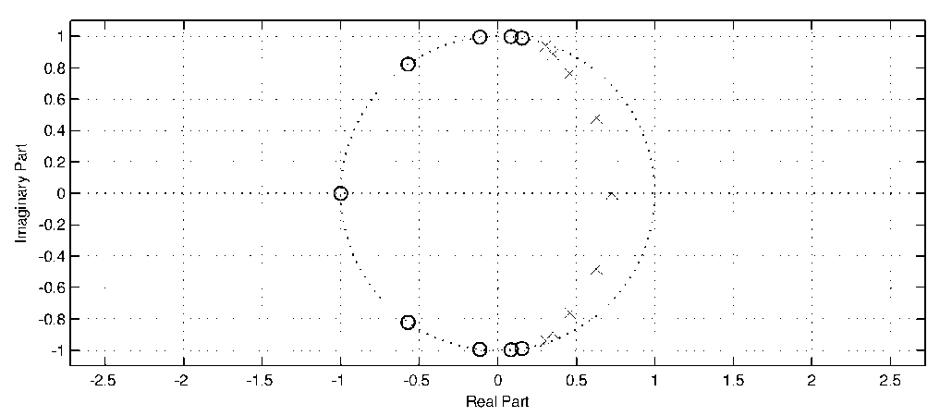
MATLAB Filter Designer Demo #2
Cascade of Biquads
IIR filter – elliptic
Use second-order sections
Filter order of 8 meets spec
Achieved Astop of ~80 dB
Poles/zeros separated in angle
Zeros on or near unit circle indicate stopband
Poles near unit circle indicate passband
Two poles very close to unit circle but still BIBO stable
Show group delay response
IIR filter – elliptic
Use second-order sections
Increase filter order to 9
Eight complex symmetric poles and one real pole:
Same observations on left

Slide 34
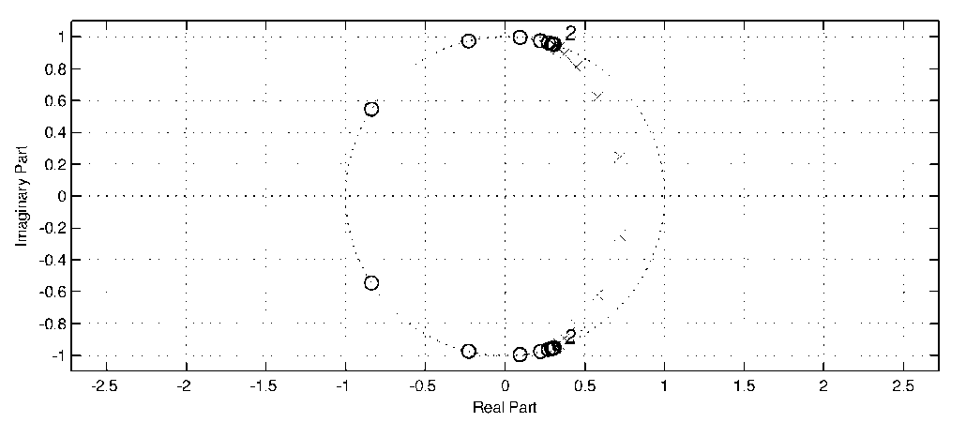
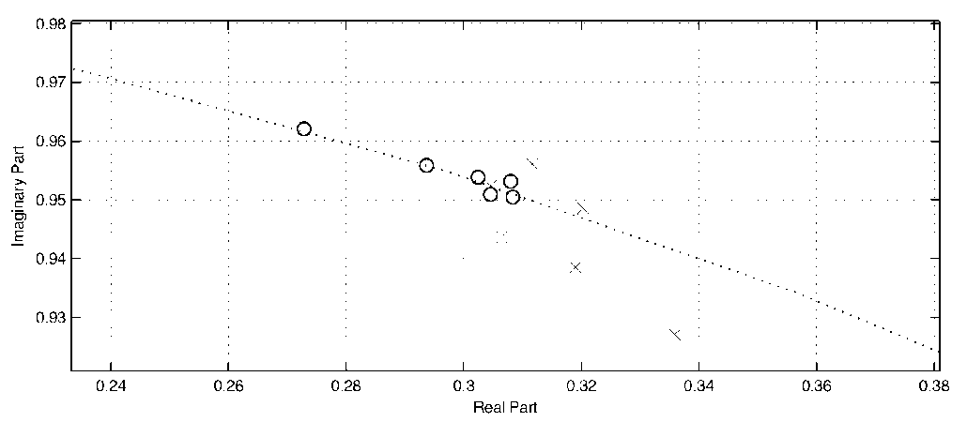
MATLAB Filter Designer Demo #3
Cascade of Biquads
IIR filter – elliptic
Use second-order sections
Increase filter order to 20
Two poles very close to unit circle but BIBO stable
Single section (Edit menu)
Oscillation frequency ~9 kHz appears in passband
BIBO unstable: two pairs of poles outside unit circle
IIR filter design algorithms return poles-zeroes-gain (PZK format): Impact on response when expanding polynomials in transfer function from factored to unfactored form (see slide 6-25)

Slide 35
MATLAB Filter Designer Demo #4
Cascade of Biquads
IIR filter - constrained least pth-norm design
Use second-order sections
Limit pole radii ≤ 0.92
Order 8 does not meet both passband/stopband specs for different weights
Order 9 does indeed meet specs using Wpass = 1.5 and Wstop = 800
Filter order might increase but worth higher complexity for being more robust perturbations in pole locations

Slide 36
Conclusion
 | FIR Filters | IIR Filters
Implementation complexity (1) | Higher | Lower (sometimes by factor of four)
Minimum order design algorithm | Parks-McClellan (Remez exchange) algorithm (2) | Elliptic design algorithm
BIBO stable? | Always | May become unstable when implemented (3)
Linear phase | If impulse response is symmetric or anti-symmetric about midpoint | No, but phase may made approximately linear over passband (or other band)
(1) For same piecewise constant magnitude specification (2) Algorithm to estimate minimum order for Parks-McClellan algorithm by Jim Kaiser may be off by 10%. Search for minimum order is often needed. (3) Choice of IIR filter structure matters -- use cascade of biquads instead of a single section. Some IIR filter design algorithms can constrain pole locations.

Slide 37
Conclusion
Keep poles computed by filter design algorithms
Polynomial deflation (rooting) reliable in floating-point
Polynomial inflation (expansion) may degrade roots
Direct form IIR structures expand zeros and poles
May become unstable for large order filters (order > 12) due to degradation in pole locations from polynomial expansion
Cascade of biquads (second-order sections)
Only poles and zeros of second-order sections expanded
Biquads placed in order of ascending quality factors
Optimal ordering of biquads requires exhaustive search and each ordering can be simulated in parallel for speed

