Slide 1
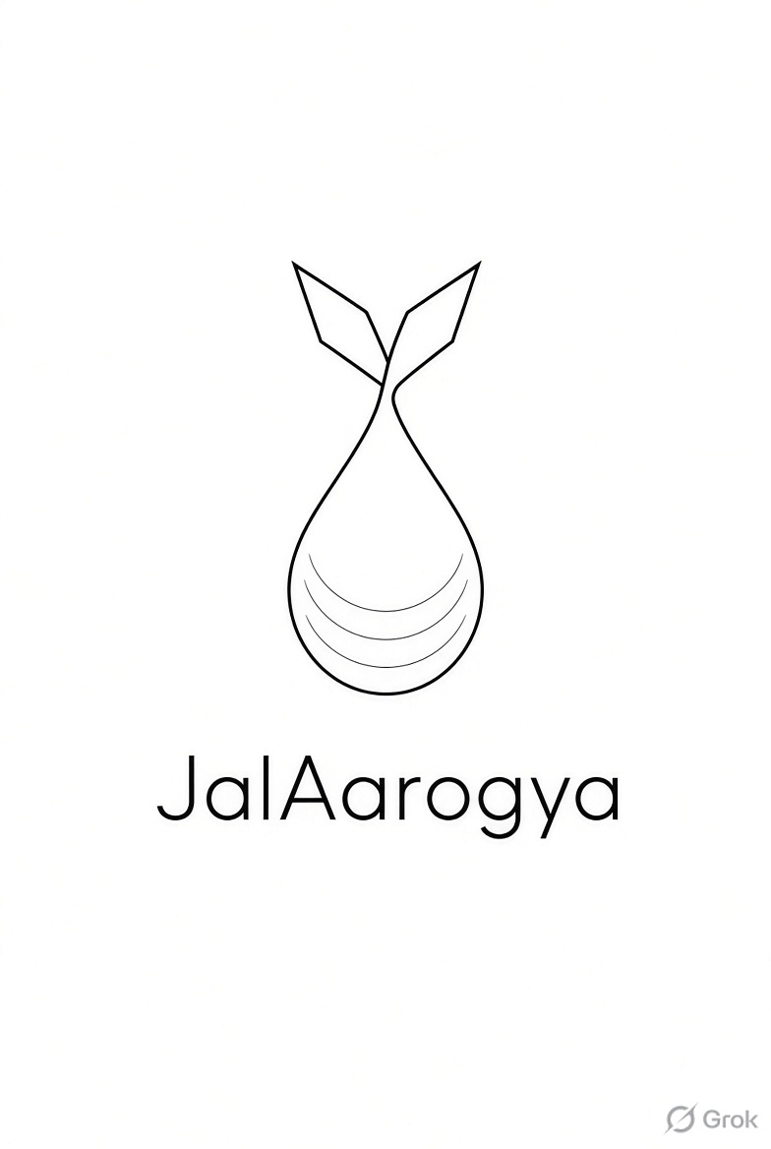
JalAarogya
AI-powered River Health & Recovery Intelligence
Godavari • Nashik • Kumbh 2027
OBSERVE → DIAGNOSE → PREDICT → RECOMMEND
Turning river data into an operational decision clock.
Team Yukti
Parthsarthi • Aryaman Tripathy • Parth Sharma • GVS Pavan Kumar • Payal Khakre
REAL • SCALABLE • KUMBH-READY

Slide 2
02
The problem in 5W
WHY THIS MATTERS
WHAT?
WHY?
AI recovery + decision-support for river management.
Grab samples arrive late; river conditions change fast.
GODAVARI RIVER
WHO?
WHEN?
NMC • water agencies • district + event teams.
WHERE?
Before • during • after major bathing events.
Upstream control → Ramkund → downstream recovery
THE GAP | Measurement • Time • Diagnosis • Recovery

Slide 3
03
Conventional vs JalAarogya
FROM MONITORING → DECISION
CONVENTIONAL
JALAAROGYA
1
Sample
Grab sample
1
Sense
Satellite + IoT + field
2
Lab
Wait for result
2
AI
Diagnose + predict
3
Report
Static reading
3
Clock
Recovery estimate
4
Action
Reactive response
4
Act
Recommend + verify
LATE • FRAGMENTED • REACTIVE
TIMELY • UNIFIED • ACTIONABLE

Slide 4
04
Input → Process → Output
THE DATA PIPELINE
INPUT
PROCESS
OUTPUT
1
SATELLITE
QA
Cloud / shadow quality check
RECOVERY CLOCK
Sentinel-2 L2A Landsat 8/9 Sentinel-1 SAR
T½ — time to 50% disturbance
MASK
Water extraction + indices
RISK / STATUS
2
GROUND
7-sensor / IoT pH • DO • turbidity + other field signals
Reach-level health signal
MODEL
Autocorrelation + recovery fit
ACTION WINDOW
3
CONTEXT
24 / 48 / 72 h decision
Weather • flow crowd • drains municipal operations
AI
Predict • rank recommend
AUDIT TRAIL
Evidence → action → verify
7 sensor parameters can anchor the AI with live ground truth.

Slide 5
05
What the system actually computes
PARAMETERS + AI DECISION LOGIC
RIVER VITALS
RECOVERY ENGINE
DECISION OUTPUT
pH
DO
1
Baseline
Compare with control / normal state
LOW
Monitor
WATER HEALTH
2
Signal
Excess index ΔX(t)
MEDIUM
Sample / inspect
3
Memory
Autocorrelation ρ(τ)
Turbidity
Temp.
Clock
T½ = τc × ln(2)
HIGH
Hold / clean / advise
4
Conductivity
ORP / other
5
Decision
Gap vs recovery → action
RECOVERY WINDOW
Example: T½ ≈ 1.55 days*
0h
24h
48h
72h

Slide 6
06
Challenges • Future • Conclusion
MAKE IT DEPLOYABLE
CHALLENGES
FUTURE SCOPE
CONCLUSION
Cloud cover / missing scenes
Live 7-sensor fusion
From data → recovery clock
Ground-truth variability
Reach-level AI forecasting
From clock → action window
Flowing water is hard to model
Scale to other river basins
From action → verification
DATA & RESOURCES USED
Sentinel-2 L2A • Copernicus / Google Earth Engine
Open-Meteo • weather context
Landsat 8/9 • USGS
Nominatim + Overpass API • geocoding / river-way context
Sentinel-1 SAR • Copernicus
Godavari Recovery Intelligence source deck • 10-year Sentinel-2 archive / 385 scenes
MPCB Nashik Water Quality • pH, DO, BOD, COD, nitrate, fecal coliform, WQI
Satellite scope document • satellite + IoT/field + laboratory + data architecture
JalAarogya | Observe • Predict • Protect
*Recovery half-life is a relative optical proxy and requires field/lab validation before bathing-safety claims.

