Slide 1
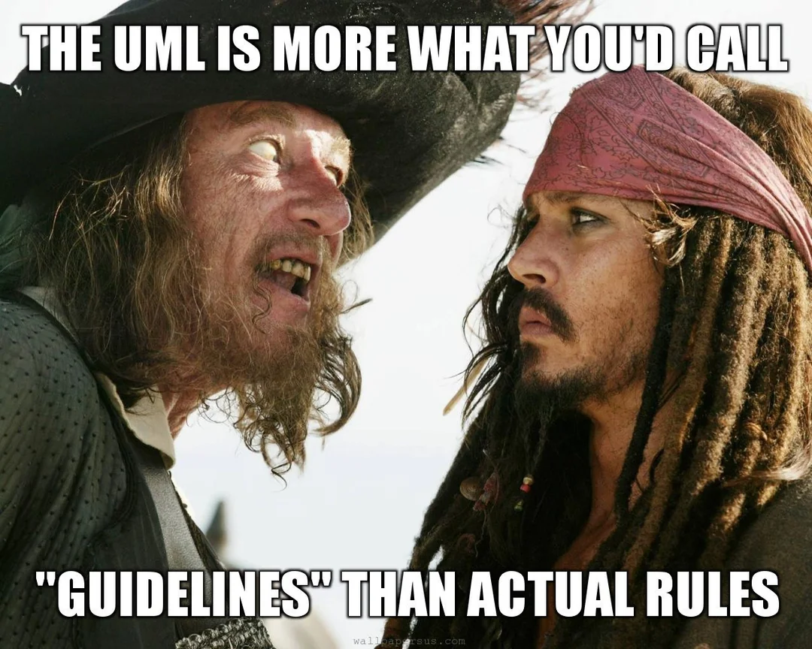
Softwareengineering WS 25/26
3. MVP

Slide 2
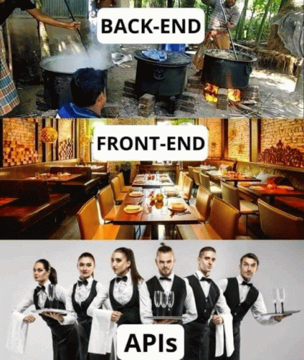
Softwareengineering WS 25/26
3. MVP

Slide 3

Softwareengineering WS 25/26
3. MVP
Teil 2 : Reflexion

Slide 4



Softwareengineering WS 25/26
3. MVP
Wie sind wir zu den Ergebnissen gekommen?

Slide 5

Softwareengineering WS 25/26
3. MVP
Herausforderungen & Probleme

Slide 6

Softwareengineering WS 25/26
3. MVP
Feedback

Slide 7

Softwareengineering WS 25/26
3. MVP

