Slide 1
AURORA-HTN-317 DSMB Site & Trial Integrity Review
Phase III randomized, double-blind, placebo-controlled trial of AHT-417 for uncontrolled hypertension
Independent biostatistical review for the Data Safety Monitoring Board
Population: ITT, n=480 (AHT-417 240 / Control 240)
Primary endpoint: Week-24 change from baseline in seated SBP
Review date 2026-08-23 | Protocol review cutoff 2026-11-30
AURORA-HTN-317 DSMB Site & Trial Integrity Review | 1

Slide 2
Executive Summary & DSMB Posture
Overall Week-24 treatment effect: +6.44 mmHg (Control minus AHT-417, 95% CI 5.37 to 7.50) - the Control arm's SBP fell by more
Influential site identified: SITE-08 (largest absolute site effect, 10.93 mmHg)
Conditional power at the last interim snapshot (AIS-017, IF=0.995) reconstructs to ~0.988 under the same-effect assumption; snapshots at/ beyond target (IF>=1.0) have undefined conditional power
External care cohort is NOT independent: 480/480 baseline SBP exact match with trial
No executed unblinded DSMB interim review can be established from supplied records
Recommendation: do not accept efficacy claims until site integrity and external-cohort independence are resolved
AURORA-HTN-317 DSMB Site & Trial Integrity Review | 2

Slide 3
Governing Analysis Specification
Population: ITT (all 480 randomized); endpoint Week-24 change from baseline in seated SBP
Endpoint imputation: LOCF cascade week24 -> week12 -> baseline; the 12 subjects with no post-baseline SBP contribute change = 0 (all sites keep full ITT denominators)
Model: chg ~ ctl * C(site) (saturated treatment-by-site model; each site effect = within-site mean difference in SBP reduction)
Sign convention: Control minus AHT-417; positive = the Control arm's seated SBP fell by more at that site
Site effect = ctl main effect + ctl:C(site)[T.<site>] interaction = mean_chg(Control) - mean_chg(AHT-417)
Assumed treatment difference -5.5 mmHg; assumed SD 11.5 mmHg; alpha 0.05 (two-sided); power 90%%
Site heterogeneity assessed via the trt-by-site interaction; a baseline-adjusted site random-intercept integrity model is fit as a sensitivity (Sheet 16)
AURORA-HTN-317 DSMB Site & Trial Integrity Review | 3

Slide 4
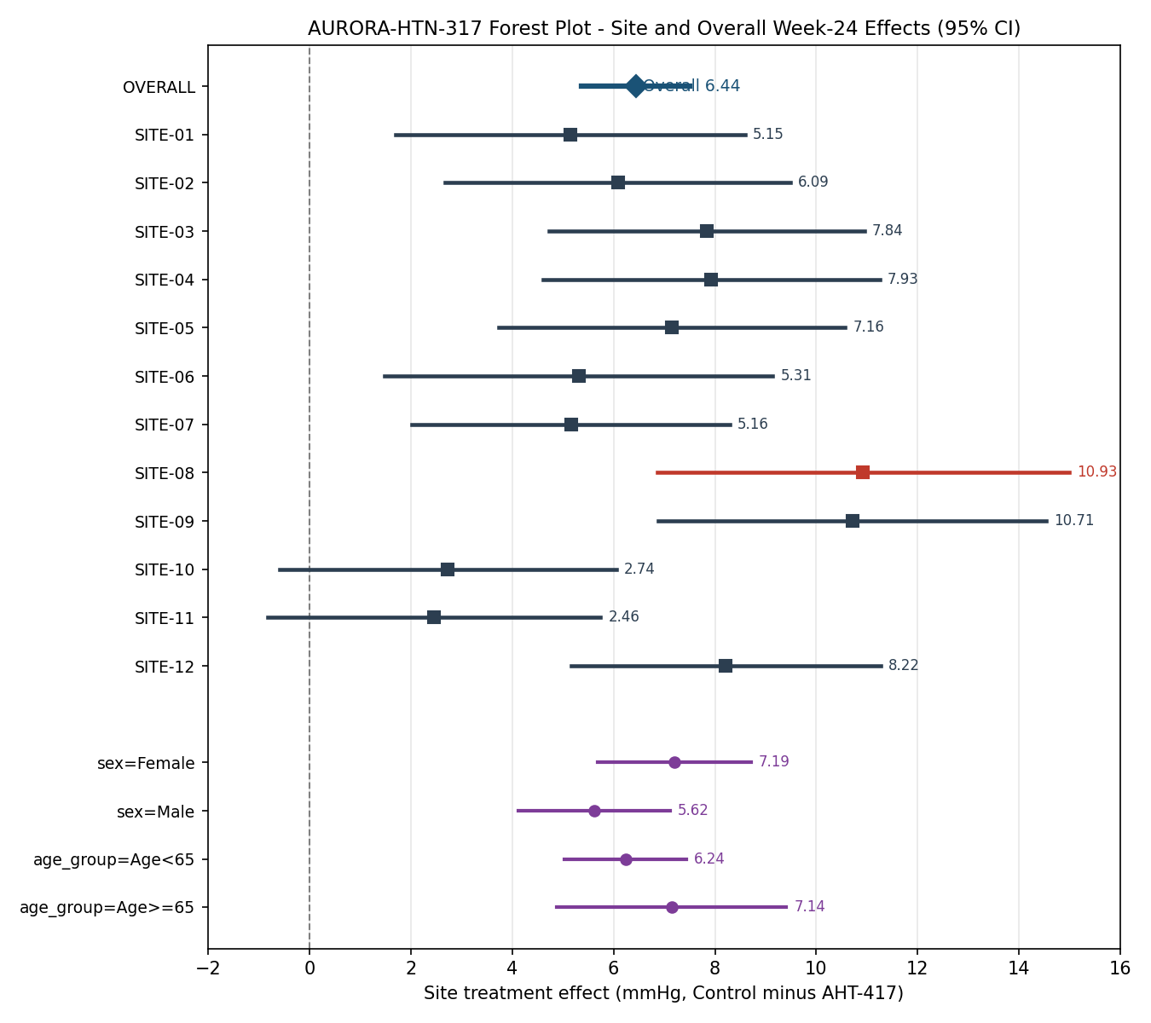
Site and Subgroup Effects with Uncertainty (Forest Plot)
Each site: treatment effect (Control minus AHT-417) with 95% CI; red = influential site
AURORA-HTN-317 DSMB Site & Trial Integrity Review | 4

Slide 5
Site-Level Treatment Effects (12 Sites)
Site | N | Effect (mmHg) | CI low | CI high | Influential
SITE-01 | 38 | 5.15 | 1.70 | 8.60
SITE-02 | 43 | 6.09 | 2.68 | 9.49
SITE-03 | 48 | 7.84 | 4.73 | 10.95
SITE-04 | 41 | 7.93 | 4.60 | 11.25
SITE-05 | 39 | 7.16 | 3.74 | 10.57
SITE-06 | 32 | 5.31 | 1.49 | 9.14
SITE-07 | 46 | 5.16 | 2.02 | 8.30
SITE-08 | 28 | 10.93 | 6.86 | 14.99 | YES
SITE-09 | 31 | 10.71 | 6.89 | 14.53
SITE-10 | 41 | 2.74 | -0.59 | 6.06
SITE-11 | 42 | 2.46 | -0.83 | 5.74
SITE-12 | 51 | 8.22 | 5.17 | 11.27
AURORA-HTN-317 DSMB Site & Trial Integrity Review | 5

Slide 6
Subgroup Effects: Age & Sex Treatment Interaction
Sign convention: Control minus AHT-417 (positive = Control arm's SBP fell by more)
Subgroup | Level | n AHT/Ctl | Effect (mmHg) | 95% CI (descriptive)
sex | Female | 119/127 | 7.19 | 5.68 to 8.71
sex | Male | 121/113 | 5.62 | 4.13 to 7.11
age_group | Age<65 | 192/188 | 6.24 | 5.04 to 7.44
age_group | Age>=65 | 48/52 | 7.14 | 4.88 to 9.41
Treatment-by-subgroup INTERACTION test (governing):
  sex [C(sex)[T.Male]]: -1.58 mmHg (95% CI -3.70 to 0.55), p=0.147 -> no significant interaction (p>=0.05)
  age_group [C(age_group)[T.Age>=65]]: 0.91 mmHg (95% CI -1.71 to 3.53), p=0.496 -> no significant interaction (p>=0.05)
Principle: heterogeneity is inferred from the interaction test above, NOT from separate within-subgroup significance tests (which conflate power with true effect modification and ignore multiplicity).
AURORA-HTN-317 DSMB Site & Trial Integrity Review | 6

Slide 7
Conditional Power Reconstruction - Method
Information convention: IF = week24_observed / target_information (target = 408)
observed_z = effect_estimate_mmHg / standard_error_mmHg
projected_final_z_same_effect = observed_z / sqrt(IF)
cp = Phi(zp + delta/sqrt(N) - z_a) + Phi(-zp - delta/sqrt(N) - z_a)
delta = -5.5 mmHg (assumed difference), N = 408, z_a = 1.96
At/ beyond target (IF >= 1.0): conditional power not defined (null)
AURORA-HTN-317 DSMB Site & Trial Integrity Review | 6

Slide 8
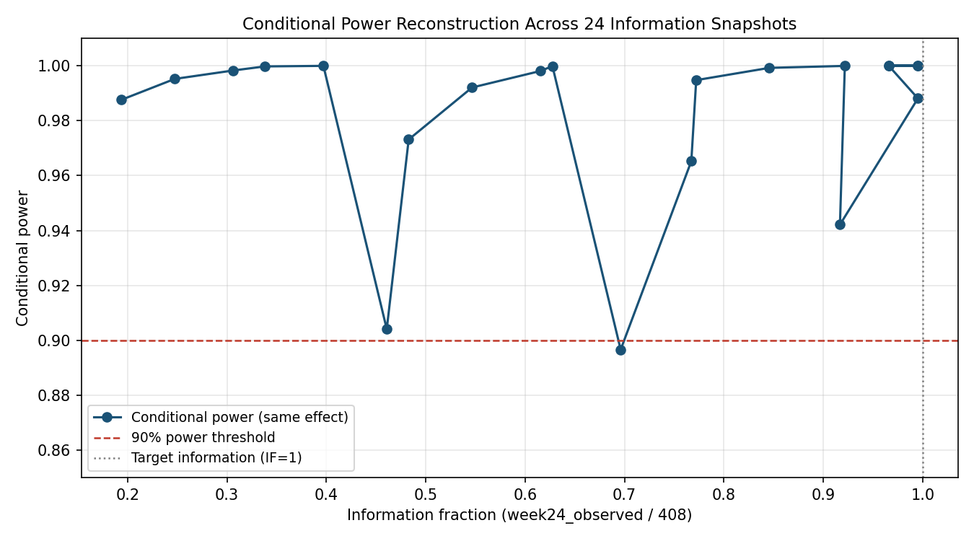
Conditional Power Across 24 Information Snapshots
Reconstructed from AIS-001..024; dashed line = 90% power threshold
AURORA-HTN-317 DSMB Site & Trial Integrity Review | 7

Slide 9
Conditional Power - Selected Snapshots
Snapshot | Info fraction | observed_z | proj final z | Cond. power
AIS-001 | 0.1936 | -1.7297 | -3.9309 | 0.987559
AIS-006 | 0.4608 | -2.0317 | -2.9931 | 0.904119
AIS-011 | 0.6961 | -2.4615 | -2.9504 | 0.896646
AIS-016 | 0.9167 | -3.1220 | -3.2608 | 0.942148
AIS-017 | 0.9951 | -3.9381 | -3.9478 | 0.988093
AIS-018 | 1.0245 | -4.8525 | -4.7941 | nan
AIS-024 | 1.0245 | -8.6496 | -8.5455 | nan
AURORA-HTN-317 DSMB Site & Trial Integrity Review | 8

Slide 10
Planned Calculation vs Executed Interim Review
Planned: one blinded information review and one unblinded DSMB review at 60% information (protocol)
This deck reconstructs the PLANNED conditional-power calculation from the 24 dated snapshots
Executed unblinded DSMB review: CANNOT be established
  - No attested DSMB meeting minutes in supplied materials
  - No unblinded analysis record or access log in supplied materials
  - Sponsor ledger entries are assertions, not execution evidence
Conclusion: the interim review is a planned calculation, not a verified executed event
AURORA-HTN-317 DSMB Site & Trial Integrity Review | 9

Slide 11
Site Leave-One-Out (Overall Effect Refit, Control minus AHT-417)
Dropped site | LOO effect (mmHg) | SE | 95% CI | Delta vs full
SITE-01 | 6.55 | 0.57 | 5.42 to 7.67 | +0.11
SITE-02 | 6.49 | 0.57 | 5.37 to 7.60 | +0.05
SITE-03 | 6.31 | 0.57 | 5.18 to 7.43 | -0.13
SITE-04 | 6.31 | 0.56 | 5.22 to 7.41 | -0.12
SITE-05 | 6.38 | 0.57 | 5.27 to 7.49 | -0.06
SITE-06 | 6.49 | 0.57 | 5.37 to 7.60 | +0.05
SITE-07 | 6.56 | 0.57 | 5.44 to 7.68 | +0.13
SITE-08 | 6.18 | 0.56 | 5.07 to 7.28 | -0.26
SITE-09 | 6.18 | 0.53 | 5.14 to 7.21 | -0.26
SITE-10 | 6.79 | 0.57 | 5.68 to 7.90 | +0.35
SITE-11 | 6.82 | 0.56 | 5.72 to 7.92 | +0.39
SITE-12 | 6.19 | 0.58 | 5.05 to 7.33 | -0.24
AURORA-HTN-317 DSMB Site & Trial Integrity Review | 10

Slide 12
External Care Benchmark Comparison
External cohort: 960 rows / 480 unique persons, 2 records per person
Baseline SBP identical: 480 of 480 exact match with trial baseline
Verdict: FAIL INDEPENDENCE - external cohort overlaps the trial on baseline
Strata (care_setting x record_complete): community referral 42 no / 438 yes; urgent clinic 42 no / 438 yes
Period / setting / variable limitations stated; not treated as trial evidence
AURORA-HTN-317 DSMB Site & Trial Integrity Review | 11

Slide 13
Missing Data & ITT Accounting
ITT: all 480 randomized retained; complete ITT values = 480
Week-12 missing: 12 | Week-24 missing: 42
Discontinued: 42 (8.8%)
Governing endpoint imputation: LOCF cascade week24 -> week12 -> baseline (consistent with README / Sheet 02 / Sheet 06)
Week-24 non-visits use the carried-forward Week-12 value; the 12 subjects with no post-baseline SBP contribute change = 0
All sites therefore keep the full ITT denominators (38/43/48/...)
AURORA-HTN-317 DSMB Site & Trial Integrity Review | 12

Slide 14
Cross-Source Contradiction Ledger
Protocol synopsis vs information snapshots: population labels differ (ITT / modified ITT / per protocol)
Sponsor evidence ledger: information-version entries are assertions without resolvable locators
Site randomization mapping: legacy center codes consolidated into 12 analysis sites
Boundary: material contradictions are bounded, not resolved, where records are absent
AURORA-HTN-317 DSMB Site & Trial Integrity Review | 13

Slide 15
DSMB Recommendations & Action
1 - IMMEDIATE: Do not accept any efficacy claim until site integrity is resolved
  Influential site SITE-08 drives a large share of the pooled effect; require site audit
2 - IMMEDIATE: Require sponsor to reconcile external cohort with trial baseline
  Independence not established (480/480 baseline match)
3 - IMMEDIATE: Provide attested DSMB minutes or confirm no unblinded review executed
4 - ROUTINE: Disclose full 24-snapshot conditional-power ladder in the report
AURORA-HTN-317 DSMB Site & Trial Integrity Review | 14

