Slide 1
A new and better Metaspace for the OpenJDK
Thomas Stüfe, SAP
09, 2019

Slide 3
Why?

Slide 4
History
“Java uses too much memory” ☹
Volker’s Memory initiative
Metaspace may consume a large part of the non-java-heap memory
I kind of “inherited” the coding -> no point in waiting for others
Encouragement from Oracle folks at FOSDEM 19
And also from jruby folks (Charles Nutter).
Lets do a clean room reimplementation!
11 Metaspace coalescation patch okay but far from perfect

Slide 5
Metadata Life Cycle Basics
Metadata get (usually) allocated when a class is loaded
Its lifetime is bound to that of the loading class loader
That loader is only collected when all its classes have been collected
-> metadata storage lives as long as there is still one “sibling” class alive
Exception: premature deallocation (uncommon)

Slide 6
Why a home-grown allocator? why not just malloc?
The obvious reason: Compressed Class Space.
We know things malloc don’t:
arena like allocation behavior
can throw away all allocations when CL dies.
no need to track individual allocations
per-CL pointer bump allocation
We know the typical allocation sizes.
Allocations owned by class loader. Typically no global lock needed.
malloc has limits (depends on OS)

Slide 7
Metaspace – how it works
Global list of mmaped regions (VirtualSpaceNode)
Region is split up in chunks which are handed to class loaders
4 kind of chunks: 1K, 4K, 64K
Loader pointer-bump-allocates from chunk until full, then gets next chunk from VirtualSpaceNode
Keeps list of chunks.
When Loader dies, all its chunks are returned to central freelist.
Premature deallocation is possible but uncommon
Chunks may be split/merged since 11

Slide 8
11 – metachunk coalescation
The „chunk size choking problem“
JDK-8198423
Chunks can be merged and split now
4x1K chunks -> 4K
16x4K chunks -> 64K
Basically the whole thing is now like a crooked buddy allocator
Also kind of inefficient
But it solved the problem
But I was afraid to touch too much, so the whole patch is one gigantic band aid
Ugly and difficult to maintain :-(

Slide 9
Problem: bad reclaim rate
Reclaiming mechanism is insufficient. Easily defeated by fragmentation.
Result: Freelists can get HUGE! (as in, up to 70% of metaspace)
-> Metaspace is not really elastic at all.

Slide 10
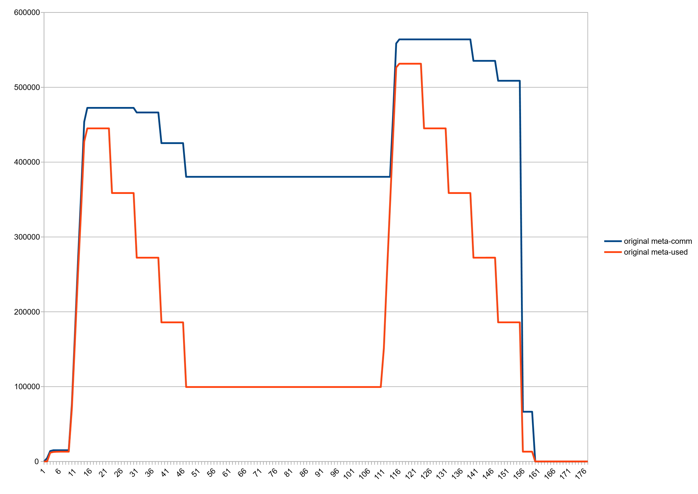
Bad reclaim rate (Example) metaspace used vs committed
Almost 300M delta!
:-(

Slide 11
Problem: bad reclaim rate (Example)
$ jcmd de.stuefe.repros.metaspace.InterleavedLoaders VM.metaspace
6918:
<cut>
Waste (percentages refer to total committed size 404,82 MB):
Committed unused: 116,00 KB ( <1%)
Waste in chunks in use: 2,95 KB ( <1%)
Free in chunks in use: 6,41 MB ( 2%)
Overhead in chunks in use: 219,69 KB ( <1%)
In free chunks: 275,21 MB ( 68%)
Deallocated from chunks in use: 1,29 MB ( <1%) (2227 blocks)
-total-: 283,24 MB ( 70%)

Slide 12
Problem: Intrachunk waste
Leftover space in chunks, unused, but owned by Class Loader
after a chunk gets retired
in the current chunk after CL stops loading classes
Problem mostly for for "micro-loaders" - loaders which load only one or a few classes (MH, Lambdas, Reflection, jruby)
Usually 2-4% but can get annoyingly large (e.g jruby)

Slide 13
Reimplementing Metaspace

Slide 14
What stays the same
We keep the same:
Global list of mmaped regions; region gets carved into CL-owned chunks; chunk freelists
We still have two “spaces”, non-class (which is still a space list) and class
Switches should keep meaning:
MaxMetaspaceSize and CompressedClassSpaceSize
no limit should trigger where it would not trigger before.

Slide 15
What is different
A different chunk geometry:
Buddy allocation scheme
Way more chunk sizes; 1K up to 4M in pow2 steps.
4M chunks are “root chunks”
Chunks get committed and uncommitted on demand
Got rid of humongous chunks :-)
Chunks can grow in-place
Deallocation can happen in-place
Chunk headers separated from Metaspace

Slide 16
Buddy allocator
Chunk sizes from 4MB (“root chunk”) … 1K (smallest) in pow2 steps
Why 1K? -> larger than 99% of InstanceKlass
Why 4M? -> comfortably larger than the largest possible InstanceKlass
13 sizes (“levels”). Root chunk is level 0.
13 freelists.
Implementation via chunk chain.
A chunk split is an insert op into a chunk header chain.
A merge is a remove op from a chunk header chain.
Pretty cheap to implement. Costs 2 pointers per chunk -> 64K for a fully fragmented 4MB range.

Slide 17
Buddy allocator: Allocation
256K
256K
512K
1M
2M
1M
1M
2M
2M
2M
4M (root chunk)
512K
512K
1M
2M
Remove root chunk from freelist
Split split split
Return the result chunk; all other splinters go back to the freelists

Slide 18
Buddy allocator: Deallocation
2M
1M
1M
2M
512K
1M
2M
512K
512K
2M
512K
256K
256K
1M
2M
256K
256K
1M
2M
Chunk becomes free:
Merge with buddy if buddy is free
Rinse repeat

Slide 19
Chunks can now grow in place :-)
If a chunk is too small to satisfy an allocation, instead of allocating a new chunk, we can attempt to grow in place.
a chunk can grow in place if it is the leader of the buddy pair and the follower chunk is free
reduces intra-chunk waste. Works best if a single CL loads undisturbed by other loaders.

Slide 20
Buddy allocation: What are the advantages?
Good defragmentation, also on longer runs.
Improved coherence of free areas -> good for uncommitting
less intrachunk waste because we have more chunk sizes to choose from.
less intrachunk waste because chunks can grow in place.
standard algorithm, easy to understand -> lower long term maintenance
Simple and cheap to implement

Slide 21
New committing/uncommitting scheme
Chunks can be committed on demand
They can start out completely uncommitted and grow as needed
Good for large chunks, e.g. BootLoader
Chunks can be uncommitted when free
E.g. Upon return to the freelist
or after a metaspace gc purge
Hence Metaspace is not committed bottom-up anymore but may be “checkered”

Slide 22
Problem: virtual memory fragmentation
Having many small virtual memory areas (eg committed and uncommited ranges) can be counterproductive
see e.g. /proc/pid/map
E.g. java thread stacks :-/
Mapping limit! vm.max_map_count
Note: Linux kernel merges regions with the same attributes together
So: we must not uncommit in a too fine granular fashion
->uncommit larger areas, not single pages
So: Chunk headers are a problem!

Slide 23
Chunk headers were a problem.
Page 0
Page 1
Page 2
Page 3
Page 0 needs to stay committed, since it contains the chunk header.
Annoying because
Header is way smaller than a page – waste of memory
It fragments the virtual memory range, since neighboring uncommited chunks cannot be fused at OS level – there is always one page commited between each chunk

Slide 24
Solution: chunk headers and payload are separated
page
page
page
page
ChunkHeaderPool
Headers now live in an outside pool
a simple slab allocator with freelist
Also better locality when walking chunk lists
One added dereference :/ but I pay for it by removing one somewhere else ☺
Now we can freely uncommit chunks fully; neighboring free uncommitted chunks are merged by OS vm manager

Slide 25
Commit Granules
Don’t commit pages. Commit larger units.
That unit is the “commit granule”.
Address range is segmented into homogenously sized commit granules.
Commit granules are committed / uncommitted as a whole only
Bit mask keeps track of which granules are committed
Default size 64K

Slide 26
Commit granules
granules
chunks
n:1 (large chunk)
1:n (small chunks)
n:1 (large chunk)
Notes:
Commit state of a chunk has nothing to do with whether chunk is free or not.
A chunk which is in use will commit on demand when allocation happens, if needed.
A chunk can contain a mixture of committed and uncommitted sections.
Chunks and granules are aligned such that no chunk struddles a granule border without containing the whole granule.

Slide 27
Allocation – committing on demand
used
used
used
chunk
granules
Notes:
Attempting to commit already committed range is a cheap noop.
If committing hits a limit (MaxMetaspaceSize), the metaspace allocation fails (->GC and perhaps OOM)
The commit mask bitmap inside VirtualSpaceNode is the “one truth” but we keep a per-chunk committed counter to speed up things
A newly allocated chunk will start out with a committed range at the begin (configurable)

Slide 28
Freeing and uncommitting
2M
2M
512K
512K
1M
2M
1M
1M
2M
512K
256K
256K
1M
2M
512K
256K
256K
1M
2M
2M
2M
Notes:
All highly configurable:
how large a chunk has to be to be uncommitted on free;
uncommit on free or only after Metaspace GC purge operation;

Slide 29
Benefits of commit granules
A simple straightforward way to manage “checkered” committed regions.
Cheap to implement (bitmap) and to manage.
Easy to configure (commit granule size)
Independent on the upper layer – in this case the buddy style allocated chunks. Very few dependencies between those two layers.
-> simple and robust

Slide 30
Results

Slide 31
Parallel Loaders Test, MS committed vs used, Before

Slide 32
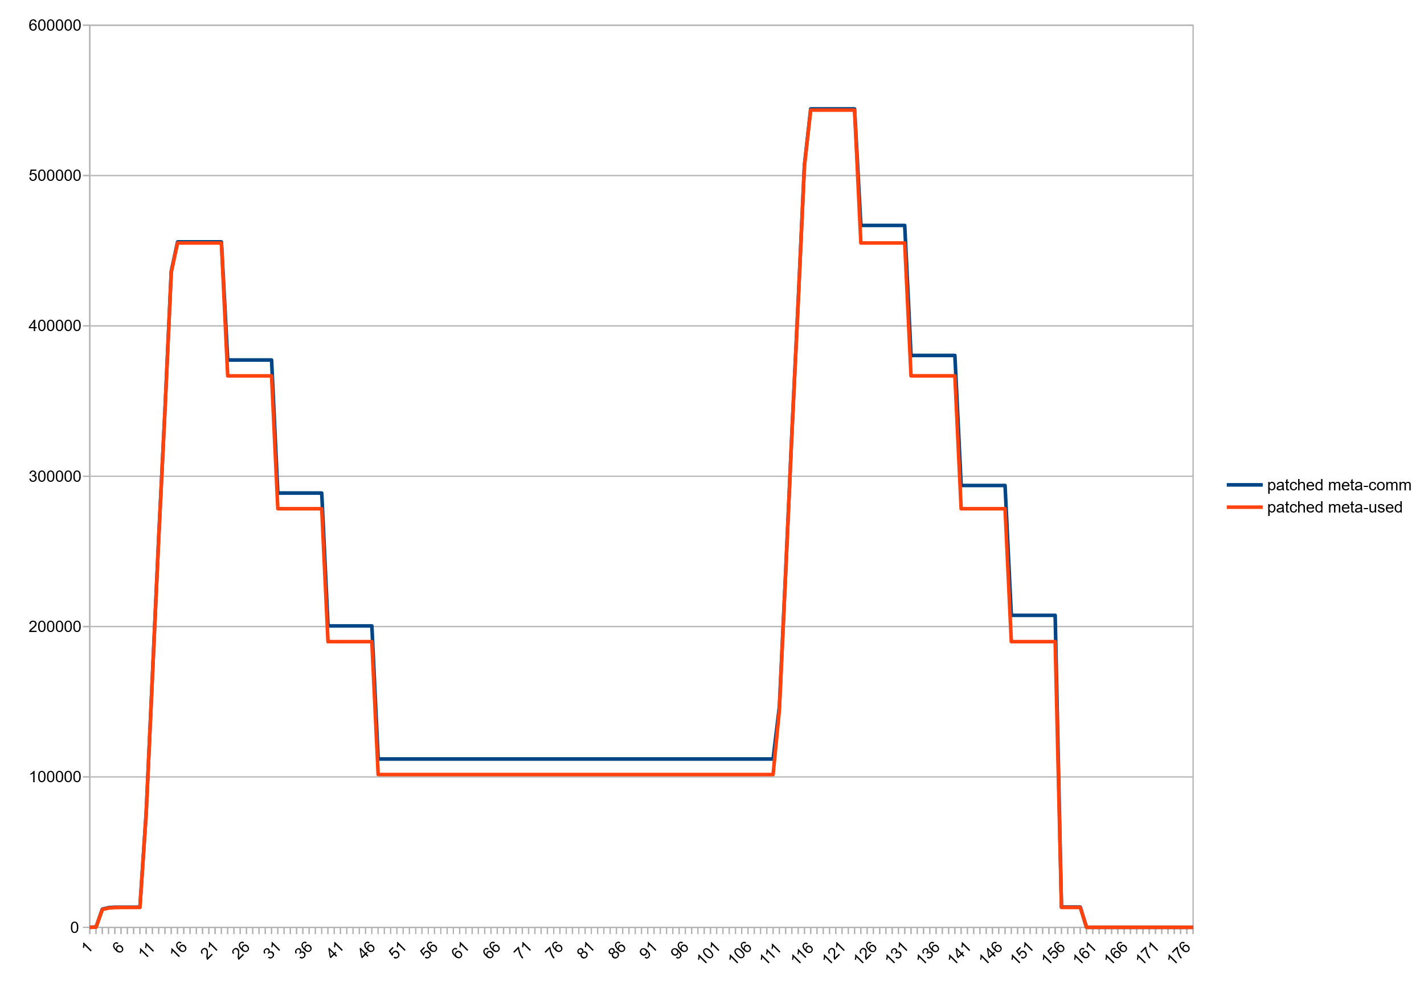
Parallel Loaders Test, MS committed vs used, After

Slide 33
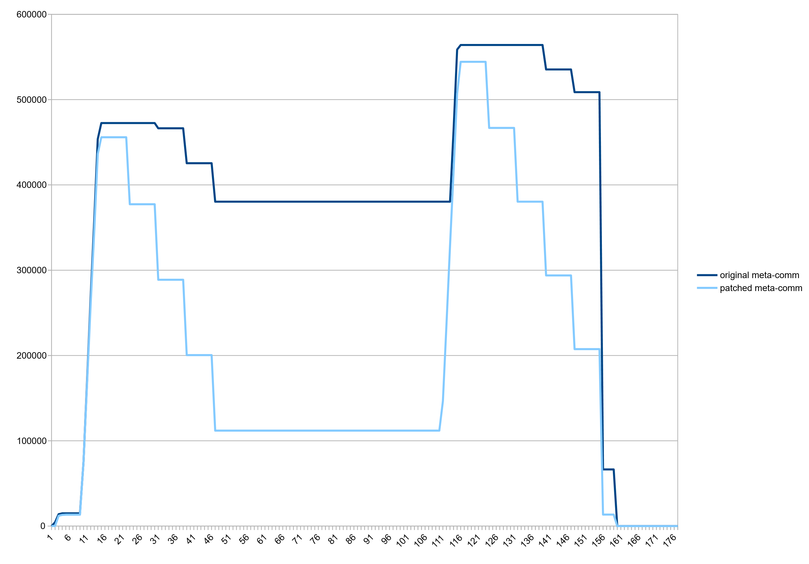
Parallel Loaders Test, MS committed, before vs after

Slide 34
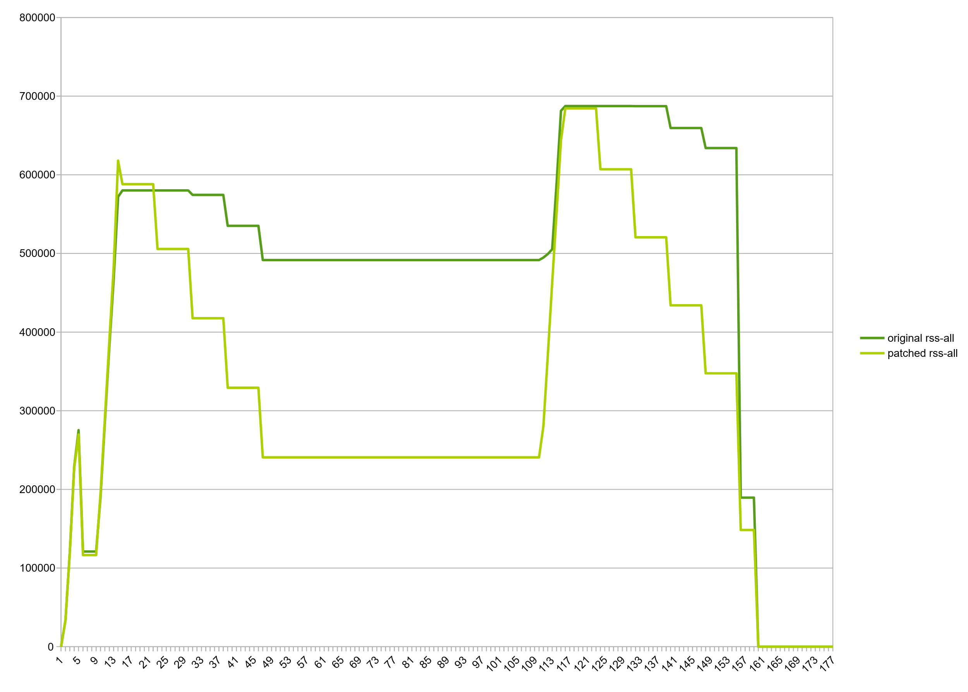
Parallel Loaders Test, Rss, before vs after

Slide 35
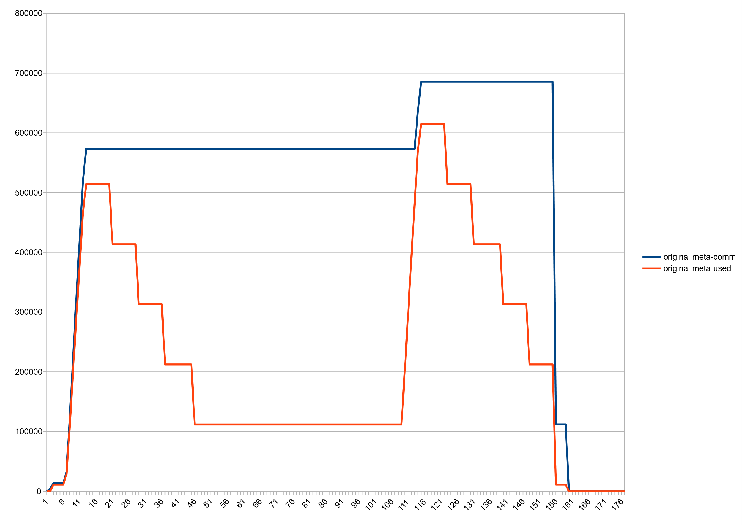
80000 micro loaders, MS committed vs used, before

Slide 36
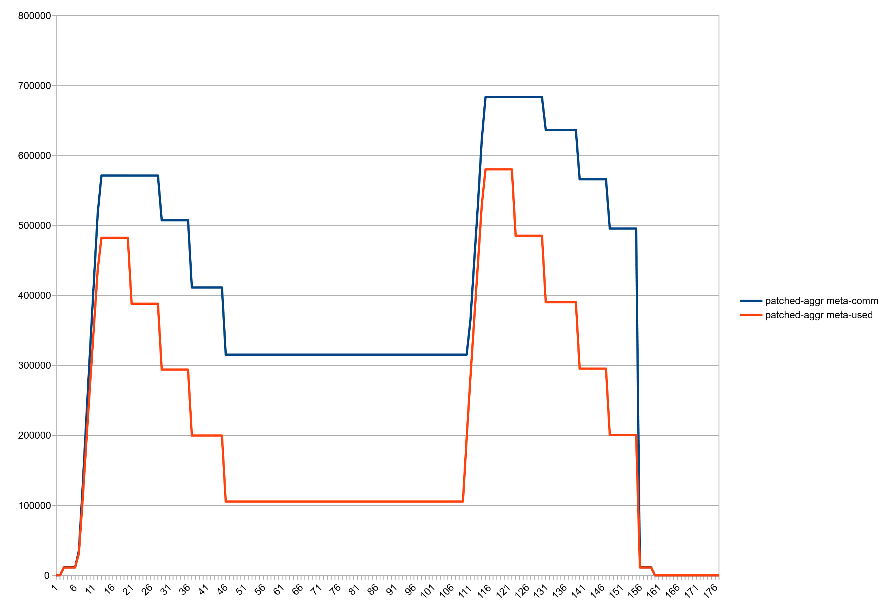
80000 micro loaders, after, MetaspaceReclaimStrategy=aggressive

Slide 37
Reduced waste even without class unloading:
Wildfly standalone, after startup: 61m -> 54m
Eclipse CDS (OpenJDK project open, after C++ indexer ran): 151m -> 131m
Minecraft 1.14: 74m -> 70m

Slide 38
Switches
MetaspaceReclaimStrategy=(none|balanced|aggressive)
“none” is for testing. Like old VM (purging is still done)
“balanced” is standard.
Commit granule size is 64K
“aggressive”
commit granule size 16K
Increases vm fragmentation but good results with micro loaders
-XX:+MetaspaceSeparateMicroCLDs

Slide 39
Code is way cleaner now!
Much less class/non-class code paths now. Not much code “knows” about class space at all.
E.g. chunk sizes are generic, not space specific
Better sectioned. Sub parts are much easier to test in isolation.
Loads of new gtests!

Slide 40
Show me the code
http://hg.openjdk.java.net/jdk/sandbox/
branch "stuefe-new-metaspace-branch“
Patch is about 20kloc
Initial patch: http://hg.openjdk.java.net/jdk/sandbox/rev/bdf136b8ae0e
Add Vitals via vitals patch at http://cr.openjdk.java.net/~stuefe/webrevs/metaspace-improvement/vitals.patch

Slide 41
Status 2019-10-09
Allocator is stable enough for daily use (under CDT)
Works with CDS, AppCDS
Some small issues remain (e.g. Large pages in metaspace)
No performance regressions found
Still to do:
Fix issues
Improve comments
Contribute

Slide 42
I wish I could also…
Make allocator better for one-class-loading-loaders (“micro clds”) – e.g. Reflection Delegators and Method Handle CLDs
Still somewhat bad intrachunk waste ( we always pay 1K for an InstanceKlass which is typically ~600byte)
Similar waste in non-class area
Band aid:
-XX:+MetaspaceSeparateMicroCLDs
Moves all allocations from known Micro-CLDs into class space
Pro: we pay ultimately less since we are not split into class chunk and non-class chunk(s)
Con: Counts toward CompressedClassSpaceSize
Idea: an own allocator for Micro CLDs
At least for the InstanceKlass structures in class space
Needs more thinking… but not impossible.

Slide 43
Future
JDK 15 (14 probably too late)?
JEP or as a simple RFE?
SapMachine 11?
SAPJVM 8?
Its all very foggy right now. But I hope to at least be able to show something at Fosdem20. Lets see…

Slide 44
Questions?

Slide 45
Thank you.
Contact information:
Thomas Stüfe, SAP

